Slide 1
Debugging in R

Slide 2
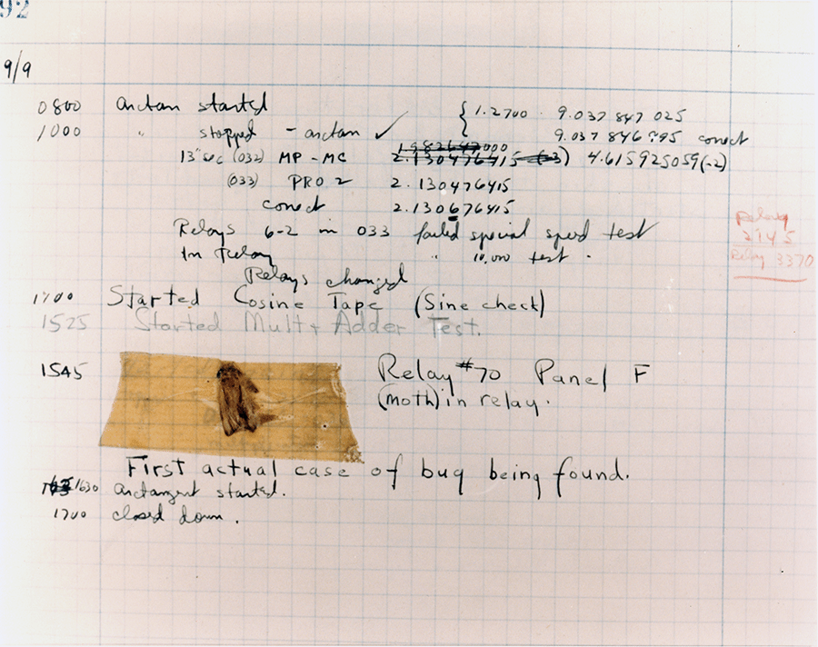
Notes:
The use of the word bug as a synonym for error originated in engineering. The term's application to computing and the inspiration for using the word debugging as a synonym for troubleshooting has been attributed to Admiral Grace Hopper, a pioneer in computer programming, who was also known for her dry sense of humor. When an actual bug (a moth) got caught between electrical relays and caused a problem in the U.S. Navy's first computer, Admiral Hopper and her team "debugged" the computer and saved the moth. It now resides in the Smithsonian Museum.

Slide 3
What is debugging?
A big topic is software engineering
Generally speaking:
identifying a problem
isolating the source of the problem
then either correcting the problem or determining a way to work around it.
(when its fixed, write a test! More on this later…)

Slide 4
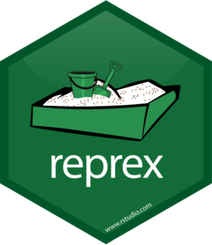
reprex
when a developer locates a code error in a computer program
Need to be able to reproduce it
Then you can ask for help e.g Stack Overflow

Slide 5
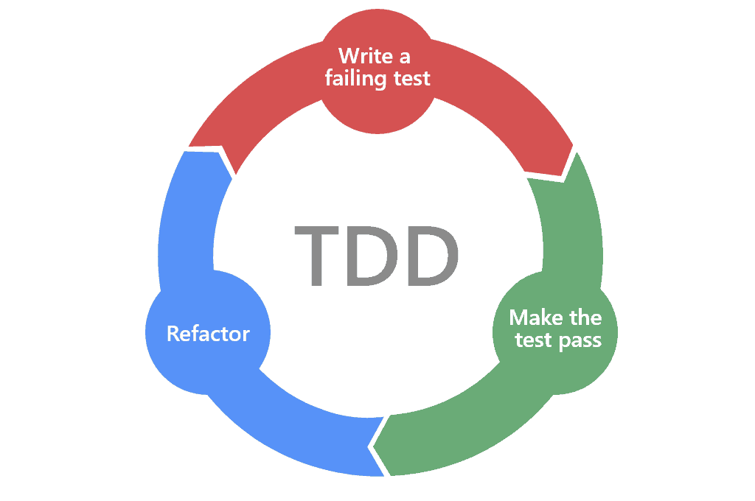

Slide 6
print(“…so far, so good…”)
Also called “tracing”
Add print statement throughout the code to see where the program gets to before an error occurs
This can actually be very effective

Slide 7
Steps of debugging
standard practice is to set up a "breakpoint" and run the program until that breakpoint
execution stops
Now you can see variables and look around
You can then
run the program to the next breakpoint
execute just the next line of code
change the value of variables or even change the contents of the line of code about to be executed.

Slide 8
Debugging in R(Studio)
Entering debugging mode
Browser()
options(error = recover)
utils::setBreakpoint()
Setting Editor breakpoints (Shift+F9/ click in margin interactively)
debug()/undebug()/debugonce()
Using the debugger
n or Enter F10 Execute next statement
s Shift+F4 Step into function
f Shift+F6 Finish function/loop
c Shift+F5 Continue running
Q Shift+F8 Stop debugging

