Slide 1
Cost-Effectiveness Model Working Example

Slide 2
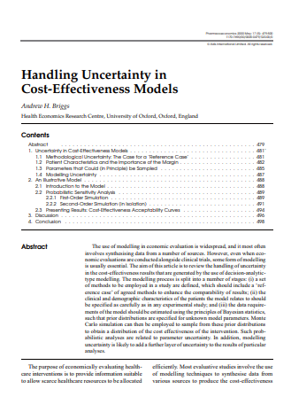


Slide 3
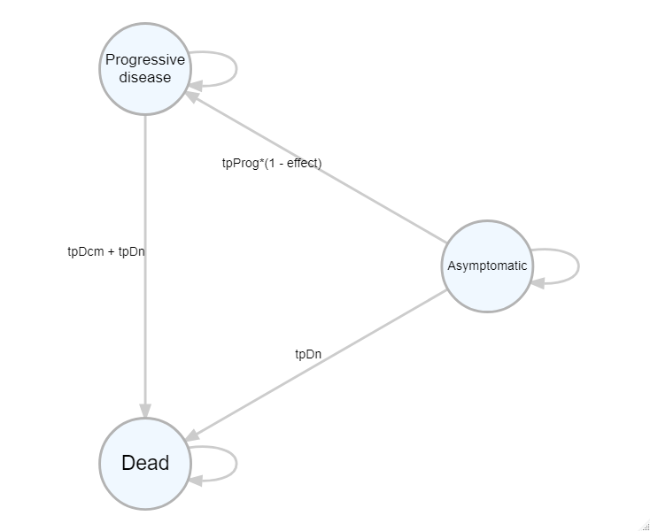
Markov model

Slide 4
