Slide 1
Project workflow skills for health economics modelling in R
Nathan Green
UCL

Slide 2
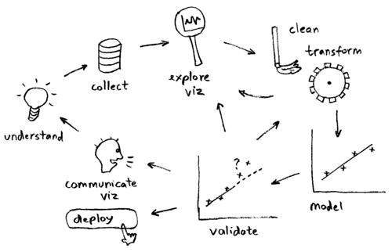

Slide 3
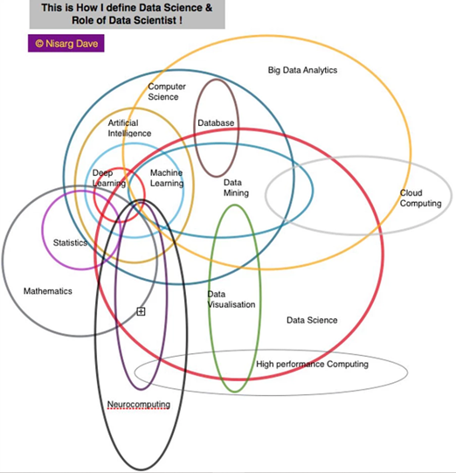

Slide 4
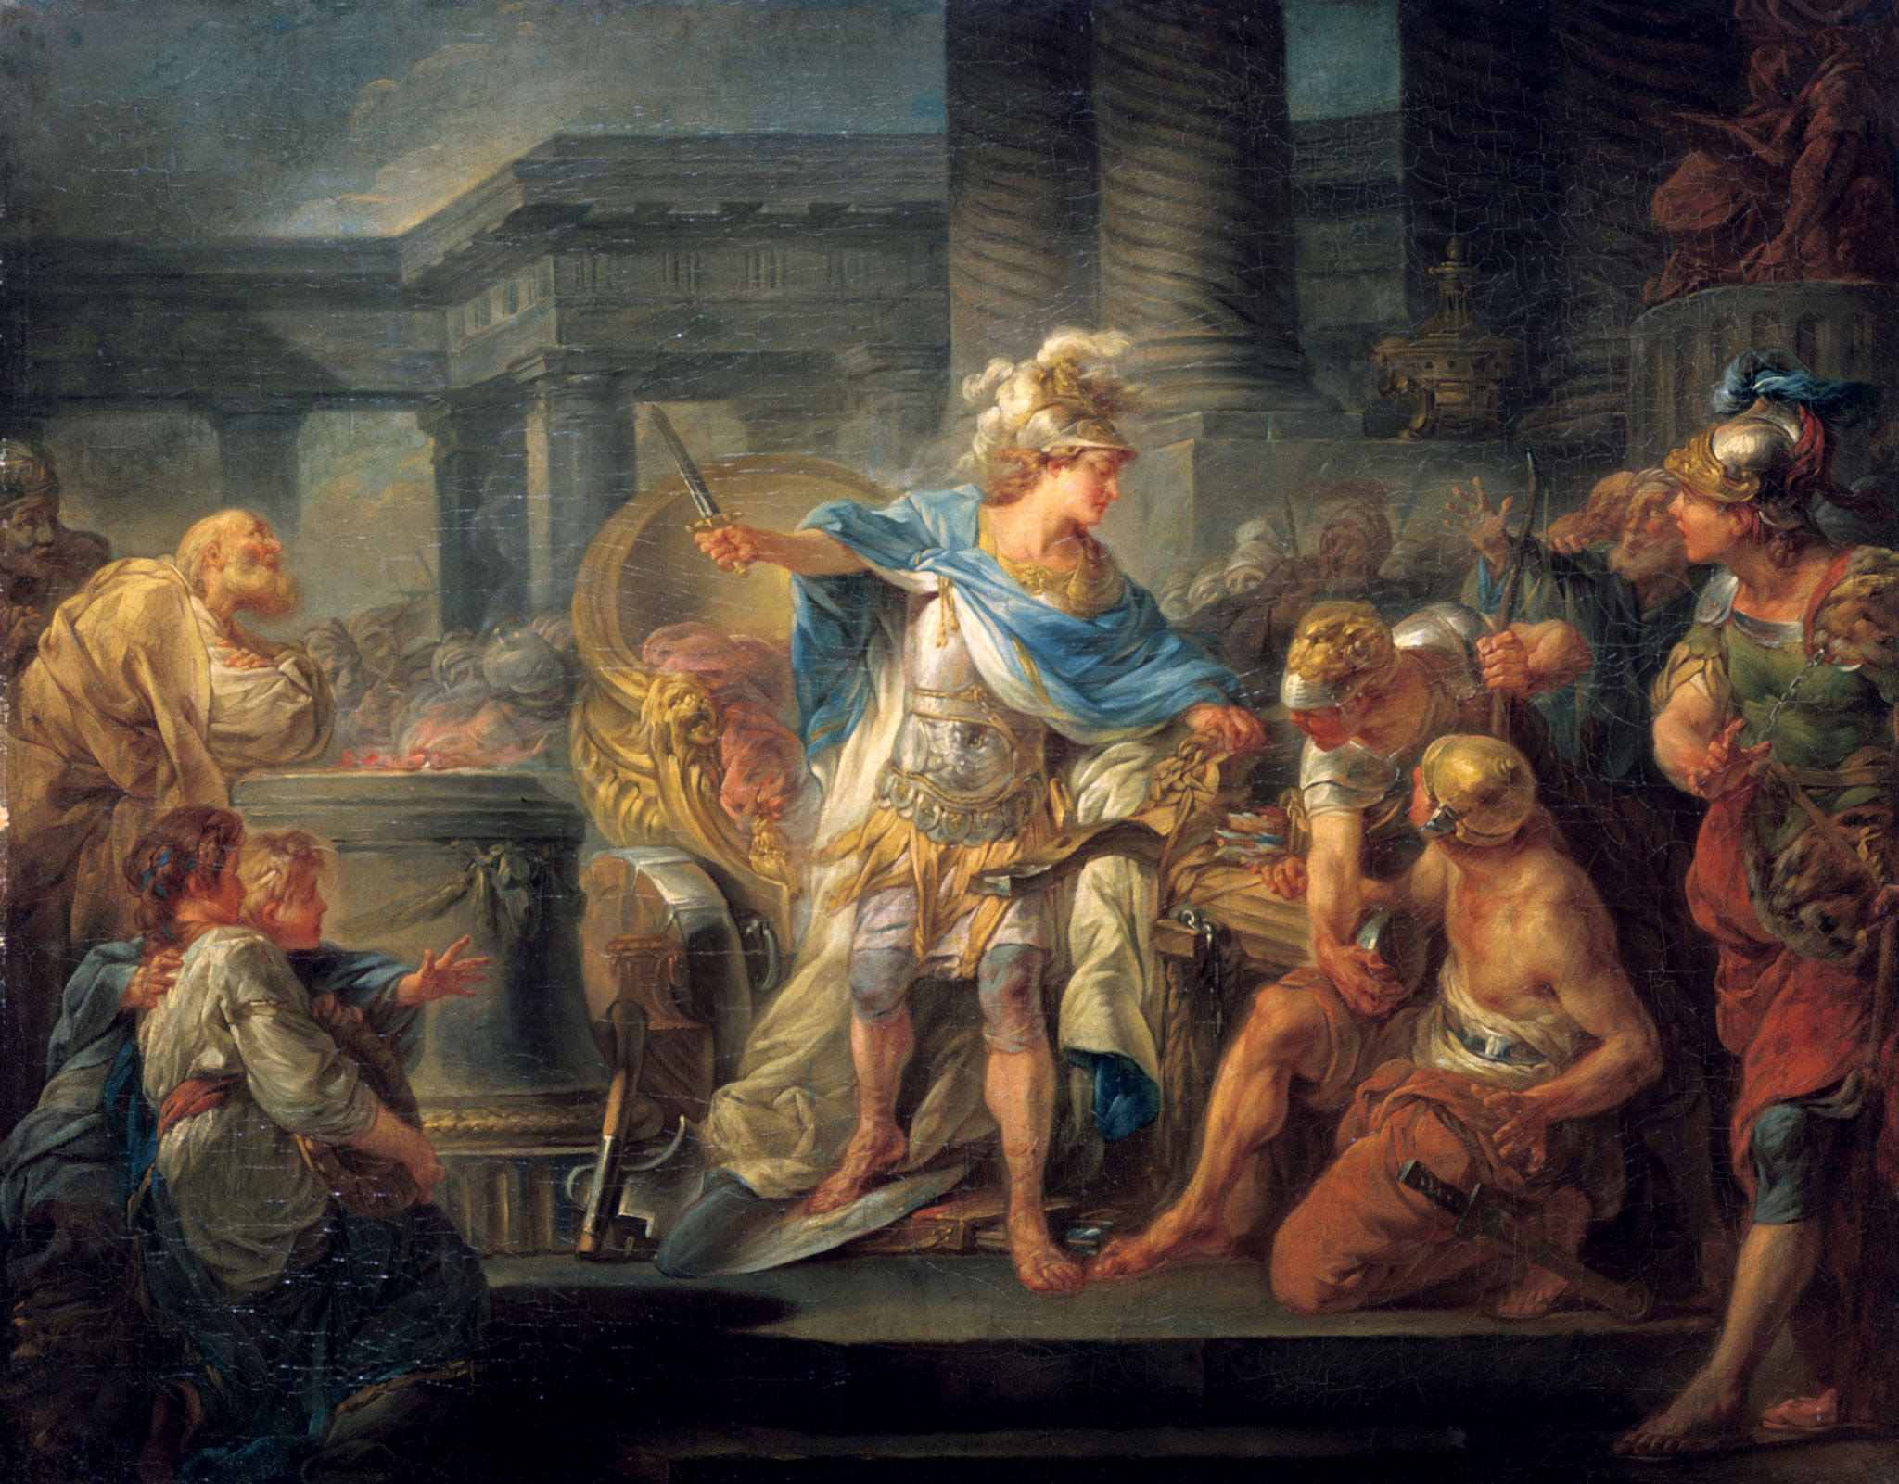

Notes:
Ancient Greek legend of Phrygian Gordium associated with Alexander the Great. It is often used as a metaphor for an intractable problem (untying an impossibly tangled knot) solved easily by finding an approach to the problem that renders the perceived constraints of the problem moot ("cutting the Gordian knot"):

Slide 5
Timetable
Introducing the Markov cost-effectiveness model 9:30-9:45
Writing clean code 9:45-10:15
Package workflows 10:15-10:45
Functions 10:45-11:15
BREAK 11:15-11:30
tidyverse 11:30-12:00
LUNCH
Basic debugging 1:00-1:45
Unit testing with testthat 1:45-2:30
BREAK 2:30-2:45
Documenting code/literate programming with RMarkdown 2:45-3:45
Recap and Q&A Session 3:45-4:30

Slide 6

Webpage
https://github.com/n8thangreen/ScHARR-open-science-workshop

