Slide 1
Introduction

Slide 2
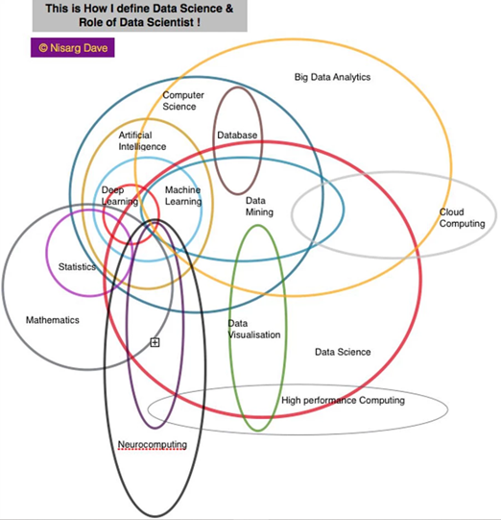

Slide 3
Timetable

Slide 4
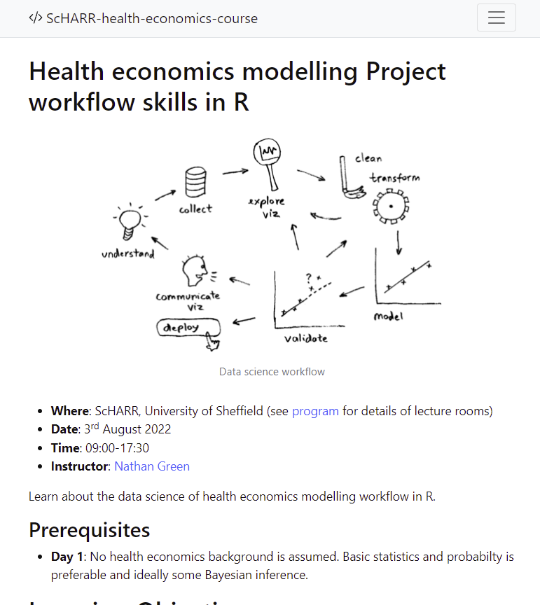
Webpage
https://github.com/n8thangreen/ScHARR-open-science-workshop

