Slide 1
The tidyverse

Slide 2
R packages for data science
The tidyverse is an opinionated collection of R packages designed for data science
All packages share an underlying design philosophy, grammar, and data structures.
Tidyverse design guide
The tidyverse style guide (https://style.tidyverse.org)
Syntax
Functions
Pipes
ggplot2
…

Slide 3
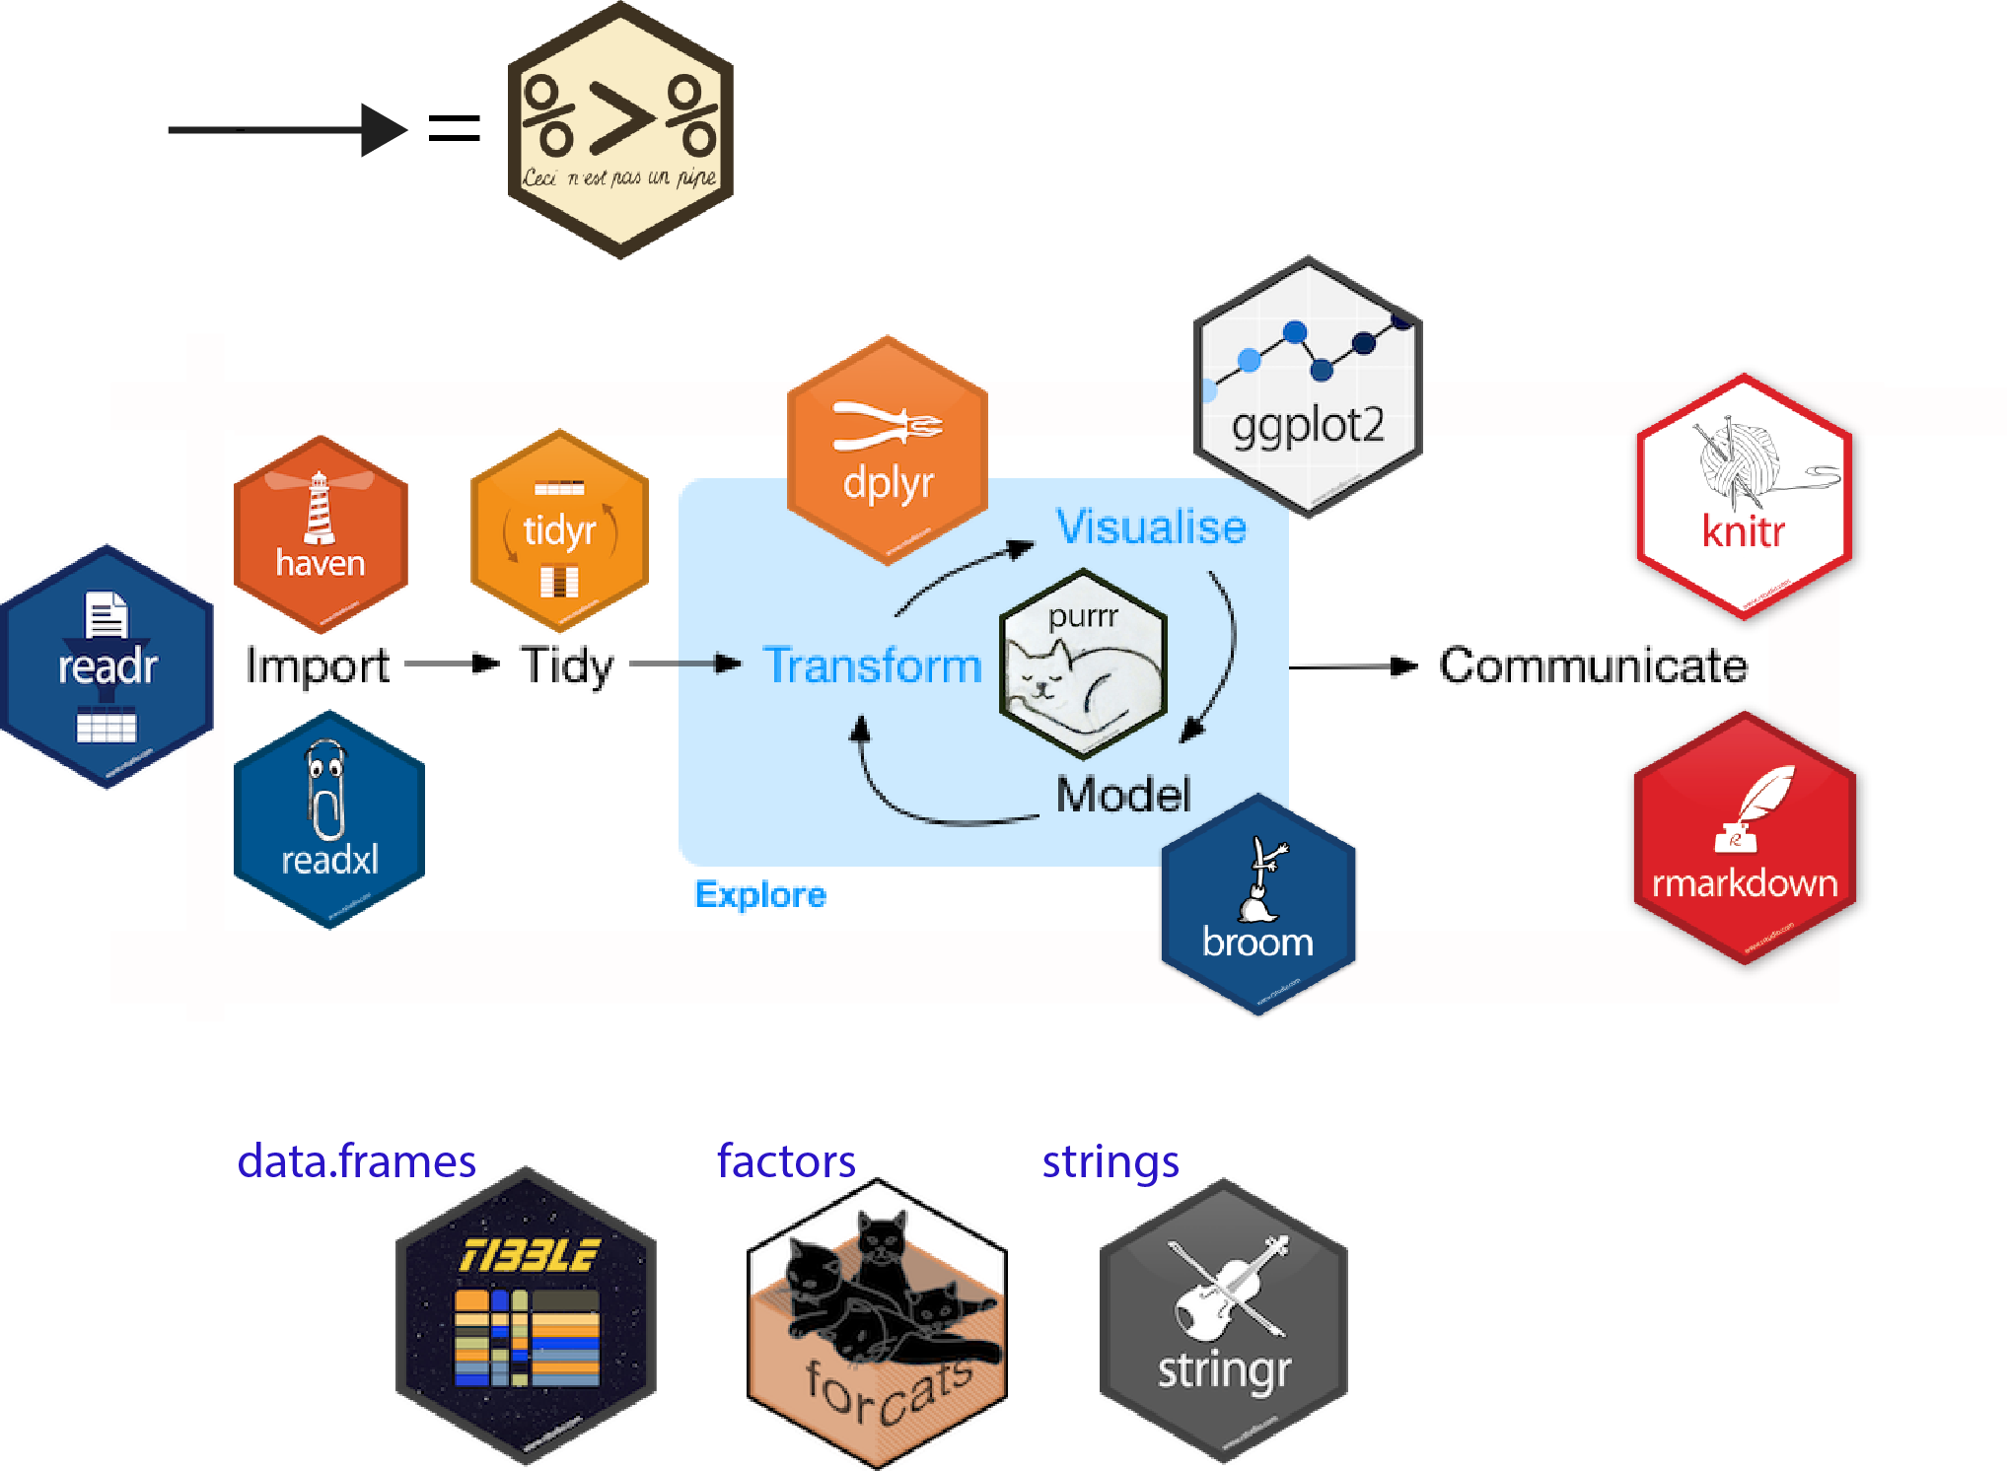

Slide 4
dplyr: a grammar of data manipulation
Provides a consistent set of verbs that help you solve the most common data manipulation challenges:
mutate() adds new variables that are functions of existing variables
select() picks variables based on their names.
filter() picks cases based on their values.
summarise() reduces multiple values down to a single summary.
arrange() changes the ordering of the rows.

Slide 5
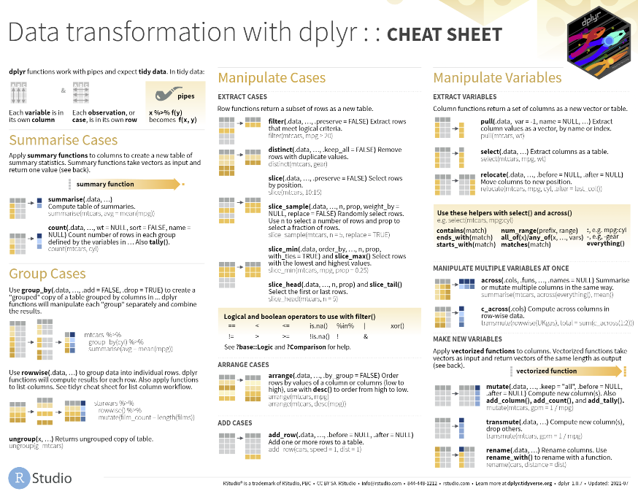

Slide 6
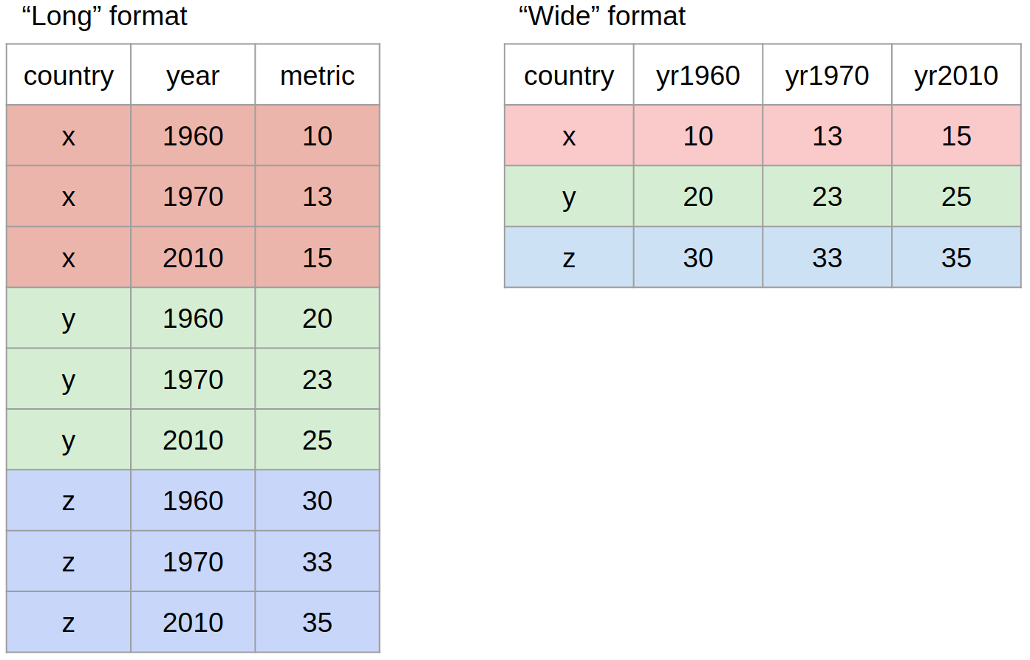
Data reshaping
Notes:
“Long” format is where we have a column for each of the types of things we measured or recorded in our data. In other words, each variable has its own column.
“Wide” format occurs when we have data relating to the same measured thing in different columns. In this case, we have values related to our “metric” spread across multiple columns (a column each for a year).
Neither of these formats is necessarily more correct than the other: it will depend on what analysis you intend on doing. However, it is worth mentioning that the “long” format is often preferred, as it is clearer how many distinct types of variables we have in the data

