Slide 1
Introduction

Slide 2
Outcomes

Slide 3
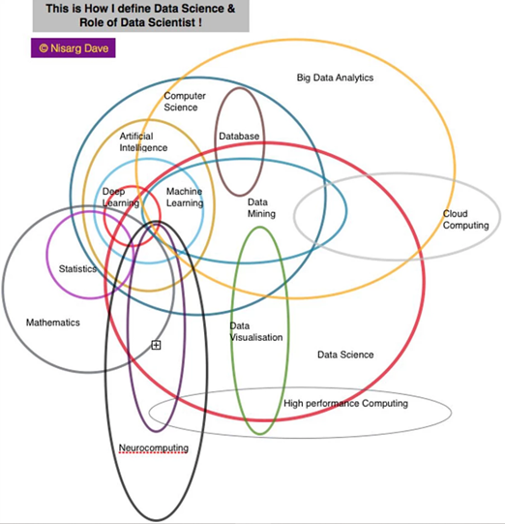

Slide 4
Timetable

Slide 5
Webpage

