Slide 1
Literate programming with RMarkdown

Slide 2
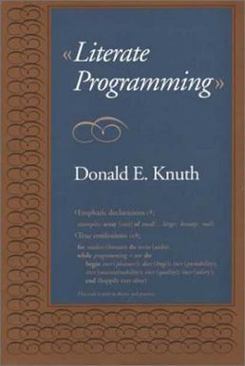
What is literate programming?
Introduced by Donald Knuth (1984)
The implementation was called "WEB" since he believed that it was one of the few three-letter words of English that had not yet been applied to computing
computer program is given an explanation of its logic in a natural language, such as Englis
interspersed (embedded) with snippets of macros and traditional source code
"tangled" code

Slide 3
What is Markdown?
Created in 2004
A lightweight markup language for creating formatted text using a plain-text editor
GitHub, Reddit, Stack Exchange,… all have their own version
Other include HTML, XML, …

Slide 4
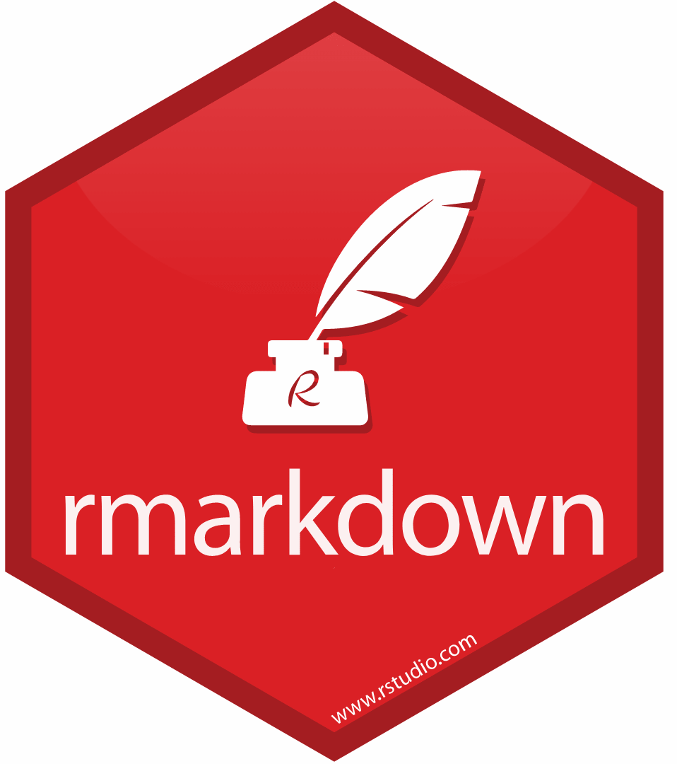
What is RMarkdown?
unified authoring framework for data science, combining/interleaving your
Code
its results
and your text
fully reproducible

Slide 5
support dozens of output formats
PDFs, Word files
Slideshows
Websites
Shiny apps
…

Slide 6
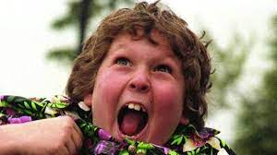
Chunks
There are two types of code in an Rmd document: code chunks and inline R code
```{r}
x <- 5 # radius of a circle
```
For a circle with the radius `r x`, its area is `r pi * x^2`.
> 50 chunk options that can be used to fine-tune the behavior of knitr https://yihui.org/knitr/options/ for full list of options.

