Slide 1
Cost-Effectiveness Model Working Example

Slide 2
Background

Slide 3
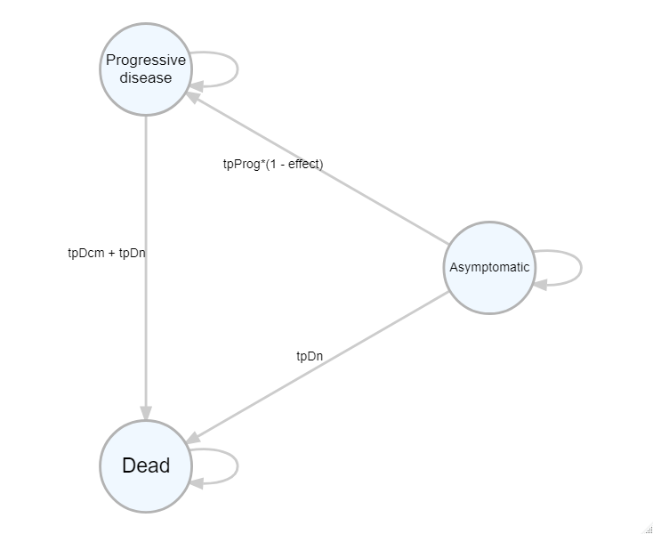

Slide 4
Briggs A, Sculpher M. Introducing Markov models for economic evaluation. PharmacoEconomics 1998; 13(4): 397-409.
Briggs AH. Handling uncertainty in cost-effectiveness models. PharmacoEconomics 2000 May;17(5):479-500.

