Slide 1

The Fiscal Bunch for Lunch Group
Purchase Card Information
Various Questions and Answers

Slide 2
When to use the P-Card
The Purchasing Card (P-Card) is available as an optional method for purchasing goods and services. University policy is that the P-card may be used for the following transactions. All other types of transaction should be enacted in the HokieMart:
Over the counter sales with local vendors
Purchases from the US Post Office
Air fare
Membership and association dues
Conference and course fees, seminars/training and other registration fees
Advertising for employment opportunities and other announcements
With vendors that do not accept HokieMart see http://www.procurement.vt.edu/HokieMart/xvendors.html
Most any other Category on the Direct Pay List that that is marked (eVA exempt) see http://www.policies.vt.edu/3220.pdf. Contact Purchasing if you have any questions. Cautions: The P-Card Program is not to be confused with the Travel Card Program which is used by employees when on business travel. The only exception to this is air fare and mass transit purchases may be charged to the P-Card . The P-Card is for university purposes only, personal use is not allowed under any circumstances. The pre-set transaction ceiling shall not be circumvented by "splitting" orders (i.e., placing more than one order in an attempt to purchase goods or services valued over the pre-set transaction limit).

Slide 3
General Restrictions
For various reasons relating to control and good business practices, the following goods and/or services typically CANNOT be purchased by university departments. To purchase these items, the department should contact the Procurement Department or the entity responsible for overseeing the goods/services, if applicable. If an occasion arises where there is an appropriate need for a department to directly purchase any of the goods/services listed below, they must have written/documented approval from Purchasing or the entity responsible for overseeing the goods/services. Departments must maintain these approvals in their files for audit purposes.
Note: See Administrative Approvals for an explanation regarding the entities responsible for specific purchases.
Narcotics or dangerous drugs (prescription drugs), except for Student Health Services and Veterinary Medical Teaching Hospital.
Advertising type novelties or gifts.
Vendor issued gift cards or prepaid phone cards. For research use see http://www.co.vt.edu/Procedures/P23715c.pdf
Alcoholic beverages. (Except for Catering Services and the Inn)
Firearms and ammunition, except for Police Department. These items must be approved through the Police Department.
Purchases from state employees or immediate family.
Air conditioners, except for Physical Plant. Refer to University Policy 5705 (http://www.policies.vt.edu/5705.pdf).
Refrigerators, freezers, and fume hoods see

Slide 4
General Restrictions cont
Administrative Approvals for other items that need EHSS approval
Campus Design and Construction, except for Physical Plant. This includes any type of renovation, security/fire systems, painting, electrical, building locks/keys, etc. Refer to University Policy 5405 (http://www.policies.vt.edu/5405.pdf) and 5620 (http://www.policies.vt.edu/5620.pdf).
Real Estate payments. The acquisition of real estate includes short-term storage units, research plots, office buildings and suites, laboratory research space, parking facilities, and apartments. Any building or land lease must be executed through the Office of Real Estate Management. Please note, Real Estate Management is also the point of contact for the renovation, maintenance and repair of all leased facilities (per university policy 5404 http://www.policies.vt.edu/5404.pdf).

Slide 5
Other Restrictions
General Restrictions for the P-Card (in addition the General Restriction above)
Radioactive materials, (except for Environmental Health and Safety Services). These materials must be purchased through Environmental Health and Safety Services.
Yearly maintenance and/or service agreements paid monthly having an annual cost exceeding $2,000.
Copier maintenance contracts.
Printing and Copying. Printing Services should be used. Blacksburg campus organizations can spend up to $50, off-campus organizations can spend up to $300, and the National Capital Region (NCR) can spend up to $2,000 per order with a commercial vendor.
New and used licensed vehicles.
Telecommunications goods and services. Purchases of all telecommunications products, services and/or maintenance contracts on telecommunications hardware and software (i.e., telephones, telephone systems, two-way radios, microwave transactions, internet subscription services, cell phones (new and replacement), cell phone accessories, XM Radio, and any cable or satellite TV services) must be purchased/requested through Communications Network Services (CNS). Cellular telephone purchases and monthly service charges are processed by CNS.

Slide 6
Other Restrictions cont
Respirators and cartridges. To ensure maximum safety and effectiveness, respirators and cartridges require technical support. This includes matching the product to the intended application and sizing to ensure a protective fit. To accomplish this, respirators and cartridges should be ordered directly from Environmental Health and Safety Services. They can be ordered by e-mail at vt-respirators@vt.edu or by directly contacting the Occupational Health and Industrial Hygiene Division at 231-2509. Respirators and cartridges should not be ordered directly from suppliers.
Suppliers with an expedited payment process.
The university has an arrangement with some major suppliers that provides expedited payment and, in some cases, discounts. This is a highly efficient way to process invoices. The HokieMart should be used exclusively with these suppliers. The P-Card should not be used as this adds to supplier costs. Names of these suppliers will be published periodically.
The P-Card may be used infrequently to satisfy urgent requirements. Routine use of the P-Card will be viewed as misuse, and may result in cancellation or suspension of the P-Card.
*The National Capital Region (NCR) includes graduate schools and research centers in Alexandria, Arlington, Falls Church, Leesburg, Manassas, and Middleburg.

Slide 7
Administrative Approvals
Some purchases require administrative approvals. Unless noted below, approvals will be obtained electronically by the HokieMart workflow. The following offices are required to review requisitions for the listed items:
SPONSORED PROGRAMS. All requisitions with a Banner Fund number beginning with a 3, 4 or 5 covering consulting agreements/contracts, maintenance agreements/contracts, as well as subcontracts must be approved by the Office Sponsored Programs.
In addition, all equipment having cost in excess of $2,000 to be charged to a sponsored project must be approved by the Office of Sponsored Programs (OSP) prior to purchase of the item.
ENVIRONMENTAL HEALTH AND SAFETY SERVICES (EHSS). Requisitions for the purchase of the following items: refrigeration units, fume hoods, biological safety cabinets, radiation survey meters, laboratory microwave units, lasers, X-ray units, gas chromatographs, anything containing asbestos, and respirators.
RADIATION SAFETY DIVISION of EHSS. Requisitions for the purchase of radioactive materials and radioactive chemicals.

Slide 8
Administrative Approvals cont
OCCUPATIONAL SAFETY DIVISION of EHSS. Certain SPECIALIZED EQUIPMENT, such as Powered Industrial Trucks (a.k.a. forklifts, powered pallet jacks, pallet trucks, rider trucks, fork trucks, or lift trucks), Aerial Lifts (a.k.a. man lifts), Scaffolding, and Mechanical Power Presses must be suitable for the location and intended use, and the operators or users must be trained and/or certified in accordance with the OSHA requirements. To assure that the equipment is appropriate and that users are appropriately trained, it is recommended that the department obtain a review from Environmental, Health and Safety Services (EHSS) prior to submitting a requisition for the purchase of such equipment. Users must be trained prior to using the listed equipment. Review of the intended purchase and training may be arranged by contacting the Occupational Safety Division of EHSS at adamsz@vt.edu or 231-5985
COMMUNICATIONS NETWORK SERVICES. Requisitions for telephone installations, equipment, and service.
UNIVERSITY POLICE. Requisitions for safety and security cameras, door locks and keys, cipher locks, card access systems, and related installation. Card access systems must be compatible with and connected into the Hokie Passport Card System. Approvals for such systems are not accomplished by the electronic workflow of the HokieMart and should be accomplished manually prior to submitting a requisition into the HokieMart system. (See University Policy 5617

Slide 9
Short List of Account Codes
12210 Organization Memberships
12220 Publication Subscriptions
12440 Management and skilled Services
12530 Maintenance Services
12480 Media Services (advertising in magazines, newspapers, etc.)
12897 Employee Training Courses, Workshops, and Conferences (registration fees)
13120 Office Supplies – General Non-Catalog Item
13410 Laboratory Supplies – General
13740 Educational Supplies (blank audio/video tapes, chalk, erasers, etc.)
13747 Textbooks
http://www.co.vt.edu/accounting_operations/Account_Code_Listing/accts.html

Slide 10
New Pcard Rule
Emergency Hire and Temp employees will no longer be issued a P-Card. These employees fall under the following employee classes.
P 14 - Faculty Wage
9A (Instructional PT Temp Adjunct)
9B (Non-Inst PT Temp Fac/Sum Research)
9C (Continuing Educ PT Temp Faculty)
9D (T/R Wages One Time Payments)
Student Wage
6B (Student Wage)
6C (Federal Work Study)
Other
6E (Emergency Hire)
6F (Sporadic Hire)

Slide 11
New Rules for Amazon Purchases
**You MUST have open an Amazon account for the P-Card that is separate than your personal account
You need to set up your Amazon account as tax exempt. Below is the link to upload the tax exempt form. Please remember to fill out the form, print it, and have it signed by someone in your department with Signature Authority. You will then have to scan it and save it to your computer for uploading on the site.
VA Sales and Use Tax Certificate of exemption: http://www.procurement.vt.edu/Department/Forms/st12.pdf
Link to upload on Amazon: https://www.amazon.com/gp/taxExemption?new_account=1&
After submitting this, you will have to wait for Amazon to approve your account as tax exempt before you make a purchase.

Slide 12
Reconciliation
Obtain payment approval signature from the Department Head or employee with signature authority. Two signatures are required on this form, therefore the cardholder (or person signing for the cardholder) cannot sign again as the approver.
If the payment is being placed on the default fund, select the "All charges and credits are correct and should be posted to the default fund" box on the P-Card Payment Certification Form.
If the payment is being distributed to multiple funds, write the corresponding fund and account codes on the P-Card statement for each transaction.
Note: You may use up to four different funds and/or account codes for a single charge.
They cannot be left in account code 13090.
Mail payment certification form and statement to Dorothy Carter in the Controllers Office mailcode 0312
Amendment: You can use the P-Card log to reconcile if it is in statement order

Slide 13
Record Retention
Record retention
File a copy of the P-Card statement, a copy the Payment Certification Form, any airline ticket documentation, any Sponsored Program approval forms, the vendor's original itemized receiving and credit documentation that pertains to that statement, and any other documentation generated to support the business purpose for the expenditure in the departmental files. SEE THE SECTION ON RECORD RETENTION BELOW - DO NOT SEND THIS DOCUMENTATION TO THE CONTROLLERS OFFICE.
Departments are responsible for retaining the file that is compiled each month after the statement is reconciled (this file must contain at a minimum a copy of the P-Card statement, a copy the P-Card Payment Certification Form, copies of any airline ticket documentation submitted to the Controller's Office, any Sponsored Program approval forms, the vendor's original itemized receiving and credit documentation that pertains to that statement, and any other documentation generated to support the business purpose for the expenditure). THE RETENTION PERIOD FOR THIS DOCUMENTATION IS TYPICALLY FIVE (5) YEARS AFTER THE CLOSE OF THE FISCAL YEAR OF CREATION.
NOTE: If you are using funds such as sponsored program funds, the retention time may be longer. See the Records Management Records Retention Schedule page for the information on determining a retention schedule for such documents.
NOTE: Each charge must have this information so the cardholder will have adequate documentation of the expense for future review by the auditors, Purchasing, Legal Counsel, or the News Media should the request be made.
Retain these records in the Department or with Records Management. These are the original records of agency therefore; they need to be retained in a neat and accessible manner so they will be readily available in the event of an audit.

Slide 14
Miscellaneous Pcard Topics
Fraud
Your card has been shut down due to possible fraud attempts on your card. Please call 866-500-8262 to review your charges. The reference number for this call is 830. If you have already contacted the, please ignore this note.
______________________________________________________________________________
Limits
Generally cards are set at 2K per transaction and 5K or 10K per month. Cardholders may not, under any circumstances, authorize any charge in excess of the transaction limit

Slide 15
P Card Questions
How do we handle the online purchases that require renewals and need to go in another employee's name? We want to keep the credit card to one person managing in our department.
Authorized use of the P-Card is limited to the person whose name is on the card. The P-Card should not to be loaned to another person. This does not preclude a cardholder from placing an order with a vendor by telephone or electronically and then sending a representative to claim the items ordered. In the event of an extended absence by the cardholder, a card may be issued to another person for the duration of the absence. Also, the Department should consider canceling the card if a person is going to be on extended leave.
Is it okay to give the number to an individual over the phone when they are ordering something at that point and they forward the receipt to us; or, does the card holder need to personally make all purchases?
Authorized use of the P-Card is limited to the person whose name is on the card. The P-Card should not to be loaned to another person. This does not preclude a cardholder from placing an order with a vendor by telephone or electronically and then sending a representative to claim the items ordered. In the event of an extended absence by the cardholder, a card may be issued to another person for the duration of the absence. Also, the Department should consider canceling the card if a person is going to be on extended leave.
It can be difficult to locate account codes. It would be helpful if a list of commonly used ones could be emailed to staff with P cards. Again, using the website it is not always clear which one to use and can be confusing. http://www.co.vt.edu/accounting_operations/Account_Code_Listing/accts.html

Slide 16
P Card Questions cont
Are there ever any exceptions to a $2K max purchase on a P-cad?
No
As a new employee I often find it challenging to locate a comprehensive list of allowable charges for the P card. Is there a list that can be emailed to staff who have P cards? The website does not seem to have a comprehensive list.
Already reviewed

Slide 17
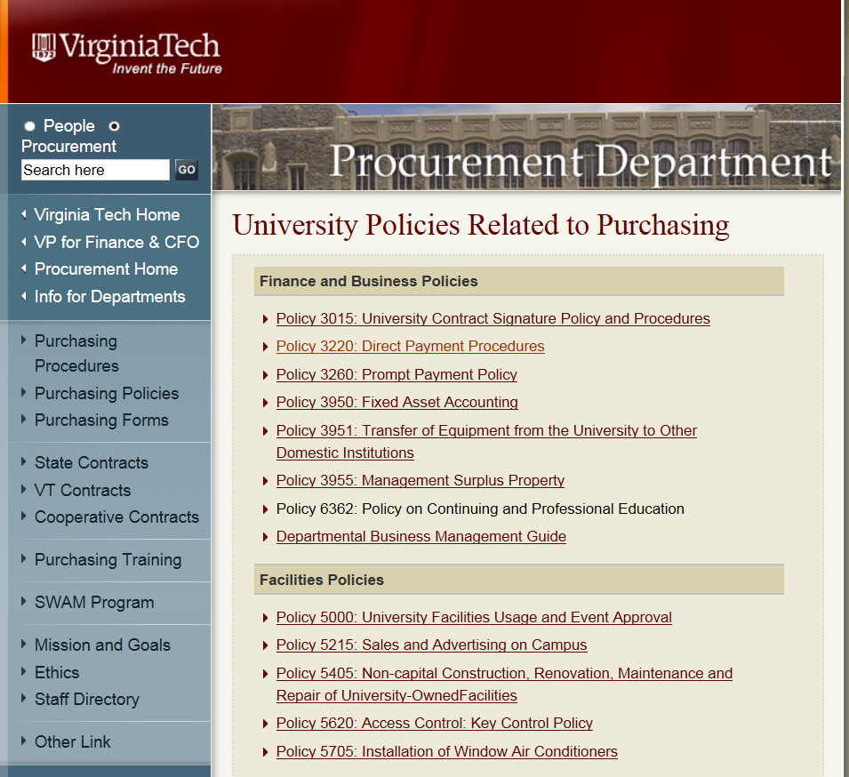
Direct Pay Procedure
http://www.policies.vt.edu/3220.pdf

Slide 18
Direct Pay Procedures
A. Items with no dollar value limitation
1. Utility payments (eVA exempt)
2. Purchases from the US Post Office (eVA exempt)
3. Licenses (Federal, state or local) excluding software licenses (eVA exempt)
4. Animal registrations (eVA transaction)
5. Payment to vendor for meals and lodging provided to invited guest, e.g. speaker or interviewee. Individual meals and lodging subject to current travel regulation limits. (eVA exempt)
6. Purchases from other governmental and public entities (Federal, State, local, town, city, state colleges and universities, authorities, public boards and state hospitals) (eVA exempt)
7. Livestock (domestic farm animals such as horses, sheep, pigs, chickens, cows, bulls, goats, etc.) (eVA transaction)
8. Credit card charges for gasoline and other emergency charges while in a transit status (eVA exempt)
9. Legal services, expert witness or other services associated with litigation or regulatory proceedings approved or obtained by the University Legal Counsel (eVA transaction)
10. Legal settlements approved by the University Legal Counsel (eVA transaction)
11. Lodging and/or meeting rooms in Hotels, Conference Centers, etc. excluding charges for additional services (see Item E(4) for valuation limit and definition of additional services). (eVA exempt)
12. Employee moving and relocation expenses being paid to moving companies. Refer to University Procedure 20345: Moving and Relocation. (eVA transaction)
13. Group travel arrangements in foreign countries. May include cost of transportation, lodging, meals and special services. (eVA exempt)
14. Royalties/broadcast rights and film rentals from the producer or protected distributors (eVA transaction)
15. Payments made to private educational institutions for transactions not associated with a sponsored research subaward (eVA exempt)
16. Membership and Association dues including related assessments. Accreditation fees. (eVA exempt)
17. University participation in intercollegiate athletic tournaments and events including team travel, registration, and tournament fees (eVA exempt)
18. Referees, Officials and Umpires for intercollegiate athletic events (eVA exempt)
19. Honoraria, fees for performing artists, speakers, lecturers, musicians, writers, and artists. For honoraria payments over $500, the faculty sponsor should submit a note of justification. No honoraria, speaker fees or other payments can be made under this provision to any Virginia Tech employee in any amount. (eVA exempt)

Slide 19
Direct Pay Procedures cont
B. Items with a valuation limit of $2,000
1. Reimbursements to university employees for goods or services purchased at personal expense for use by the university, not to exceed $2,000 per reimbursement. Itemized receipts are required. Personal use items, gifts and entertainment are not eligible for reimbursement from state funds. Travel-related expenses (meals, car rental, lodging, etc.) should be reimbursed under travel procedures. (eVA exempt)
C. Items with a valuation limit of $10,000
1. Freight bills/express shipping/common carriers/tariffs, import and export duties and customs brokerage fees. Refer all charges expected to exceed this amount to purchasing for competitive rate quotes. (eVA transaction)
D. Items with a valuation limit of $12,500
1. Medical payments for student athletes injured while participating in an intercollegiate athletic activity. Total payments to a physician per injury per athlete shall not exceed $12,500. (eVA exempt)
E. Items with a valuation limit of $50,000
1. Conference fee/course fees/seminars/training sessions/tuition and other registration fees attended by university employees and students and guests. Total university payments to a trainer should not exceed $50,000 per year under direct pay procedures. (eVA exempt)
2. Consulting and/or training services associated with academic or research programs including travel and living expenses (established University Travel Management Contract must be used where applicable). Total university payments to an individual consultant or consulting firm should not exceed $50,000 per year under direct pay procedures. (eVA transaction)
3. Advertising for employment opportunities and other announcements (all media). (eVA exempt)

Slide 20
Direct Pay Procedures cont
4. Additional services (meals, audio-visual equipment, etc.) associated with lodging and/or meeting rooms in Hotels, Conference Centers, etc. (eVA transaction)
5. Subscriptions, books, pre-printed materials, reprints, publishers page changes, book subscriptions, book subventions, subscription mailing list (printed or electronic), pre-recorded audio and video cassettes, conference proceedings, slide presentations, tapes, CDs and diskettes, when available only from the publisher or producer. (eVA transaction)
6. Alcohol purchased from ABC stores (eVA exempt)
7. Photographers (excluding graduation photographic services for which there is a university contract). (eVA transaction)
8. Academic testing services (eVA exempt)
9. Rental fees for exhibitions of historical artifacts and original works of art. Fees may include other associated charges such as transportation, freight, supplemental insurance, etc. (eVA exempt)
10. Group travel arrangements within the United States. May include cost of transportation, lodging, meals and special services. If lodging only is being obtained, use item A-11. If the group travel costs will be in excess of $50,000 paid to the same vendor, Purchasing will need to complete a Purchase Order. (eVA exempt)
Documentation. Even though university policy may not require the preparation of a purchase order for direct pay transactions, some vendors may desire this documentation in confirmation of the university’s intentions. The Purchasing Department will prepare such documentation upon request and receipt of a Requisition for Purchase. More commonly, vendors will seek to have the university employee sign some form of contract for the goods or services. University Policy 3015 details contract signature authority

Slide 21
Miscellaneous Questions
When the Controller's office finds an error on an expense voucher, we were notified of the error. That doesn't happen anymore. Is there a reason?
All changes to travel vouchers are documented on the image in the Banner system. Department users can view the images to see the changes. In the new electronic travel & expense system (which should be implemented campus wide during the next year), the Controller’s office will not make any changes to travel reimbursement requests. The requests will be returned electronically with notes for correction by the department. The department will have to correct and resubmit the reimbursement. Hopefully, this will achieve the goal the departments desire.
On average, how long does it take to process a travel reimbursement?
It depends on the volume of work and staffing situation in the Controller’s Office (vacancies on travel staff, etc.). However, we strive to process reimbursements within 7 days from receipt (maximum of 10 days) when fully staffed. Today, we are approximately 4 days out. If problems are encountered with the request and it we must collect additional information for the department, it may take longer than the 7 to 10 days.
I think it would be helpful to have a list of 'specialists' in the Controller's office; i.e., Travel people, account number assistance, new vendor questions, etc. Is there such a list?
By calling our main number 1-6418, general accounts payable questions can be answered by selecting option one (Dee Acord normally handles these calls). For travel questions, select option 2, these calls are answered by a member of the travel staff (alternating employees daily). For new vendor questions, normally, these should be routed to Procurement.

