Slide 1
Efficient BVH-based Collision Detection Scheme with Ordering and Restructuring
Xinlei Wang¹, Min Tang^{1,3}, Dinesh Manocha^{2,1}, Ruofeng Tong¹
¹ Zhejiang University, China
² University of North Carolina at Chapel Hill, America
³ Alibaba-Zhejiang University Joint Institute of Frontier Technologies, China
Notes:
Good morning everyone. My name is Wang Xinlei. I am currently a third-year PhD student from Zhejiang University. I’ve been practicing GPU programming in the past two years, and the work I’m about to introduce is one of the GPU projects I’ve done so far. The paper I’m going to present today is “Efficient BVH-based Collision Detection Scheme with Ordering and Restructuring”…

Slide 2
In this talk
Overview of related work
GPU algorithm design and implementation
Ordering scheme
Quality Metric
Restructuring scheme
Comparisons, etc.
Notice
Focus on BVH-based methods
Focus on the broad-phase collision detection
Exclude narrow-phase CD and collision response
BVH maintenance
BVTT front maintenance
Narrow-phase Collision Detection
Collision Response
Collision Handling Cycle
Notes:
Let’s first take a look at the outcome of this talk.
Since we are presenting our whole collision detection framework on GPU, all important related work will be briefly introduced in the beginning.
Then we come up with new approaches to deal with the critical problems encountered during the development.
Finally, comparisons with other state-of-the-art methods will be presented and discussions will be made.
Also, note that we mainly focus on the BVH-based broad-phase collision detection, which are the first two sub-steps shown in boldface on the right. We will skip the narrow-phase detection and collision response which are not the subjects of our paper.

Slide 3
Conventional BVH-based Collision Detection (1/4)
BVH based Collision Detection
BVTT front based Collision Detection
Notes:
Before we go into the topic, I assume most people here are familiar with the term Bounding Volume Hierarchy and Bounding Volume Test Tree. Anyway, we will get the idea as we walk through the related work.

Slide 4
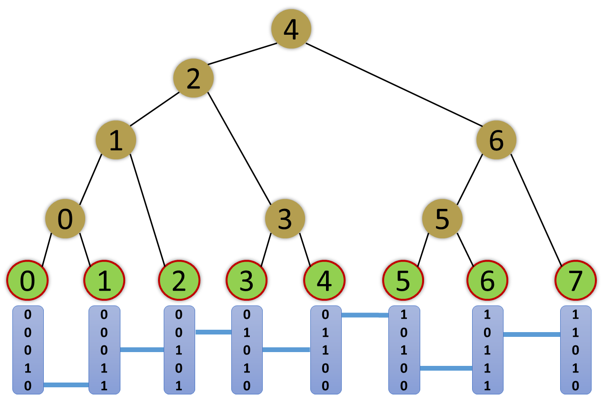
BVH (Bounding Volume Hierarchy) Construction
BVH Construction
[2012 Karras] builds all nodes in parallel
[2014 Apetrei] builds & refits in one iteration
BVH Stackless Traversal
[2007 Damkjaer] depth-first order traversal using escape index
BVTT Front Tracking
[1998 Klosowski] BVTT front tracking
[2011 Tang] first implementation on GPU
Linear BVH built on top of primitives sorted by their Morton codes
Notes:
In our framework, we select BVH as our spatial acceleration structure because it is simple and easy to build.
In 2012, Karras first came up with an algorithm to construct the whole BVH on GPU entirely in parallel. Apetrei further improves it by combining building and refitting in a single kernel and builds the tree in a bottom-up fashion. The topology of the BVH is decided by the length of the common prefix between two adjacent Morton codes. They appear as the blue bars between the binary codes of adjacent primitives. Here, each primitive corresponds to a leaf node in our BVH.
That’s all about BVH construction.

Slide 5
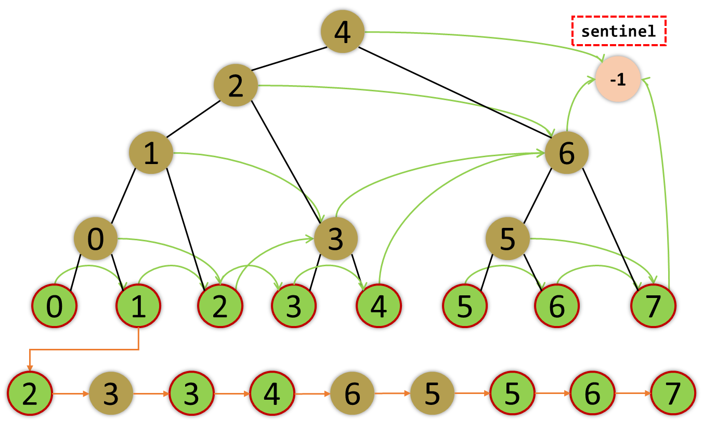
Stackless BVH Traversal
BVH Construction
[2012 Karras] builds all nodes in parallel
[2014 Apetrei] builds & refits in one iteration
BVH Stackless Traversal
[2007 Damkjaer] depth-first order traversal using escape index
BVTT Front Tracking
[1998 Klosowski] BVTT front tracking
[2011 Tang] first implementation on GPU
Depth-first order traversal track of Primitive-1 assuming it collides with all the other primitives
Notes:
After the construction of the BVH is completed, we begin the collision detection by traversing this binary tree in parallel. More specifically, each GPU thread is checking all the intersections between its primitive and the entire BVH.
We use the depth-first search algorithm by Damkjaer which replaces the local stacks from all the GPU threads with a single table storing all the escape indices indicating the nodes to search next when backtracking.
The sequence underneath is an example of the self collision detection of primitive 1. Assume that it collides with all the other primitives in this BVH, so the searching will always come down to the bottom level before moving foward. Whenever reaching the leaf, it follows the green arrow to back trace the tree.

Slide 6
BVTT (Bounding Volume Test Tree) front tracking
BVH Construction
[2012 Karras] builds all nodes in parallel
[2014 Apetrei] builds & refits in one iteration
BVH Stackless Traversal
[2007 Damkjaer] depth-first order traversal using escape index
BVTT Front Tracking
[1998 Klosowski] BVTT front tracking
[2011 Tang] first implementation on GPU
4
2
1
6
0
3
5
0
1
2
3
4
5
6
7
Each primitive has such a local BVTT front Collision detection begins from the front
Notes:
However, the above BVH-based collision detection can be further accelerated by utilizing spatial-temporal coherence between successive frames in physics-based animations.
Here, BVTT stands for Bounding Volume Test Tree, it is essentially a search tree of the collision detection, and BVTT front is composed of non-overlapping nodes during a previous collision detection traversal.
In our case, this BVTT is identical to our BVH, because we are checking the intersection between each primitive with the BVH in parallel, and there is a local BVTT front for every primitive, as marked by the dotted line. When performing front-based collision detection, each thread is assigned with a front node and begins searching from the location indicated by its front node.

Slide 7

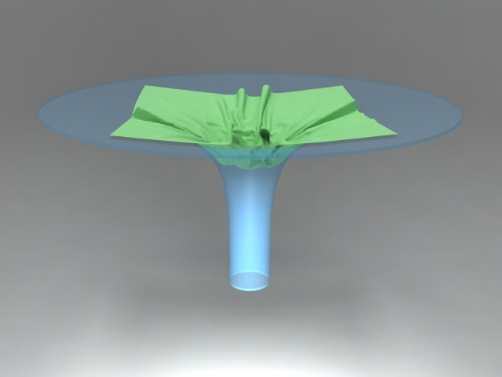
Motivation
BVH-based Collision Detection Algorithms on GPU far from optimized
Culling efficiency of BVH degenerates as models undergo deformable motion
Flag (from ARCSim)
80K triangles
6.48 ms/ frame
7.62x speedup
Funnel (from UNC)
18K triangles
0.6 ms/ frame
2~3x speedup
Notes:
That’s all about related work. So what else needs to be done here?
First of all, the existing algorithm is far from optimal. Take a peak at the results of our method on the right. As you can see, the performance speedup is clearly notable.
As GPUs continue to get faster, we intend to utilize its growing computing ability and power more efficiently. So we need to improve the previous algorithm for collision detection.
The other one is a long standing problem of BVH-based collision detection that the culling efficiency of BVH may degenerate as models undergo deformable motions. We propose a new quality metric to identify such nodes and then perform restructuring on those subtrees.

Slide 8
Ordering (2/4)
BVH ordering
BVTT front ordering
Notes:
You may wonder what exactly are the problems of the conventional method. Before introducing the ordering scheme, we need to analyse the existing collision detection algorithm in order to understand its problem.

Slide 9
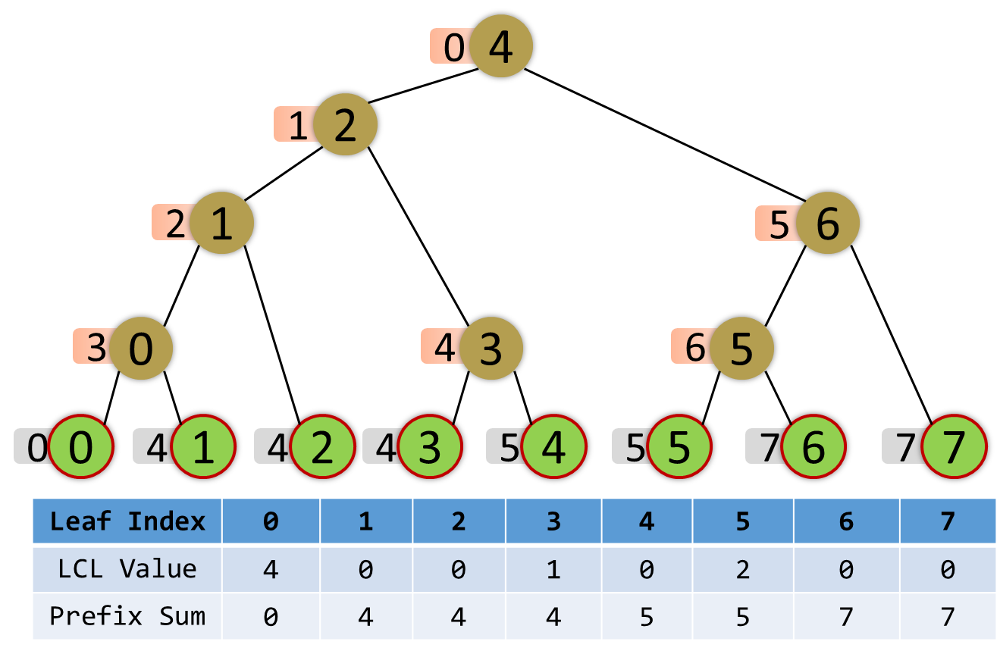
BVH-based Collision Detection
Full traversal of the internal nodes
Original BVH 4 2 1 0 3 6 5
Ordered BVH 0 1 2 3 4 5 6
How to compute BVH order
Calculate the LCL-value of each leaf node
Compute prefix sums of LCL-values
Assign the indices from LCA from top to bottom
4
2
1
6
0
3
5
0
1
2
3
4
5
6
7
0
Sort
1
2
5
3
4
6
0
1
2
3
4
5
6
7
Notes:
Basically, every BVH-based collision detection kernel has to traverse the BVH to check all the potential bounding box intersections.
Most operations including querying each node’s bounding volume, left boundary index, escape index, etc are memory operations. The only compute operation is just the intersection test that are merely composed of comparations of two floating numbers.
Therefore, the program is obviously memory bound. So we need to examine how the memory is accessed to get a better idea.
The upper BVH is the original tree built by the previous construction algorithm. It is fast, however the layout of those nodes do not necessarily match their traversal order, which is the depth-first order.
So for each thread, the memory locations it visits are mostly disordered. However, if we sort those internal nodes in depth-first order, the node index accessed during searching is guaranteed to be ascending. It is clearer if we compare the full traversal paths of both BVHs. Suppose each GPU cache line can hold two internal nodes and we have the capacity of only one cache line, then for the original BVH, it misses the cache 6 times out of 7 accesses, while for the ordered BVH, only four cache misses happens.
For most GPUs today, accessing DRAM is generally at least one order of magnitude slower than accessing the cache. And because the second sequence is more cache-friendly, its performance is also higher than the original one.
This is the case for a single thread. When it comes to GPU, all the primitives are first sorted using Morton codes so that they are also in close proximity in space. Then these primitives are handed out to each GPU thread one after another, therefore adjacent GPU threads tend to share a similar traversal path of the BVH.
In a word, the ordering of BVH also brings significant improvement to our parallel implementation.
The ordering procedure is composed of three steps.
First LCL values of all leaf nodes are calculated during BVH construction…
The left child levels value (LCL value) used in our table indicate how many straight left children there are above each leaf node.
For example, we look at the fifth-leaf, there are two ancestors straight up on the left branch, so its LCL-value is 2… (Use pen) [the number of ancestor nodes straight up on the left branch…]
Secondly, the prefix sums of those LCL values are computed using the scan algorithm. The results are in the last row (Use pen), and also displayed in the grey tags on the left side of leaf nodes.
In the final step, the ordered indices of those internal nodes displayed in the pink tags are calculated individually by each leaf node from top to bottom. In the meantime, the internal nodes are scattered to their expected positions in the ordered BVH.
The overhead of BVH ordering is negligible.
Note:
In a SIMT architecture, rather than a single thread issuing vector instructions applied to data vectors, multiple threads issue common instructions to arbitrary data. [Nvidia developer blog]

Slide 10
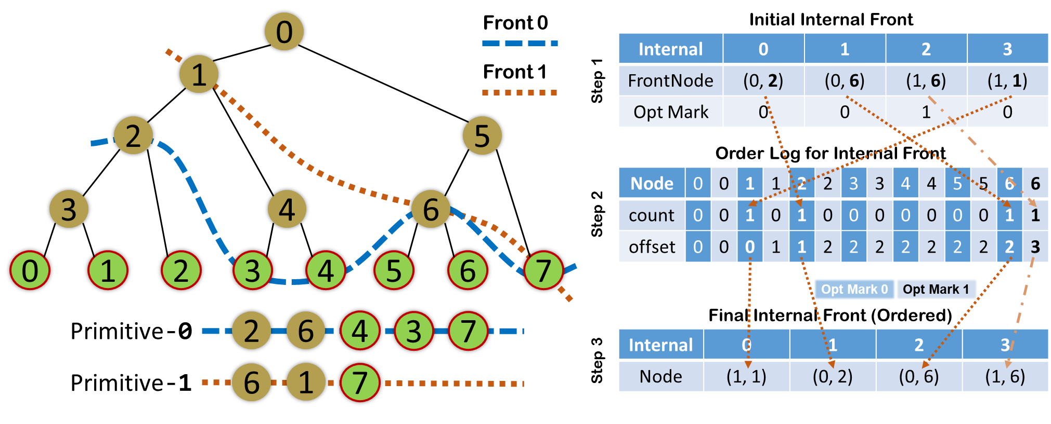
Front-based Collision Detection
Each front node indicates the starting location of its traversal
Front node (i, j): previously primitive i stopped descending at node j
If j corresponds to a leaf, then node(i, j) is external; otherwise, internal
Sprout when overlapping; preserve or prune otherwise
How to compute BVTT front log
Sort front nodes according to the j s (the second component)
Consider thread divergence (refer to paper)
Notes:
The situation is a bit more complex in front-based collision detection. Each GPU thread is assigned with a front node accordingly instead of a primitive as in previous BVH-based collision detection.
The BVTT front node is essentially a pair of BVH index. It is either internal or external, depending on its second component.
If j corresponds to a leaf, then node(i, j) is external; otherwise, internal. We separate these two kinds of fronts under the consideration of memory access efficiency, because leaf nodes and internal BVH nodes are also stored separately. The GPU thread will first locate the index j, and start finding all the intersections of primitive i and the subtree rooted at node j.
For each front node, one of the three maintenance operations will be applied. If the two BVH nodes, which are node i and node j, are overlapping, then this front node is definitely doing sprouting. Otherwise, the thread will climb up from node j until it no longer intersects with the current ancestor node k, or the node k is not an LCA (left-child ancestor) any more. In the latter case, the front node is pruned. In the former case, a new front node named node(I, k) will be pushed to the front.
As in the previous BVH-based algorithm, we want to sort the fronts according to j, because it is the initial search location of BVH and we want adjacent threads to search in a similar area of the same BVH. The ordered fronts are expected to be more cache-friendly.
After going through all the details of front-based collision detection, we want to know how to quickly order the front nodes.
Here we highlight the local fronts of two primitives, front 0 and front 1.
For simplicity, we only focus on the internal front nodes here, which are surrounded by the red box.
Let’s move on to the charts on the right.
The ordering procedure is mostly the same.
First step is counting, the second one is computing the prefix sums, which are the offsets of each segment. In the final step, the nodes are ordered accordingly.

Slide 11
Statistics (1/2) – Effectiveness of ordering
Without ordering
With ordering
L2 Cache Hit Rate (L1 Reads)
88%
Global Load L2 Transactions/Access
31.7
Maximum Divergence
99.9%
L2 Cache Hit Rate (L1 Reads)
92%
Global Load L2 Transactions/Access
23.4
Maximum Divergence
65.7%
The overhead of histogram sort is low (~1ms)
2~3x speedup !
Notes:
So how well does the ordering scheme perform?
Here we display a part of the run-time statistics from our experiments. More specifically, these are the data of the most-used collision detection kernel in the cloth ball benchmark
We see that the cache hit rate rises, divergence rate decreases along with less DRAM accesses, all due to our ordering scheme.
Most importantly, the performance is also much higher at the cost of just a histogram sort.

Slide 12
Statistics (2/2) – Overhead of ordering
 | BVTT Front Length Variation (Internal + External) | Histogram Sort (ms) | Radix Sort (ms)
Flamenco | (644429 + 486981) ~ (1442704 + 753844) | 0.40 ~ 0.70 | 8.20 ~ 12.2
Funnel | (205651 + 149119) ~ (697200 + 214470) | 0.14 ~ 0.27 | 1.53 ~ 2.50
Cloth Ball | (982110 + 755381) ~ (4371698 + 1675945) | 0.55 ~ 1.70 | 9.50 ~ 13.25
Notes:
The ordering itself is also lightweight and within our tolerance. Compared with the common radix sort solution, the histogram sort we use is an order of magnitude faster in general.

Slide 13
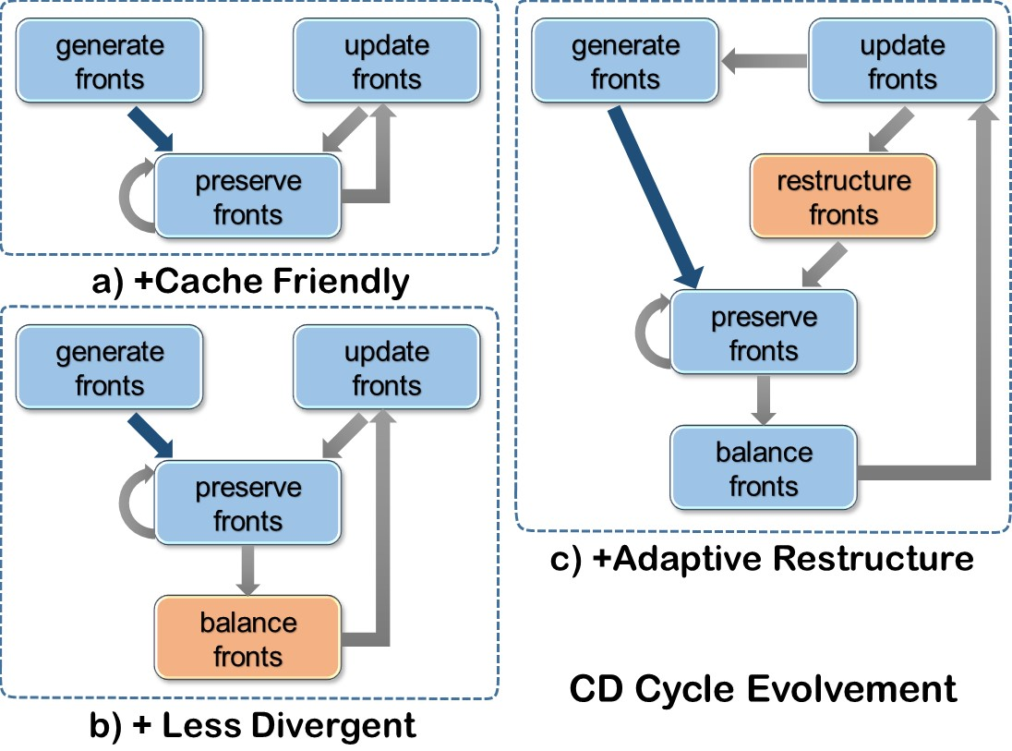
Cycle of our framework (BVTT front part)
Notes:
So far we’ve accomplished the left two cycles, a and b, which handles the memory issues and branching divergence effectively.
In the next part, we’ll add the restructuring functionality into the cycle. Then we can have our complete framework for collision detection

Slide 14
Restructuring (3/4)
* Quality metric
BVH restructuring
BVTT front restructuring
Notes:
The premise of restructuring is to identify those which needs to be restructured.

Slide 15
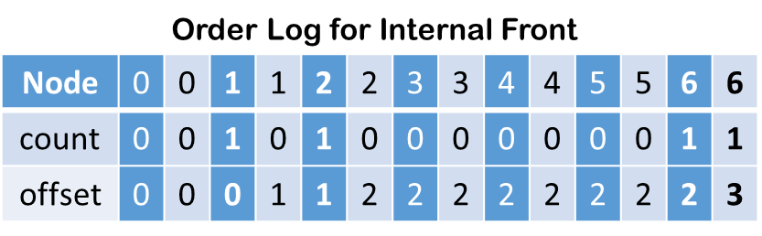
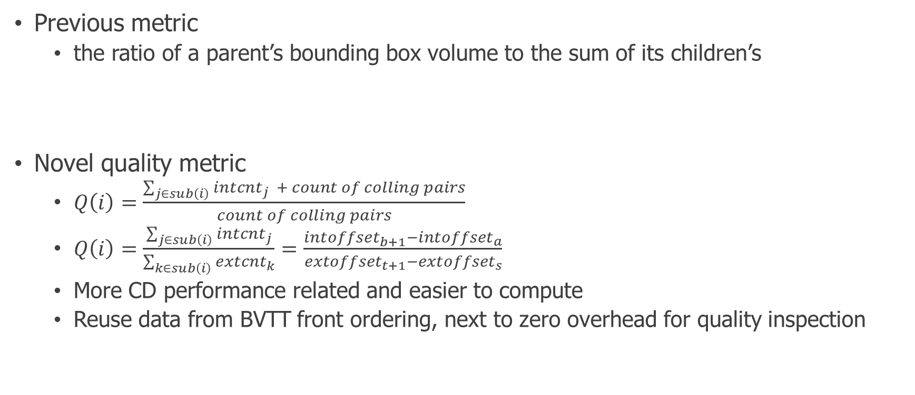
BVH Quality Inspection through BVTT Front Log
Previous metric
the ratio of a parent’s bounding box volume to the sum of its children’s
Novel quality metric
$Q\left(i\right)=\frac{\sum_{j∈sub\left(i\right)}{{intcnt}_{j}} + count of colling pairs}{count of colling pairs}$
$Q\left(i\right)=\frac{\sum_{j∈sub\left(i\right)}{{intcnt}_{j}}}{\sum_{k∈sub\left(i\right)}{{extcnt}_{k}}}=\frac{{intoffset}_{b+1}−{intoffset}_{a}}{{extoffset}_{t+1}−{extoffset}_{s}}$
More CD performance related and easier to compute
Reuse data from BVTT front ordering, next to zero overhead for quality inspection
Notes:
And the means to do that is the quality metric of the BVH.
Previous metric considers the ratio of a parent’s bounding box volume to the sum of its children’s. The lower that value is, the higher possibility that node needs restructuring. It makes sense because this metric is related with the size of two children’s intersecting volume which describes the extent of separation between the two children.
Here we propose a new metric. It is correlated with the number of front nodes therefore it is much more performance related. To understand what this metric means. We have to assume the number of external front nodes is an approximation to the count of the actual colliding pairs. Then the total number of front nodes divided by this count means the average number of front nodes it takes to calculate a colliding pair. We ignore the constant term, and use the approximation, we then get our final.
Whenever the quality metric rises, it means we need more front nodes to compute a colliding pair. The reason of that is mostly due to BVH degenerations.
Also, the front size may grow as the number of colliding pairs increases. Gladly, through our experiments, we confirm that this metric remains stable if we exclude the factor of BVH degenerations. So, we adopt this new metric as a reference to do the quality inspection.
Remember the slide we showed before about BVTT front log, the offset log is prefix sums of the counts of front nodes. Here we directly borrow the values from that table. (Use pen)
The overall computation of this metric is therefore fairly lightweight.

Slide 16
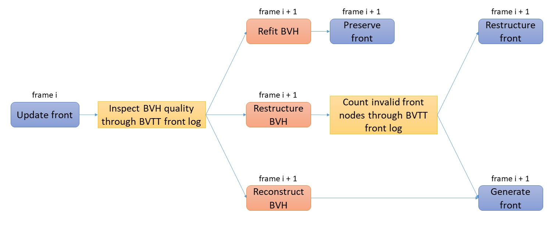
Restructuring Scheme
BVH restructuring
“Construct” over candidates selected by the metric
BVTT front restructuring
Only re-compute invalid front nodes
Saves half of the time compared to a total reconstruction
Notes:
After the candidates for restructuring are selected, we use the same algorithm for construction in the restructuring process, the only difference is the scale of restructuring is restricted to the restructuring marks.
The overall decision tree is …

Slide 17
Comparison & Discussion (4/4)
Comparison
Discussion
Notes:
Eventually we have come to the last part of the talk. You will see several comparisons with previous state-of-the-art collision detection algorithms.

Slide 18
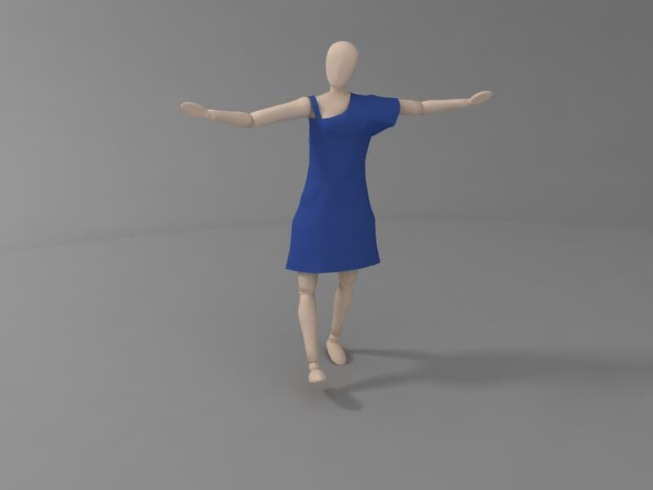

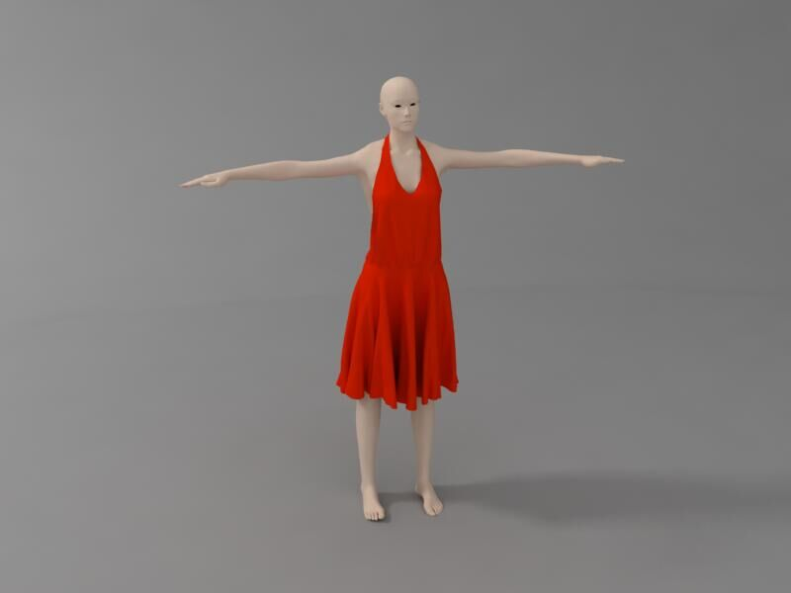
ARCSim benchmarks
DressBlue (61k) | Flag (80k) | Sphere (67k) | Victor (158k)
9.84ms | 11.73ms | 8.81ms | 4.01ms
3.51X | 7.62X | 6.84X | 5.26X
Notes:
These four benchmarks from the ARCSim simulator are tested on Tesla k40c GPU. The chart records the performance of the broad-phase collision detection and demonstrate a speed-up from more than 3 to 7 over the previous state-of-the-art BVH-based method.

Slide 19
UNC dynamic scene benchmarks
Octree Grid [2014 Wong]
GTX 780
kDet (Spatial Hashing) [2017 Weller]
GTX 1080
Benchmark (Frame Counts) | Triangles ×1,000 | OTG CCD (ms) | Ours (ms) | Speedup (times)
Funnel (500) | 18 | 3.4 | 1.4 | 2.43
ClothBall (94) | 92 | 9.2 | 6.0 | 1.53
Flamenco (506) | 49 | 10.8 | 3.8 | 2.85
N-body*(76) | 146 | 19.1 | 10.5 | 1.82
Benchmark (Frame Counts) | Triangles ×1,000 | kDet (ms) | Ours (ms) | Speedup (times)
Dragon* (16) | 252 | 9.3 | 6.8 | 1.37
ClothBall (94) | 92 | 6.1 | 2.3 | 2.65
N-body*(76) | 146 | 4.4 | 4.3 | 1.02
Funnel (500) | 18 | 1.7 | 0.6 | 2.83
Notes:
Also we pick five benchmarks from UNC library and test on two graphics cards.
Besides BVH-based methods, there are other solutions to collision detection.
The first one displayed on the left is based on a structure which combines an octree and grid, while the other one uses spatial hashing to implement their algorithm. Both methods are spatial-subdivision based algorithms while ours is object-division based.
Let’s look at these tables, all the benchmarks that are not marked with an asterisk suffix are using BVTT front for accelerations, and the speedup is mostly between 2 and 3. In other cases where only BVH is used, our performance is comparable or even higher.
In a word, our framework has the advantage of speed.

Slide 20
Summary
Ordering improves memory access efficiency, reduces thread divergence
Quality inspection is light-weight, performance-related, and prevents BVH quality degeneration
Restructuring avoids expensive total reconstructions of BVH and BVTT front
Limitations
Relatively large memory consumption (due to BVTT front storage)
Fixed cycle length insensitive to motion variation
Notes:
To summarize, I list three features of our scheme. Inspite of the above advantages, there are also two downsides that might become a limitation in its application.
Firstly, it has to consume a relatively-large amount of memory space to store the BVTT front.
Secondly, the BVH & BVTT front is maintained periodically and the quality inspection is only performed once per cycle. Since the length of the cycle is fixed, our scheme is not able to adapt to such variation.
Be ware that these two issues are not critical in our experiments, so our framework works just fine with the benchmarks.
And due to the reuse of BVH structure, our framework has its potential in its application in the rendering

Slide 21
Thank you Q & A
E-mail
wxlwxl1993@zju.edu.cn
Project Website
https://github.com/littlemine/BVH-based-Collision-Detection-Scheme
Notes:
Thank you for listening. If you want to know more about the project or have questions later, feel free to visit this address and contact me through the e-mail. And if there are questions now, I‘d be glad to try my best offering an answer.

