Slide 1
Announcements
Weekly Reading Assignment:
Chapter 7 and 8 (CLRS)
Homework #3 is due on 10/6/05
Extra help session today after class

Slide 2
Lower Bounds for Sorting
Sorting methods that determine sorted order based only on comparisons between input elements must take Ω(n lg n) comparisons in the worst case to sort. Thus, merge sort and heapsort are asymptotically optimal.
Other sorting methods (counting sort, radix sort, bucket sort) use operations other than comparisons to determine the order can do better -- run in linear time.

Slide 3
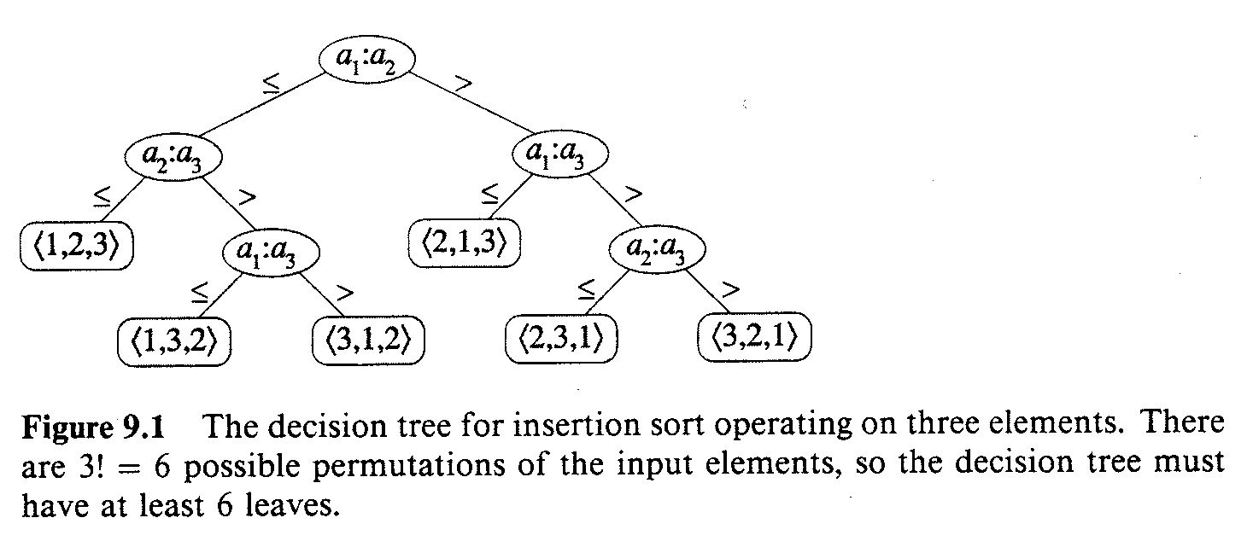
Decision Tree
Each internal node is annotated by a_{i}: a_{j} for some i and j in range 1 ≤ i,j ≤ n. Each leave is annotated by a permutation π(i).

Slide 4
Lower Bound for Worst Case
Any decision tree that sorts n elements has height Ω(n lg n).
Proof: There are n! permutations of n elements, each permutation representing a distinct sorted order, the tree must have at least n! leaves. Since a binary tree of height h has no more than 2^{h} leaves, we have
  n! ≤ 2^{h} ⇒ h ≥ lg(n!)
  By Stirling’s approximation: n! > (n/e)^{n}
  h ≥ lg(n!) ≥ lg(n/e)^{n} = n lg n - n lg e = Ω(n lg n)

Slide 5
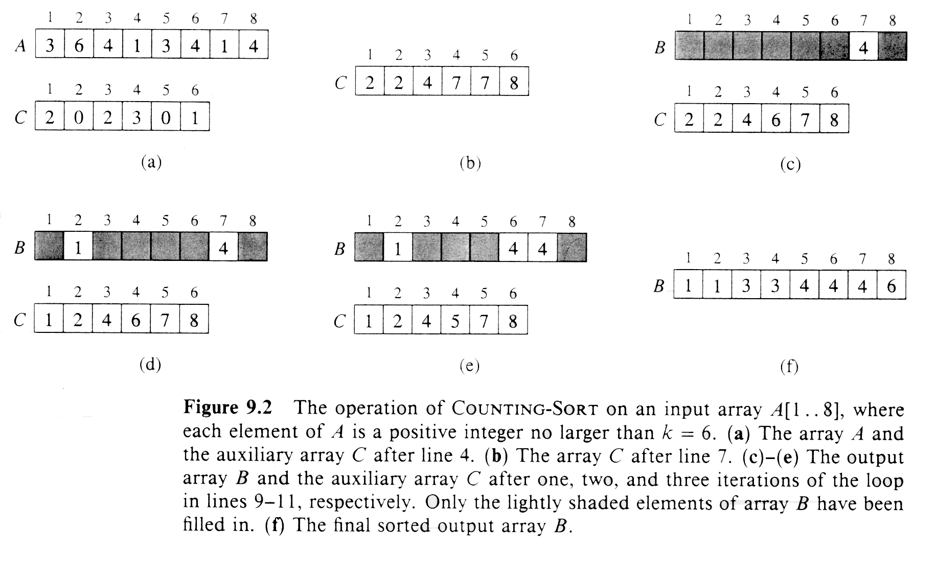
Counting Sort
Assuming each of n input elements is an integer ranging 1 to k, when k = O(n) sort runs in O(n) time.

Slide 6
Counting-Sort (A, B, k)
1. for i ← 1 to k
2. do C[i] ← 0
3. for j ← 1 to length[A]
4. do C[A[j]] ← C[A[j]] + 1
5. for i ← 2 to k
6. do C[i] ← C[i] + C[i-1]
7. for j ← length[A] downto 1
8. do B[C[A[ j ]]] ← A[j]
9. C[A[j]] ← C[A[j]] - 1

Slide 7
Algorithm Analysis
The overall time is O(n+k). When we have k=O(n), the worst case is O(n).
  for-loop of lines 1-2 takes time O(k)
  for-loop of lines 3-4 takes time O(n)
  for-loop of lines 5-6 takes time O(k)
  for-loop of lines 7-9 takes time O(n)
Stable, but not in place.
No comparisons made: it uses actual values of the elements to index into an array.

Slide 8
Radix Sort
It was used by the card-sorting machines to read the punch cards.
The key is sort the “least significant digit” first and the remaining digits in sequential order. The sorting method used to sort each digit must be “stable”.
  If we start with the “most significant digit”, we’ll need extra storage.

Slide 9
An Example
392 631 928 356
356 392 631 392
446 532 532 446
928 ⇒ 495 ⇒ 446 ⇒ 495
631 356 356 532
532 446 392 631
495 928 495 928
↑ ↑ ↑

Slide 10
Radix-Sort(A, d)
1. for i ← 1 to d
2. do use a stable sort to sort array A on digit i
** To prove the correctness of this algorithm by induction on the column being sorted:
Proof: Assuming that radix sort works for d-1 digits, we’ll show that it works for d digits.
Radix sort sorts each digit separately, starting from digit 1. Thus radix sort of d digits is equivalent to radix sort of the low-order d -1 digits followed by a sort on digit d .

Slide 11
Correctness of Radix Sort
By our induction hypothesis, the sort of the low-order d-1 digits works, so just before the sort on digit d , the elements are in order according to their low-order d-1 digits. The sort on digit d will order the elements by their dth digit.
Consider two elements, a and b, with dth digits a_{d} and b_{d}:
If a_{d} < b_{d} , the sort will put a before b, since a < b regardless of the low-order digits.
If a_{d} > b_{d} , the sort will put a after b, since a > b regardless of the low-order digits.
If a_{d} = b_{d} , the sort will leave a and b in the same order, since the sort is stable. But that order is already correct, since the correct order of is determined by the low-order digits when their dth digits are equal.

Slide 12
Algorithm Analysis
Each pass over n d-digit numbers then takes time Θ(n+k).
There are d passes, so the total time for radix sort is Θ(d n+ d k).
When d is a constant and k = O(n), radix sort runs in linear time.
Radix sort, if uses counting sort as the intermediate stable sort, does not sort in place.
  If primary memory storage is an issue, quicksort or other sorting methods may be preferable.

Slide 13
Bucket Sort
Counting sort and radix sort are good for integers. For floating point numbers, try bucket sort or other comparison-based methods.
Assume that input is generated by a random process that distributes the elements uniformly over interval [0,1). (Other ranges can be scaled accordingly.)
The basic idea is to divide the interval into n equal-sized subintervals, or “buckets”, then insert the n input numbers into the buckets. The elements in each bucket are then sorted; lists from all buckets are concatenated in sequential order to generate output.

Slide 14
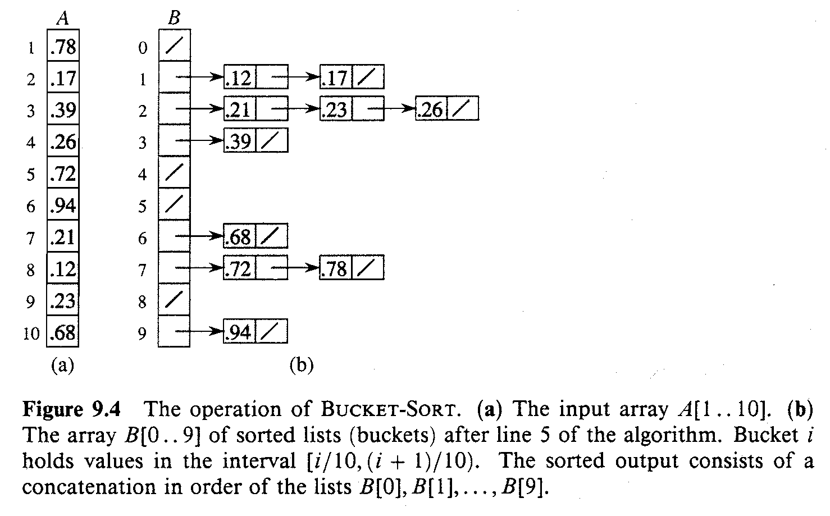
An Example

Slide 15
Bucket-Sort (A)
1. n ← length[A]
2. for i ← 1 to n
3. do insert A[i] into list B[ ⎣nA[i]⎦ ]
4. for i ← 0 to n-1
5. do sort list B[i] with insertion sort
6. Concatenate the lists B[i]s together in order

Slide 16
Algorithm Analysis
All lines except line 5 take O(n) time in the worst case. Total time to examine all buckets in line 5 is O(n), without the sorting time.
To analyze sorting time, let n_{i} be a random variable denoting the number of elements placed in bucket B[i]. The total time to sort is
∑_{i = 0 to n-1} O(E[n_{i}²]) = O( ∑_{i = 0 to n-1} E[n_{i}²] ) = O(n)
E[n_{i}²] = Var[n_{i}] + E²[n_{i}]
= n p (1 - p) + 1² = 1 - (1/n) + 1
= 2 - 1/n = Θ(1)

Slide 17
Review: Binomial Distribution
Given n independent trials, each trial has two possible outcomes. Such trials are called “Bernoulli trials”. If p is the probability of getting a head, then the probability of getting k heads in n tosses is given by (CLRS p.1113)
P(X=k) = (n!/(k!(n-k)!)) p^{k} (1-p)^{n-k} = b(k;n,p)
This probability distribution is called the “binomial distribution”. p^{k} is the probability of tossing k heads and (1-p)^{n-k} is the probability of tossing n-k tails. (n!/(k!(n-k)!)) is the total number of different ways that the k heads could be distributed among n tosses.

Slide 18
Review: Binomial Distribution
See p. 1113-1116 for the derivations.
E[x] = n p
Var[x] = E[X²] - E²[X] = n p (1-p)
E[X²] = Var[X] + E²[X]
= n p (1-p) + (n p)² = 1(1-p) + 1²

