Slide 1
Announcements
Weekly Reading: Chap 8 & 9 (CLRS)
Homework#3 due today
In-Class Midterm Review on Thursday, October 27, 2005
In-Class Midterm on Thursday, November 3, 2005

Slide 2
Order Statistic
ith order statistic of a set of n elements is the ith smallest element
Minimum: the first order statistic
Maximum: the nth order statistic
Selection problem can be specified as:
  Input: A set A of n distinct numbers and a number i, with 1≤ i ≤ n
  Ouput: the element x ∈ A that is larger than exactly i-1 other elements of A

Slide 3
Minimum (A)
1. min ← A[1]
2. for i ← 2 to length[A]
3. do if min > A[i]
4. then min ← A[i]
5. return min

Slide 4
Algorithm Analysis
T(n) = Θ(n) for Minimum(A) or Maximum(A)
Line 4 is executed Θ(lg n)
For any 1≤ i ≤ n, the probability of line 4 is executed is the probability that A[i] is the minimum among all A[j] for 1≤ j ≤ i, which is 1/i. So, the expectation of s
        E[s] = E[s₁ + s₂ +...+ s_{n}]
        = 1/1 + …. + 1/n
        = ln n + O(1) = Θ(lg n)
Only 3 ⎡n/2⎤ comparisons are necessary to find both the minimum and the maximum.

Slide 5
Randomized-Select
Partition the input array around a randomly chosen element x using Randomized-Partition. Let k be the number of elements on the low side and n-k on the high side.
Use Randomized-Select recursively to find the ith smallest element on the low side if i ≤ k , or the (i-k)th smallest element on the high side if i > k

Slide 6
Randomized-Select (A, p, r, i)
1. if p = r
2. then return A[p]
3. q ← Randomized-Partition(A, p, r)
4. k ← q - p + 1
5. if i ≤ k
6. then Randomized-Select(A, p, q, i)
7. else Randomized-Select(A, q+1, r, i-k)
The worst-case running time can be Θ(n²), but the average performance is O(n).

Slide 7
Randomized-Partition Example
8 | 1 | 5 | 3 | 4
Goal: Find 3rd smallest element

Slide 8
Randomized-Partition Example
8 | 1 | 5 | 3 | 4

Slide 9
Randomized-Partition Example
8 | 1 | 5 | 3 | 4
1 | 3 | 8 | 5 | 4

Slide 10
Randomized-Partition Example
8 | 1 | 5 | 3 | 4
1 | 3 | 8 | 5 | 4
8 | 5 | 4

Slide 11
Randomized-Partition Example
8 | 1 | 5 | 3 | 4
1 | 3 | 8 | 5 | 4
8 | 5 | 4

Slide 12
Randomized-Partition Example
8 | 1 | 5 | 3 | 4
1 | 3 | 8 | 5 | 4
4 | 5 | 8

Slide 13
Randomized-Partition Example
8 | 1 | 5 | 3 | 4
1 | 3 | 8 | 5 | 4
4 | 5 | 8
4

Slide 14
Average-Case Analysis
T(n) ≤ 1/n( T(max(1, n-1)) +∑_{k =1 to n-1}T(max(k, n-k)) ) + O(n)
≤ 1/n( T(n-1) + 2 ∑_{k = ⎡n/2⎤ to n-1} T(k) )+ O(n)
= 2/n ∑_{k = ⎡n/2⎤ to n-1} T(k) + O(n)
Substitution Method: Guess T(n) ≤ c n
T(n) ≤ 2/n ∑_{k = ⎡n/2⎤ to n-1} ck + O(n)
≤ 2c/n ( ∑_{k = 1 to n-1} k - ∑_{k = 1 to ⎡n/2⎤ -1} k ) + O(n)
= 2c/n ( (n-1)n/2 - 1/2( ⎡n/2⎤ -1 ) ⎡n/2⎤ ) + O(n)
≤ c(n - 1) - (c/n)(n/2 -1)(n/2) + O(n)
≤ c(3n/4 - 1/2) + O(n)
≤ cn ⇐ if we pick c large enough so that
c(n/4 + 1/2) dominates O(n)

Slide 15
Selection in Worst-Case Linear Time
It finds the desired element(s) by recursively partitioning the input array
Basic idea: to generate a good split when array is partitioned using a modified deterministic partition

Slide 16
Selection
Divide the n elements of input array into ⎣n/5⎦ groups of 5 elements each and at most one group made up of the remaining (n mod 5) elements.
Find the median of each group by insertion sort & take its middle element (smaller of 2 if even number input).
Use Select recursively to find the median x of the ⎡n/5⎤ medians found in step 2.
Partition the input array around the median-of-medians x using a modified Partition. Let k be the number of elements on the low side and n-k on the high side.
Use Select recursively to find the ith smallest element on the low side if i ≤ k , or the (i-k)th smallest element on the high side if i > k

Slide 17
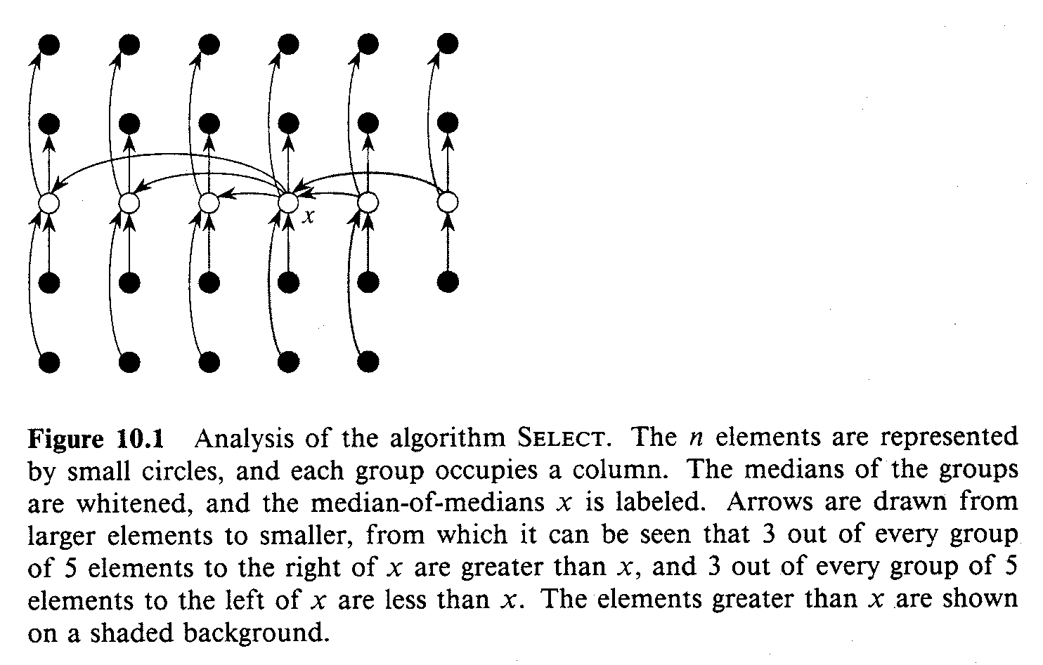
Pictorial Analysis of Select

Slide 18
Algorithm Analysis (I)
At least half of the medians found in step 2 are greater or equal to the median-of-medians x. Thus, at least half of the ⎡n/5⎤ groups contribute 3 elements that are greater than x, except the one that has < 5 and the one group containing x. The number of elements > x is at least
3 ( ⎡(1/2)⎡n/5⎤⎤ - 2) ≥ 3n/10 - 6
Similarly the number of elements < x is at least 3n/10 - 6. In the worst case, SELECT is called recursively on at most 7n/10 + 6.

Slide 19
Solving Recurrence
Step 1, 2 and 4 take O(n) time. Step 3 takes time T(⎡n/5⎤) and step 5 takes time at most T(7n/10 + 6).
    T(n) ≤ Θ(1), if n ≤ 80
    T(n) ≤ T( ⎡n/5⎤ ) + T(7n/10 + 6) + O(n), if n > 80
Substitution Method: Guess T(n) ≤ cn
T(n) ≤ c ⎡n/5⎤ + c (7n/10 + 6) + O(n)
≤ cn/5 + c + 7cn/10 + 6c + O(n)
≤ 9 c n / 10 + 7 c + O(n) = c n - (c(n/10-7) - O(n))
≤ c n ⇐ if we choose c large enough such
that c(n/10 - 7) is larger than O(n), n>80

Slide 20
Algorithm Analysis (II)
Assumption: ignoring the partial group
At least half of the 5-element medians found in step 2 are less or equal to the median-of-medians x. Thus, at least half of the ⎣n/5⎦ groups contribute 3 elements that are greater than x. The number of elements ≤ x is at least 3 ⎣n/10⎦
For n ≥ 50, 3 ⎣n/10⎦ ≥ n/4 => the running time on n < 50 is O(1)
Similarly at least n/4 elements ≥ x

Slide 21
Solving Recurrence
Step 1, 2 and 4 take O(n) time. Step 3 takes time T(⎣n/5⎦ ) and step 5 takes time at most T(3n/4).
    T(n) ≤ Θ(1), if n ≤ 50
    T(n) ≤ T(⎣n/5⎦ ) + T(3n/4) + O(n), if n > 50
Substitution Method: Guess T(n) ≤ cn
T(n) ≤ c n/5 + 3cn/4 + O(n)
≤ 19 c n / 20 + O(n)
= c n - ( c n / 20 - O(n))
≤ c n ⇐ if we choose c large enough such
that c n/20 is larger than O(n), n > 50

