Slide 1
Announcements
Weekly reading assignment:
Chapter 12 & 13, CLRS
Homework #4 Due on October 27
Extra Help Sessions after class today and Thursday, 10/27/05

Slide 2
Dictionary Operations
Direct-Address-Search (T, k)
return T[k]
Direct-Address-Insert (T, x)
T[key[x]] ← x
Direct-Address-Delete (T, x)
T[key[x]] ← NIL
* Each takes O(1) time in the worst case.

Slide 3
Hash Tables
An effective data structure for dictionaries
Search an element takes Θ(n) time in the worst case and O(1) time on average (direct addressing takes O(1) time in the worst case)
When the total number of keys stored are much less than total possible, it is better than direct-address tables (arrays)

Slide 4
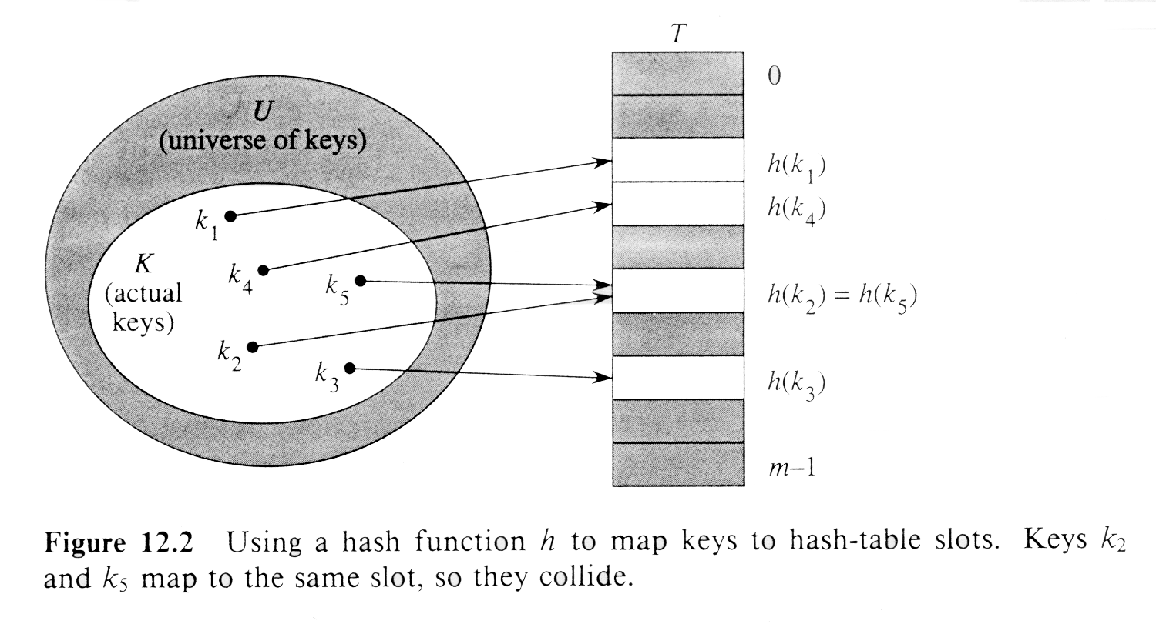
Hashing

Slide 5
Definitions
With hashing, the element is stored in slot h(k); a “hashing function” h is used to compute the slot from the key k. Here h maps the universe U of keys into slots of a “hash table” T[0,...m-1]:
h : U → {0,1,…, m-1}
An element with key k “hashes” to slot h(k). h(k) is the “hash value” of key k.
Collision: two keys hash into the same slot

Slide 6
Hash Tables
Great for finding things quickly
Bad for finding minimum, maximum, etc. (priority queue is better for this)
Issues:
  Collision resolution
  Design of hashing functions

Slide 7
Methods of Resolution
Open Addressing
Chaining: put all elements that hash to the same slot in a linked list.

Slide 8
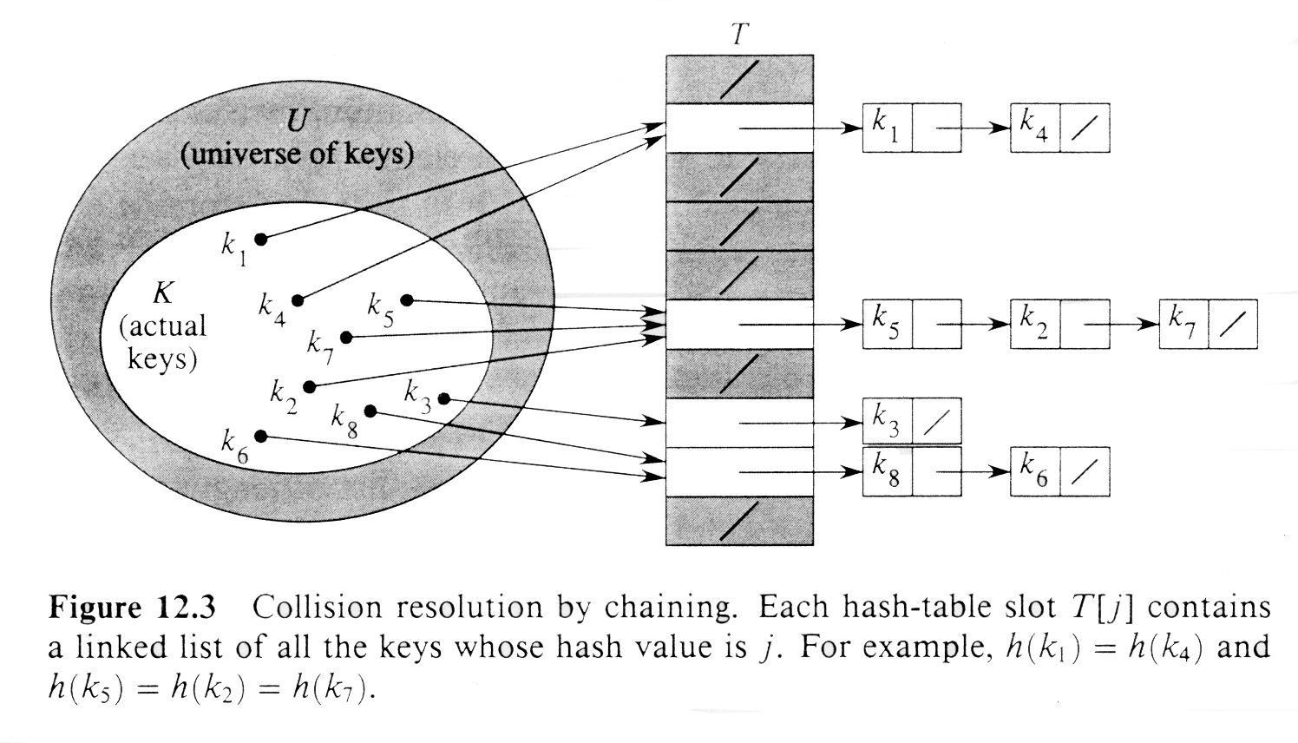
Collision Resolution by Chaining

Slide 9
Hashing with Chaining
Chained-Hash-Search (T, k)
search an element with key k in list T[h(k)]
Chained-Hash-Insert (T, x)
insert x at the head of list T[h(key[x])]
Chained-Hash-Delete (T, x)
delete x from the list T[h(key[x])]
* Insertion takes O(1) time in the worst case; deletion can also take O(1) time. Searching’s worst-case time is proportional to length of T.

Slide 10
Analysis on Chained-Hash-Search
Load factor α=n/m = average keys per slot,
for m slots to store n elements
Worst case: Θ(n) + time to compute h(k)
Average case depends on how well h distributes the keys among m slots.
Assume simple uniform hashing and O(1) time to compute h(k), time required to search an element with key k depends linearly on length of T[h(k)].
Consider expected number of elements examined by search algorithm, i.e. the number of elements in T[h(k)] that are checked to see if their keys = k.

Slide 11
Costs of Search
Cost of an unsuccessful search = 1+α = Θ(1+α)
  1 to access the slot & α expected time to search the list
Cost of a successful search = 1+ α/2 = Θ(1+α)
  1 to access the slot & α/2 expected time to search the list

Slide 12
Worst Case Time for Chained Hash Search
If n = O(m), then α = n/m = O(m)/m = O(1). Searching takes constant time on average. Thus, all dictionary operations can be supported in O(1) time on average.

Slide 13
Good Hash Functions
Satisfies (approximately) the assumption of simple uniform hashing, i.e. each element is equally likely to hash into any of the m slots, independently of where any other element has hashed to.
Regularity in key distribution should not affect uniformity.
e.g. Each key is drawn independently from U according to a probability distribution P:
∑_{k:h(k) = j} P(k) = 1/m for j = 0, 1, … , m-1
An example is division method.

Slide 14
Division Method
Map a key k into one of m slots by taking the remainder of k divided by m. That is,
h(k) = k mod m
Don’t pick certain values, such as m = 2 ^{p}
Or hash won’t depend on all bits of k.
Primes, not too close to power of 2 (or 10) are good.

Slide 15
Multiplication Method
If 0 < A < 1, h(k) = ⎣m (kA mod 1)⎦ = ⎣m kA - ⎣kA⎦ ⎦
where kA mod 1 means the fraction part of kA
The value of m is not critical, typically a power of 2, m = 2 ^{p} (A common implementation on most computers is given in Figure 12.4.)
For example, m = 1000, k = 123, A ≈ 0.6180339887…
h(k) = ⎣1000 (123*0.6180339887 mod 1)⎦
= ⎣1000 * 0.018169... ⎦ = 18

Slide 16
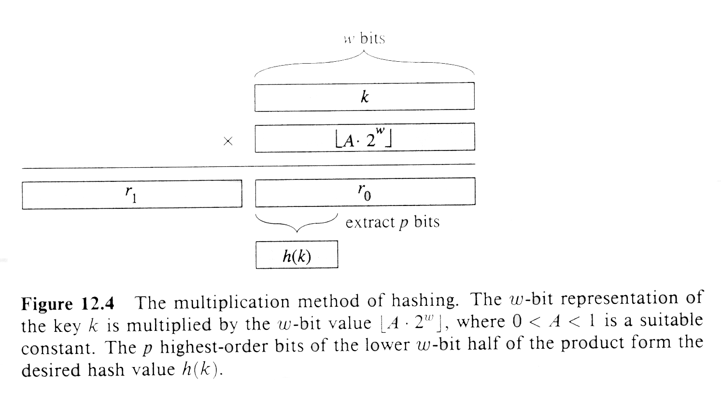
Multiplication Method

Slide 17
Another Example
Assume m = 8 = 2³, and 7-bit words
Think of the machine integer A as having a radix point on the left
h(k) takes fractional part of product, discard rest, shifts fractional part left and takes the shifted-out bits.
Example: see one on the board

Slide 18
Universal Hashing
Choose the hashing function randomly s.t. it is independent of keys that will actually be stored.
Select the hash function at random at run time from a carefully designed class of functions.
Let H be a collection of hash functions that map a universe U of keys into the range {0, 1,…, m-1}. H is said to be “universal”, if for each pair of distinct keys, x, y∈U, number of hash functions for which h(x)=h(y) is precisely |H|/m. The chance of a collision between 2 keys is exactly 1/m.

Slide 19
Theorem
If h is chosen from a universal collection of hash functions and is used to hash n keys into a table of size m, where n ≤ m, the expected number of collisions involving a particular key x is less than 1.
(Proof) Let C_{yz} be a random variable that = 1, if h(y) = h(z) and 0 otherwise. E[C_{yz}] = 1/m.
Let C_{x} be the total number of collisions involving key x in a hash table T of size m. Then,
E[C_{x}] = ∑_{y∈T y≠ x} E[C_{xy}] = (n-1)/m < α.

Slide 20
Example of Universal Hashing
The class H defined by
H = _{a} {h_{a}} with h_{a}(x) = ∑_{i=0 to r} a_{i}x_{i} mod m
is a universal function, where the table size m is a prime, the key x is decomposed into bytes s.t. x = <x₀ ,…, x_{r}> and a = <a₀ ,…, a_{r}> denote a sequence of r+1 elements randomly chosen from the set {0, 1, … , m-1}.

Slide 21
Open Addressing
All elements are stored in the hash table itself. Each table entry contains either an element of the dynamic set or NIL.
There are no list/elements outside of table. The hash table fills up s.t. no further insertion can be made. The load factor never exceeds 1.
To perform insertion, successively examine or probe the hash table till an empty slot is found. The sequence of probed positions depends on the key being inserted. We require every key k, the probe sequence <h(k,0), h(k,1), …, h(k, m-1)> be a permutation of <0, 1, …, m-1>.

Slide 22
Hash-Insert (T, k)
1. i ← 0
2. repeat j ← h(k, i)
3. if T[j] = NIL
4. then T[j] ← k
5. return j
6. else i ← i + 1
7. until i = m
8. Error “hash table overflow”

Slide 23
Hash-Search (T, k)
1. i ← 0
2. repeat j ← h(k, i)
3. if T[j] = k
4. then return j
5. i ← i + 1
6. until T[j] = NIL or i = m
7. return NIL

Slide 24
Linear Probing
Given an ordinary hash function h’:U→{0,…, m-1}, linear probing uses the hashing function:
h(k,i) = (h’(k) + i) mod m
The initial probe position is T[h’(k)], the next is T[h’(k)+1], and so on upto T[m], then wrap around.
Only m distinct probe sequences are used. Easy to implement, but suffers “primary clustering”. Long runs of occupied slots build up and increases the search time.

Slide 25
Quadratic Probing
Given an ordinary hash function h’:U→{0,…, m-1}, linear probing uses the hashing function:
h(k,i) = (h’(k) + c₁i + c₂i²) mod m
The initial probe position is T[h’(k)], later probe positions are offset by amounts that depends on a quadratic function of the probe number i.
If two keys have the same initial probe position, then their probe sequences are the same, since h(k₁, 0) = h(k₂, 0) implies h(k₁, i) = h(k₂, i). This leads to “secondary clustering”.

Slide 26
Double Hashing
h₁ and h₂ are auxiliary hash functions and the initial positions probed is T[h₁(k)]; successive probe positions are offset from previous positions by amount h₂(k), modulo m. The function has the form:
h(k,i) = (h₁(k) + i h₂(k)) mod m
The probe sequences depends two ways upon the key k, since both position and offset or both may vary. The value of h₂(k) must be relatively prime to m. E.g., let m be a power of 2 and h₂ be chosen always to return an odd integer.

