Slide 1
Announcements
Weekly reading assignment:
Chapter 12 & 13, CLRS
Homework #4 Due on October 27
Extra Help Session after class on Thursday, 10/27/05

Slide 2
Binary Search Tree
Can be represented by a linked data structure in which each node is an object. Each node contains fields: key, left, right and parent.
The keys are stored in such a way that they satisfy the binary-search-tree property:
Let x be a node in a binary search tree. If y is a node in the left subtree of x, then key[y] ≤ key[x]. If y is a node in the right subtree of x, then key[x] ≤ key[y].
Example: Input is D, A, B, H, K, F

Slide 3
What are BSTs good for?
Building priority queues
  Extraction of min/max
Sorting
  Searching
  Insertion
  Deletion
Querying
  Database
  Geometric operations

Slide 4
Inorder-Tree-Walk(x)
1. if x ≠ NIL
2. then Inorder-Tree-Walk(left[p])
3. print key[x]
4. Inorder-Tree-Walk(right[p])
Q: How long does the walk take?
Q: Can you prove its correctness?

Slide 5
Proving Correctness
Must prove that it prints all elements, in order, and that it terminates
Induction on size of tree. Size=1: Easy
Size >1:
  Prints left subtree in order by induction
  Prints root, which comes after all elements in left subtree (still in order)
  Prints right subtree in order (all elements come after root, so still in order)

Slide 6
Example
D
A
H
B
F
K

Slide 7
Example
D
A
H
B
F
K
NIL
A
B
D
F
H
K

Slide 8
Querying a Binary Search Tree
All dynamic-set operations such as “search”, “minimum”, “maximum”, “successor” and “predecessor” can be supported in O(h) time.
For a balanced binary tree, h = Θ(log n); for an unbalanced tree that resembles a linear chain of n nodes, then h = Θ(n) in the worst case.

Slide 9
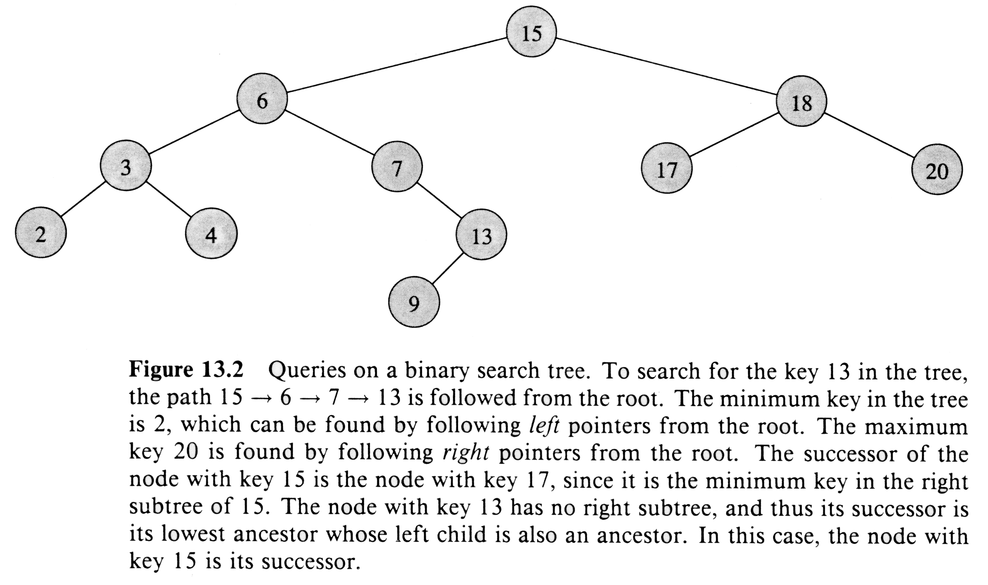
Querying a Binary Search Tree

Slide 10
Tree-Search(x, k)
1. if x = NIL or k = key[x]
2. then return x
3. if k < key[x]
4. then return Tree-Search(left[x], k)
5. else return Tree-Search(right[x], k)

Slide 11
Iterative-Tree-Search(x, k)
1. while x ≠ NIL and k ≠ key[x]
2. do if k < key[x]
3. then x ← left[x]
4. else x ← right[x]
5. return x

Slide 12
Finding Min & Max
Minimum(x) Maximum(x)
1. while left[x] ≠ NIL 1. while right[x] ≠ NIL
2. do x ← left[x] 2. do x ← right[x]
3. return x 3. return x
Q: How long do they take?

Slide 13
Tree Successor
D
H
A
B
F
K
C

Slide 14
Successor(x) in Words
if right(x) is not empty
then return minimum in right subtree
else keep going up and leftward on the tree to the node where it makes the first right turn (i.e., find the lowest ancestor whose left child is also an ancestor)

Slide 15
Tree-Successor (x)
1. if right[x] ≠ NIL
2. then return Tree-Minimum(right[x])
3. y ← p[x]
4. while y ≠ NIL and x = right[y]
5. do x ← y
6. y ← p[y]
7. return y
Think about predecessor ……

Slide 16
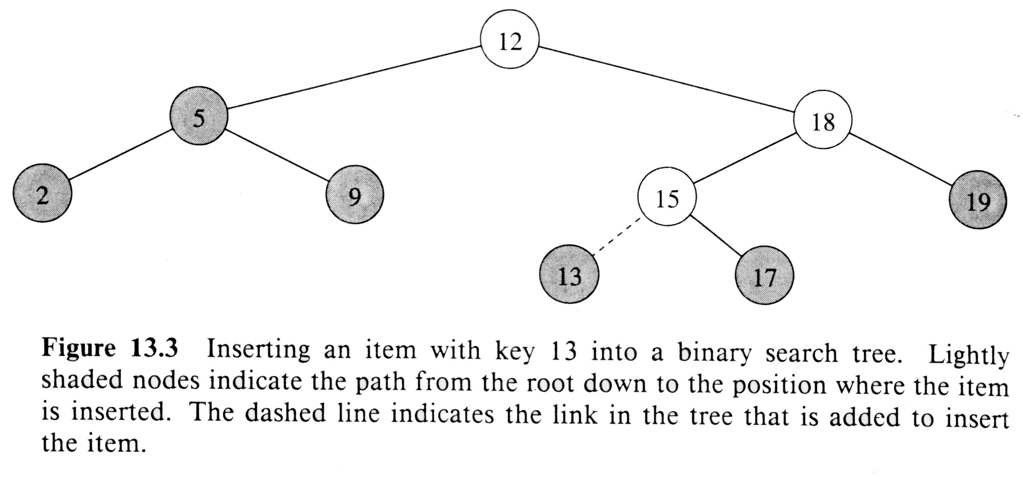
Node Insertion

Slide 17
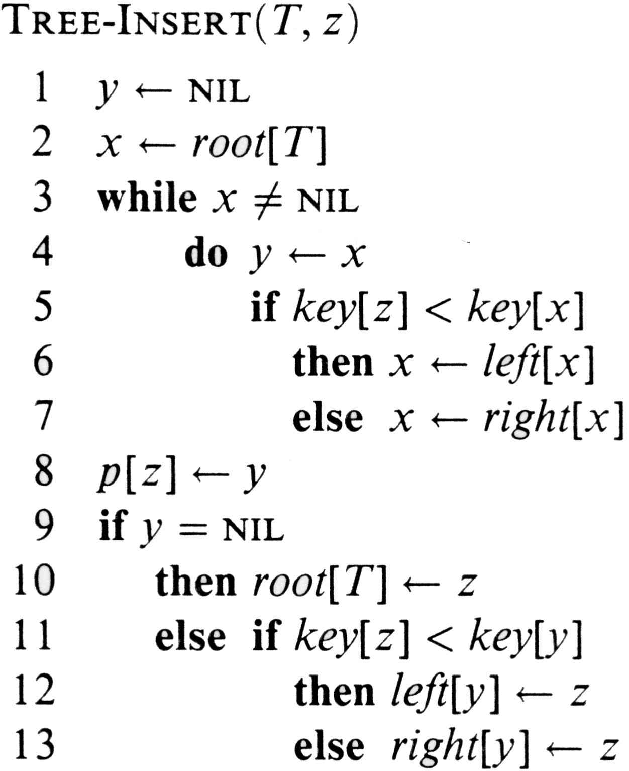

Slide 18
Analysis on Insertion
Initialization: O(1)
While loop in lines 3-7 causes 2 pointers
(x is the candidate location to insert z, and y is the parent of x) to move down the tree till we reach a leaf (x = NIL). This runs in O(h) time on a tree of height h.
Lines 8-13 insert the value: O(1)
⇒ TOTAL: O(h) time to insert a node

Slide 19
Exercise: Sorting Using BSTs
Sort (A)
for i = 1 to n
do tree-insert(A[i])
inorder-tree-walk(root)
  What are the worst case and best case running times?
  In practice, how would this compare to other sorting algorithms?

Slide 20
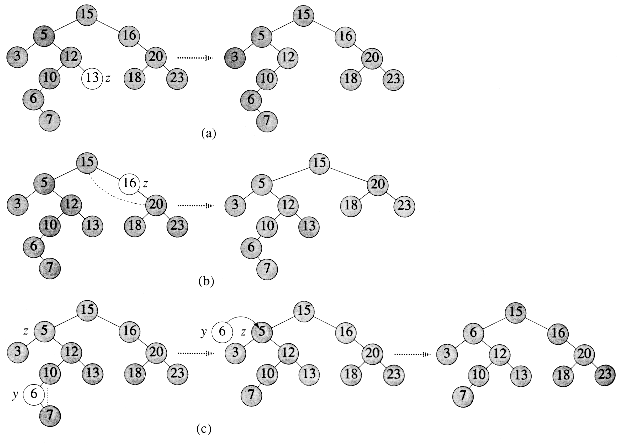
Node Deletion

Slide 21
Tree-Delete (T, x)
if x has no children ♦ case 0
then remove x
if x has one child ♦ case 1
then make p[x] link to child
if x has two children ♦ case 2
then swap x with its successor
perform case 0 or case 1 to delete it
⇒ TOTAL: O(h) time to delete a node

Slide 22
Alternate Form of Case 2
Delete successor of x (but save the data)
Overwrite x with data from successor
Equivalent; steps in different order

Slide 23
Correctness of Tree-Delete
How do we know case 2 should go to case 0 or case 1 instead of back to case 2?
  Because when x has 2 children, its successor is the minimum in its right subtree, and that successor has no left child (hence 0 or 1 child).
Equivalently, we could swap with predecessor instead of successor. It might be good to alternate to avoid creating lopsided tree.

