Slide 1
Announcements
Weekly Reading Assignment:
Chapter 22
Homework #5 due on Nov. 17, 2005

Slide 2
Graphs
A collection of vertices or nodes, connected by a collection of edges.
Applicable to many applications where there is some “connection” or “relationship” or “interaction” between pairs of objects
  network communication & transportation
  VLSI design & logic circuit design
  surface meshes in CAD/CAM & GIS
  path planning for autonomous agents
  precedence constraints in scheduling

Slide 3
Basic Definitions
Directed Graph (or digraph) G = (V, E) consists of a finite set V, called vertices or nodes, and E, a set of ordered pairs, called edges of G. E is a binary relation on V. Self-loops are allowed. Multiple edges are not allowed, though (v, w) and (w, v) are distinct edges.
Undirected Graph (or graph) G = (V, E) consists of a finite set V of vertices, and a set E of unordered pairs of distinct vertices, called edges of G. No self-loops are allowed.

Slide 4
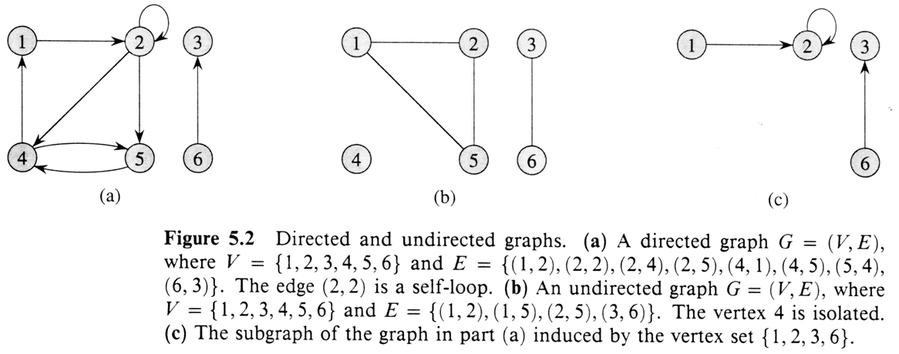
Examples of Digraphs & Graphs

Slide 5
Definitions
Vertex w is adjacent to vertex v if there is an edge (v,w). Given an edge e = (u,v) in an undirected graph, u and v are the endpoints of e and e is incident on u (or on v). In a digraph, u & v are the origin and destination. e leaves u and enters v.
A digraph or graph is weighted if its edges are labeled with numeric values.
In a digraph,
  Out-degree of v: number of edges coming out of v
  In-degree of v: number of edges coming in to v
In a graph, degree of v: no. of incident edges to v

Slide 6
Combinatorial Facts
In a graph
    0 ≤ e ≤ C(n,2) = n (n-1) / 2 ∈ O(n²)
    ∑ _{v∈V} deg(v) = 2e
In a digraph
    0 ≤ e ≤ n²
    ∑ _{v∈V} in-deg(v) = ∑ _{v∈V} out-deg(v) = e
A graph is said to be sparse if e ∈ O(n), and dense otherwise.

Slide 7
Definitions (Path vs. Cycle)
Path: a sequence of vertices <v₀, …, v_{k}> s.t. (v_{i-1},v_{i}) is an edge for i = 1 to k, in a digraph. The length of the path is the number of edges, k.
w is reachable from u if there is a path from u to w. A path is simple if all vertices are distinct.
Cycle: a path containing at least 1 edge and for which v₀ = v_{k}, in a digraph. A cycle is simple if, in addition, all vertices are distinct.
For graphs, the definitions are the same, but a simple cycle must visit ≥ 3 distinct vertices.

Slide 8
History on Cycles/Paths
Eulerian cycle is a cycle (not necessarily simple) that visits every edge of a graph exactly once.
Hamiltonian cycle (path) is a cycle (path in a directed graph) that visits every vertex exactly once.

Slide 9
Definitions (Connectivity)
Acyclic: if a graph contains no simple cycles
Connected: if every vertex of a graph can reach every other vertex
Connected: every pair of vertices is connected by a path
Connected Components: equivalence classes of vertices under “is reachable from” relation
Strongly connected: for any 2 vertices, they can reach each other in a digraph
G = (V, E) & G’ = (V’, E’) are isomorphic, if ∃ a bijection f : V→ V’ s.t. v, u∈E iff (f(v), f(u)) ∈E’.

Slide 10
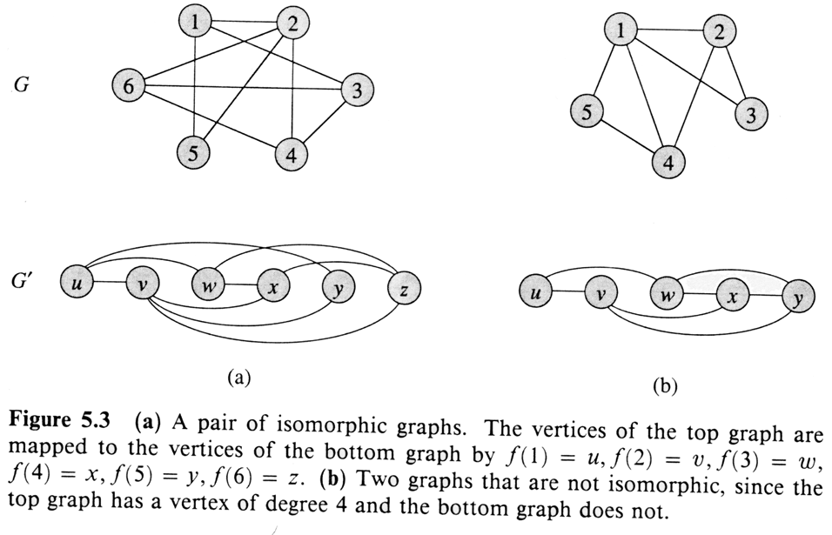
Examples for Isomorphic Graphs

Slide 11
Free Trees, Forests, and DAG’s
Free Tree Forest DAG

Slide 12
Graph Representations
Let G = (V, E) be a digraph with n = |V| & e = |E|
Adjacency Matrix: a n x n matrix for 1 ≤ v,w ≤ n
A[v,w] = 1 if (v,w) ∈ E and 0 otherwise
If digraph has weights, store them in matrix.
Adjacency List: an array Adj[1…n] of pointers where for 1 ≤ v ≤ n, Adj[v] points to a linked list containing the vertices which are adjacent to v. If the edges have weights then they may also be stored in the linked list elements.

Slide 13
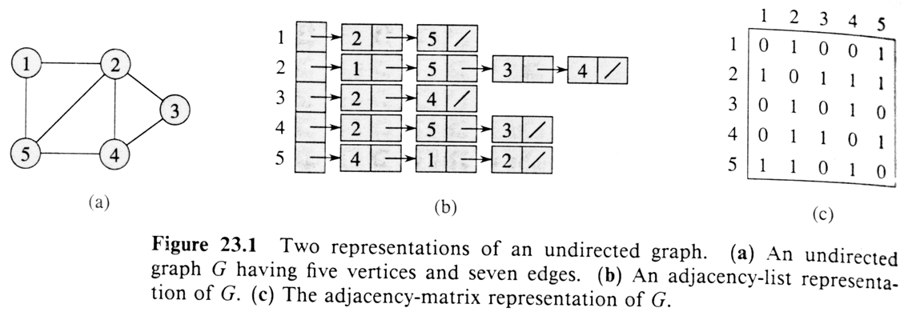
Example for Graphs
NOTE: it is common to include cross links between corresponding edges,
when you need to mark the edges you visit before. E.g. (v,w) = (w,v)

Slide 14
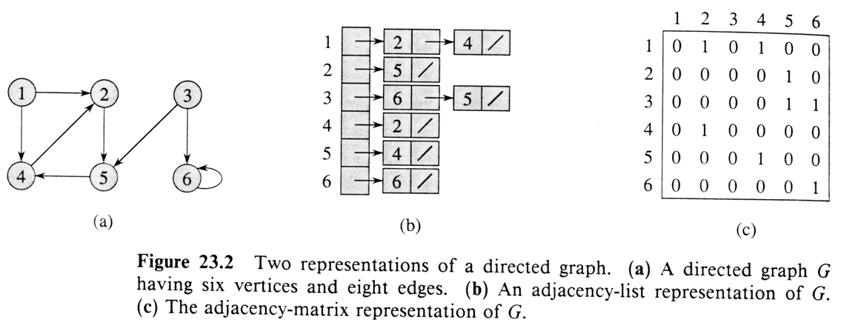
Example for Digraphs

Slide 15
Finding Shortest Paths
Given an undirected graph and source vertex s, the length of a path in a graph (without edge weights) is the number of edges on the path. Find the shortest path from s to each other vertex in the graph.
Brute-Force: enumerate all simple paths starting from s and keep track of the shortest path arriving at each vertex. There may be n! simple paths in a graph…

Slide 16
Breadth-First-Search (BFS)
Given:
  G = (V, E)
  A distinguished source vertex
Systematically explores the edges of G to discover every vertex that is reachable from s
  Computes (shortest) distance from s to all reachable vertices
  Produces a breadth-first-tree with root s that contains all reachable vertices

Slide 17
Breadth-First-Search (BFS)
BFS colors each vertex:
    white -- undiscovered
    gray -- discovered but “not done yet”
    black -- all adjacent vertices have been discovered

Slide 18
BFS for Shortest Paths
1
S
1
1
Finished
Discovered
Undiscovered

Slide 19
BFS for Shortest Paths
2
2
2
1
S
2
S
1
1
2
2
Finished
Discovered
Undiscovered

Slide 20
BFS for Shortest Paths
2
3
3
2
2
3
1
S
S
S
2
1
1
2
2
3
3
Finished
Discovered
Undiscovered

Slide 21
BFS(G,s)
1. for each vertex u in (V[G] \ {s})
2 do color[u] ← white
3 d[u] ← ∝
4 π[u] ← nil
5 color[s] ← gray
6 d[s] ← 0
7 π[s] ← nil
8 Q ← Φ
9 enqueue(Q,s)
10 while Q ≠ Φ
11 do u ← dequeue(Q)
12 for each v in Adj[u]
13 do if color[v] = white
14 then color[v] ← gray
15 d[v] ← d[u] + 1
16 π[v] ← u
17 enqueue(Q,v)
18 color[u] ← black
white: undiscovered
gray: discovered
black: finished
Q: a queue of discovered vertices
color[v]: color of v
d[v]: distance from s to v
π[u]: predecessor of v

Slide 22
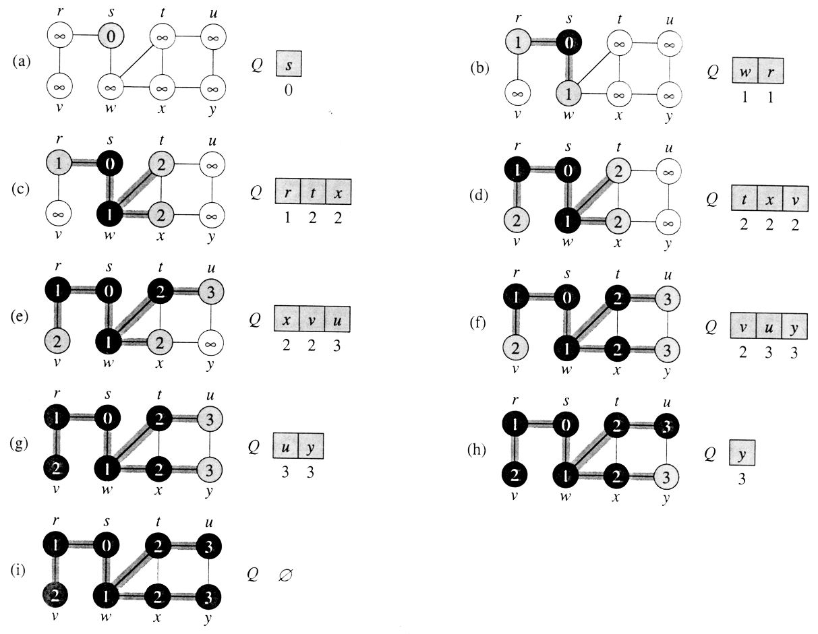
Operations of BFS on a Graph

Slide 23
Breadth-First Tree
For a graph G = (V, E) with source s, the predecessor subgraph of G is G_{π} = (V_{π} , E_{π}) where
  V_{π} ={v∈V : π[v] ≠ NIL}{s}
  E_{π} ={(π[v],v)∈E : v ∈ V_{π} - {s}}
The predecessor subgraph G_{π} is a breadth-first tree if:
  V_{π} consists of the vertices reachable from s and
  for all v∈V_{π} , there is a unique simple path from s to v in G_{π} that is also a shortest path from s to v in G.
The edges in E_{π} are called tree edges.
|E_{π} | = |V_{π} | - 1

Slide 24
Intuition: Breadth-First Tree
The predecessor pointers of the BFS define an inverted tree (an acyclic directed graph in which the source is the root, and every other node has a unique path to the root). If we make these edges bidirectional we get a rooted unordered tree called a BFS tree for G.
There are potentially many BFS trees for a given graph, depending on where the search starts and in what order vertices are placed on the queue. These edges of G are called tree edges and the remaining edges of G are called cross edges.

Slide 25
Analysis of BFS
Initialization takes O(V).
Traversal Loop
  After initialization, each vertex is enqueued and dequeued at most once, and each operation takes O(1). So, total time for queuing is O(V).
  The adjacency list of each vertex is scanned at most once. The sum of lengths of all adjacency lists is Θ(E).
Summing up over all vertices => total running time of BFS is O(V+E), linear in the size of the adjacency list representation of graph.

Slide 26
Shortest Paths
Shortest-Path distance δ (s, v) from s to v is the minimum number of edges in any path from vertex s to vertex v, or else ∞ if there is no path from s to v.
A path of length δ (s, v) from s to v is said to be a shortest path from s to v.

Slide 27
Lemmas
Let G = (V, E) be a directed or undirected graph, and let s∈V be an arbitrary vertex. Then, for any edge (u,v)∈E, δ (s, v) ≤ δ (s, u) + 1.
Let G = (V, E) be a directed or undirected graph, and suppose that BFS is run on G from a given source vertex s∈V. Then upon termination, for each vertex v∈V, the value d[v] computed by BFS satisfies d[v] ≥ δ (s, v).
Suppose that during the execution of BFS on a graph G, the queue Q contains vertices (v₁, …, v_{r}), where v₁ is the head of Q and v_{r} is the tail. Then, d[v_{r}] ≤ d[v₁] + 1 and d[v_{i}] ≤ d[v_{i+1}] for i = 1, 2, …, r-1.

Slide 28
Correctness of BFS
Let G = (V, E) be a directed or undirected graph, and suppose that BFS is run on G from a given source vertex s∈V. Then, during its execution, BFS discovers every vertex v∈V that is reachable from the source s, and upon termination, d[v]=δ (s, v) for all v∈V. Moreover, for any vertex v≠ s that is reachable from s, one of the shortest paths from s to v is the shortest path from s to π[v] followed by the edge (π[v], v).

Slide 29
Depth-First-Search (DFS)
Explore edges out of the most recently discovered vertex v
When all edges of v have been explored, backtrack to explore edges leaving the vertex from which v was discovered (its predecessor)
“Search as deep as possible first”
Whenever a vertex v is discovered during a scan of the adjacency list of an already discovered vertex u, DFS records this event by setting predecessor π[v] to u.

Slide 30
Depth-First Trees
Coloring scheme is the same as BFS. The predecessor subgraph of DFS is G_{π} = (V , E_{π}) where E_{π} ={(π[v],v) : v ∈ V and π[v] ≠ NIL}. The predecessor subgraph G_{π} forms a depth-first forest composed of several depth-first trees. The edges in E_{π} are called tree edges.
Each vertex u has 2 timestamps: d[u] records when u is first discovered (grayed) and f[u] records when the search finishes (blackens). For every vertex u, d[u] < f[u].

Slide 31
DFS(G)
1. for each vertex u ∈ V[G]
2. do color[u] ← WHITE
3. π[u] ← NIL
4. time ← 0
5. for each vertex u ∈ V[G]
6. do if color[v] = WHITE
7. then DFS-Visit(v)

Slide 32
DFS-Visit(u)
1. color[u] ← GRAY
∇ White vertex u has been discovered
2. d[u] ← ++time
3. for each vertex v ∈ Adj[u]
4. do if color[v] = WHITE
5. then π[v] ← u
6. DFS-Visit(v)
7. color[u] ← BLACK
∇ Blacken u; it is finished.
8. f[u] ← time++

Slide 33
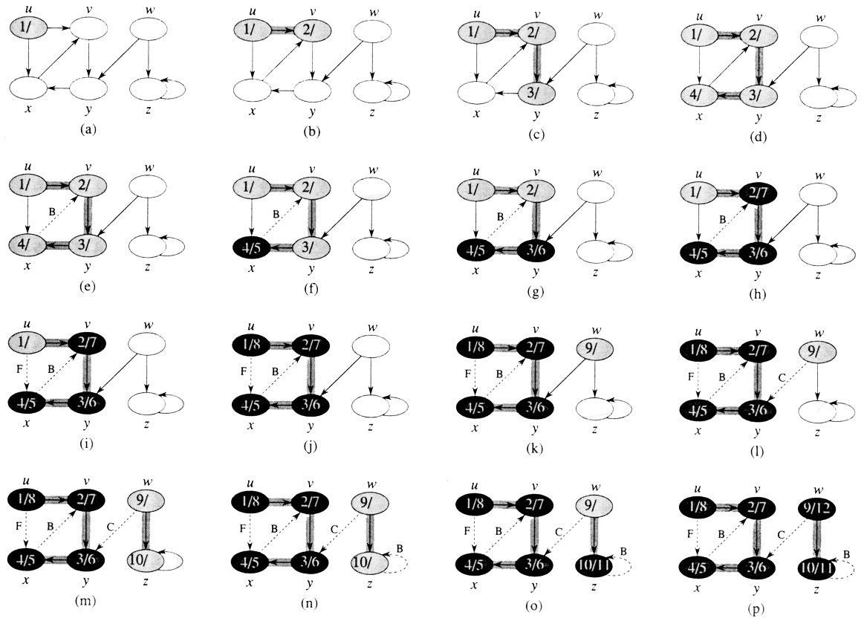
Operations of DFS

Slide 34
Analysis of DFS
Loops on lines 1-2 & 5-7 take Θ(V) time, excluding time to execute DFS-Visit.
DFS-Visit is called once for each white vertex v∈V when it’s painted gray the first time. Lines 3-6 of DFS-Visit is executed |Adj[v]| times. The total cost of executing DFS-Visit is ∑_{v∈V}|Adj[v]| = Θ(E)
Total running time of DFS is Θ(V+E).

