Slide 1
Announcements
Reading: Chapter 22
Extra Help Sessions on Nov. 15, 29, and Dec. 8 in SN011 (after class)
Final Review Dec. 12, 3-5pm, SN115

Slide 2
Properties of DFS
Predecessor subgraph G_{π} forms a forest of trees (the structure of a depth-first tree mirrors the structure of DFS-Visit)
The discovery and finishing time have parenthesis structure, i.e. the parentheses are properly nested. (See the figures and next theorem)

Slide 3
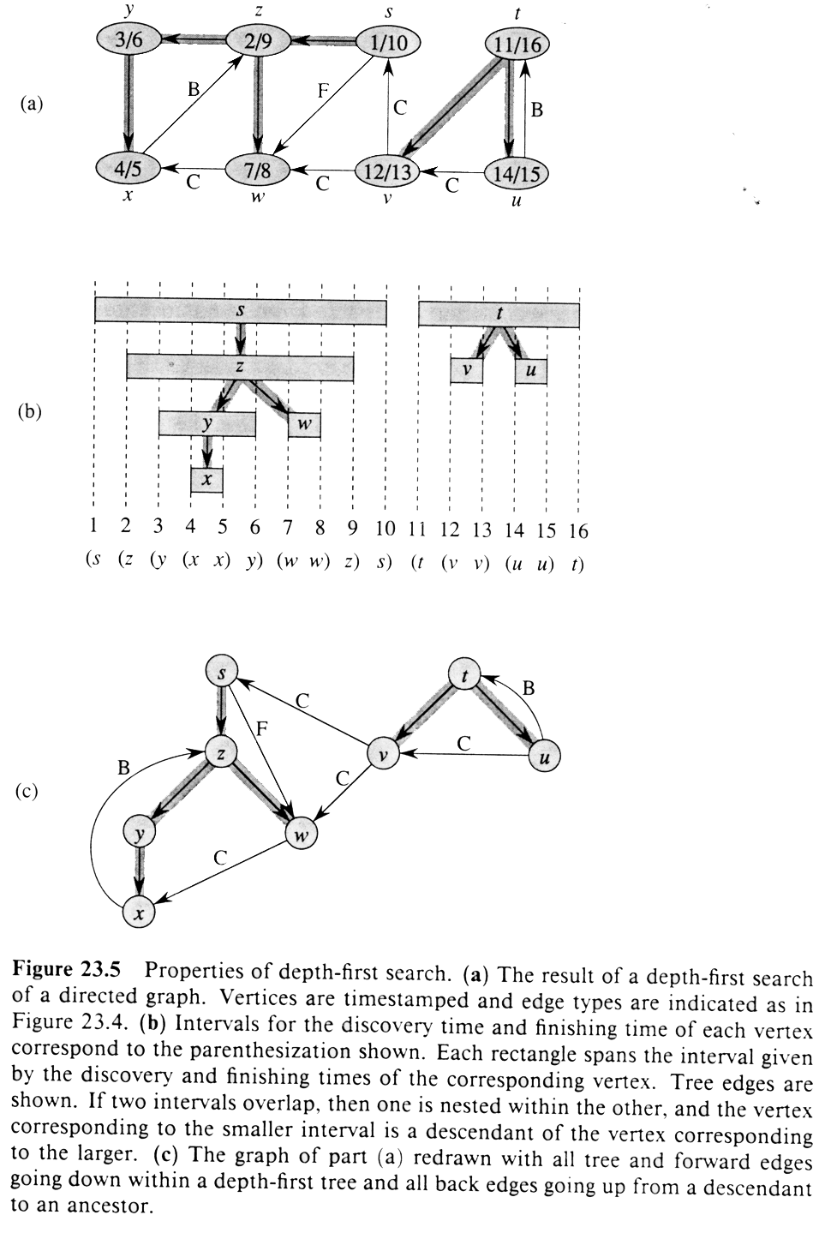

Slide 4
DFS & Parenthesis Lemma
a
d
1/10
C
a
11/14
d
b
f
e
C
f
e
2/5
6/9
12/13
b
F
B
c
g
c
g
3/4
7/8
C
1
2
3
4
5
6
7
8
9
10
11
12
13
14

Slide 5
Parenthesis Theorem
In any DFS of a graph G = (V, E), for any two vertices u and v, exactly one of the followings holds:
the interval [d[u], f[u]] and [d[v], f[v]] are entirely disjoint
the interval [d[u], f[u]] is contained entirely within the interval [d[v], f[v]], and u is a descendant of v in the depth-first tree, or
the interval [d[v], f[v]] is contained entirely within the interval [d[u], f[u]], and v is a descendant of u in the depth-first tree

Slide 6
Nesting of Descendent’ Intervals
Vertex v is a proper descendant of vertex u in the depth-first forest for a (direct or undirected) graph G if and only if d[u] < d[v] < f[v] < f[u]
Proof follows directly from Parenthesis Theorem (see the complete proof in the textbook CLR)

Slide 7
White-Path Theorem
In a depth-first forest of a graph G, vertex v is a descendant of vertex u if and only if at the time d[u] that the search discovers u, vertex v can be reached from u along a path consisting entirely of white vertices.
Proof:
⇒ Assume v is a descendant of u and use Corollary on Nesting of Descendant’s Interval
⇐ By contradiction: suppose that v is reachable from u but v doesn’t become a descendant of u. Use Parenthesis Theorem and NDI Corollary.

Slide 8
Classification of Edges
DFS can be used to classify edges of G:
1. Tree edges: edges in the depth-first forest G_{π} . Edge (u, v) is a tree edge if v was first discovered by exploring edge (u, v).
2. Back edges: edges (u, v) connecting a vertex u to an ancestor v in a depth-first tree. Self-loops are considered to be back edges.
3. Forward edges: nontree edges (u, v) connecting a vertex u to a descendant v in a depth-first tree.
4. Cross edges: all other edges.

Slide 9
Algorithm for Edge-Classification
Modify DFS so that each edge (u, v) can be classified by the color of the vertex v that is reachable when the edge is first explored:
1. WHITE indicates a tree edge
2. GRAY indicates a back edge
3. BLACK indicates a forward or cross edges

Slide 10
Theorem
In a depth-first search of an undirected graph G, every edge of G is either a tree edge or a back edge.
This lays the foundation for topological sort and many other applications (to be discussed in the next lecture).

Slide 11
Directed Acyclic Graph
A directed acyclic graph (DAG) arises in many applications where there are precedence or ordering constraints (e.g. scheduling problems). For instance, if there are a series of tasks to be performed, and certain tasks must precede other tasks (e.g. in construction you must build the first floor before the second, but you can do the electrical wiring while you install the windows).
In general, a precedence constraint graph is a DAG, in which vertices are tasks and edge (u,v) means that task u must be completed before task v begins.

Slide 12
Topological Sort
Given a directed acyclic graph (DAG) G = (V, E), topological sort is a linear ordering of all vertices of the DAG such that if G contains an edge (u, v), u appears before v in the ordering.
In general, there may be many legal topological orders for a given DAG.

Slide 13
Topological-Sort (G)
1. Call DFS(G) to compute finishing time f[v] for each vertex
2. As each vertex is finished, insert it onto the front of linked list
3. Return the linked list of vertices

Slide 14
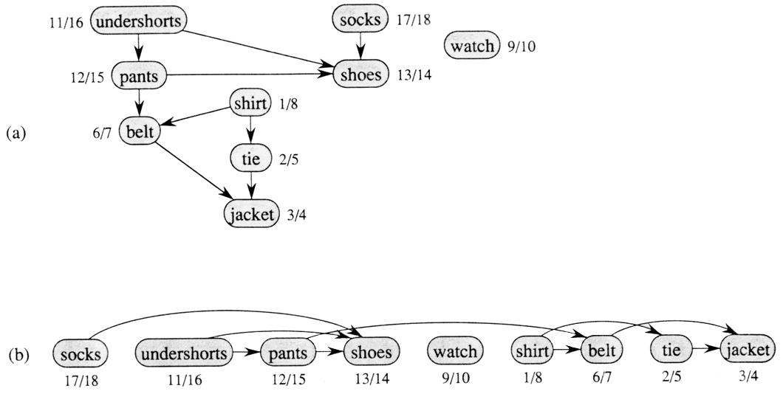
An Example

Slide 15
Another Example
Consider the example given in the book, but we do our DFS in a different order, so we get a different final ordering. But, both are legitimate, given the precedence constraints.
1/10
U- shorts
shirt
11/14
socks
15/16
2/9
pants
tie
12/13
3/6
belt
7/8
shoes
4/5
jacket

Slide 16
Another Example
Consider the example given in the book, but we do our DFS in a different order, so we get a different final ordering. But, both are legitimate, given the precedence constraints.
1/10
U- shorts
shirt
11/14
socks
15/16
2/9
pants
tie
12/13
3/6
belt
7/8
shoes
4/5
jacket
Final Ordering: socks, shirt, tie, u-shorts, pants, shoes, belt, jacket

Slide 17
Analysis of Topological-Sort
Line1: DFS takes Θ (V+E)
Line 2: Each insertion takes O(1) for |V| vertices
Total: Θ (V+E) time

Slide 18
A Compact Version: TopSort(G)
1. for each u∈V color[u] = white; // initialization
2. L = new linked_list; // L: empty linked list
3. for each u∈V
4. if (color[u] == white) TopVisit(u);
5. return L; // L gives final order
TopVisit(u) { // start search at u
1. color[u] = gray; // mark u visited
2. for each v∈Adj(u)
3. if (color[v] == white) TopVisit(v);
4. append u to the front of L // finish & add u to L
}

Slide 19
Lemma
Consider a directed graph G and a forest of DFS for G. G has a cycle if and only if the DFS forest has a back edge.
Proof:
(⇐) If there is a back edge (u, v) , then v is an ancestor of u, and by following tree edges from v to u, we get a cycle.
(⇒) By contrapositive: suppose there are no back edges. By White-Path Theorem, each of the remaining types of edges, tree, forward and cross all have the property that they go from vertices with higher finishing time to vertices with lower finishing time. Thus, along any path, finish time monotonically decrease. This implies there can be no cycle.

Slide 20
Applications of DFS
Decomposing a directed graph into its strongly connected components
Determining articulation points, bridges & biconnected components of an undirected graph

Slide 21
Strongly Connected Components
Digraphs are often used in communication and transportation networks, where people want to know that the networks are complete in the sense that from any location it is possible to reach another location in the digraph.
A digraph is “strongly connected”, if for every pair of vertices u, v ∈ V, u can reach v and vice versa. We say that two vertices u and v are “mutually reachable”. Mutual reachability is an equivalence relation.

Slide 22
Component DAG
If we merge the vertices in each strong com-ponent into a single super vertex, and joint two super vertices (A, B) if and only if there are vertices u ∈ A and v ∈ B such that (u, v) ∈ E, then the resulting digraph, called the component digraph, is necessarily acyclic.
c
b
a, b, c
a
d
f
h
f, g, h, i
e
d, e
g
i

Slide 23
Finding Strongly Connected Components
Use depth-first search twice
Trick: Reverse directions of edges, search in reverse order of finishing times (topological order for reversed graph)
But why do we need this trick…?

Slide 24
Strong Components & DFS
Each strong component is just a subtree of DFS Forest. Is it always true for any DFS? (See Figure 2 on the board or the handout)
Does there always exist a way to order the DFS such that it is true?

Slide 25
Ordering DFS
Once the DFS starts within a given strong com-ponent, it must visit every vertex within the component (and possibly some others) before finishing.
The search may “leak out” into other strong components, so doesn’t give us a list of strong components.
But, if we visit nodes in reverse topological order, each search cannot leak out into other components, since those components would have been visited earlier in the search.

Slide 26
StrongComp(G)
1. Run DFS(G), computng finish time f[u] for each vertex u
2. Compute R = Reverse(G), reversing all edges of G
3. Sort the vertices of R (by CountingSort) in decreasing order of f[u]
4. Run DFS(R) using this order
5. Each DFS tree is a strong component; output vertices of each tree in the DFS forest
Total running time is Θ(n + e)

Slide 27
Correctness (Intuition)
At least one component must have all edges incoming. Want to visit that one first, to avoid leakage.
If you reversed the edges, that component would be the first one in a topological sort.
c
b
a, b, c
a
d
f
h
f, g, h, i
e
d, e
g
i

Slide 28
Correctness (Intuition)
Fortunately, reversing the edges doesn’t change the strongly connected components. That is, mutual reachability between two vertices is the same for G and G^{T}.
So: Do a topological sort, then reverse the edges, then do DFS in sorted order.

Slide 29
Correctness
Refer to the textbook for a formal proof. Here is some intuition why it works:
  Strong components are not affected by reversing all edges in the digraph. i.e. mutual reachability between two vertices are the same in G and G^{T}
  The main idea is to visit the strong components in a reverse topological order so to avoid “leak”.
  If we simply visit the components in reverse topologoical order, we would visit the vertices in increasing order of finish time, starting with the lowest finishing time. (This won’t work)
  Consider max finish time in each component. Visit the components related to the topological order.

Slide 30
Lemma
Consider a digraph G on which DFS has been run. Label each component with the maximum finish time of all the vertices in the component, and sort these in decreasing order. Then this order is a topological order for the component digraph.
Example (Figure 3): The maximum finish time for each component are 18 (for {a, b, c}), 17 (for {d,e}), and 12 (for {f, g, h, I}). The order <18, 17, 12> is a valid topological order for the component digraph.

Slide 31
Definitions
Articulation Point (or cut vertex): any vertex whose removal (together with any incident edges) results in a disconnected graph
Bridge: an edge whose removal results in a disconnected graph
Biconnected: containing no articulation points. (In general a graph is k -connected, if k vertices must be removed to disconnect the graph.)
Biconnected Components: a maximal set of edges s.t. any 2 edges in the set lie on a common simple cycle

Slide 32
Articulation Points and DFS
Basic idea: use the structures in the DFS tree to find articulation points.
Assume G is connected, so there is only one tree in the DFS forest. Since G is undirected, we don’t distinguish between forward & back edges -- we call them both back edges. There are no cross edges.

Slide 33
Observations
An internal vertex u of the DFS tree (other than the root) is an articulation point if and only if there exists a subtree rooted at a child of u such that there is no back edge from any vertex in this subtree to a proper ancestor of u.
A leaf of the DFS tree is never an articulation point.
The root of the DFS tree is an articulation point if and only if it has two or more children.

Slide 34
Articulation Points by DFS
Observation 2 & 3 are easy to check.
Observation 1: is there some back edge from some subtree to an ancestor of a given vertex? Keep track of back edge that goes highest in the tree (cloest to the root). We do this by keeping track of “discovery time”: i.e. find the back edge (v, w) with the smallest d[w].

Slide 35
Basic Algorithm
Given G, compute the DFS tree, T(G).
Traverse T(G) in postorder. For each node v visited, calculate low[v] defined as
low[v] = min(d[v], d[w])
(u, w): a back edge for some descendant u of v
Articulation points are determined as follows:
  Root of T(G), if and only if it has more than 1 child
  A node v other than the root, if and only if has a child x such that low[x] ≥ d[v]

Slide 36
ArtPt(u)
1. Color[u] = gray
2. Low[u] = d[u] = ++time
3. for each (v ∈ Adj(u)) {
4. if (color[v] == white) // (u, v) is a tree edge
5. pred[v] = u
6. ArtPt(v)
7. Low[u] = min(Low[u], Low[v]) // update Low[u]
8. if (pred[v] == NULL) { // root: apply Observation 3
9. if (v is u‘s second++ child)
10. Add u to set of articulation points
11. }
12. else if (Low[v] ≥ d[u]) { // internal node: apply Obs. 1
13. Add u to set of articulation points
14. }
15. else if (v ≠ pred[u]) // (u, v) is a back edge
16. Low[u] = min(Low[u], d[v]) // update Low[u]
17. }

