Slide 1
Announcements
Weekly Reading Assignments: Chapters 23 & 24 (CLRS)

Slide 2
Definitions for Shortest Paths
Think of vertices as cities and the edge weights as the distance from one city to another. Define the length of a path to be the sum of edge weights along the path. Define the distance between two vertices, u and v, δ(u,v) to be the length of the minimum length path from u to v.
A shortest path from vertex u to vertex v is then defined as any path p with weight w(p) = δ(u,v).

Slide 3
Single-Source Shortest Paths
Given a directed graph G = (V, E) with edge weights and a distinguished source vertex, s∈V, determine the distance from the source vertex to every vertex in the graph.
BFS finds short-paths from a single source vertex to all other vertices in O(n+e) time, assuming the graph has no edge weights.
Edge weights can be negative; but in order for the problem to be well-defined there must be no cycle whose total cost is negative.

Slide 4
Variants
Single-destination shortest-paths problem: Find a shortest path to a given destination vertex t from every vertex v ∈ V.
Single-pair shortest-path problem: Find a shortest path from u to v for given vertices u and v. If we solve the single-source shortest paths problem, we also solve this problem.
All-pairs shortest-paths problem: Find a shortest path from u to v for every pair of vertices u and v. This can be solved by the single-source problem run for each vertex.

Slide 5
Relaxation
Maintain an estimate of the shortest path for each vertex v, call it d[v].
Initially d[v] will be the length of the shortest path that the algorithm of knows from s to v. This value will always be greater than or equal to the true shortest path distance from s to v.
Initially, we know of no paths, so all d[v]=∞ & d[s]=0.
As the algorithm goes on and sees more vertices, it tries to update d[v] for each vertex in the graph, until all d[v] values converge to true shortest distances.

Slide 6
Find Shortest Path by Relaxation
If the solution is not yet an optimal value, then push a little closer to the optimum. If we find a path from s to v shorter than d[v], then update d[v].
Consider an edge from a vertex u to v whose weight is w(u,v). Suppose that we have already computed current estimates on d[u] and d[v]. We know that there is a path from s to u of weight d[u]. By taking this path and following it with the edge (u,v) we get a path to v of length d[u]+w(u,v). If this path is better than the existing path of length d[v] to v, we should take it.

Slide 7
Relax (u, v)
1. if d[u] + w(u,v) < d[v] // is the path thru u shorter?
2. then d[v] ← d[u] + w(u,v); // yes, then take it.
3. π[v] ← u;
// the shortest way back to the source is thru
// u by updating the predecessor pointer
NOTE: If we perform Relax (u, v) repeatedly over all edges of the graph, all the d[v] values will eventually converge to the true final distance values from s. How to do this most efficiently?

Slide 8
Dijkstra’s Algorithm
Maintains a subset of vertices, S ⊆ V, for which we know their true distance d[u]=δ(s,u). Initially S =∅ and we set d[s]=0 and all others to ∞. One by one we select vertices from V - S to add to S.
For each vertex u ∈ V-S, we have computed a distance estimate d[u]. The greedy approach is to take the vertex for which d[u] is minimum, i.e. take unprocessed vertex that is closest to s.
We store the vertices of V - S in a priority queue (heap), where the key value of each vertex u is d[u]. All operations can be done in O(lg n) time.

Slide 9
Dijkstra(G, w, s)
1. Q ← V[G] and S ← ∅
2. for each vertex u ∈ Q // initialization: O(V) time
3. do d[u] ← ∞ and π[u] ← NIL
4. d[s] ← 0 // start at the source
5. π[s] ← NIL // set parent of s to be NIL
6. while Q ≠ ∅ // till all vertices processed
7. do u ← Extract-Min(Q) // select closest to s
S ← S ∪ {u}
8. for each v ∈ adj[u]
9. do if v ∈ Q and (d[u] + w(u,v) < d[v])
10. then π[v] ← u
11. d[v] ← d[u] + w(u,v) // Relax (u,v)
12. decrease_Key(Q, v, d[v])

Slide 10
Example: Dijkstra’s Algorithm
c
b
1
∞
∞
7
a
0
3
2
8
4
5
2
∞
∞
5
e
d
Black: in S

Slide 11
Example: Dijkstra’s Algorithm
c
b
1
∞
∞
7
a
0
3
2
8
4
5
2
∞
∞
5
e
d
Black: in S

Slide 12
Example: Dijkstra’s Algorithm
c
b
1
7
∞
7
a
0
3
2
8
4
5
2
∞
∞
5
e
d
Black: in S

Slide 13
Example: Dijkstra’s Algorithm
1
7
∞
7
0
3
2
8
4
5
2
2
∞
5
Black: in S

Slide 14
Example: Dijkstra’s Algorithm
1
7
∞
7
0
3
2
8
4
5
2
2
∞
5
Black: in S

Slide 15
Example: Dijkstra’s Algorithm
1
5
10
7
0
3
2
8
4
5
2
2
7
5
Black: in S

Slide 16
Example: Dijkstra’s Algorithm
1
5
6
7
0
3
2
8
4
5
2
2
7
5
Black: in S

Slide 17
Example: Dijkstra’s Algorithm
1
5
6
7
0
3
2
8
4
5
2
2
7
5
Black: in S

Slide 18
Example: Dijkstra’s Algorithm
1
5
6
7
0
3
2
8
4
5
2
2
7
5
Black: in S

Slide 19
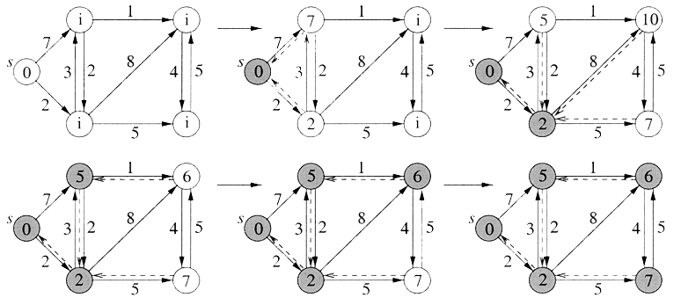
The Sequence of Relaxations
Notes:
Duplicate of sequence of slides, retained for student’s notes.

Slide 20
Correctness
Let δ(s,v) be length of true shortest path from s to v. Need to show: d[v]=δ(s,v) for each v when the algorithm terminates
Lemma: When a vertex u is added to S, d[u]=δ(s,u).
Proof:
Suppose that at some point Dijkstra’s algorithm first attempts to add a vertex u to S for which d[u] ≠ δ(s,u).
  Note d[u] is never less than δ(s,u), thus d[u]>δ(s,u).

Slide 21
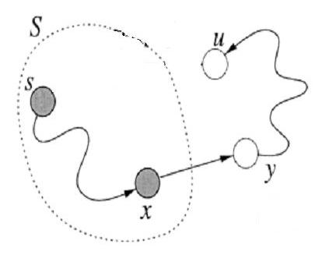
Proof (I)
Just prior to the insertion of u, consider the true shortest path from s to u.
  Because s ∈ S and u ∈ V - S, at some point this path must first jump out of S.
  Let (x, y) be the edge where it jumps out, so that x ∈ S and y ∈ V - S. (It might happen that x=s and/or y=u).

Slide 22
Proof (II): y ≠ u
We argue that y ≠ u after all
  Since x ∈ S we have d[x]=δ(s,x). (Remember that u was the first vertex added to S that violated this criterion.)
  Since we applied relaxation to x when it was added, we would have set d[y] = d[x] + w(x,y) = δ(s,y).
  Since (x,y) is on a shortest path from s to u, it is on a shortest path from s to y. Thus d[y] is now correct.
  By hypothesis, d[u] is not correct, so u and y cannot be the same.

Slide 23
Conclusion of Proof
Notice:
  y appears somewhere along the shortest path from s to u (but not at u)
  All subsequent edges following y are of weight ≥ 0,
Therefore, δ(s,y) ≤ δ(s,u), so d[y]=δ(s,y) ≤ δ(s,u)<d[u]
But, d[u] ≤ d[y] because u is added before y, and we add nodes with lower d values first.
Contradiction!

Slide 24
Correctness
We have just proved that, when a vertex u is added to S, d[u]=δ(s,u).
Every vertex is eventually added to S, so the algorithm assigns the correct distances to all vertices.
This guarantees that the shortest-paths tree is correct because relaxation correctly updates parent pointers (see book for details).

