Slide 1
Announcements
Weekly Reading Assignment:
Chapter 23, 24
Quiz 5 (last one) today
Homework #7 is due on Monday, Dec. 12, 2005

Slide 2
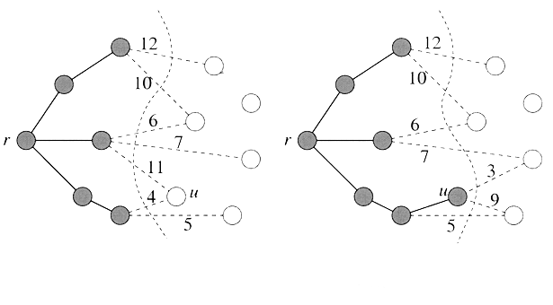
Intuition behind Prim’s Algorithm
Consider the set of vertices S currently part of the tree, and its complement (V-S). We have a cut of the graph and the current set of tree edges A is respected by this cut.
Which edge should we add next? Light edge!

Slide 3
Basics of Prim ’s Algorithm
It works by adding leaves on at a time to the current tree.
  Start with the root vertex r (it can be any vertex). At any time, the subset of edges A forms a single tree. S = vertices of A.
  At each step, a light edge connecting a vertex in S to a vertex in V- S is added to the tree.
  The tree grows until it spans all the vertices in V.
Implementation Issues:
  How to update the cut efficiently?
  How to determine the light edge quickly?

Slide 4
Implementation: Priority Queue
Priority queue implemented using heap can support the following operations in O(lg n) time:
  Insert (Q, u, key): Insert u with the key value key in Q
  u = Extract_Min(Q): Extract the item with minimum key value in Q
  Decrease_Key(Q, u, new_key): Decrease the value of u’s key value to new_key
All the vertices that are not in the S (the vertices of the edges in A) reside in a priority queue Q based on a key field. When the algorithm terminates, Q is empty. A = {(v, π[v]): v ∈ V - {r}}

Slide 5
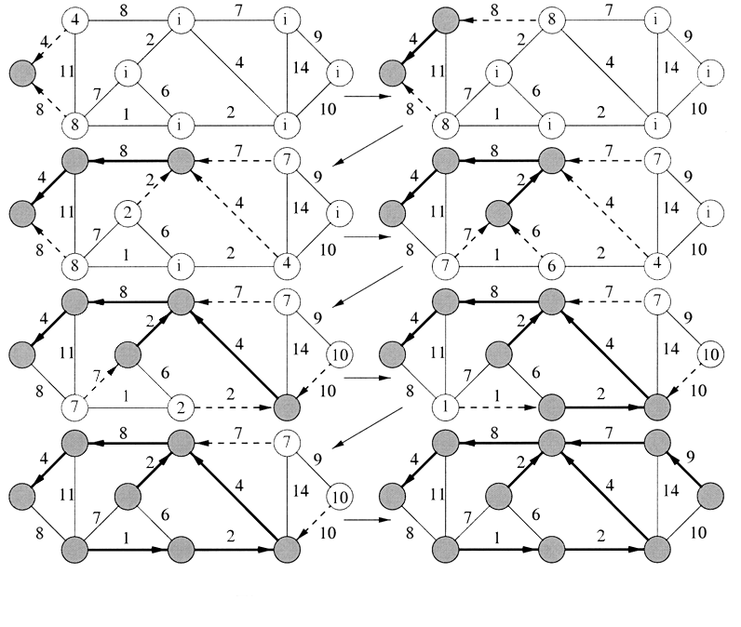
Example: Prim’s Algorithm

Slide 6
MST-Prim(G, w, r)
1. Q ← V[G]
2. for each vertex u ∈ Q // initialization: O(V) time
3. do key[u] ← ∞
4. key[r] ← 0 // start at the root
5. π[r] ← NIL // set parent of r to be NIL
6. while Q ≠ ∅ // until all vertices in MST
7. do u ← Extract-Min(Q) // vertex with lightest edge
8. for each v ∈ adj[u]
9. do if v ∈ Q and w(u,v) < key[v]
10. then π[v] ← u
11. key[v] ← w(u,v) // new lighter edge out of v
12. decrease_Key(Q, v, key[v])

Slide 7
Analysis of Prim
Extracting the vertex from the queue: O(lg n)
For each incident edge, decreasing the key of the neighboring vertex: O(lg n) where n = |V|
The other steps are constant time.
The overall running time is, where e = |E|
T(n) = ∑_{u∈V}(lg n + deg(u) lg n) = ∑_{u∈V} (1+ deg(u)) lg n
= lg n (n + 2e) = O((n + e) lg n)
Essentially same as Kruskal’s: O((n+e) lg n) time

Slide 8
Correctness of Prim
Again, show that every edge added is a safe edge for A
Assume (u, v) is next edge to be added to A.
Consider the cut (A, V-A).
  This cut respects A (why?)
  and (u, v) is the light edge across the cut (why?)
Thus, by the MST Lemma, (u,v) is safe.

