Slide 1
Announcements
Weekly Reading Assignment:
CLRS, Chapter 15
Homework #7 due on Monday, Dec. 12, 2005 (by 3:30pm in SN115)

Slide 2
Optimization Problems
In which a set of choices must be made in order to arrive at an optimal (min/max) solution, subject to some constraints. (There may be several solutions to achieve an optimal value.)
Two common techniques:
  Dynamic Programming (global)
  Greedy Algorithms (local)

Slide 3
Dynamic Programming
Similar to divide-and-conquer, it breaks problems down into smaller problems that are solved recursively.
In contrast, DP is applicable when the sub-problems are not independent, i.e. when sub-problems share sub-sub-problems. It solves every sub-sub-problem just once and save the results in a table to avoid duplicated computation.

Slide 4
Elements of DP Algorithms
Sub-structure: decompose problem into smaller sub-problems. Express the solution of the original problem in terms of solutions for smaller problems.
Table-structure: Store the answers to the sub-problem in a table, because sub-problem solutions may be used many times.
Bottom-up computation: combine solutions on smaller sub-problems to solve larger sub-problems, and eventually arrive at a solution to the complete problem.

Slide 5
Applicability to Optimization Problems
Optimal sub-structure (principle of optimality): for the global problem to be solved optimally, each sub-problem should be solved optimally. This is often violated due to sub-problem overlaps. Often by being “less optimal” on one problem, we may make a big savings on another sub-problem.
Small number of sub-problems: Many NP-hard problems can be formulated as DP problems, but these formulations are not efficient, because the number of sub-problems is exponentially large. Ideally, the number of sub-problems should be at most a polynomial number.

Slide 6
Optimized Chain Operations
Determine the optimal sequence for performing a series of operations. (the general class of the problem is important in compiler design for code optimization & in databases for query optimization)
For example: given a series of matrices: A₁…A_{n} , we can “parenthesize” this expression however we like, since matrix multiplication is associative (but not commutative).
Multiply a p x q matrix A times a q x r matrix B, the result will be a p x r matrix C. (# of columns of A must be equal to # of rows of B.)

Slide 7
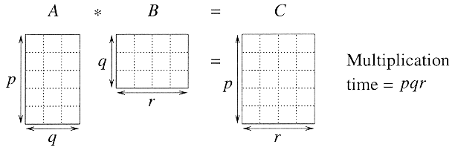
Matrix Multiplication
In particular for 1 ≤ i ≤ p and 1 ≤ j ≤ r,
C[i, j] = ∑_{k = 1 to q} A[i, k] B[k, j]
Observe that there are pr total entries in C and each takes O(q) time to compute, thus the total time to multiply 2 matrices is pqr.

Slide 8
Chain Matrix Multiplication
Given a sequence of matrices A₁ A₂…A_{n} , and dimensions p₀ p₁…p_{n} where A_{i} is of dimension p_{i-1} x p_{i} , determine multiplication sequence that minimizes the number of operations.
This algorithm does not perform the multiplication, it just figures out the best order in which to perform the multiplication.

Slide 9
Example: CMM
Consider 3 matrices: A₁ be 5 x 4, A₂ be 4 x 6, and A₃ be 6 x 2.
Mult[((A₁ A₂)A₃)] = (5x4x6) + (5x6x2) = 180
Mult[(A₁ (A₂A₃ ))] = (4x6x2) + (5x4x2) = 88
Even for this small example, considerable savings can be achieved by reordering the evaluation sequence.

Slide 10
Naive Algorithm
If we have just 1 item, then there is only one way to parenthesize. If we have n items, then there are n-1 places where you could break the list with the outermost pair of parentheses, namely just after the first item, just after the 2nd item, etc. and just after the (n-1)th item.
When we split just after the kth item, we create two sub-lists to be parenthesized, one with k items and the other with n-k items. Then we consider all ways of parenthesizing these. If there are L ways to parenthesize the left sub-list, R ways to parenthesize the right sub-list, then the total possibilities is L∗R.

Slide 11
Cost of Naive Algorithm
The number of different ways of parenthesizing n items is
P(n) = 1, if n = 1
P(n) = ∑_{k = 1 to n-1} P(k)P(n-k), if n ≥ 2
This is related to Catalan numbers (which in turn is related to the number of different binary trees on n nodes). Specifically P(n) = C(n-1).
C(n) = (1/(n+1)) C(2n, n) ∈ Ω(4^{n} / n^{3/2})
where C(2n, n) stands for the number of various ways to choose n items out of 2n items total.

Slide 12
DP Solution (I)
Let A_{i…j} be the product of matrices i through j. A_{i…j} is a p_{i-1} x p_{j} matrix. At the highest level, we are multiplying two matrices together. That is, for any k, 1 ≤ k ≤ n-1,
A_{1…n} = (A_{1…k})(A_{k+1…n})
The problem of determining the optimal sequence of multiplication is broken up into 2 parts:
  : How do we decide where to split the chain (what k)?
  A : Consider all possible values of k.
  : How do we parenthesize the subchains A_{1…k} & A_{k+1…n}?
  A : Solve by recursively applying the same scheme.
  NOTE: this problem satisfies the “principle of optimality”.
Next, we store the solutions to the sub-problems in a table and build the table in a bottom-up manner.

Slide 13
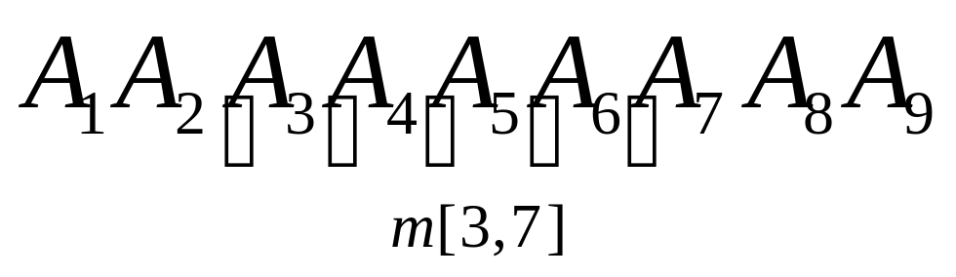
DP Solution (II)
For 1 ≤ i ≤ j ≤ n, let m[i, j] denote the minimum number of multiplications needed to compute A_{i…j} .
Example: Minimum number of multiplies for A_{3…7}
In terms of p_{i} , the product A_{3…7} has
dimensions ____.

Slide 14
DP Solution (III)
The optimal cost can be described be as follows:
  i = j ⇒ the sequence contains only 1 matrix, so m[i, j] = 0.
  i < j ⇒ This can be split by considering each k, i ≤ k < j,
  as A_{i…k} (p_{i-1} x p_{k} ) times A_{k+1…j} (p_{k} x p_{j}).
This suggests the following recursive rule for computing m[i, j]:
m[i, i] = 0
m[i, j] = min_{i ≤ k < j} (m[i, k] + m[k+1, j] + p_{i-1}p_{k}p_{j} ) for i < j

Slide 15
Computing m[i, j]
For a specific k,
(A_{i} …A_{k})( A_{k+1} … A_{j})
=
m[i, j] = min_{i ≤ k < j} (m[i, k] + m[k+1, j] + p_{i-1}p_{k}p_{j} )

Slide 16
Computing m[i, j]
For a specific k,
(A_{i} …A_{k})( A_{k+1} … A_{j})
= A_{i…k}( A_{k+1} … A_{j}) (m[i, k] mults)
m[i, j] = min_{i ≤ k < j} (m[i, k] + m[k+1, j] + p_{i-1}p_{k}p_{j} )

Slide 17
Computing m[i, j]
For a specific k,
(A_{i} …A_{k})( A_{k+1} … A_{j})
= A_{i…k}( A_{k+1} … A_{j}) (m[i, k] mults)
= A_{i…k} A_{k+1…j} (m[k+1, j] mults)
m[i, j] = min_{i ≤ k < j} (m[i, k] + m[k+1, j] + p_{i-1}p_{k}p_{j} )

Slide 18
Computing m[i, j]
For a specific k,
(A_{i} …A_{k})( A_{k+1} … A_{j})
= A_{i…k}( A_{k+1} … A_{j}) (m[i, k] mults)
= A_{i…k} A_{k+1…j} (m[k+1, j] mults)
= A_{i…j} (p_{i-1} p_{k} p_{j} mults)
m[i, j] = min_{i ≤ k < j} (m[i, k] + m[k+1, j] + p_{i-1}p_{k}p_{j} )

Slide 19
Computing m[i, j]
For a specific k,
(A_{i} …A_{k})( A_{k+1} … A_{j})
= A_{i…k}( A_{k+1} … A_{j}) (m[i, k] mults)
= A_{i…k} A_{k+1…j} (m[k+1, j] mults)
= A_{i…j} (p_{i-1} p_{k} p_{j} mults)
For solution, evaluate for all k and take minimum.
m[i, j] = min_{i ≤ k < j} (m[i, k] + m[k+1, j] + p_{i-1}p_{k}p_{j} )

Slide 20
Matrix-Chain-Order(p)
1. n ← length[p] - 1
2. for i ← 1 to n // initialization: O(n) time
3. do m[i, i] ← 0
4. for L ← 2 to n // L = length of sub-chain
5. do for i ← 1 to n - L+1
6. do j ← i + L - 1
7. m[i, j] ← ∞
8. for k ← i to j - 1
9. do q ← m[i, k] + m[k+1, j] + p_{i-1} p_{k} p_{j}
10. if q < m[i, j]
11. then m[i, j] ← q
12. s[i, j] ← k
13. return m and s

Slide 21
Analysis
The array s[i, j] is used to extract the actual sequence (see next).
There are 3 nested loops and each can iterate at most n times, so the total running time is Θ(n³).

Slide 22
Extracting Optimum Sequence
Leave a split marker indicating where the best split is (i.e. the value of k leading to minimum values of m[i, j]). We maintain a parallel array s[i, j] in which we store the value of k providing the optimal split.
If s[i, j] = k, the best way to multiply the sub-chain A_{i…j} is to first multiply the sub-chain A_{i…k} and then the sub-chain A_{k+1…j} , and finally multiply them together. Intuitively s[i, j] tells us what multiplication to perform last. We only need to store s[i, j] if we have at least 2 matrices & j > i.

Slide 23
Mult (A, i, j)
1. if (j > i)
2. then k = s[i, j]
3. X = Mult(A, i, k) // X = A[i]...A[k]
4. Y = Mult(A, k+1, j) // Y = A[k+1]...A[j]
5. return X*Y // Multiply X*Y
6. else return A[i] // Return ith matrix

Slide 24
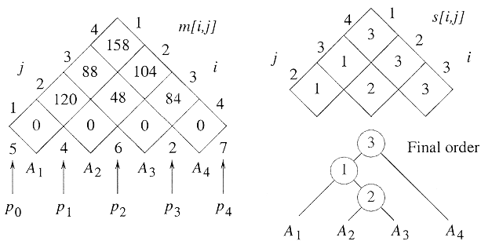
Example: DP for CMM
The initial set of dimensions are <5, 4, 6, 2, 7>: we are multiplying A₁ (5x4) times A₂ (4x6) times A₃ (6x2) times A₄ (2x7). Optimal sequence is (A₁ (A₂A₃ )) A₄.

Slide 25
Finding a Recursive Solution
Figure out the “top-level” choice you have to make (e.g., where to split the list of matrices)
List the options for that decision
Each option should require smaller sub-problems to be solved
Recursive function is the minimum (or max) over all the options
m[i, j] = min_{i ≤ k < j} (m[i, k] + m[k+1, j] + p_{i-1}p_{k}p_{j} )

