Slide 1
Announcements
Homework #7 is due next Monday, Dec. 10, 2005
Final in SN014, 4:00-7:00pm, on Thursday, Dec. 15, 2005
Lin’s Office Hours Final Week:
3:00pm - 4:00pm on Dec. 14 and Dec. 15

Slide 2
Steps in DP: Step 1
Think what decision is the “last piece in the puzzle”
  Where to place the outermost parentheses in a matrix chain multiplication
  (A₁) (A₂ A₃ A₄)
  (A₁ A₂) (A₃ A₄)
  (A₁ A₂ A₃) (A₄)

Slide 3
DP Step 2
Ask what subproblem(s) would have to be solved to figure out how good your choice is
  How to multiply the two groups of matrices, e.g., this one (A₁) (trivial) and this one (A₂ A₃ A₄)

Slide 4
DP Step 3
Write down a formula for the “goodness” of the best choice
m[i, j] = min_{i ≤ k < j} (m[i, k] + m[k+1, j] + p_{i-1}p_{k}p_{j} )

Slide 5
DP Step 4
Arrange subproblems in order from small to large and solve each one, keeping track of the solutions for use when needed
Need 2 tables
  One tells you value of the solution to each subproblem
  Other tells you last option you chose for the solution to each subproblem

Slide 6
Matrix-Chain-Order(p)
1. n ← length[p] - 1
2. for i ← 1 to n // initialization: O(n) time
3. do m[i, i] ← 0
4. for L ← 2 to n // L = length of sub-chain
5. do for i ← 1 to n - L+1
6. do j ← i + L - 1
7. m[i, j] ← ∞
8. for k ← i to j - 1
9. do q ← m[i, k] + m[k+1, j] + p_{i-1} p_{k} p_{j}
10. if q < m[i, j]
11. then m[i, j] ← q
12. s[i, j] ← k
13. return m and s

Slide 7
Polygons
A polygon is a piecewise linear closed curve in the plane. We form a cycle by joining line segments end to end. The line segments are called the sides of the polygon and the endpoints are called the vertices.
A polygon is simple if it does not cross itself, i.e. if the edges do not intersect one another except for two consecutive edges sharing a common vertex. A simple polygon defines a region consisting of points it encloses. The points strictly within this region are in the interior of this region, the points strictly on the outside are in its exterior, and the polygon itself is the boundary of this region.

Slide 8
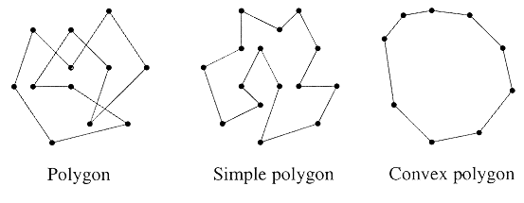
Convex Polygons
A simple polygon is said to be convex if given any two points on its boundary, the line segment between them lies entirely in the union of the polygon and its interior.
Convexity can also be defined by the interior angles. The interior angles of vertices of a convex polygon are at most 180 degrees.

Slide 9
Triangulations
Given a convex polygon, assume that its vertices are labeled in counterclockwise order P=<v₀,…,v_{n-1}>. Assume that indexing of vertices is done modulo n, so v₀ = v_{n}. This polygon has n sides, (v_{i-1} ,v_{i} ).
Given two nonadjacent v_{j} , where i < j, the line segment (v_{i} ,v_{j} ) is a chord. (If the polygon is simple but not convex, a segment must also lie entirely in the interior of P for it to be a chord.) Any chord subdivides the polygon into two polygons.
A triangulation of a convex polygon is a maximal set T of chords. Every chord that is not in T intersects the interior of some chord in T. Such a set of chords subdivides interior of a polygon into set of triangles.

Slide 10
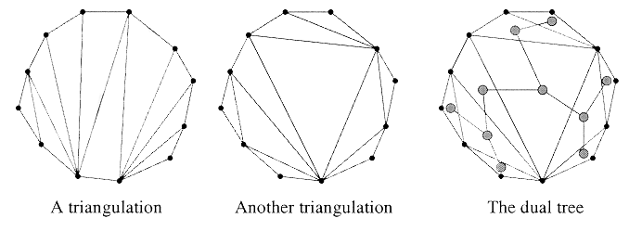
Example: Polygon Triangulation
Dual graph of the triangulation is a graph whose vertices are
the triangles, and in which two vertices share an edge if the
triangles share a common chord. NOTE: the dual graph is a
free tree. In general, there are many possible triangulations.

Slide 11
Minimum-Weight Convex Polygon Triangulation
The number of possible triangulations is exponential in n, the number of sides. The “best” triangulation depends on the applications.
Our problem: Given a convex polygon, determine the triangulation that minimizes the sum of the perimeters of its triangles.
Given three distinct vertices, v_{i} , v_{j} and v_{k} , we define the weight of the associated triangle by the weight function
w(v_{i} , v_{j} , v_{k}) = |v_{i} v_{j} | + |v_{j} v_{k} | + |v_{k} v_{i} |,
where |v_{i} v_{j} | denotes length of the line segment (v_{i ,}v_{j} ).

Slide 12
Correspondence to Binary Trees
In MCM, the associated binary tree is the evaluation tree for the multiplication, where the leaves of the tree correspond to the matrices, and each node of the tree is associated with a product of a sequence of two or more matrices.
Consider an (n+1)-sided convex polygon, P=<v₀,…,v_{n}> and fix one side of the polygon, (v₀ ,v_{n}). Consider a rooted binary tree whose root node is the triangle containing side (v₀ ,v_{n}), whose internal nodes are the nodes of the dual tree, and whose leaves correspond to the remaining sides of the tree. The partitioning of a polygon into triangles is equivalent to a binary tree with n-1 leaves, and vice versa.

Slide 13
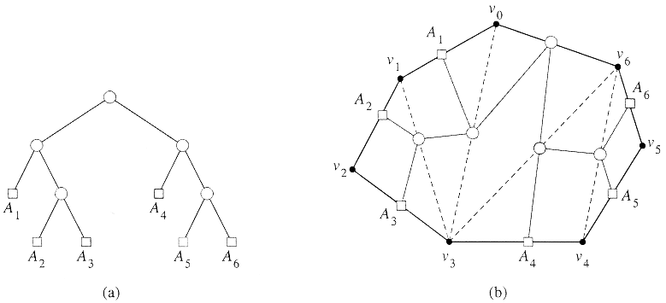
Binary Tree for Triangulation
The associated binary tree has n leaves, and hence n-1 internal nodes. Since each internal node other than the root has one edge entering it, there are n-2 edges between the internal nodes.

Slide 14
Lemma
A triangulation of a simple polygon has n-2 triangles and n-3 chords.
(Proof) The result follows directly from the previous figure. Each internal node corresponds to one triangle and each edge between internal nodes corresponds to one chord of triangulation. If we consider an n-vertex polygon, then we’ll have n-1 leaves, and thus n-2 internal nodes (triangles) and n-3 edges (chords).

Slide 15
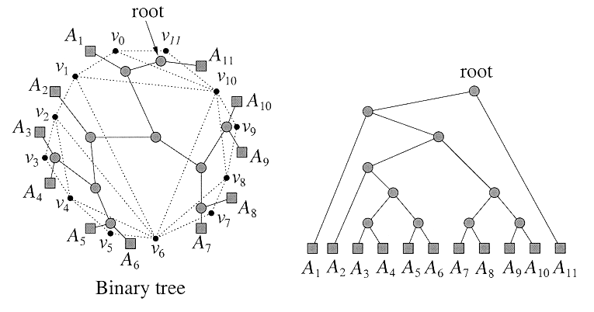
Another Example of Binary Tree for Triangulation

Slide 16
DP Solution (I)
For 1 ≤ i ≤ j ≤ n, let t[i, j] denote the minimum weight triangulation for the subpolygon <v_{i-1}, v_{i} ,…, v_{j}>.
We start with v_{i-1} rather than v_{i}, to keep the structure as similar as possible to the matrix chain multiplication problem.
v₅
v₄
v₃
Min. weight
triangulation
= t[2, 5]
v₆
v₂
v₀
v₁

Slide 17
DP Solution (II)
Observe: if we can compute t[i, j] for all i and j (1 ≤ i ≤ j ≤ n), then the weight of minimum weight triangulation of the entire polygon will be t[1, n].
For the basis case, the weight of the trivial 2-sided polygon is zero, implying that t[i, i] = 0 (line (v_{i-1}, v_{i})).

Slide 18
DP Solution (III)
In general, to compute t[i, j], consider the subpolygon <v_{i-1}, v_{i} ,…, v_{j}>, where i ≤ j. One of the chords of this polygon is the side (v_{i-1}, v_{j}). We may split this subpolygon by introducting a triangle whose base is this chord, and whose third vertex is any vertex v_{k}, where i ≤ k ≤ j-1. This subdivides the polygon into 2 subpolygons <v_{i-1},...v_{k}> & <v_{k+1},... v_{j}>, whose minimum weights are t[i, k] and t[k+1, j].
We have following recursive rule for computing t[i, j]:
t[i, i] = 0
t[i, j] = min_{i ≤ k ≤ j-1} (t[i, k] + t[k+1, j] + w(v_{i-1}v_{k}v_{j} )) for i < k

Slide 19
Weighted-Polygon-Triangulation(V)
1. n ← length[V] - 1 // V = <v₀ ,v₁ ,…,v_{n}>
2. for i ← 1 to n // initialization: O(n) time
3. do t[i, i] ← 0
4. for L ← 2 to n // L = length of sub-chain
5. do for i ← 1 to n-L+1
6. do j ← i + L - 1
7. t[i, j] ← ∞
8. for k ← i to j - 1
9. do q ← t[i, k] + t[k+1, j] + w(v_{i-1} , v_{k} , v_{j})
10. if q < t[i, j]
11. then t[i, j] ← q
12. s[i, j] ← k
return t and s

Slide 20
Assembly-Line Scheduling
Two parallel assembly lines in a factory, lines 1 and 2
Each line has n stations S_{i,1}…S_{i,n}
For each j, S_{1, j} does the same thing as S_{2, j} , but it may take a different amount of assembly time a_{i, j}
Transferring away from line i after stage j costs t_{i, j}
Also entry time e_{i} and exit time x_{i} at beginning and end

Slide 21
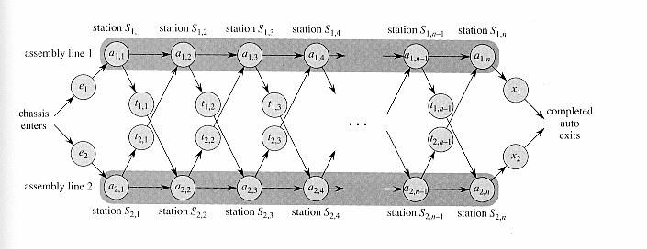
Assembly Lines

Slide 22
Finding Subproblem
Pick some convenient stage of the process
  Say, just before the last station
What’s the next decision to make?
  Whether the last station should be S_{1,n} or S_{2,n}
What do you need to know to decide which option is better?
  What the fastest times are for S_{1,n} & S_{2,n}

Slide 23
Recursive Formula for Subproblem
=min ( ,
Fastest time through prev station (same line)
Fastest time to any given station
Fastest time through prev station (other line)
)
+
Time it takes to switch lines

Slide 24
Recursive Formula (II)
Let f_{i} [ j] denote the fastest possible time to get the chassis through S _{i, j}
Have the following formulas:
f₁[ 1] = e₁ + a_{1,1}
f₁[ j] = min( f₁[ j-1] + a_{1, j}, f₂ [ j-1]+t_{2, j-1}+ a_{1, j} )
Total time:
f * = min( f₁[n] + x₁, f₂ [ n]+x₂)

Slide 25
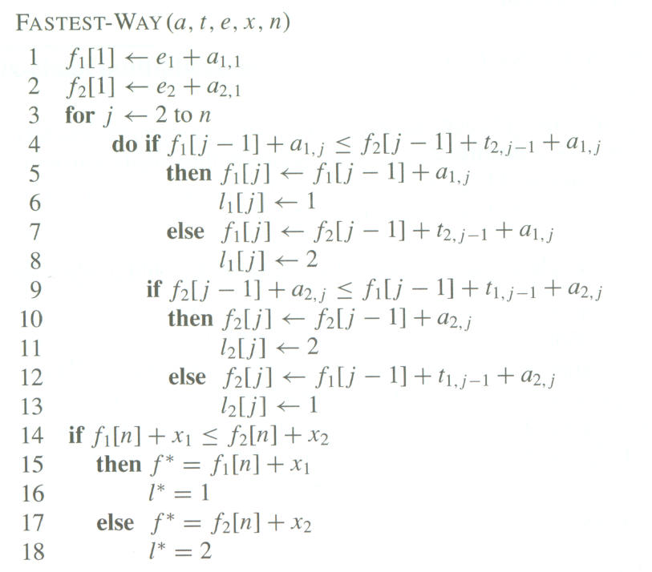

Slide 26
Analysis
Only loop is lines 3-13 which iterate n-1 times: Algorithm is O(n).
The array l records which line is used for each station number

Slide 27
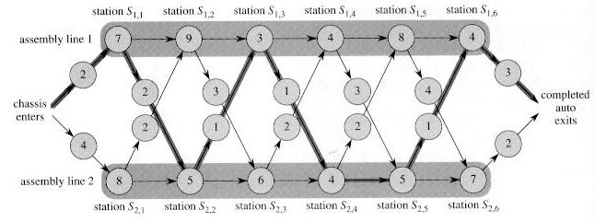
Example

