Slide 1
Announcements
TA’s Office Hours now
  Monday, 2:00pm – 2:30pm
  Wednesday, 2:00pm – 3:30pm
Reading Assignments:
Chapter 4 & 5 (Textbook: CLRS)
Reminder: Homework #1 is due today
Homework #2 is due on Sept 20, 2005

Slide 2
Iteration Method
Expand (iterate) the recurrence and express it as a summation of terms dependent only on n and the initial conditions
The key is to focus on 2 parameters
  the number of times the recurrence needs to be iterated to reach the boundary condition
  the sum of terms arising from each level of the iteration process
Techniques for evaluating summations can then be used to provide bounds on solution.
Notes:
Go back and forth between this slide and the next

Slide 3
An Example
Solve: T(n) = 3T(n/4) + n
T(n) = n + 3T(n/4)
= n + 3[ n/4 + 3T(n/16) ]
= n + 3[n/4] + 9T(n/16)
= n + 3[n/4] + 9 [n/16] + 27T(n/64)
T(n) ≤ n + 3n/4 + 9n/16 + 27n/64 + … + 3^{log4 n}Θ(1)
≤ n ∑ (3/4)^{i} + Θ(n^{log43})
= 4n+ o(n)
= O(n)
Notes:
Then do example T(n) = T(n/2) + 1

Slide 4
Recursion Trees
Keep track of the time spent on the subproblems of a divide and conquer algorithm
A convenient way to visualize what happens when a recursion is iterated
Help organize the algebraic bookkeeping necessary to solve the recurrence

Slide 5
Merge Sort
Running times to merge two sublists
n
n/2
n/2
n/4
n/4
n/4
n/4
Running time to sort the left sublist

Slide 6
Running Time
n
n=n
n/2
n/2
2¢(n/2) = n
lg n
n/4
n/4
n/4
n/4
4¢(n/4) = n
Total: n lg n

Slide 7
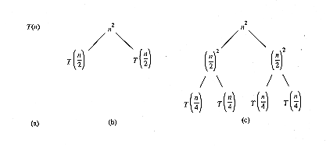
Recursion Trees and Recurrences
Useful even when a specific algorithm is not specified
  For T(n) = 2T(n/2) + n², we have

Slide 8
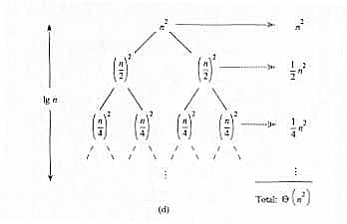
Recursion Trees
T(n) = Θ(n²)

Slide 9
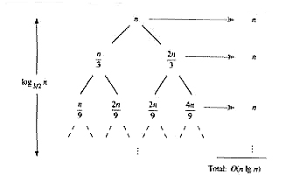
Recursion Trees
For T(n) = T(n/3) + T(2n/3) + n
T(n) = O(n lg n)

Slide 10
Master Method
Provides a “cookbook” method for solving recurrences of the form
T(n) = a T(n/b) + f(n)
Assumptions:
  a ≥ 1 and b ≥ 1 are constants
  f(n) is an asymptotically positive function
  T(n) is defined for nonnegative integers
  We interpret n/b to mean either ⎣n/b⎦ or ⎡n/b⎤

Slide 11
The Master Theorem
With the recurrence T(n) = a T(n/b) + f(n) as in the previous slide, T(n) can be bounded asymptotically as follows:
1. If f(n)=O(n^{logba-ε}) for some constant ε > 0, then T(n)= Θ(n^{logba}).
2. If f(n) = Θ(n^{logba}), then T(n) = Θ(n^{logba} lg n).
3. If f(n) = Ω ( n^{logba+ε} ) for some constant ε > 0, and if a f(n/b) ≤ c f(n) for some constant c < 1 and all sufficiently large n,
then T(n)= Θ(f(n)).

Slide 12
Simplified Master Theorem
Let a ≥ 1 and b > 1 be constants and let T(n) be the recurrence
T(n) = a T(n/b) + c n^{k}
defined for n ≥ 0.
1. If a > b^{k}, then T(n) = Θ( n^{logba} ).
2. If a = b^{k}, then T(n) = Θ( n^{k} lg n ).
3. If a < b^{k}, then T(n) = Θ( n^{k} ).

Slide 13
Examples
T(n) = 16T(n/4) + n
  a = 16, b = 4, thus n^{logba} = n^{log416} = Θ(n²)
  f(n) = n = O(n^{log416 -} ^{ε} ) where ε = 1 ⇒ case 1.
  Therefore, T(n) = Θ(n^{logba} ) = Θ(n²)
T(n) = T(3n/7) + 1
  a = 1, b=7/3, and n^{logba} = n^{log 7/3 1} = n⁰ = 1
  f(n) = 1 = Θ(n^{logba}) ⇒ case 2.
  Therefore, T(n) = Θ(n^{logba} lg n) = Θ(lg n)

Slide 14
Examples (Cont.)
T(n) = 3T(n/4) + n lg n
  a = 3, b=4, thus n^{logba} = n^{log43} = O(n^{0.793})
  f(n) = n lg n = Ω(n^{log43 + ε} ) where ε ≈ 0.2 ⇒ case 3.
  Therefore, T(n) = Θ(f(n)) = Θ(n lg n)
T(n) = 2T(n/2) + n lg n
  a = 2, b=2, f(n) = n lg n, and n^{logba} = n^{log22} = n
  f(n) is asymptotically larger than n^{logba}, but not polynomially larger. The ratio lg n is asymptotically less than n^{ε} for any positive ε. Thus, the Master Theorem doesn’t apply here.

Slide 15
Exercises
Use the Master Method to solve the following:
  T(n) = 4T(n/2) + n
  T(n) = 4T(n/2) + n²
  T(n) = 4T(n/2) + n³

