Slide 1
Announcements
Weekly Reading Assignment:
Chapter 6 (CLRS)
Homework #3 is due on Thursday, October 6, 2005
Extra help session next Thursday, September 29, 2005

Slide 2
Heapsort
Heapsort (Chapter 6)
  Data Structure
  Maintain the Heap Property
  Build a Heap
  Heapsort Algorithm
  Priority Queue

Slide 3
Heap Data Structure
Construct in Θ(n) time
Extract maximum element in Θ(lg n) time
Leads to Θ(n lg n) sorting algorithm:
  Build heap
  Repeatedly extract largest remaining element (constructing sorted list from back to front)
Heaps useful for other purposes too

Slide 4
Properties
Conceptually a complete binary tree
Stored as an array
Heap Property: for every node i other than the root,
A[Parent(i)] ≥ A[i]
  Algorithms maintain heap property as data is added/removed

Slide 5
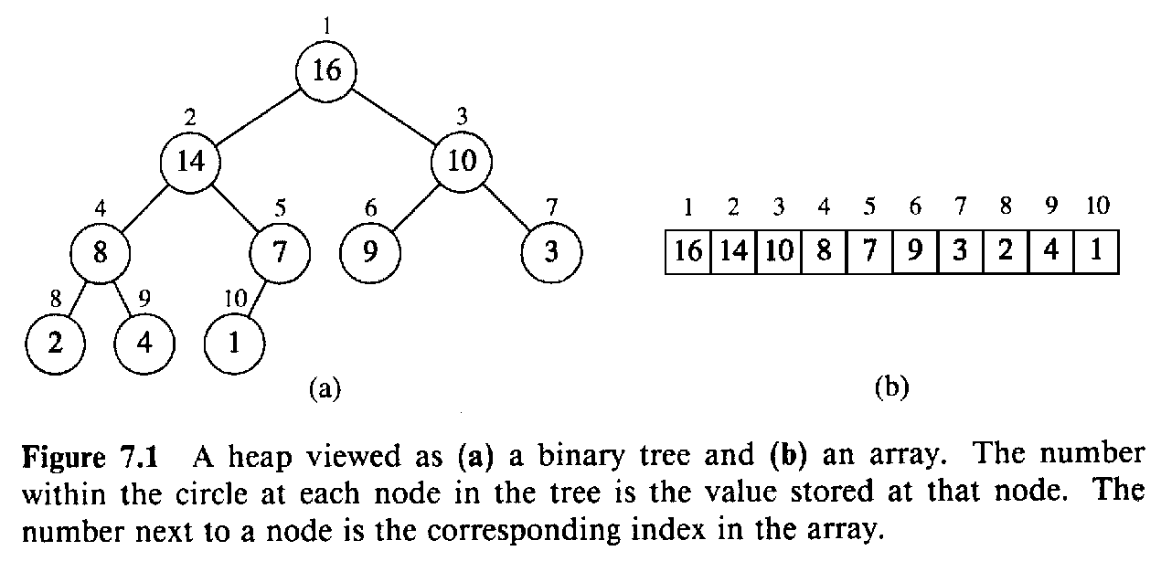
Array Viewed as Binary Tree
Last row filled from left to right

Slide 6
Basic Operations
Parent(i)
return ⎣i/2⎦
Left(i)
return 2i
Right(i)
return 2i+1

Slide 7
Height
Height of a node in a tree: the number of edges on the longest simple downward path from the node to a leaf
Height of a tree: the height of the root
Height of the tree for a heap: Θ(lg n)
  Basic operations on a heap run in O(lg n) time

Slide 8
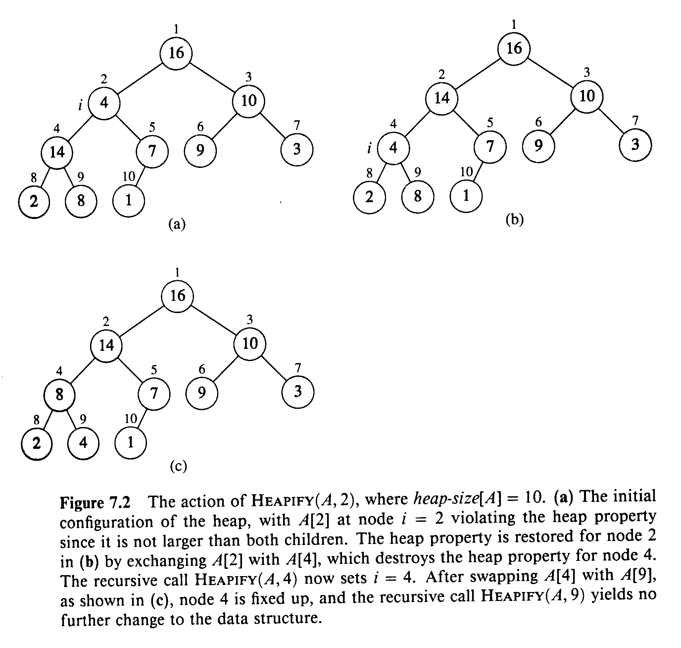
Maintaining Heap Property

Slide 9
Heapify (A, i)
1. l ← left(i)
2. r ← right(i)
3. if l ≤ heap-size[A] and A[l] > A[i]
4. then largest ← l
5. else largest ← i
6. if r ≤ heap-size[A] and A[r] > A[largest]
7. then largest ← r
8. if largest≠ i
9. then exchange A[i] ↔ A[largest]
10. Heapify(A, largest)

Slide 10
Running Time for Heapify(A, i)
1. l ← left(i)
2. r ← right(i)
3. if l ≤ heap-size[A] and A[l] > A[i]
4. then largest ← l
5. else largest ← i
6. if r ≤ heap-size[A] and A[r] > A[largest]
7. then largest ← r
8. if largest≠ i
9. then exchange A[i] ↔ A[largest]
10. Heapify(A, largest)
T(i) =
Θ(1) +
T(largest)

Slide 11
Running Time for Heapify(A, n)
So, T(n) = T(largest) + Θ(1)
Also, largest ≤ 2n/3 (worst case occurs when the last row of tree is exactly half full)
T(n) ≤ T(2n/3) + Θ(1) ⇒ T(n) = O(lg n)
Alternately, Heapify takes O(h) where h is the height of the node where Heapify is applied

Slide 12
Build-Heap(A)
1. heap-size[A] ← length[A]
2. for i ← ⎣length[A]/2⎦ downto 1
3. do Heapify(A, i)

Slide 13
Running Time
The time required by Heapify on a node of height h is O(h)
Express the total cost of Build-Heap as
∑_{h=0 to lgn} ⎡n / 2^{h+1}⎤ O(h) = O(n ∑_{h=0 to lgn} h/2^{h} )
And, ∑_{h=0 to ∞} h/2^{h} = (1/2) / (1 - 1/2)² = 2
Therefore, O(n ∑_{h=0 to lgn} h/2^{h}) = O(n)
  Can build a heap from an unordered array in linear time

Slide 14
Heapsort (A)
1. Build-Heap(A)
2. for i ← length[A] downto 2
3. do exchange A[1] ↔ A[i]
4. heap-size[A] ← heap-size[A] - 1
5. Heapify(A, 1)

Slide 15
Algorithm Analysis
In-place
Not Stable
Build-Heap takes O(n) and each of the n-1 calls to Heapify takes time O(lg n).
Therefore, T(n) = O(n lg n)

Slide 16
Priority Queues
A data structure for maintaining a set S of elements, each with an associated value called a key.
Applications: scheduling jobs on a shared computer, prioritizing events to be processed based on their predicted time of occurrence.
Heap can be used to implement a priority queue.

Slide 17
Basic Operations
Insert(S, x) - inserts the element x into the set S, i.e. S → S ∪ {x}
Maximum(S) - returns the element of S with the largest key
Extract-Max(S) - removes and returns the element of S with the largest key

Slide 18
Heap-Extract-Max(A)
1. if heap-size[A] < 1
2. then error “heap underflow”
3. max ← A[1]
4. A[1] ← A[heap-size[A]]
5. heap-size[A] ← heap-size[A] - 1
6. Heapify(A, 1)
7. return max

Slide 19
Heap-Insert(A, key)
1. heap-size[A] ← heap-size[A] + 1
2. i ← heap-size[A]
3. while i > 1 and A[Parent(i)] < key
4. do A[i] ← A[Parent(i)]
5. i ← Parent(i)
6. A[i] ← key

Slide 20
Running Time
Running time of Heap-Extract-Max is O(lg n).
  Performs only a constant amount of work on top of Heapify, which takes O(lg n) time
Running time of Heap-Insert is O(lg n).
  The path traced from the new leaf to the root has length O(lg n).

Slide 21
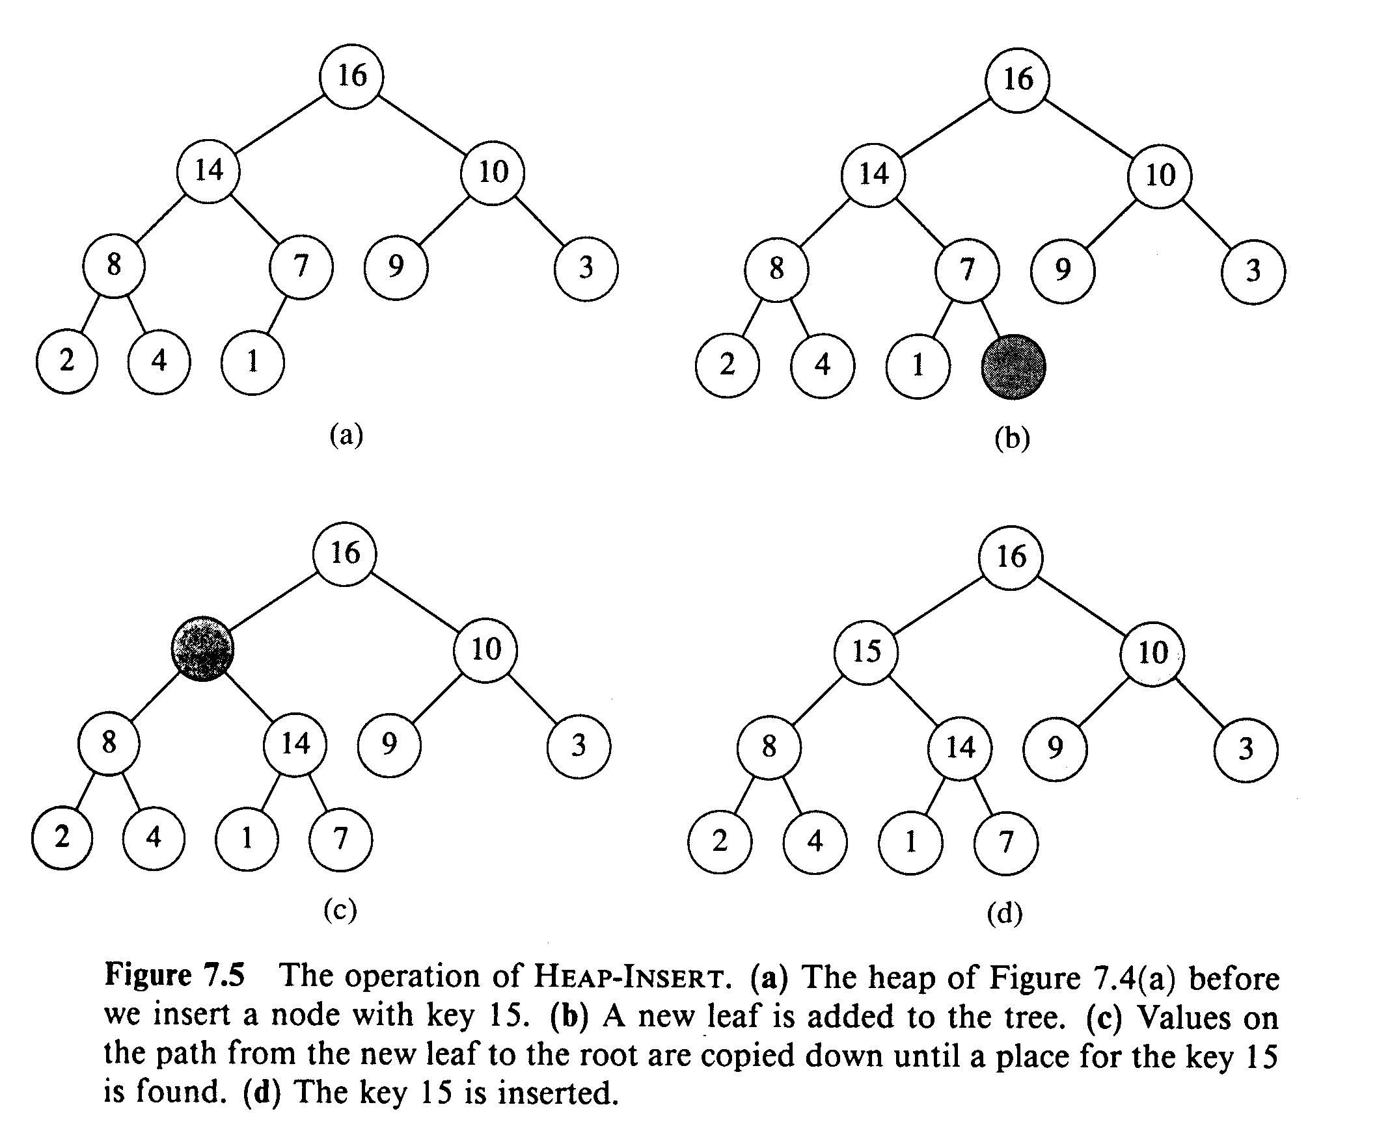
Examples

