Slide 1
Announcements
Weekly Reading Assignment:
  this week: Chapter 7 & 8 (CLRS)
  next week: Chapter 9 (CLRS)
Extra Help Session: SN014, starting at 4:50pm this Thursday, September 29, 2005 in SN014

Slide 2
QuickSort
Divide: A[p…r] is partitioned (rearranged) into two nonempty subarrays A[p…q] and A[q+1…r] s.t. each element of A[p…q] is less than or equal to each element of A[q+1…r]. Index q is computed here.
Conquer: two subarrays are sorted by recursive calls to quicksort.
Combine: no work needed since the subarrays are sorted in place already.

Slide 3
Quicksort (A, p, r)
1. if p < r
2. then q ← Partition(A, p, r)
3. Quicksort(A, p, q)
4. Quicksort(A, q+1, r)
* In place, not stable

Slide 4
Partition(A, p, r)
1. x ← A[p]
2. i ← p - 1
3. j ← r + 1
4. while TRUE
5. do repeat j ← j - 1
6. until A[j] ≤ x
7. repeat i ← i + 1
8. until A[i] ≥ x
9. if i < j
10. then exchange A[i] ↔ A[j]
11. else return j

Slide 5
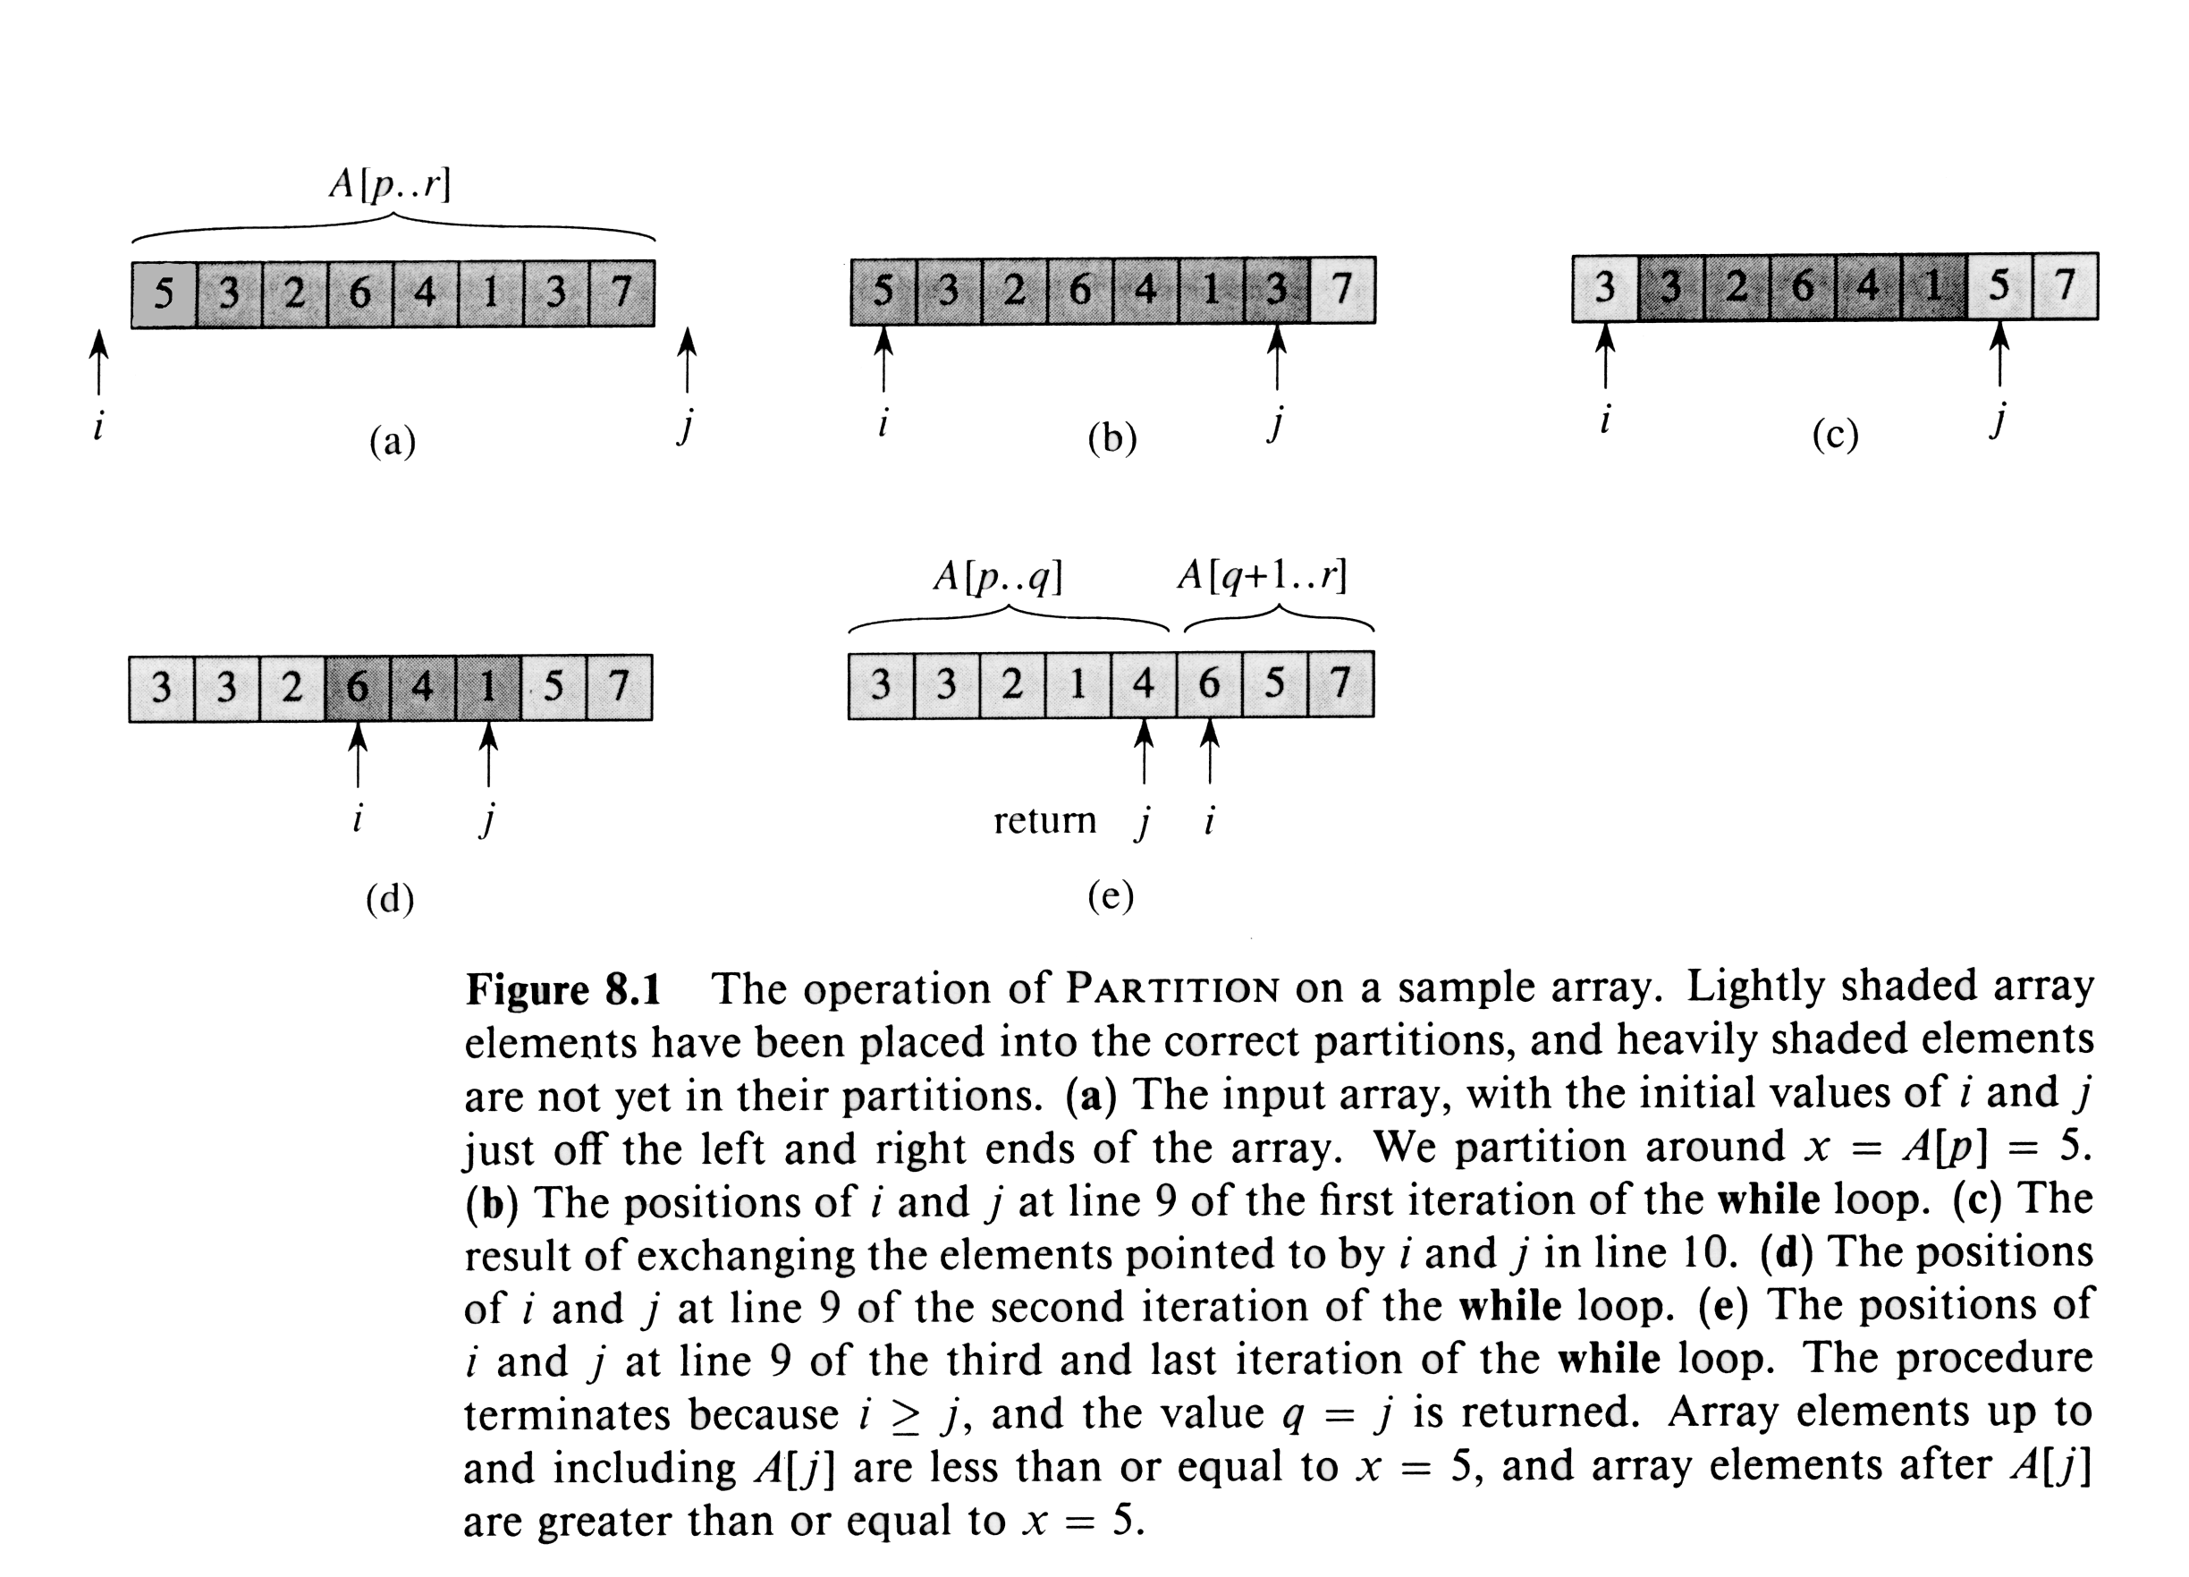
Example: Partitioning Array

Slide 6
Algorithm Analysis
The running time of quicksort depends on whether the partitioning is balanced or not.
Worst-Case Performance (unbalanced):
T(n) = T(1) + T(n-1) + Θ(n) ⇐ partitioning takes Θ(n)
= ∑_{k = 1 to n}Θ(k) ⇐ T(1) takes Θ(1) time & reiterate
= Θ ( ∑ _{k = 1 to n} k )
= Θ(n²)
* This occurs when the input is completely sorted.

Slide 7
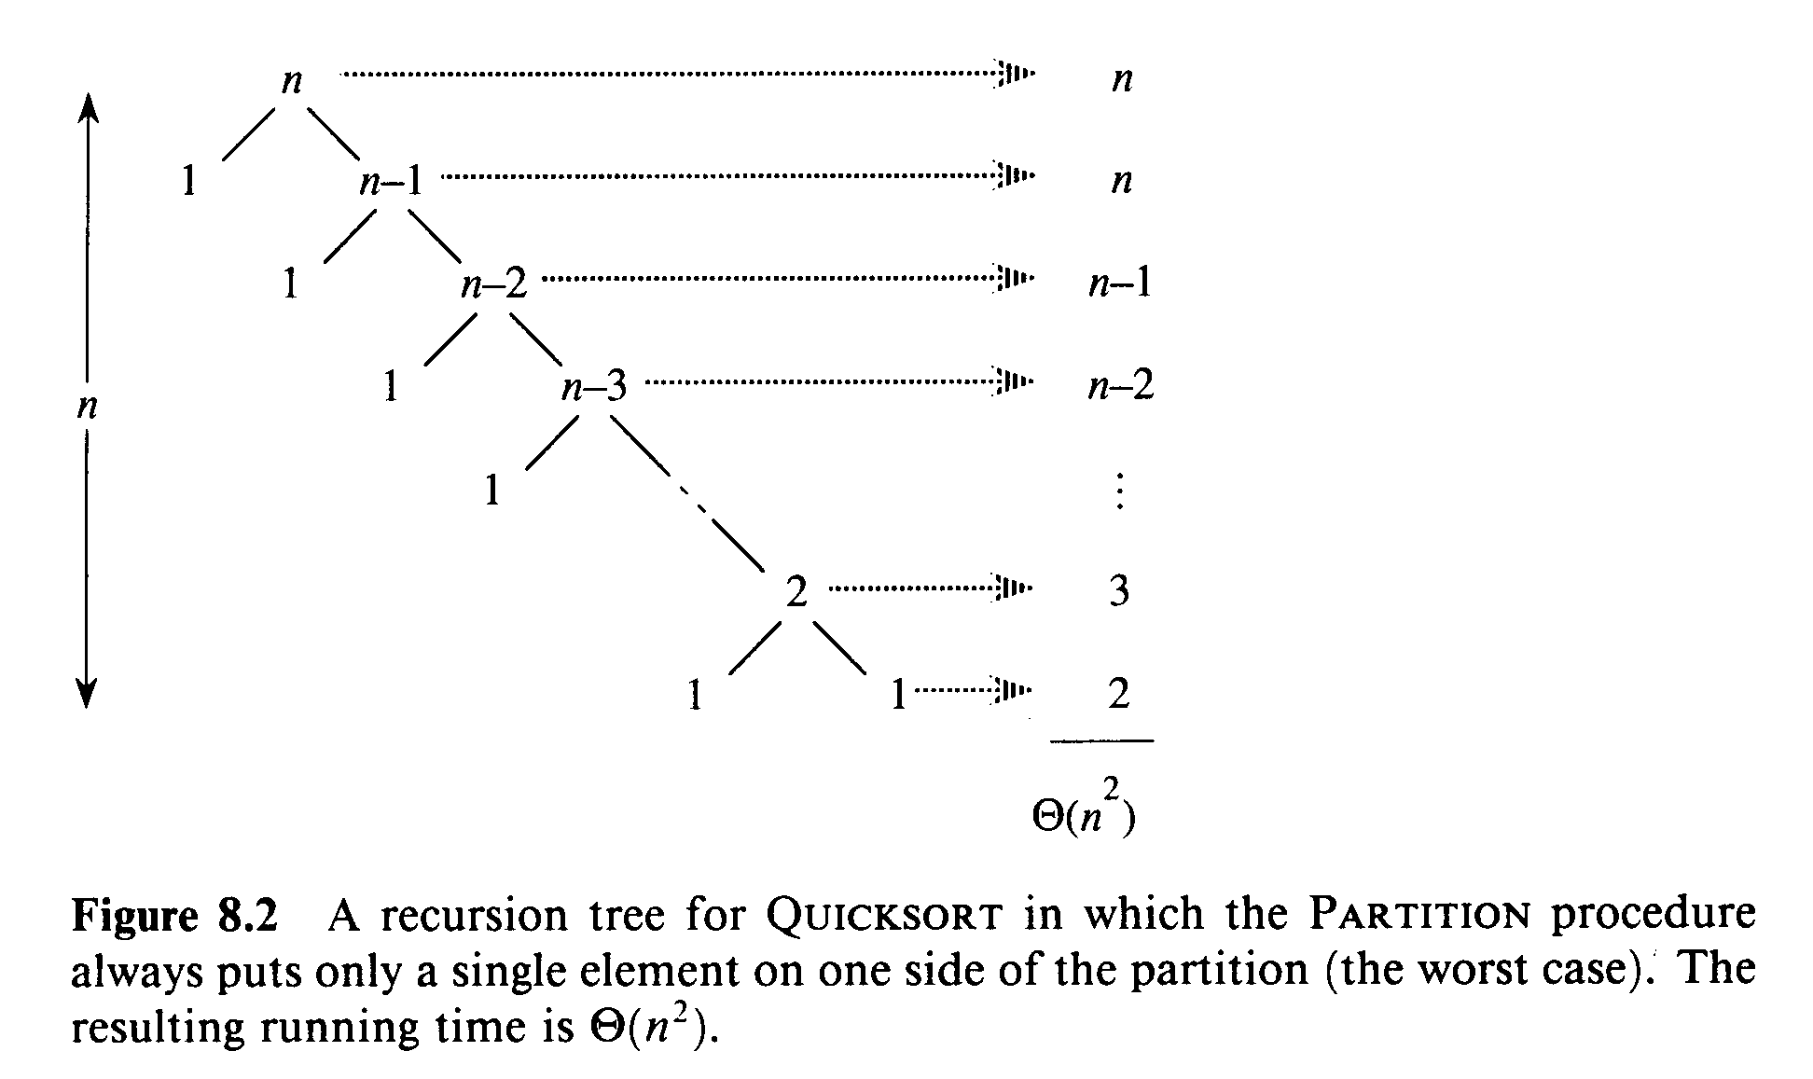
Worst Case Partitioning

Slide 8
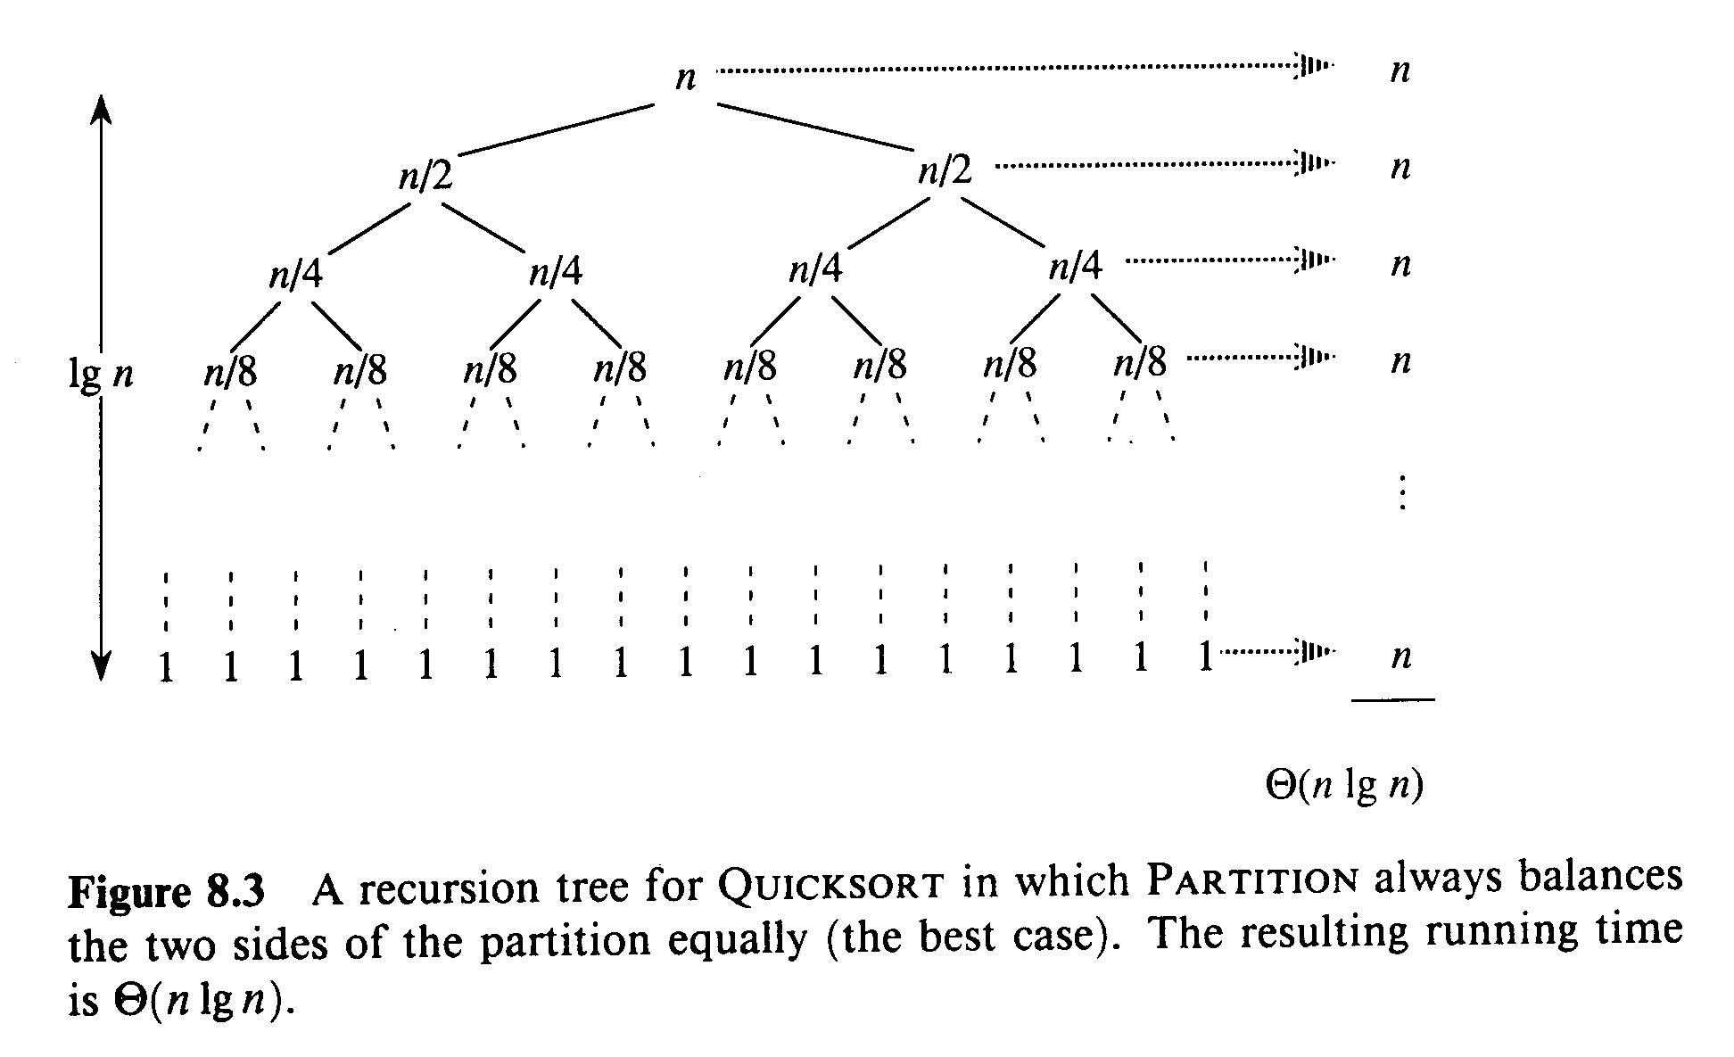
Best Case Partitioning

Slide 9
Analysis for Best Case Partition
When the partitioning procedure produces two regions of size n/2, we get the a balanced partition with best case performance:
T(n) = 2T(n/2) + Θ(n)
So, T(n) = Θ(n log n)
Can it perform better than O(n logn) on any input?

Slide 10
Average-Case Behavior
For example, when the partitioning algorithm always produces a 7-to-3 proportional split:
T(n) = T(7n/10) + T(3n/10) + n
Solve the recurrence by visualizing recursion tree, each level has a cost of n with the height of lg n. So, we get T(n) = Θ(n log n) when the split has constant proportionality.
For a split of proportionality α, where 0 ≤ α ≤ 1/2, the minimum depth of the tree is - lg n / lg α and the maximum depth is - lg n / lg (1- α ).

Slide 11
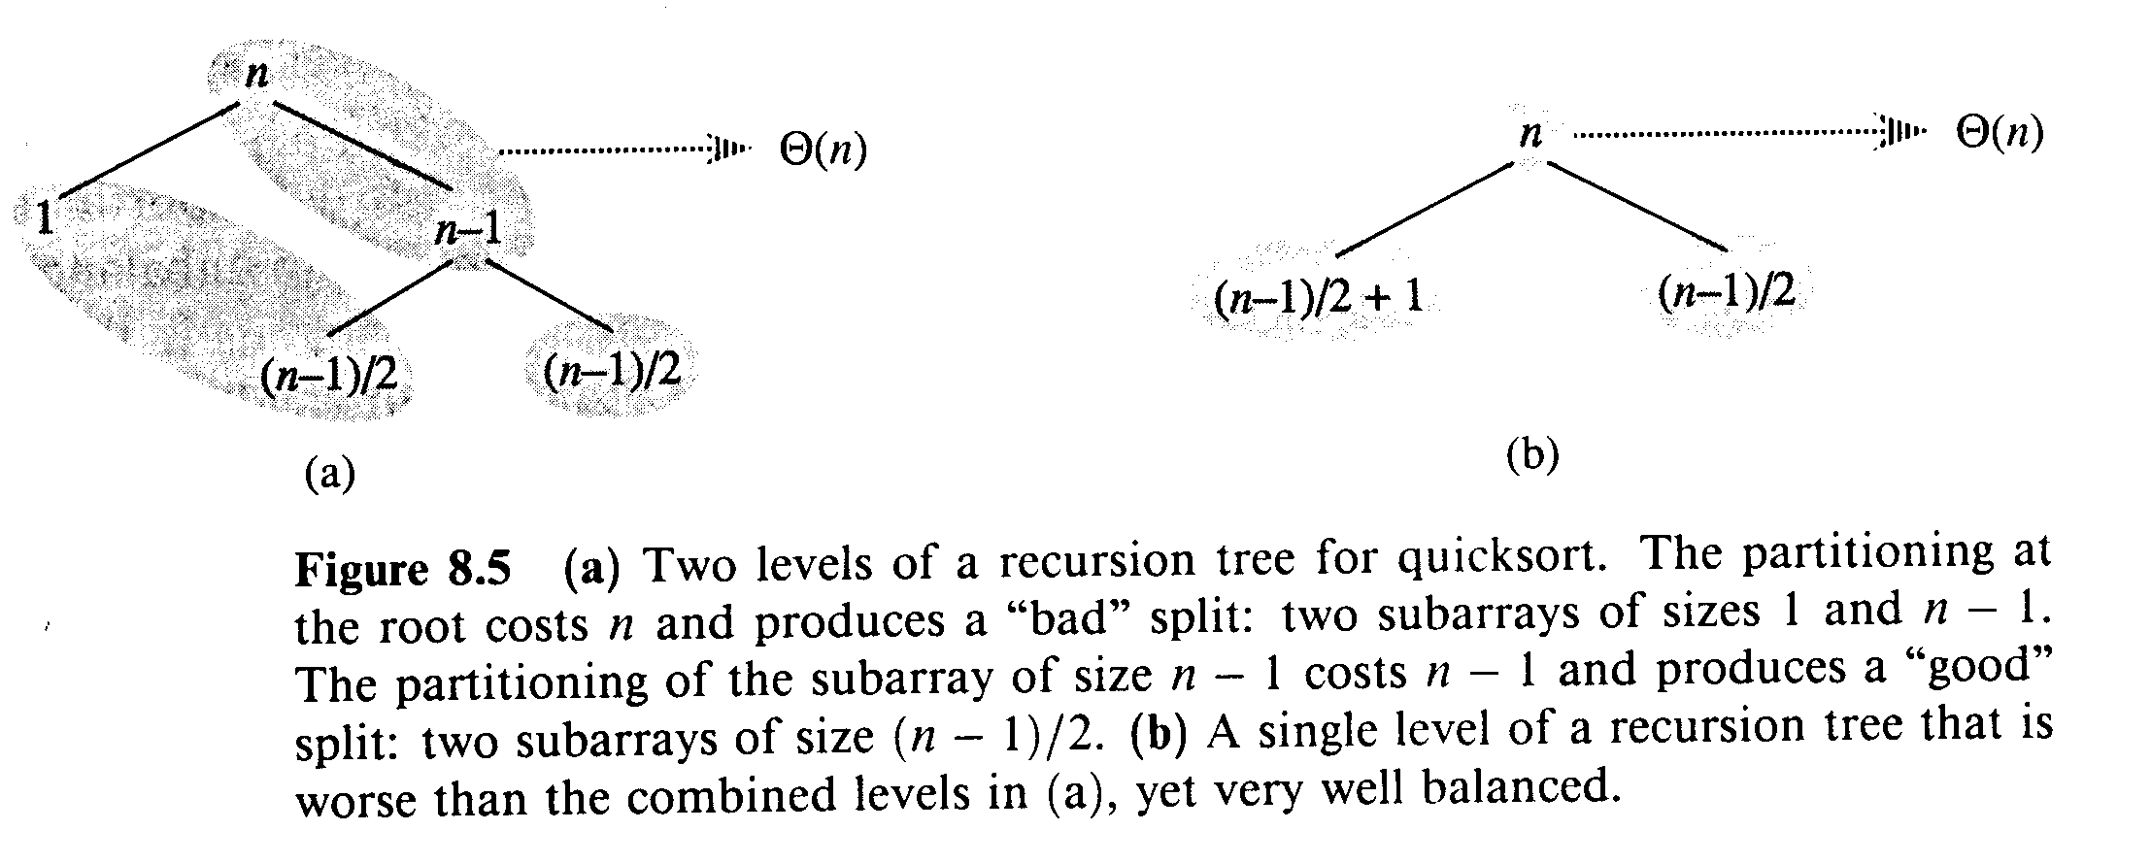
Average-Case Splitting
The combination of good and bad splits would result in T(n) = Θ(n log n), but with slightly larger constant hidden by the O-notation. (Rigorous average-case analysis later)

Slide 12
Randomized Quicksort
An algorithm is randomized if its behavior is determined not only by the input but also by values produced by a random-number generator. No particular input elicits worst-case behavior. Two possible versions of quicksort:
  Impose a distribution on input to ensure that every permutation is equally likely. This does not improve the worst-case running time, but makes run time independent of input ordering.
  Exchange A[p] with an element chosen at random from A[p…r] in Partition. This ensures that the pivot element is equally likely to be any of input elements.

Slide 13
Randomized-Partition(A, p, r)
1. i ← Random (p, r)
2. exchange A[p] ↔ A[i]
3. return Partition(A, p, r)

Slide 14
Randomized-Quicksort (A, p, r)
1. if p < r
2. then q ← Randomized-Partition(A, p, r)
3. Randomized-Quicksort(A, p, q)
4. Randomized-Quicksort(A, q+1, r)

Slide 15
Worst-Case Analysis
T(n) = max (T(q) + T(n - q)) + Θ(n)
^{1 ≤ q ≤ n-1}
Substitution method: Guess T(n) ≤ cn²
T(n) ≤ max (cq² + c(n - q)²) + Θ(n)
^{1 ≤ q ≤ n-1}
= c · max (q² + (n - q)²) + Θ(n)
^{1 ≤ q ≤ n-1}
Take derivatives to get maximum at q = 1, n-1:
T(n) ≤ cn² - 2c(n - 1) + Θ(n) ≤ cn²
Therefore, the worst case running time is Θ(n²)

Slide 16
Average-Case Analysis
Partitioning depends only on the rank of x =A[p].
When rank(x) = 1, index i stops at i = p and j stops j = p. q = p is returned. So, the probability of the low side has one element is 1/n.
When rank(x) ≥ 2, there is at least one element smaller than x =A[p]. When the “Partition” terminates, each of the rank(x)-1 elements in the low side of the partition is strictly less than x. For each i = 1, … , n-1, the probability is 1/n that the low side has i elements.

Slide 17
Recurrence for Average-Case
Combining two cases, the size q - p + 1 of low side partition is 1 with probability of 2/n, and the size is i with probability of 1/n for i = 2,…,n-1. So,
T(n) = 1/n(T(1) +T(n-1) +∑_{q=1 to n-1}(T(q)+T(n - q)))+Θ(n)
= 1/n (Θ(1) +O(n²) +∑_{q=1 to n-1}T(q)+T(n - q)) + Θ(n)
= 1/n (∑_{q=1 to n-1}T(q)+T(n - q)) + Θ(n)
= 2/n (∑_{k=1 to n-1}T(k)) + Θ(n)

Slide 18
Solving Recurrence
Substitution Method: Guess T(n) ≤ a n lg n + b
T(n) = 2/n (∑_{k=1 to n-1}T(k)) + Θ(n)
≤ 2/n (∑_{k=1 to n-1} a k lg k + b) + Θ(n)
= (2a/n ∑_{k=1 to n-1} k lg k) + 2b(n -1)/n + Θ(n)
≤ 2a/n(n² lg n/ 2 - n²/8) + 2b(n -1)/n + Θ(n)
≤ a n lg n + b + (Θ(n) + b - an/4)
≤ a n lg n + b ⇐ if we choose a large enough

