Slide 1
References
Collision Detection between Geometric Models: A Survey, by M. Lin and S. Gottschalk, Proc. of IMA Conference on Mathematics of Surfaces 1998.
I-COLLIDE: Interactive and Exact Collision Detection for Large-Scale Environments, by Cohen, Lin, Manocha & Ponamgi, Proc. of ACM Symposium on Interactive 3D Graphics, 1995.
(More details in Chapter 3 of M. Lin's Thesis)
A Fast Procedure for Computing the Distance between Objects in Three-Dimensional Space, by E. G. Gilbert, D. W. Johnson, and S. S. Keerthi, In IEEE Transaction of Robotics and Automation, Vol. RA-4:193--203, 1988.

Slide 2
Geometric Proximity Queries
Given two object, how would you check:
  If they intersect with each other while moving?
  If they do not interpenetrate each other, how far are they apart?
  If they overlap, how much is the amount of penetration

Slide 3
Collision Detection
    Update configurations w/ TXF matrices
    Check for edge-edge intersection in 2D
    (Check for edge-face intersection in 3D)
    Check every point of A inside of B &
    every point of B inside of A
    Check for pair-wise edge-edge intersections
    Imagine larger input size: N = 1000+ ……

Slide 4
Classes of Objects & Problems
    2D vs. 3D
    Convex vs. Non-Convex
    Polygonal vs. Non-Polygonal
    Open surfaces vs. Closed volumes
    Geometric vs. Volumetric
    Rigid vs. Non-rigid (deformable/flexible)
    Pairwise vs. Multiple (N-Body)
    CSG vs. B-Rep
    Static vs. Dynamic
    And so on… This may include other geometric representation schemata, etc.

Slide 5
Some Possible Approaches
    Geometric methods
    Algebraic Techniques
    Hierarchical Bounding Volumes
    Spatial Partitioning
    Others (e.g. optimization)

Slide 6
Voronoi Diagrams
Given a set S of n points in R² , for each point p_{i} in S, there is the set of points (x, y) in the plane that are closer to p_{i} than any other point in S, called Voronoi polygons. The collection of n Voronoi polygons given the n points in the set S is the "Voronoi diagram", Vor(S), of the point set S.
Intuition: To partition the plane into regions, each of these is the set of points that are closer to a point p_{i} in S than any other. The partition is based on the set of closest points, e.g. bisectors that have 2 or 3 closest points.

Slide 7
Generalized Voronoi Diagrams
The extension of the Voronoi diagram to higher dimensional features (such as edges and facets, instead of points); i.e. the set of points closest to a feature, e.g. that of a polyhedron.
FACTS:
  In general, the generalized Voronoi diagram has quadratic surface boundaries in it.
  If the polyhedron is convex, then its generalized Voronoi diagram has planar boundaries.

Slide 8
Voronoi Regions
A Voronoi region associated with a feature is a set of points that are closer to that feature than any other.
FACTS:
  The Voronoi regions form a partition of space outside of the polyhedron according to the closest feature.
  The collection of Voronoi regions of each polyhedron is the generalized Voronoi diagram of the polyhedron.
  The generalized Voronoi diagram of a convex polyhedron has linear size and consists of polyhedral regions. And, all Voronoi regions are convex.

Slide 9
Voronoi Marching
Basic Ideas:
Coherence: local geometry does not change much, when computations repetitively performed over successive small time intervals
Locality: to "track" the pair of closest features between 2 moving convex polygons(polyhedra) w/ Voronoi regions
Performance: expected constant running time, independent of the geometric complexity

Slide 10
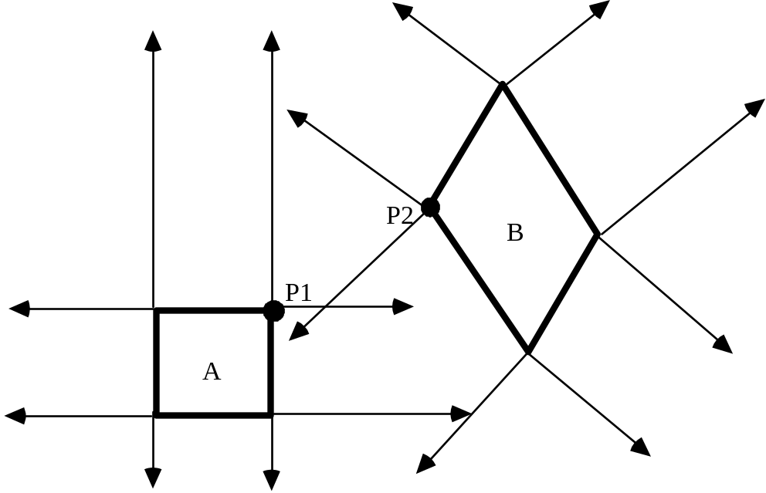
Simple 2D Example
Objects A & B and their Voronoi regions: P1 and P2 are the pair of closest points between A and B. Note P1 and P2 lie within the Voronoi regions of each other.

Slide 11
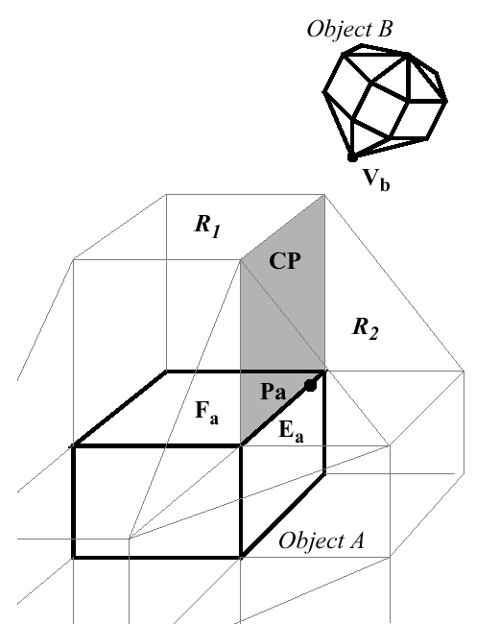
Basic Idea for Voronoi Marching

Slide 12
Linear Programming
In general, a d-dimensional linear program-ming (or linear optimization) problem may be posed as follows:
Given a finite set A in R^{d}
For each a in A, a constant K_{a} in R, c in R^{d}
Find x in R^{d} which minimize <x, c>
Subject to <a, x> ≥ K_{a}, for all a in A .
where <*, *> is standard inner product in R^{d}.

Slide 13
LP for Collision Detection
Given two finite sets A, B in R^{d}
For each a in A and b in B,
Find x in R^{d} which minimize whatever
Subject to <a, x> > 0, for all a in A
And <b, x> < 0, for all b in B
where d = 2 (or 3).

Slide 14
Minkowski Sums/Differences
Minkowski Sum (A, B) = { a + b | a ∈ A, b ∈ B }
Minkowski Diff (A, B) = { a - b | a ∈ A, b ∈ B }
A and B collide iff Minkowski Difference(A,B) contains the point 0.

Slide 15
Some Minkowski Differences
A
B
A
B

Slide 16
Minkowski Difference & Translation
Minkowski-Diff(Trans(A, t₁), Trans(B, t₂)) = Trans(Minkowski-Diff(A,B), t₁ - t₂)
Trans(A, t₁) and Trans(B, t₂) intersect iff Minkowski-Diff(A,B) contains point (t₂ - t₁).

Slide 17
Properties
Distance
  distance(A,B) = min _{a ∈ A, b∈ B} || a - b ||₂
  distance(A,B) = min _{c ∈ Minkowski-Diff(A,B)} || c ||₂
  if A and B disjoint, c is a point on boundary of Minkowski difference
Penetration Depth
  pd(A,B) = min{ || t ||₂ | A ∩ Translated(B,t) = ∅ }
  pd(A,B) = min_{t ∉Minkowski-Diff(A,B)} || t ||₂
  if A and B intersect, t is a point on boundary of Minkowski difference

Slide 18
Practicality
Expensive to compute boundary of Minkowski difference:
  For convex polyhedra, Minkowski difference may take O(n²)
  For general polyhedra, no known algorithm of complexity less than O(n⁶) is known

Slide 19
GJK for Computing Distance between Convex Polyhedra
GJK-DistanceToOrigin ( P ) // dimension is m
1. Initialize P₀ with m+1 or fewer points.
2. k = 0
3. while (TRUE) {
4. if origin is within CH( P_{k} ), return 0
5. else {
6. find x ∈ CH(P_{k}) closest to origin, and S_{k} ⊂ P_{k} s.t. x ∈ CH(S_{k})
7. see if any point p_{-x} in P more extremal in direction -x
8. if no such point is found, return |x|
9. else {
10. P_{k+1} = S_{k} ∪ {p_{-x}}
11. k = k + 1
12. }
13. }
14. }

Slide 20
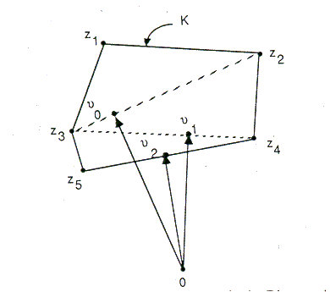
An Example of GJK

Slide 21
Running Time of GJK
Each iteration of the while loop requires O(n) time.
O(n) iterations possible. The authors claimed between 3 to 6 iterations on average for any problem size, making this “expected” linear.
Trivial O(n) algorithms exist if we are given the boundary representation of a convex object, but GJK will work on point sets - computes CH lazily.

Slide 22
More on GJK
Given A = CH(A’) A’ = { a₁, a₂, ... , a_{n} } and
B = CH(B’) B’ = { b₁, b₂, ... , b_{m} }
Minkowski-Diff(A,B) = CH(P), P = {a - b | a∈ A’, b∈ B’}
Can compute points of P on demand:
  p_{-x} = a_{-x} - b_{x} where a_{-x} is the point of A’ extremal in direction -x, and b_{x} is the point of B’ extremal in direction x.
The loop body would take O(n + m) time, producing the “expected” linear performance overall.

Slide 23
Large, Dynamic Environments
For dynamic simulation where the velocity and acceleration of all objects are known at each step, use the scheduling scheme (implemented as heap) to prioritize “critical events” to be processed.
Each object pair is tagged with the estimated time to next collision. Then, each pair of objects is processed accordingly. The heap is updated when a collision occurs.

Slide 24
Scheduling Scheme
a_{max}: an upper bound on relative acceleration between any two points on any pair of objects.
a_{lin}: relative absolute linear
α: relative rotational accelerations
ω: relative rotational velocities
r: vector difference btw CoM of two bodies
d: initial separation for two given objects
        a_{max} = | a_{lin} + α x r + ω x ω x r |
        v_{i} = | v_{lin} + ω x r |
Estimated Time to collision:
t_{c} = { (v_{i}² + 2 a_{max} d)^{1/2} - v_{i} } / a_{max}

Slide 25
Collide System Architecture
Transform
Sweep & Prune
Overlap
Simulation
Exact
Collision
Detection
Analysis &
Response
Parameters
Collision

Slide 26
Sweep and Prune
Compute the axis-aligned bounding box (fixed vs. dynamic) for each object
Dimension Reduction by projecting boxes onto each x, y, z- axis
Sort the endpoints and find overlapping intervals
Possible collision -- only if projected intervals overlap in all 3 dimensions

Slide 27
Sweep & Prune
T = 1
e₃
e₂
b₃
e₁
b₂
b₁
b₁
b₂
e₁
e₂
b₃
e₃
T = 2
e₂
e₁
b₂
e₃
b₁
b₃
b₁
b₂
e₁
e₂
b₃
e₃

Slide 28
Updating Bounding Boxes
Coherence (greedy algorithm)
Convexity properties (geometric properties of convex polytopes)
Nearly constant time, if the motion is relatively “small”

Slide 29
Use of Sorting Methods
Initial sort -- quick sort runs in O(m log m) just as in any ordinary situation
Updating -- insertion sort runs in O(m) due to coherence. We sort an almost sorted list from last stimulation step. In fact, we look for “swap” of positions in all 3 dimension.

Slide 30
Implementation Issues
Collision matrix -- basically adjacency matrix
Enlarge bounding volumes with some tolerance threshold
Quick start polyhedral collision test -- using bucket sort & look-up table

