Slide 1
Reading Assignments
Interactive Collision Detection, by P. M. Hubbard, Proc. of IEEE Symposium on Research Frontiers in Virtual Reality, 1993.
Evaluation of Collision Detection Methods for Virtual Reality Fly-Throughs, by Held, Klosowski and Mitchell, Proc. of Canadian Conf. on Computational Geometry 1995.
Efficient collision detection using bounding volume hierarchies of k-dops, by J. Klosowski, M. Held, J. S. B. Mitchell, H. Sowizral, and K. Zikan, IEEE Trans. on Visualization and Computer Graphics, 4(1):21--37, 1998.

Slide 2
Reading Assignments
OBB-Tree: A Hierarchical Structure for Rapid Interference Detection, by S. Gottschalk, M. Lin and D. Manocha, Proc. of ACM Siggraph, 1996.
Rapid and Accurate Contact Determination between Spline Models using ShellTrees, by S. Krishnan, M. Gopi, M. Lin, D. Manocha and A. Pattekar, Proc. of Eurographics 1998.
Fast Proximity Queries with Swept Sphere Volumes, by Eric Larsen, Stefan Gottschalk, Ming C. Lin, Dinesh Manocha, Technical report TR99-018, UNC-CH, CS Dept, 1999. (Part of the paper in Proc. of IEEE ICRA’2000)

Slide 3
Methods for General Models
Decompose into convex pieces, and take minimum over all pairs of pieces:
  Optimal (minimal) model decomposition is NP-hard.
  Approximation algorithms exist for closed solids, but what about a list of triangles?
Collection of triangles/polygons:
  n*m pairs of triangles - brute force expensive
  Hierarchical representations used to accelerate minimum finding

Slide 4
Hierarchical Representations
Two Common Types:
  Bounding volume hierarchies – trees of spheres, ellipses, cubes, axis-aligned bounding boxes (AABBs), oriented bounding boxes (OBBs), K-dop, SSV, etc.
  Spatial decomposition - BSP, K-d trees, octrees, MSP tree, R-trees, grids/cells, space-time bounds, etc.
Do very well in “rejection tests”, when objects are far apart
Performance may slow down, when the two objects are in close proximity and can have multiple contacts

Slide 5
BVH vs. Spatial Partitioning
BVH: SP:
- Object centric - Space centric
- Spatial redundancy - Object redundancy

Slide 6
BVH vs. Spatial Partitioning
BVH: SP:
- Object centric - Space centric
- Spatial redundancy - Object redundancy

Slide 7
BVH vs. Spatial Partitioning
BVH: SP:
- Object centric - Space centric
- Spatial redundancy - Object redundancy

Slide 8
BVH vs. Spatial Partitioning
BVH: SP:
- Object centric - Space centric
- Spatial redundancy - Object redundancy

Slide 9
Spatial Data Structures & Subdivision
Uniform Spatial Sub
Quadtree/Octree
kd-tree
BSP-tree
Many others……
(see the lecture notes)

Slide 10
Uniform Spatial Subdivision
Decompose the objects (the entire simulated environment) into identical cells arranged in a fixed, regular grids (equal size boxes or voxels)
To represent an object, only need to decide which cells are occupied. To perform collision detection, check if any cell is occupied by two object
Storage: to represent an object at resolution of n voxels per dimension requires upto n³ cells
Accuracy: solids can only be “approximated”

Slide 11
Octrees
Quadtree is derived by subdividing a 2D-plane in both dimensions to form quadrants
Octrees are a 3D-extension of quadtree
Use divide-and-conquer
Reduce storage requirements (in comparison to grids/voxels)

Slide 12
Bounding Volume Hierarchies
Model Hierarchy:
  each node has a simple volume that bounds a set of triangles
  children contain volumes that each bound a different portion of the parent’s triangles
  The leaves of the hierarchy usually contain individual triangles
A binary bounding volume hierarchy:

Slide 13
Type of Bounding Volumes
Spheres
Ellipsoids
Axis-Aligned Bounding Boxes (AABB)
Oriented Bounding Boxes (OBBs)
Convex Hulls
k-Discrete Orientation Polytopes (k-dop)
Spherical Shells
Swept-Sphere Volumes (SSVs)
  Point Swetp Spheres (PSS)
  Line Swept Spheres (LSS)
  Rectangle Swept Spheres (RSS)
  Triangle Swept Spheres (TSS)

Slide 14
BVH-Based Collision Detection

Slide 15
Collision Detection using BVH
1. Check for collision between two parent nodes (starting from the roots of two given trees)
2. If there is no interference between two parents,
3. Then stop and report “no collision”
4. Else All children of one parent node are checked
against all children of the other node
5. If there is a collision between the children
6. Then If at leave nodes
7. Then report “collision”
8. Else go to Step 4
9. Else stop and report “no collision”

Slide 16
Evaluating Bounding Volume Hierarchies
Cost Function:
F = N_{u} x C_{u} + N_{bv} x C_{bv} + N_{p} x C_{p}
F: total cost function for interference detection
N_{u}: no. of bounding volumes updated
C_{u}: cost of updating a bounding volume,
N_{bv}: no. of bounding volume pair overlap tests
C_{bv}: cost of overlap test between 2 BVs
N_{p}: no. of primitive pairs tested for interference
C_{p}: cost of testing 2 primitives for interference

Slide 17
Designing Bounding Volume Hierarchies
The choice governed by these constraints:
  It should fit the original model as tightly as possible (to lower N_{bv} and N_{p})
  Testing two such volumes for overlap should be as fast as possible (to lower C_{bv})
  It should require the BV updates as infrequently as possible (to lower N_{u})

Slide 18
Observations
Simple primitives (spheres, AABBs, etc.) do very well with respect to the second constraint. But they cannot fit some long skinny primitives tightly.
More complex primitives (minimal ellipsoids, OBBs, etc.) provide tight fits, but checking for overlap between them is relatively expensive.
Cost of BV updates needs to be considered.

Slide 19
Trade-off in Choosing BV’s
Sphere
AABB
OBB
6-dop
Convex Hull
increasing complexity & tightness of fit
decreasing cost of (overlap tests + BV update)

Slide 20
Building Hierarchies
Choices of Bounding Volumes
  cost function & constraints
Top-Down vs. Bottum-up
  speed vs. fitting
Depth vs. breadth
  branching factors
Splitting factors
  where & how

Slide 21
Sphere-Trees
A sphere-tree is a hierarchy of sets of spheres, used to approximate an object
Advantages:
  Simplicity in checking overlaps between two bounding spheres
  Invariant to rotations and can apply the same transformation to the centers, if objects are rigid
Shortcomings:
  Not always the best approximation (esp bad for long, skinny objects)
  Lack of good methods on building sphere-trees

Slide 22
Methods for Building Sphere-Trees
“Tile” the triangles and build the tree bottom-up
Covering each vertex with a sphere and group them together
Start with an octree and “tweak”
Compute the medial axis and use it as a skeleton for multi-res sphere-covering
Others……

Slide 23
k-DOP’s
k-dop: k-discrete orientation polytope a convex polytope whose facets are determined by half-spaces whose outward normals come from a small fixed set of k orientations
For example:
  In 2D, an 8-dop is determined by the orientation at +/- {45,90,135,180} degrees
  In 3D, an AABB is a 6-dop with orientation vectors determined by the +/-coordinate axes.

Slide 24
Choices of k-dops in 3D
6-dop: defined by coordinate axes
14-dop: defined by the vectors (1,0,0), (0,1,0), (0,0,1), (1,1,1), (1,-1,1), (1,1,-1) and (1,-1,-1)
18-dop: defined by the vectors (1,0,0), (0,1,0), (0,0,1), (1,1,0), (1,0,1), (0,1,1), (1,-1,0), (1,0,-1) and (0,1,-1)
26-dop: defined by the vectors (1,0,0), (0,1,0), (0,0,1), (1,1,1), (1,-1,1), (1,1,-1), (1,-1,-1), (1,1,0), (1,0,1), (0,1,1), (1,-1,0), (1,0,-1) and (0,1,-1)

Slide 25
Building Trees of k-dops
The major issue is updating the k-dops:
  Use Hill Climbing (as proposed in I-Collide) to update the min/max along each k/2 directions by comparing with the neighboring vertices
  But, the object may not be convex…… Use the approximation (convex hull vs. another k-dop)

Slide 26
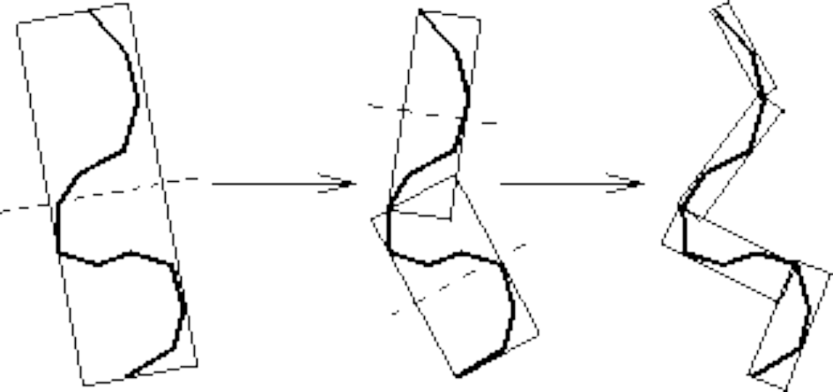
Building an OBBTree
Recursive top-down construction:
partition and refit

Slide 27
Building an OBB Tree
Given some polygons,
consider their vertices...

Slide 28
Building an OBB Tree
… and an arbitrary line

Slide 29
Building an OBB Tree
Project onto the line
Consider variance of
distribution on the line

Slide 30
Building an OBB Tree
Different line,
different variance

Slide 31
Building an OBB Tree
Maximum Variance

Slide 32
Building an OBB Tree
Minimal Variance

Slide 33
Building an OBB Tree
Given by eigenvectors
of covariance matrix
of coordinates
of original points

Slide 34
Building an OBB Tree
Choose bounding box
oriented this way

Slide 35
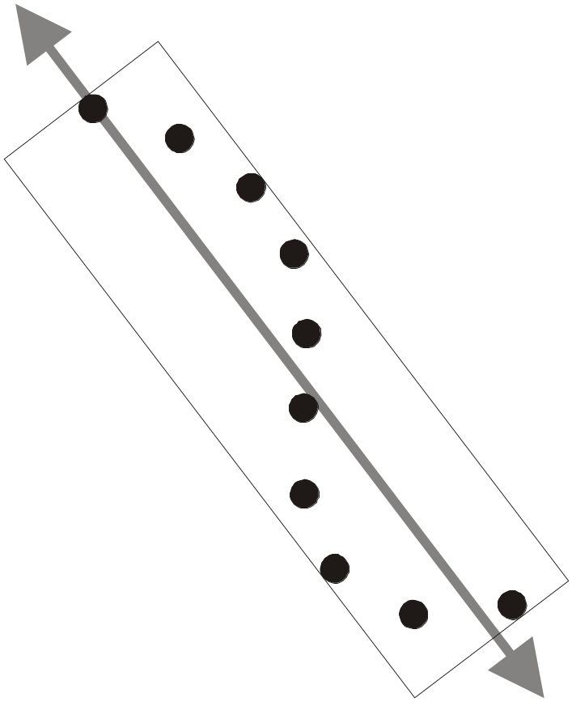
Building an OBB Tree: Fitting
Covariance matrix of
point coordinates describes
statistical spread of cloud.
OBB is aligned with directions of
greatest and least spread
(which are guaranteed to be orthogonal).

Slide 36
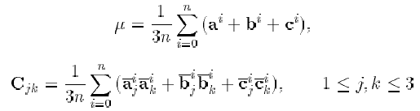
Fitting OBBs
Let the vertices of the i'th triangle be the points a^{i}, b^{i}, and c^{i}, then the mean µ and covariance matrix C can be expressed in vector notation as:
where n is the number of triangles, and

Slide 37
Building an OBB Tree
Good Box

Slide 38
Building an OBB Tree
Add points:
worse Box

Slide 39
Building an OBB Tree
More points:
terrible box

Slide 40
Building an OBB Tree
Compute with extremal points only

Slide 41
Building an OBB Tree
“Even” distribution:
good box

Slide 42
Building an OBB Tree
“Uneven” distribution:
bad box

Slide 43
Building an OBB Tree
Fix: Compute facets of convex hull...

Slide 44
Building an OBB Tree
Better: Integrate over facets

Slide 45
Building an OBB Tree
… and sample them uniformly

Slide 46
Building an OBB Tree: Summary
OBB Fitting algorithm:
covariance-based
use of convex hull
not foiled by extreme distributions
O(n log n) fitting time for single BV
O(n log² n) fitting time for entire tree

Slide 47
Tree Traversal
Disjoint bounding volumes:
No possible collision

Slide 48
Tree Traversal
Overlapping bounding volumes:
  split one box into children
  test children against other box

Slide 49
Tree Traversal

Slide 50
Tree Traversal
Hierarchy of tests

Slide 51
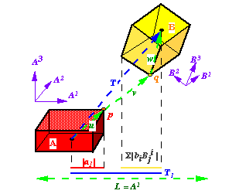
Separating Axis Theorem
L is a separating axis for OBBs A & B, since A & B become disjoint intervals under projection onto L

Slide 52
Separating Axis Theorem
Two polytopes A and B are disjoint iff there
exists a separating axis which is:
perpendicular to a face from either
or
perpedicular to an edge from each

Slide 53
Implications of Theorem
Given two generic polytopes, each with E edges and F faces, number of candidate axes to test is:
2F + E²
OBBs have only E = 3 distinct edge directions, and only F = 3 distinct face normals. OBBs need at most 15 axis tests.
Because edge directions and normals each form orthogonal frames, the axis tests are rather simple.

Slide 54
OBB Overlap Test: An Axis Test
L
s
h
a
h
b
L is a separating axis iff:
s
>
h
+
h
a
b

Slide 55
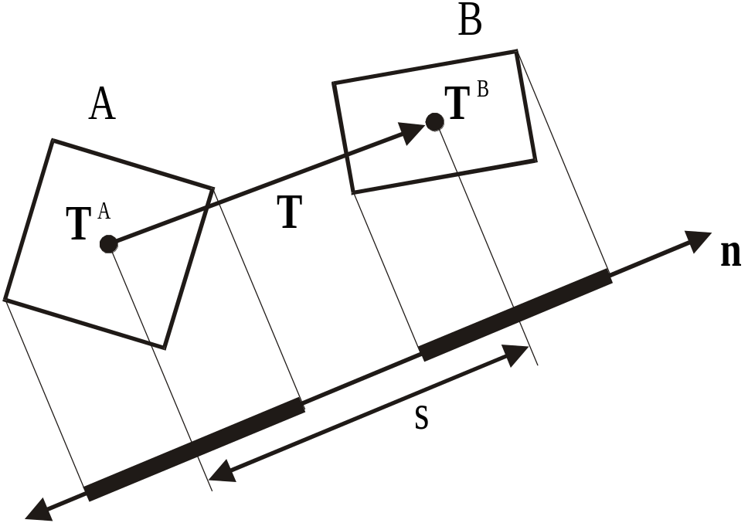
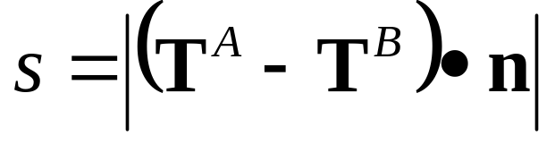
OBB Overlap Test: Axis Test Details
Box centers project to interval midpoints, so
midpoint separation is length of vector T’s image.

Slide 56
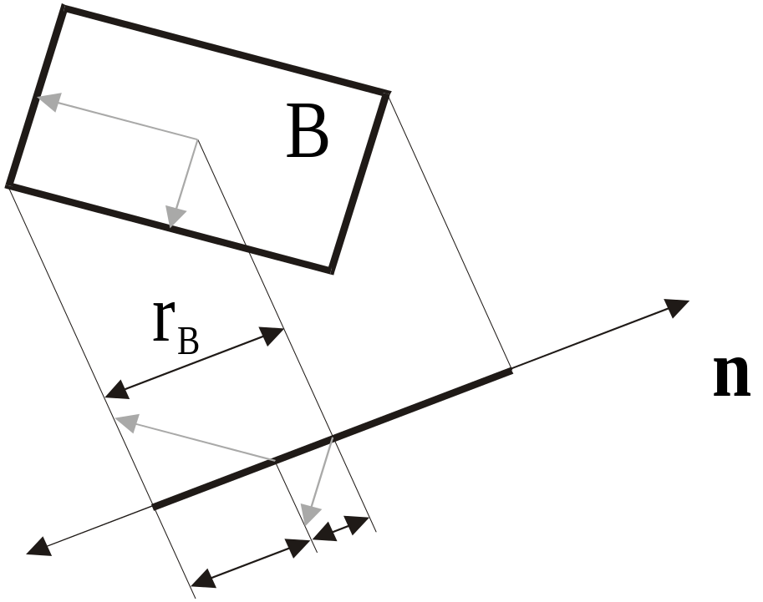
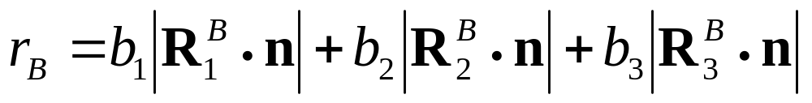
OBB Overlap Test: Axis Test Details
Half-length of interval is sum of box axis images.

Slide 57
OBB Overlap Test
Typical axis test for 3-space.
Up to 15 tests required.
s = fabs(T2 * R11 - T1 * R21);
ha = a1 * Rf21 + a2 * Rf11;
hb = b0 * Rf02 + b2 * Rf00;
if (s > (ha + hb)) return 0;

Slide 58
OBB Overlap Test
Strengths of this overlap test:
  89 to 252 arithmetic operations per box overlap test
  Simple guard against arithmetic error
  No special cases for parallel/coincident faces, edges, or vertices
  No special cases for degenerate boxes
  No conditioning problems
  Good candidate for micro-coding

Slide 59
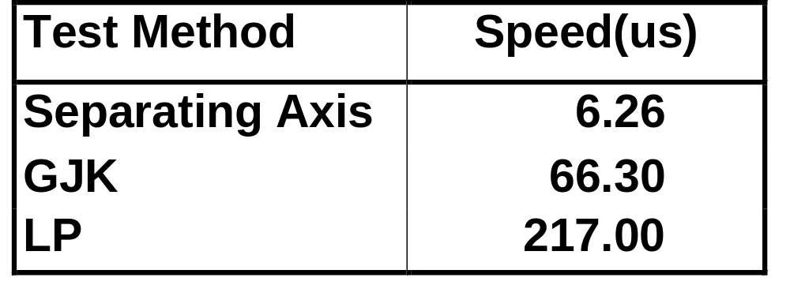
OBB Overlap Tests: Comparison
Benchmarks performed on SGI Max Impact,
250 MHz MIPS R4400 CPU, MIPS R4000 FPU

Slide 60
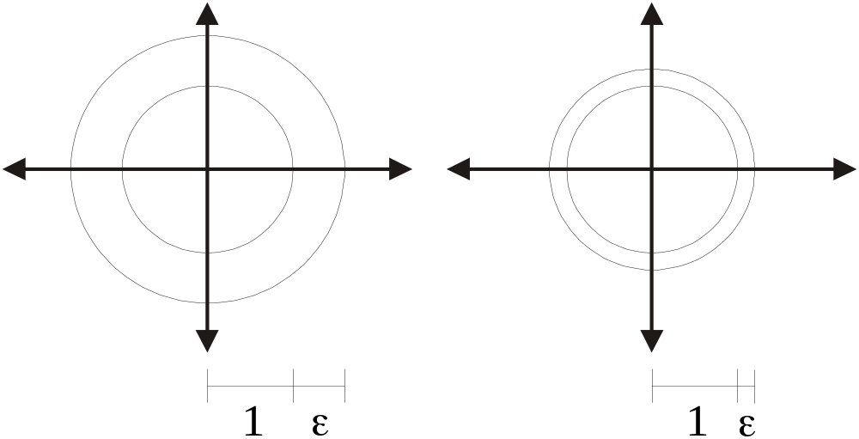
Parallel Close Proximity
Two models are in parallel close proximity when every point on each model is a given fixed distance (ε) from the other model.
Q: How does the number of BV tests increase as the gap size decreases?
Notes:
In order to quantify the performance of the various BV types, we consider an easily parameterized configuration: parallel close proximity. When the models are concentric, every point on one model is a fixed distance (epsilon) from the other model, and vice-versa. This is our definition of transverse contact.
This means the two models are offset surfaces of one another, and the offset is the gap size (epsilon).
As epsilon decreases, we will have to descend the hierarchies more and more deeply in order to bound the models apart. How far will we have to go? That depends on the specific shape of the bounding volumes.

Slide 61
Parallel Close Proximity: Convergence
1
Notes:
Consider two bounding volumes covering opposing parallel segments. We will call the distance between the segments one unit.

Slide 62
Parallel Close Proximity: Convergence
1
1
/
/
2
2
4
Notes:
When the separation is cut in half, we have to BVs half as big, which means we have to use twice as many. On each successive halving of the gap, we double the number of BV required. At each successive level, each sphere covers half the length of segment as the level above, and each sphere sticks out half as far away from the segment. Because the length covered and the amount extended from the segment diminish proportionally, we say spheres have linear convergence.

Slide 63
Parallel Close Proximity: Convergence
1
Notes:
For AABBs, the reasoning is the same. Consider the two line segments, and the AABBs which bound them. If the segments were themselves axis-aligned, then the AABBs would fit perfectly. Let us assume the segments are tilted some arbitrary amount. Then, let us define the closest distance they can get without the AABBs touching to be one unit.

Slide 64
Parallel Close Proximity: Convergence
1
1
/
/
2
4
2
Notes:
Now, keeping the tilt angle the same, but cutting the gap size in half results in a doubling of the number of required AABBs. This is true regardless of the angle of the line. As with spheres, with each successive level of the hierarchy, the amount the AABB extends outward from the segment diminishes at the same rate as does the amount of segment covered, so AABBs have linear convergence.

Slide 65
Parallel Close Proximity: Convergence
1
Notes:
OBBs are different. First of all, any straight segment of any tilt angle would be bounded perfectly by a well-fitted OBB, so we will assume we are working with parallel arcs of low curvature. Given the arcs of specific curvature, position them as closely as possible without letting the OBBs touch.
Note, the longer the radius of curvature relative to the size of the OBBs, the tighter the fit will be.

Slide 66
Parallel Close Proximity: Convergence
1
1
/
/
4
16
Notes:
If the curvature is low, then will be able to reduce the gap by approximately a factor of four, and still bound the arcs apart by only doubling the number of OBBs. Each additional factor of four reduction in gap size doubles the number of OBBs.
One way of thinking about this is that the radius of curvature stays fixed, but since the OBBs are getting smaller, the radius curvature is increasing relative to the OBBs, and hence, the fit is getting progressively tighter.
The amount the OBB extends away from the arc is proportional to the SQUARE of the arc length covered.

Slide 67
Parallel Close Proximity: Convergence
1
1
1
/
/
/
4
4
4
Notes:
Now, notice what quartering the gap does with each BV type. It quadruples the number of BVs required by spheres and AABBs, but it only doubles the number required by OBBs. This means that for every quartering of the gap, we descend additional two levels of the sphere and AABB trees, but only one additional level of the OBB tree.

Slide 68
Performance: Overlap Tests
k
2k
O(n)
O(n²)
OBBs
Spheres & AABBs

Slide 69
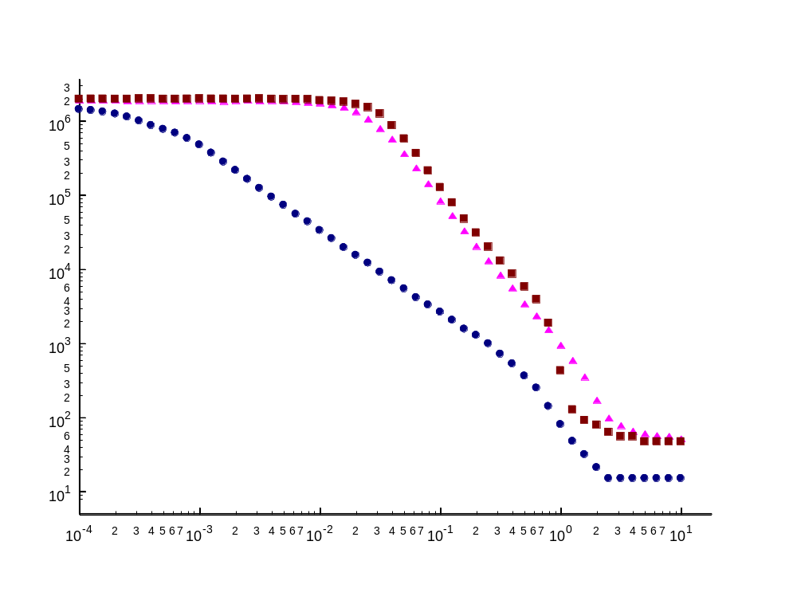
OBBs asymptotically outperform AABBs and spheres
Parallel Close Proximity: Experiment
Log-log plot
Number of BV tests
Gap Size (ε)
Notes:
We verify this in the plot of BV tests versus gap size. This log-log plot shows gap size for concentric spheres on the x-axis, and number of BV tests for that configuration -- the experiment was repeated for each BV type. For extremely large gap sizes, on the right, we have a unit size sphere model inside a very large sphere model -- and there is some minimum number of BV tests required to determine non contact. Then, as we reduce the gap size, we start seeing an increase in the number of BV tests needed -- but the rate of increase of the AABB and sphere tests is greater than the rate of increase of the OBB tests. In fact, the slopes are different -- the AABB and sphere slopes are approximately twice that of the OBB slope. On a log-log plot, only monomial functions are straight lines, and the slope is the degree of the monomial. This means the slope -2 of the AABBs and sphere indicates v = O(1/e^2) and the -2 slope for OBBs means v = O(1/e). So indeed, the former is the square of the latter.

Slide 70
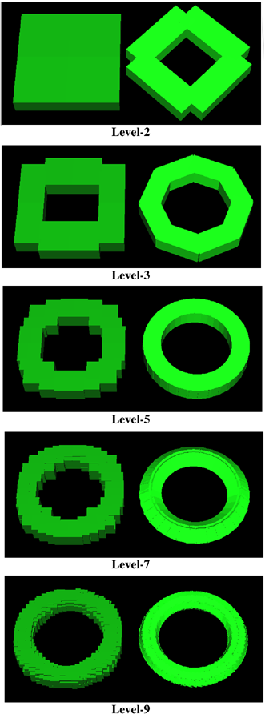
Example: AABB’s vs. OBB’s
Approximation
of a Torus

Slide 71
Implementation: RAPID
Available at: http://www.cs.unc.edu/~geom/OBB
Part of V-COLLIDE: http://www.cs.unc.edu/~geom/V_COLLIDE
Thousands of users have ftp’ed the code
Used for virtual prototyping, dynamic simulation, robotics & computer animation

Slide 72
Hybrid Hierarchy of
Swept Sphere Volumes
PSS LSS RSS
[LGLM99]

Slide 73
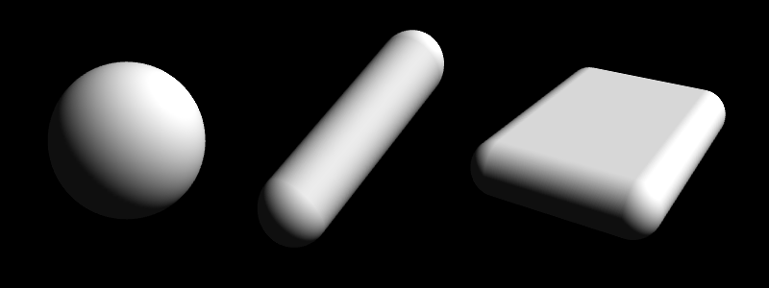
Swept Sphere Volumes (S-topes)
PSS LSS RSS

Slide 74
SSV Fitting
Use OBB’s code based upon Principle Component Analysis
For PSS, use the largest dimension as the radius
For LSS, use the two largest dimensions as the length and radius
For RSS, use all three dimensions

Slide 75
Overlap Test
One routine that can perform overlap tests between all possible combination of CORE primitives of SSV(s).
The routine is a specialized test based on Voronoi regions and OBB overlap test.
It is faster than GJK.

Slide 76
Hybrid BVH’s Based on SSVs
Use a simpler BV when it prunes search equally well - benefit from lower cost of BV overlap tests
Overlap test (based on Lin-Canny & OBB overlap test) between all pairs of BV’s in a BV family is unified
Complications
  deciding which BV to use either dynamically or statically

Slide 77
PQP: Implementation
Library written in C++
Good for any proximity query
5-20x speed-up in distance computation over prior methods
Available at http://www.cs.unc.edu/~geom/SSV/

