Slide 1
Rigid Body Dynamics (I)
COMP259 March 28, 2006
Nico Galoppo von Borries

Slide 2
From Particles to Rigid Bodies
Particles
  No rotations
  Linear velocity v only
Rigid bodies
  Body rotations
  Linear velocity v
  Angular velocity ω

Slide 3
Outline
Rigid Body Preliminaries
  Coordinate system, velocity, acceleration, and inertia
State and Evolution
Quaternions
Collision Detection and Contact Determination
Colliding Contact Response

Slide 4
Coordinate Systems
Body Space (Local Coordinate System)
  bodies are specified relative to this system
  center of mass is the origin (for convenience)
    We will specify body-related physical properties (inertia, …) in this frame

Slide 5
Coordinate Systems
World Space
  bodies are transformed to this common system
  p(t) = R(t) p₀ + x(t)
  x(t) represents the position of the body center
  R(t) represents the orientation
    Alternatively, use quaternion representation

Slide 6
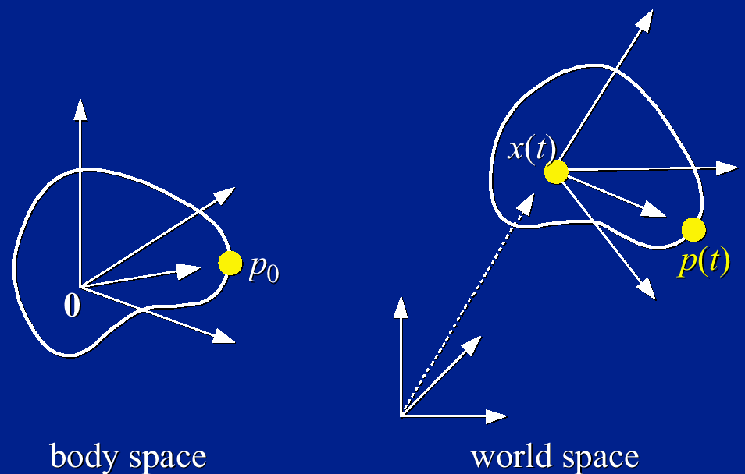
Coordinate Systems
Meaning of R(t): columns represent the coordinates of the body space base vectors (1,0,0), (0,1,0), (0,0,1) in world space.

Slide 7
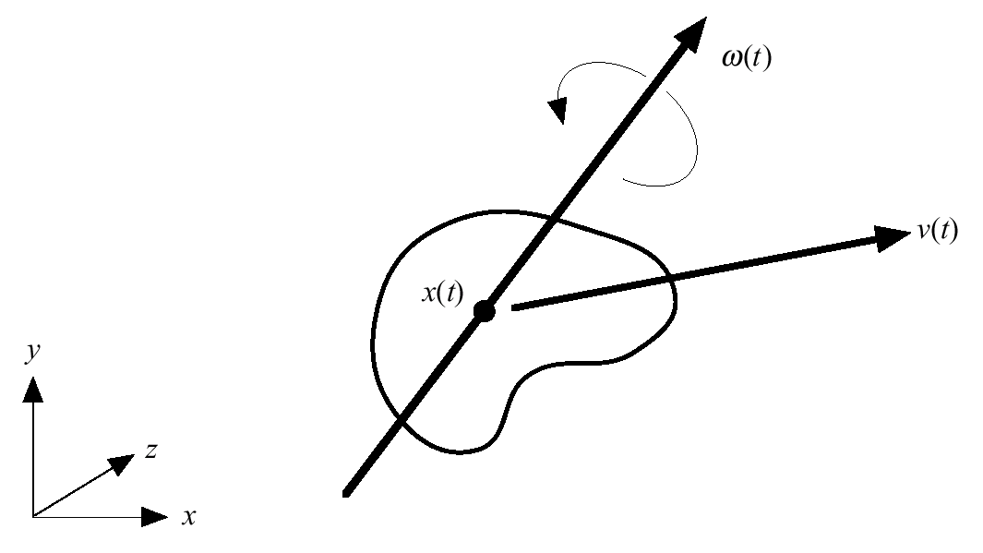
Kinematics: Velocities
How do x(t) and R(t) change over time?
Linear velocity v(t) = dx(t)/dt is the same:
  Describes the velocity of the center of mass (m/s)
Angular velocity ω(t) is new!
  Direction is the axis of rotation
  Magnitude is the angular
  velocity about the axis
  (degrees/time)
  There is a simple
  relationship between
  R(t) and ω(t)

Slide 8
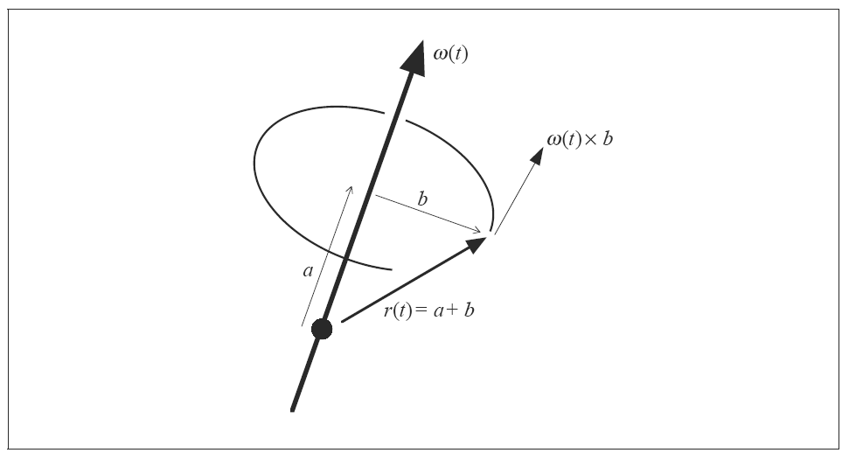
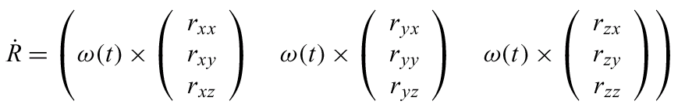
Kinematics: Velocities
Then

Slide 9
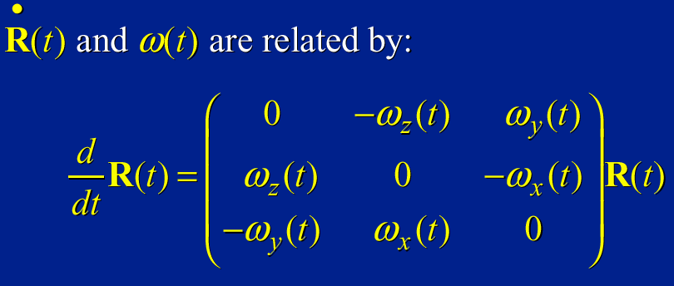

Angular Velocities

Slide 10
Dynamics: Accelerations
How do v(t) and dR(t)/dt change over time?
First we need some more machinery
  Forces and Torques
  Momentums
  Inertia Tensor
Simplify equations by formulating accelerations terms of momentum derivatives instead of velocity derivatives

Slide 11
Forces and Torques
External forces F_{i}(t) act on particles
  Total external force F=∑ F_{i}(t)
Torques depend on distance from the center of mass:
  τ_{i} (t) = (r_{i}(t) – x(t)) £ F_{i}(t)
  Total external torque
  τ = ∑ ((r_{i}(t)-x(t)) £ F_{i}(t)
F(t) doesn’t convey any information about where the various forces act
τ(t) does tell us about the distribution of forces

Slide 12
Linear Momentum
Linear momentum P(t) lets us express the effect of total force F(t) on body (simple, because of conservation of energy):
F(t) = dP(t)/dt
Linear momentum is the product of mass and linear velocity
  P(t) =∑ m_{i}dr_{i}(t)/dt
  =∑ m_{i}v(t) + ω(t) £ ∑m_{i}(r_{i}(t)-x(t))
But, we work in body space:
  P(t)=∑ m_{i}v(t)= Mv(t) (linear relationship)
  Just as if body were a particle with mass M and velocity v(t)
  Derive v(t) to express acceleration:
  dv(t)/dt = M⁻¹ dP(t)/dt
Use P(t) instead of v(t) in state vectors

Slide 13
Angular momentum
Same thing, angular momentum L(t) allows us to express the effect of total torque τ(t) on the body:
Similarily, there is a linear relationship between momentum and velocity:
  I(t) is inertia tensor, plays the role of mass
Use L(t) instead of ω(t) in state vectors

Slide 14
Inertia Tensor
3x3 matrix describing how the shape and mass distribution of the body affects the relationship between the angular velocity and the angular momentum I(t)
Analogous to mass – rotational mass
We actually want the inverse I⁻¹(t) for computing ω(t)=I⁻¹(t)L(t)

Slide 15







Inertia Tensor
Bunch of volume integrals:
Ixx =
Iyy =
Izz =
Ixy = Iyx =
Ixz = Izx =
Iyz = Izy =

Slide 16
Inertia Tensor
Compute I in body space I_{body} and then transform to world space as required
  I(t) varies in world space, but I_{body} is constant in body space for the entire simulation
I(t)= R(t) I_{body} R⁻¹(t)= R(t) I_{body} R^{T}(t)
I⁻¹(t)= R(t) I_{body}⁻¹ R⁻¹(t)= R(t) I_{body}⁻¹ R^{T}(t)
Intuitively: transform ω(t) to body space, apply inertia tensor in body space, and transform back to world space

Slide 17
Computing I_{body}⁻¹
There exists an orientation in body space which causes I_{xy}, I_{xz}, I_{yz} to all vanish
  Diagonalize tensor matrix, define the eigenvectors to be the local body axes
  Increases efficiency and trivial inverse
Point sampling within the bounding box
Projection and evaluation of Greene’s thm.
  Code implementing this method exists
  Refer to Mirtich’s paper at
  http://www.acm.org/jgt/papers/Mirtich96

Slide 18
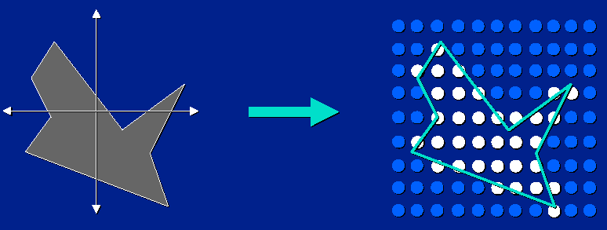
Approximation w/ Point Sampling
Pros: Simple, fairly accurate, no B-rep needed.
Cons: Expensive, requires volume test.

Slide 19
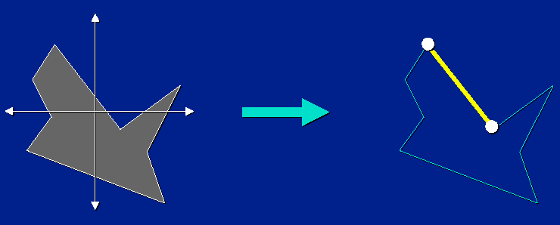
Use of Green’s Theorem
Pros: Simple, exact, no volumes needed.
Cons: Requires boundary representation.

Slide 20
Outline
Rigid Body Preliminaries
State and Evolution
  Variables and derivatives
Quaternions
Collision Detection and Contact Determination
Colliding Contact Response

Slide 21
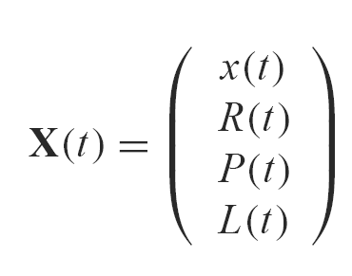
New State Space
Spatial information
Velocity information
v(t) replaced by linear momentum P(t)
ω(t) replaced by angular momentum L(t)
Size of the vector: (3+9+3+3)N = 18N

Slide 22
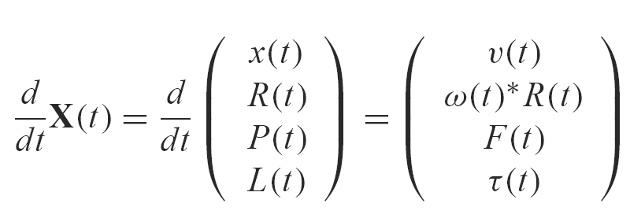
Taking the Derivative
Conservation of momentum (P(t), L(t)) lets us express the accelerations in terms of forces and torques.

Slide 23
Simulate: next state computation
From X(t) certain quantities are computed
  I⁻¹(t) = R(t) I_{body}⁻¹ R^{T}(t)
  v(t) = P(t) / M
  ω(t) = I⁻¹(t) L(t)
We cannot compute the state of a body at all times but must be content with a finite number of discrete time points, assuming that the acceleration is continuous
Use your favorite ODE solver to solve for the new state X(t), given previous state X(t-Δt) and applied forces F(t) and τ(t)
X(t) Ã Solver::Step(X(t-Δ t), F(t), τ (t))

Slide 24
Simple simulation algorithm
X Ã InitializeState()
For t=t₀ to t_{final} with step Δ t
ClearForces(F(t), τ(t))
AddExternalForces(F(t), τ(t))
X_{new} Ã Solver::Step(X, F(t), τ(t))
X Ã X_{new}
t Ã t + Δt
End for

Slide 25
Outline
Rigid Body Preliminaries
State and Evolution
Quaternions
  Merits, drift, and re-normalization
Collision Detection and Contact Determination
Colliding Contact Response

Slide 26
Unit Quaternion Merits
Problem with rotation matrices: numerical drift
R(t) = dR(t)/dt*Δt R(t₋₁)R(t₋₂)R(t₋₃)☹
A rotation in 3-space involves 3 DOF
Unit quaternions can do it with 4
Rotation matrices R(t) describe a rotation using 9 parameters
Drift is easier to fix with quaternions
  renormalize

Slide 27
Unit Quaternion Definition
q = [s,v] -- s is a scalar, v is vector
A rotation of θ about a unit axis u can be represented by the unit quaternion:
[cos(θ/2), sin(θ /2) * u]
|| [s,v] || = 1 -- the length is taken to be the Euclidean distance treating [s,v] as a 4-tuple or a vector in 4-space

Slide 28
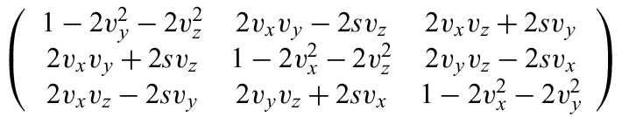
Unit Quaternion Operations
Multiplication is given by:
dq(t)/dt = ½ ω(t) q(t) = [0, ½ ω(t)] q(t)
R =

Slide 29
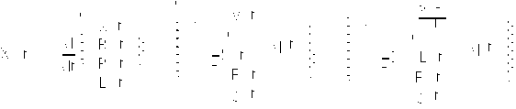
Unit Quaternion Usage
To use quaternions instead of rotation matrices, just substitute them into the state as the orientation (save 5 variables)
where
R = QuatToMatrix(q(t))
I⁻¹(t) = R I_{body}⁻¹ R^{T}

Slide 30
Outline
Rigid Body Preliminaries
State and Evolution
Quaternions
Collision Detection and Contact Determination
  Contact classification
  Intersection testing, bisection, and nearest features
Colliding Contact Response

Slide 31
What happens when bodies collide?
Colliding
  Bodies bounce off each other
  Elasticity governs ‘bounciness’
  Motion of bodies changes discontinuously within a discrete time step
  ‘Before’ and ‘After’ states need to be computed
In contact
  Resting
  Sliding
  Friction

Slide 32
Detecting collisions and response
Several choices
  Collision detection: which algorithm?
  Response: Backtrack or allow penetration?
Two primitives to find out if response is necessary:
  Distance(A,B): cheap, no contact information ! fast intersection query
  Contact(A,B): expensive, with contact information

Slide 33
Distance(A,B)
Returns a value which is the minimum distance between two bodies
Approximate may be ok
Negative if the bodies intersect
Convex polyhedra
  Lin-Canny and GJK -- 2 classes of algorithms
Non-convex polyhedra
  much more useful but hard to get distance fast
  PQP/RAPID/SWIFT++
Remark: most of these algorithms give inaccurate information if bodies intersect, except for DEEP

Slide 34
Contacts(A,B)
Returns the set of features that are nearest for disjoint bodies or intersecting for penetrating bodies
Convex polyhedra
  LC & GJK give the nearest features as a bi-product of their computation – only a single pair. Others that are equally distant may not be returned.
Non-convex polyhedra
  much more useful but much harder problem especially contact determination for disjoint bodies
  Convex decomposition: SWIFT++

Slide 35
Prereq: Fast intersection test
First, we want to make sure that bodies will intersect at next discrete time instant
If not:
  X_{new} is a valid, non-penetrating state, proceed to next time step
If intersection:
  Classify contact
  Compute response
  Recompute new state

Slide 36
Bodies intersect ! classify contacts
Colliding contact (Today)
  v_{rel} < -ε
  Instantaneous change in velocity
  Discontinuity: requires restart of the equation solver
Resting contact (Thursday)
  -ε < v_{rel} < ε
  Gradual contact forces avoid interpenetration
  No discontinuities
Bodies separating
  v_{rel} > ε
  No response required

Slide 37
Collisiding contacts
At time t_{i}, body A and B intersect and
v_{rel} < -ε
Discontinuity in velocity: need to stop numerical solver
Find time of collision t_{c}
Compute new velocities v⁺(t_{c}) → X⁺(t)
Restart ODE solver at time t_{c} with new state X⁺(t)

Slide 38
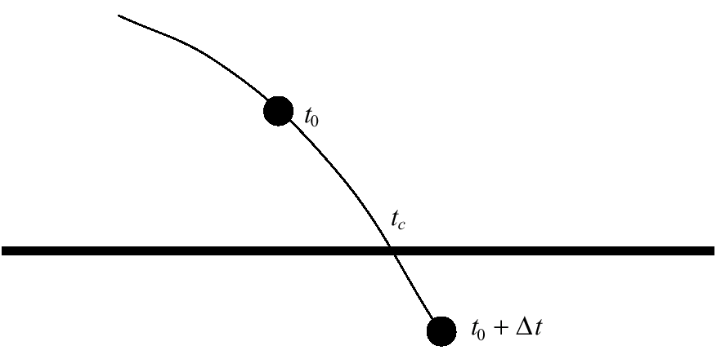
Time of collision
We wish to compute when two bodies are “close enough” and then apply contact forces
Let’s recall a particle colliding with a plane

Slide 39
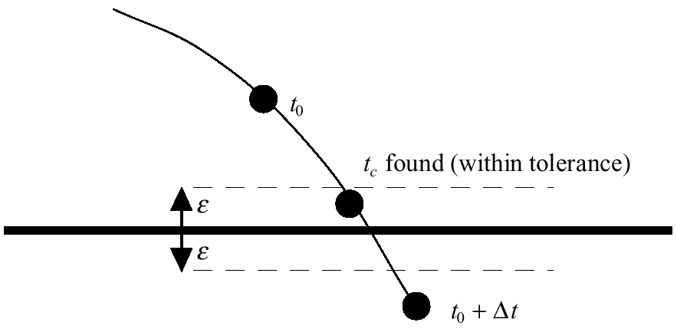
Time of collision
We wish to compute t_{c} to some tolerance

Slide 40
Time of collision
A common method is to use bisection search until the distance is positive but less than the tolerance
Use continuous collision detection
(cf.Dave Knott’s lecture)
t_{c} not always needed
! penalty-based methods

Slide 41
findCollisionTime(X,t,Δt)
0 for each pair of bodies (A,B) do
1 Compute_New_Body_States(Scopy, t, H);
2 hs(A,B) = H; // H is the target timestep
3 if Distance(A,B) < 0 then
4 try_h = H/2; try_t = t + try_h;
5 while TRUE do
6 Compute_New_Body_States(Scopy, t, try_t - t);
7 if Distance(A,B) < 0 then
8 try_h /= 2; try_t -= try_h;
9 else if Distance(A,B) < ε then
10 break;
11 else
12 try_h /= 2; try_t += try_h;
13 hs(A,B) = try_t – t;
14 h = min( hs );

Slide 42
Outline
Rigid Body Preliminaries
State and Evolution
Quaternions
Collision Detection and Contact Determination
Colliding Contact Response
  Normal vector, restitution, and force application

Slide 43
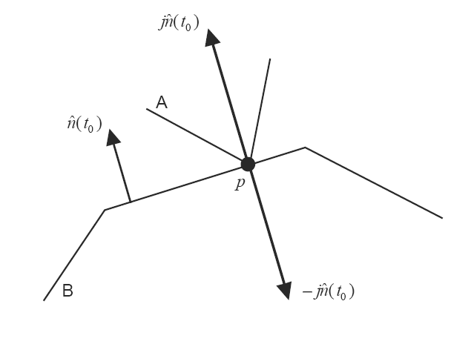
What happens upon collision
Impulses provide instantaneous changes to velocity, unlike forces
Δ(P) = J
We apply impulses to the colliding objects, at the point of collision
For frictionless bodies,
the direction will be
the same as the
normal direction:
J = j^{T}n

Slide 44
Colliding Contact Response
Assumptions:
  Convex bodies
  Non-penetrating
  Non-degenerate configuration
    edge-edge or vertex-face
    appropriate set of rules can handle the others
Need a contact unit normal vector
  Face-vertex case: use the normal of the face
  Edge-edge case: use the cross-product of the direction vectors of the two edges

Slide 45

Colliding Contact Response
Point velocities at the nearest points:
Relative contact normal velocity:

Slide 46

Colliding Contact Response
We will use the empirical law of frictionless collisions:
  Coefficient of restitution є [0,1]
    є = 0 -- bodies stick together
    є = 1 – loss-less rebound
After some manipulation of equations...

Slide 47
Apply_BB_Forces()
For colliding contact, the computation can be local
  0 for each pair of bodies (A,B) do
  1 if Distance(A,B) < ε then
  2 Cs = Contacts(A,B);
  3 Apply_Impulses(A,B,Cs);

Slide 48
Apply_Impulses(A,B,Cs)
The impulse is an instantaneous force – it changes the velocities of the bodies instantaneously: Δv = J / M
  0 for each contact in Cs do
  1 Compute n
  Compute j
  J = j^{T}n
  3 P(A) += J
  4 L(A) += (p - x(t)) x J
  5 P(B) -= J
  6 L(B) -= (p - x(t)) x J

Slide 49
Simulation algorithm with Collisions
X Ã InitializeState()
For t=t₀ to t_{final} with step Δt
ClearForces(F(t), τ(t))
AddExternalForces(F(t), τ(t))
X_{new} Ã Solver::Step(X, F(t), τ(t), t, Δt)
t Ã findCollisionTime()
X_{new} Ã Solver::Step(X, F(t), τ(t), t, Δt)
C Ã Contacts(X_{new})
while (!C.isColliding())
applyImpulses(X_{new})
end if
X Ã X_{new}
t Ã t + Δt
End for

Slide 50
Penalty Methods
If we don’t look for time of collision t_{c} then we have a simulation based on penalty methods: the objects are allowed to intersect.
Global or local response
  Global: The penetration depth is used to compute a spring constant which forces them apart (dynamic springs)
  Local: Impulse-based techniques

Slide 51
Global penalty based response
Global contact force computation
0 for each pair of bodies (A,B) do
1 if Distance(A,B) < ε then
2 Flag_Pair(A,B);
3 Solve For_Forces(flagged pairs);
4 Apply_Forces(flagged pairs);

Slide 52
Local penalty based response
Local contact force computation
0 for each pair of bodies (A,B) do
1 if Distance(A,B) < ε then
2 Cs = Contacts(A,B);
3 Apply_Impulses(A,B,Cs);

Slide 53
References
D. Baraff and A. Witkin, “Physically Based Modeling: Principles and Practice,” Course Notes, SIGGRAPH 2001.
B. Mirtich, “Fast and Accurate Computation of Polyhedral Mass Properties,” Journal of Graphics Tools, volume 1, number 2, 1996.
D. Baraff, “Dynamic Simulation of Non-Penetrating Rigid Bodies”, Ph.D. thesis, Cornell University, 1992.
B. Mirtich and J. Canny, “Impulse-based Simulation of Rigid Bodies,” in Proceedings of 1995 Symposium on Interactive 3D Graphics, April 1995.
B. Mirtich, “Impulse-based Dynamic Simulation of Rigid Body Systems,” Ph.D. thesis, University of California, Berkeley, December, 1996.
B. Mirtich, “Hybrid Simulation: Combining Constraints and Impulses,” in Proceedings of First Workshop on Simulation and Interaction in Virtual Environments, July 1995.
COMP259 Rigid Body Simulation Slides, Chris Vanderknyff 2004

