Slide 1
Rigid Body Dynamics (II)
COMP259 March 30, 2006
Nico Galoppo von Borries

Slide 2
Bodies intersect ! classify contacts
Bodies separating
  v_{rel} > ε
  No response required
Colliding contact (Last time)
  v_{rel} < -ε
Resting contact (Today)
  -ε < v_{rel} < ε
  Gradual contact forces avoid interpenetration
  All resting contact forces must be computed and applied together because they can influence one another

Slide 3
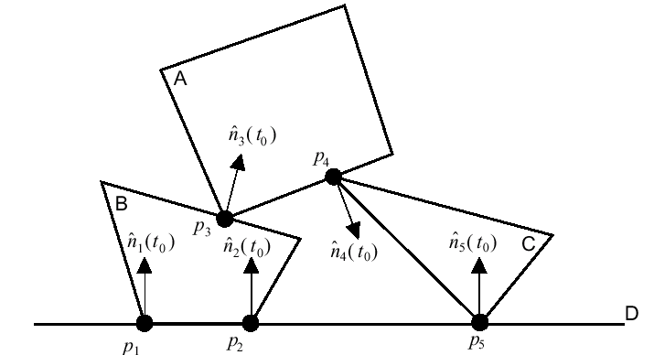
Resting Contact Response

Slide 4
Handling of Resting Contact
Global vs. Local Methods
  Constraint-based vs. Impulse-based
Colliding Contacts
Resting Contacts
Force application
Friction

Slide 5
Impulse vs. Constraint
Impulse-based dynamics (local)
  Faster
  Simpler
  No explicit contact constraints
Constraint-based dynamics (global)
  Must declare each contact to be a resting contact or a colliding contact

Slide 6
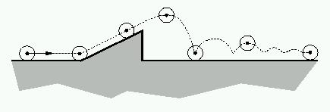
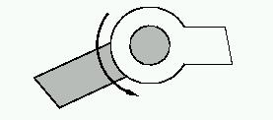
Impulse vs. Constraint
Impulse-based dynamics (local)
Constraint-based dynamics (global)

Slide 7
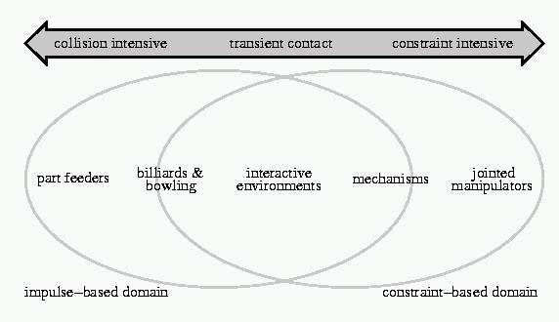
Impulse vs. Constraint

Slide 8
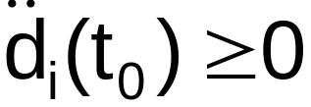

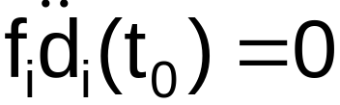
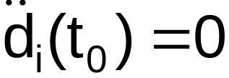
Resting Contact Response
The forces at each contact must satisfy three criteria
  Prevent inter-penetration:
  Repulsive -- we do not want the objects to be glued together:
  Should become zero when the bodies start to separate:
To implement hinges and pin joints:

Slide 9

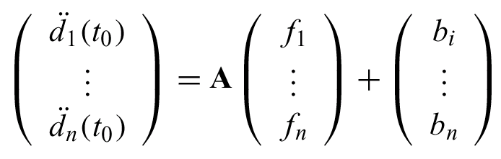
Resting Contact Response
We can formulate using LCP:

Slide 10
Linear Complimentary Problem (LCP)
Need to solve a quadratic program to solve for the f_{i}’s
  General LCP is NP-complete problem
  A is symmetric positive semi-definite (SPD) making the solution practically possible
There is an iterative method to solve for without using a quadratic program
[Baraff, Fast contact force computation for nonpenetrating rigid bodies ]

Slide 11
Linear Complimentary Problem (LCP)
In general, LCP can be solved with either:
  pivoting algos (like Gauss elimination)
    they change the matrix
    do not provide useful intermediate result
    may exploit sparsity well
  iterative algos (like Conjugate Gradients)
    only need read access to matrix
    can stop early for approximate solution
    faster for large matrices
    can be warm started (ie. from previous result)
Slide courtesy of Moravanszky (ETHZ 2002)

Slide 12
Global vs. local?
Global LCP formulation can work for either constraint-based forces or with impulses
  Hard problem to solve
  System very often ill-conditioned, iterative LCP solver slow to converge

Slide 13
Local vs. Global
Impulses often applied in local contact resolution scheme
Applied impulses can break non-penetration constraint for other contacting points
Often applied iteratively, until all resting contacts are resolved

Slide 14
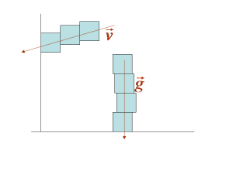
Hard case for local approach
Prioritize contact points along major axes of acceleration (gravity) and velocity
  Performance improvement:
  25% on scene with 60 stacked objects

Slide 15
Global Resting Contact Resolution
X Ã InitializeState()
For t=t₀ to t_{final} with step Δt
ClearForces(F(t), τ(t))
AddExternalForces(F(t), τ(t))
X_{new} Ã Solver::Step(X, F(t), τ(t), t, Δt)
t Ã findCollisionTime()
X_{new} Ã Solver::Step(X, F(t), τ(t), t, Δt)
C Ã Contacts(X_{new})
while (!C.isColliding())
applyImpulses(X_{new})
end if
X Ã X_{new}
t Ã t + Δt
End for
C Ã Contacts(X_{new})
while (!C.isColliding())
applyImpulses(X_{new})
end if
restingC Ã C.restingSet()
solveLCP(restingC, X_{new})
X Ã X_{new}
t Ã t + Δt
End for

Slide 16
Frictional Forces Extension
Constraint-based dynamics
  Reformulate constraints and solve
  No more on this here
Impulse-based dynamics
  Must not add energy to the system in the presence of friction so we have to reformulate the impulse to be applied

Slide 17
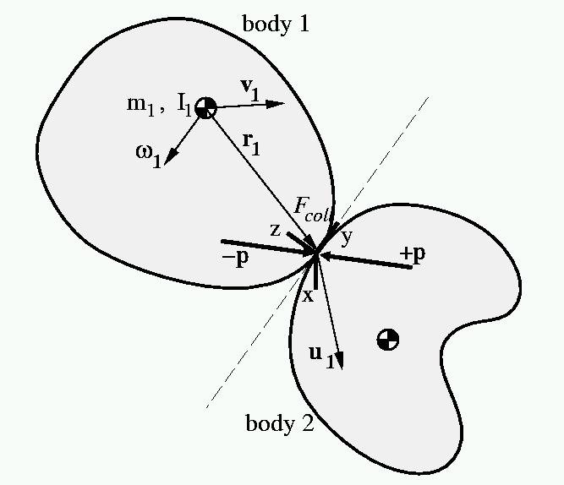
Collision Coordinate System
p is the applied impulse. We use j because P is for linear momentum

Slide 18
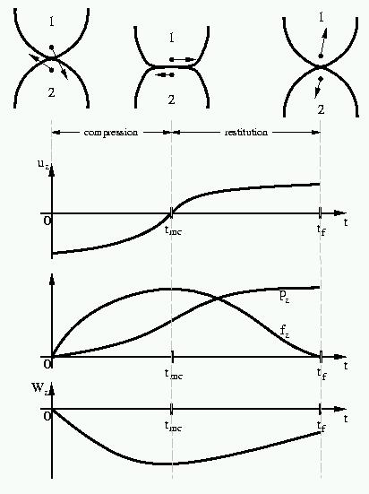
Impulse Reformulation
When two real bodies collide there is a period of deformation during which elastic energy is stored in the bodies followed by a period of restitution during which some of this energy is returned as kinetic energy and the bodies rebound of each other.

Slide 19
Impulse Reformulation
The collision is instantaneous but we can assume that it occurs over a very small period of time: 0 → t_{mc} → t_{f}.
t_{mc} is the time of maximum compression
u_{z} is the relative normal velocity. We used v_{rel} before. From now on we will use v_{z}.

Slide 20
Impulse Reformulation
p_{z} is the impulse magnitude in the normal direction. We used j before. From now on we will use j_{z}.
W_{z} is the work done in the normal direction.

Slide 21



Impulse Reformulation (I)
v⁻=v(0), v⁰=v(t_{mc}), v⁺=v(t_{f}), v_{rel}=v_{z}
Newton’s Empirical Impact Law:
  Coefficient of restitution ε relates before-collision to after-collision relative velocity
Poisson’s Hypothesis:
The normal component of impulse delivered during restitution phase is ε times the normal component of impulse delivered during the compression phase
Both these hypotheses can cause increase of energy when friction is present!

Slide 22


Impulse Reformulation (II)
Stronge’s Hypothesis:
The positive work done during the restitution phase is -ε² times the negative work done during compression
Energy of the bodies does not increase when friction present

Slide 23

Friction Formulae
Assume the Coulomb friction law:
  At some instant during a collision between bodies 1 and 2, let v be the contact point velocity of body 1 relative to the contact point velocity of body 2. Let v_{t} be the tangential component of v and let be a unit vector in the direction of v_{t}. Let f_{z} and f_{t} be the normal and tangential (frictional) components of force exerted by body 2 on body 1, respectively.

Slide 24
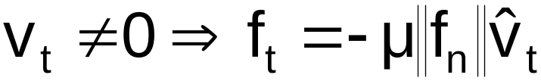
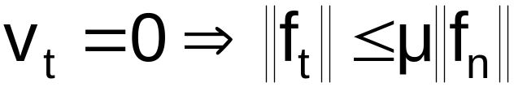
Coulomb Friction model
Sliding (dynamic) friction
Dry (static) friction
(ie. the friction cone)
Assume no rolling friction

Slide 25
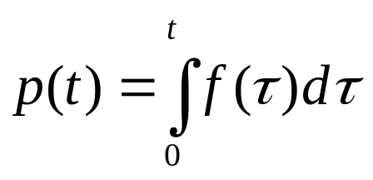
Impulse with Friction
Recall that the impulse looked like this for frictionless collisions:
Remember: p_{z}(t) = j(t)
Recall also that Δv_{z} = j/M and ΔL = r£j^{T}n
All are parameterized by time

Slide 26
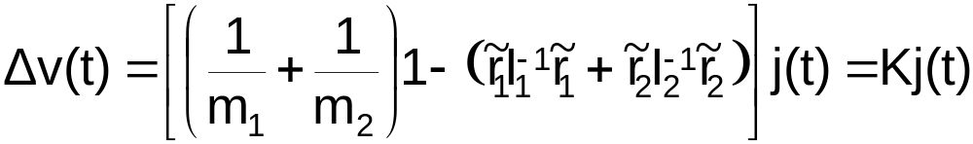
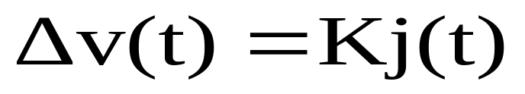
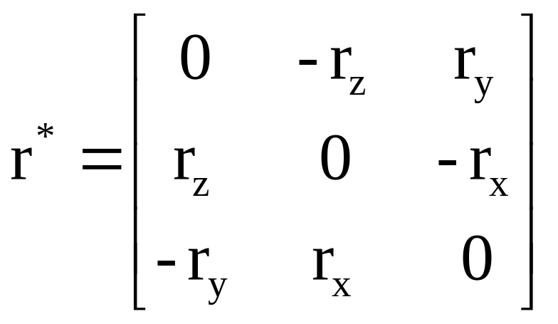
Impulse with Friction
where:
r = (p-x) is the vector from the center of mass to the contact point

Slide 27
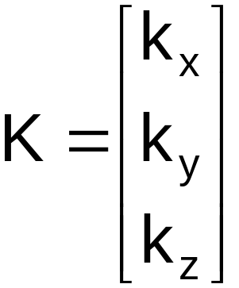
The K Matrix
K is constant over the course of the collision, nonsingular, symmetric, and positive definite

Slide 28

Collision Functions
We assume collision to occur over zero time interval ! velocities discontinuous over time
Reparameterize Δv(t) = K j(t) from t to γ
Take γ such that it is monotonically increasing during the collision:
Let the duration of the collision → 0.
The functions v, j, W, all evolve continuously over the compression and the restitution phases with respect to γ.

Slide 29
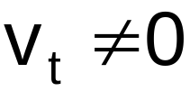
Sliding or Sticking?
Sliding occurs when the relative tangential velocity
  Use the friction equation to formulate
Sticking occurs otherwise
  Is it stable or instable?
  Which direction does the instability get resolved?

Slide 30




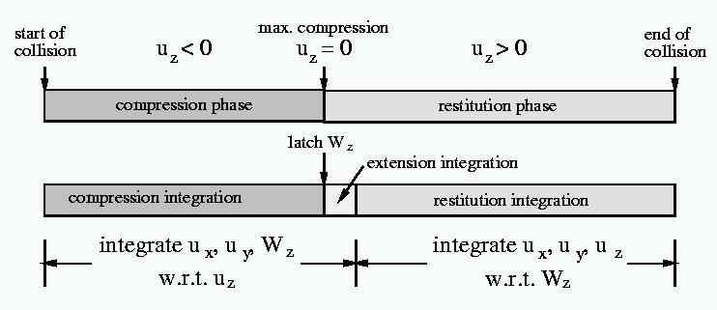
Sliding Formulation
For the compression phase, use
  is the relative normal velocity at the start of the collision (we know this)
  At the end of the compression phase,
For the restitution phase, use
  W_{z}⁰ is the amount of work that has been done in the compression phase
  From Stronge’s hypothesis, we know that

Slide 31
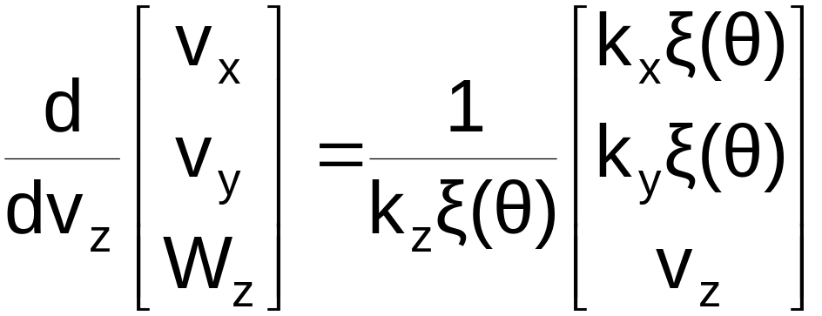
Sliding Formulation
Compression phase equations are:

Slide 32
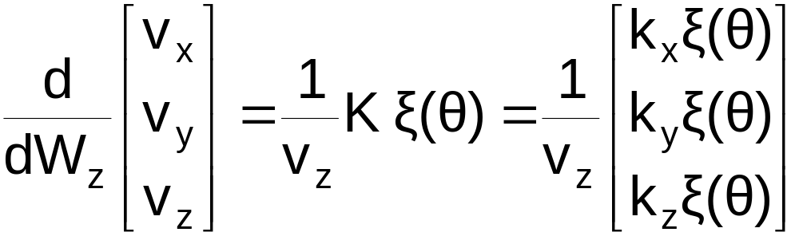
Sliding Formulation
Restitution phase equations are:

Slide 33
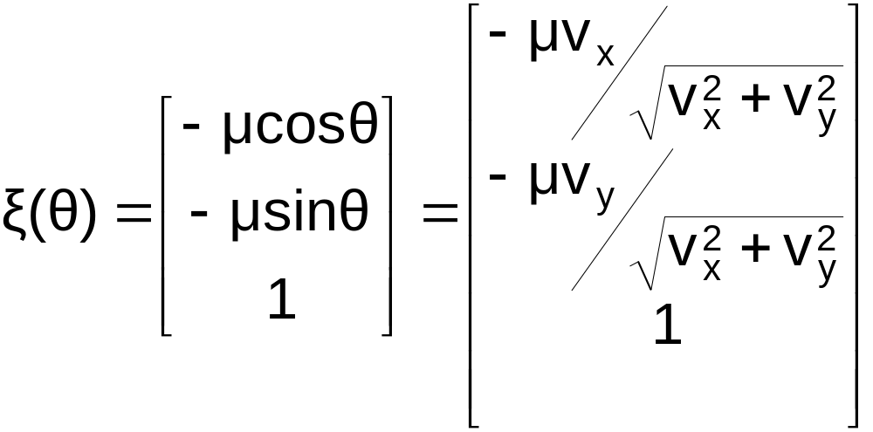
Sliding Formulation
where the sliding vector is:

Slide 34
Sliding Formulation
Notice that there is a problem at the point of maximum compression because v_{z} = 0:

Slide 35
Sliding Formulation
Let us integrate using v_{z} a bit into the restitution phase (extension integration) so that we never divide by 0.
But we don’t want to integrate too far! Otherwise we exceed the amount of work that is to be done in the restitution phase.
We are safe if we stop at:

Slide 36
Sliding Formulation

Slide 37
Sliding Formulation
There is another problem if the tangential velocity becomes 0 because the equations that we have derived were based on which no longer holds.
This brings us to the sticking formulation

Slide 38
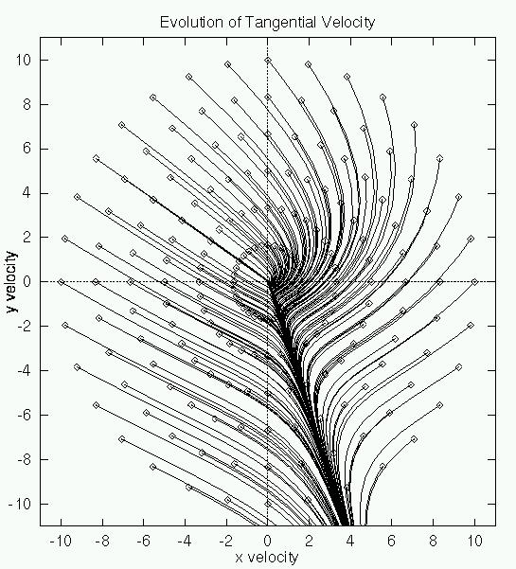
Sticking Formulation

Slide 39
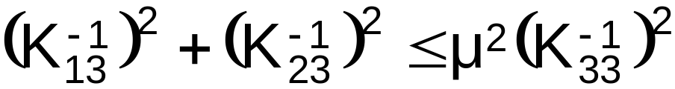
Sticking Formulation
Stable if
  This means that static friction takes over for the rest of the collision and v_{x} and v_{y} remain 0
If instable, then in which direction do v_{x} and v_{y} leave the origin of the v_{x}, v_{y} plane?
  There is an equation in terms of the elements of K which yields 4 roots. Of the 4 only 1 corresponds to a diverging ray – a valid direction for leaving instable sticking.

Slide 40
Sticking Formulation
If sticking occurs, then the remainder of the collision may be integrated analytically due to the existence of closed form solutions to the resulting simplified equations.

Slide 41
Resting Contacts with Impulses
Modeled by artificial train of collisions
The resulting collision impulses model a constant reaction force (do not work on stationary objects)
Problem: book on table: through collisions, energy steadily decreases, book sinks into table
#of collisions increases, simulator comes to grinding halt!
Introduce microcollisions
  Microcollision impulses are not computed in the standard way, but with artificial coefficient of restitution ε(δ)
  Applied only if normal velocity is ‘small’

Slide 42
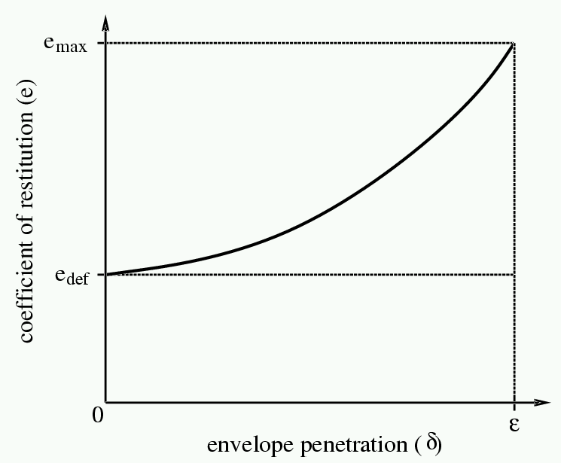
Artificial restitution for microcollisions
є = f( Distance(A,B) )

Slide 43
Other problems arise:
  Boosted elasticity from microcollisions makes box on ramp ‘bounce’ as if ramp were vibrating
  Stacked books cause too many collision impulses, propagated up and down the stack
  Weight of pile of books causes deep penetration between table and bottom book ! large reaction impulses cause instabilities
Microcollisions are an ad-hoc solution!
Constrained-based approaches are a better solution for these situations

