Slide 1
Review
Particle Dynamics
(see transparencies in class)

Slide 2
Disclaimer
The following slides reuse materials from SIGGRAPH 2001 Course Notes on Physically-based Modeling (copyright © 2001 by Andrew Witkin at Pixar).

Slide 3
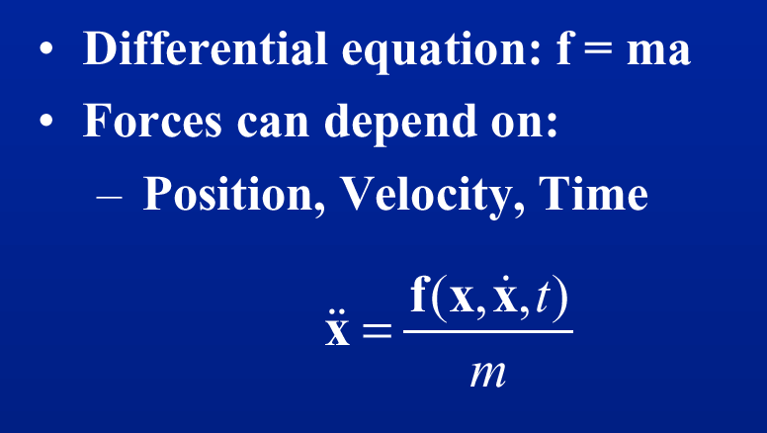
A Newtonian Particle

Slide 4
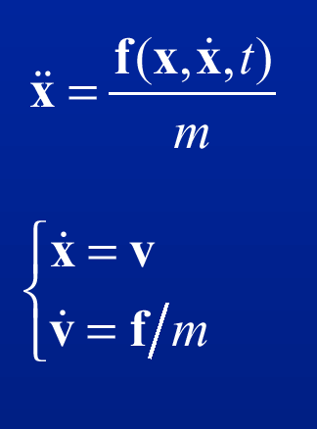
Second Order Equations
As discussed in the last lecture,
we can transform a second
order equation into a couple of
first order equations.
⇐ ⇐ ⇐ as shown here.

Slide 5
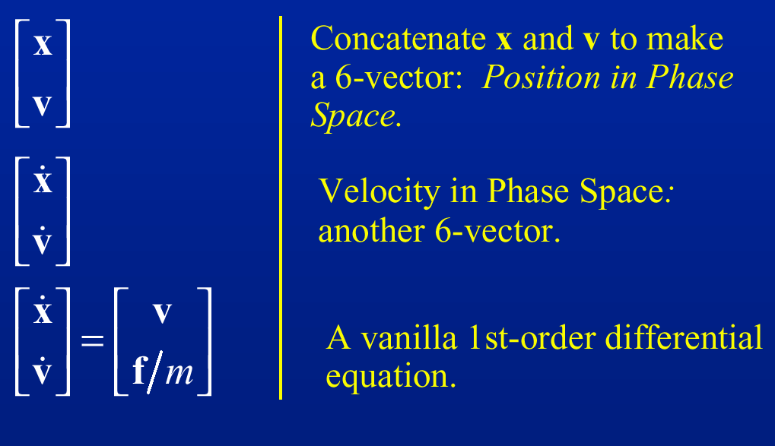
Phase (State) Space

Slide 6
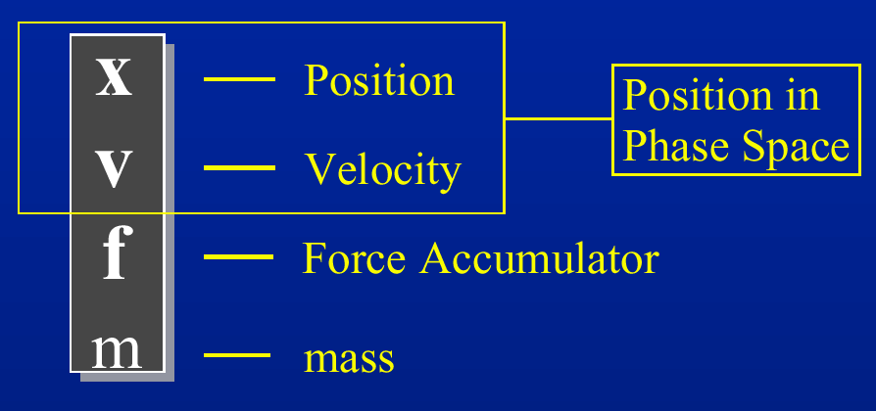
Particle Structure

Slide 7
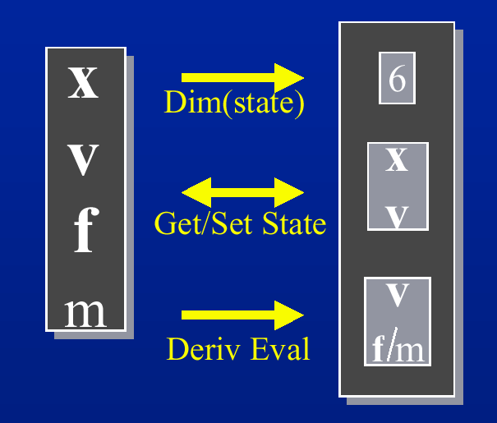
Solver Interface

Slide 8
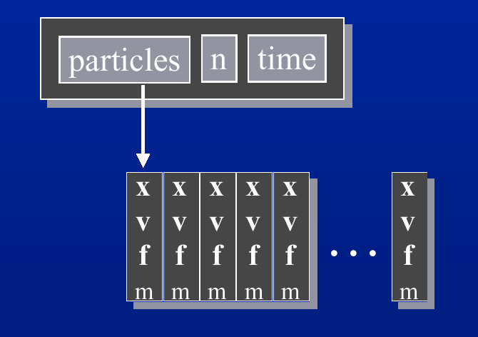
Particle Systems

Slide 9
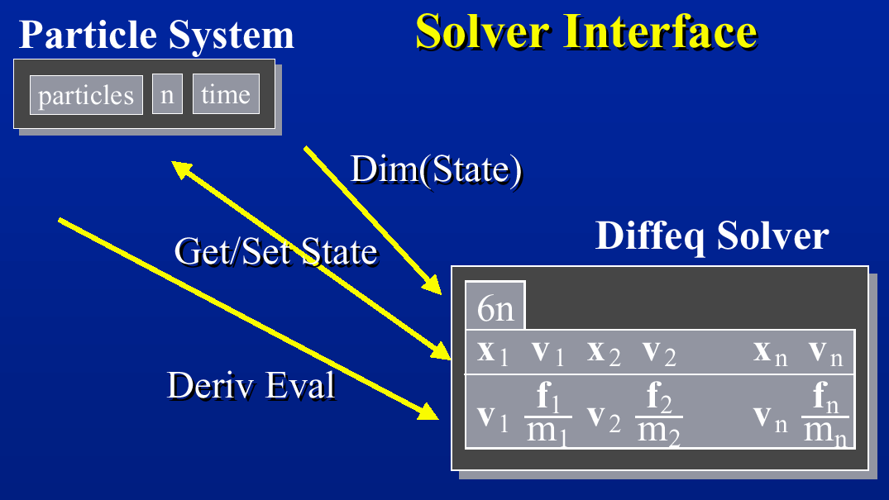
Overall Setup

Slide 10
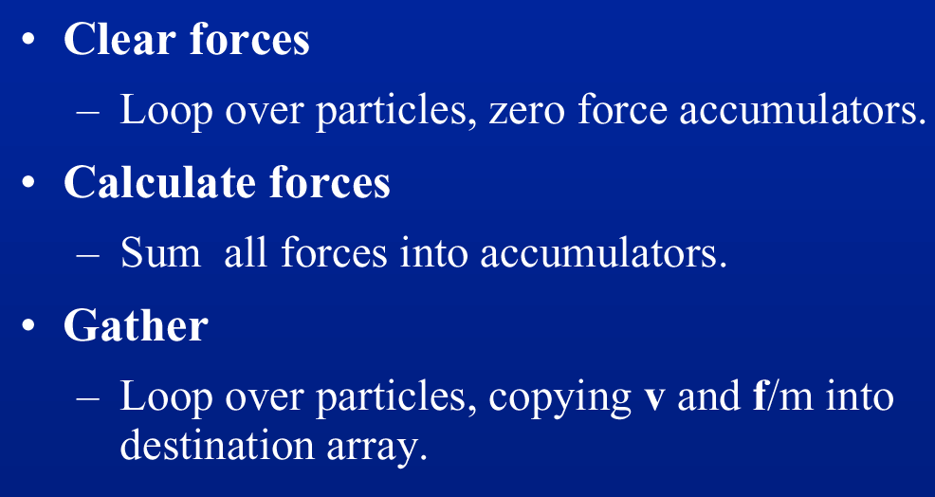
Derivatives Evaluation Loop

Slide 11
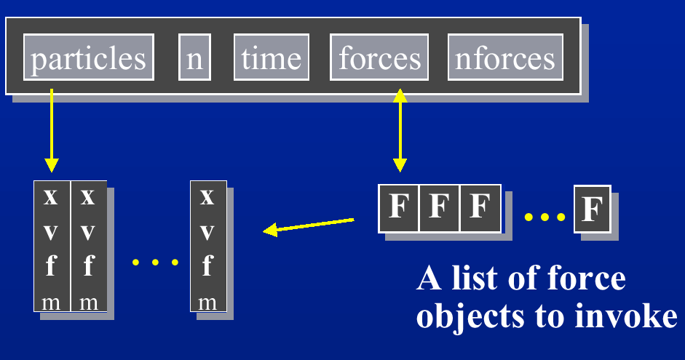
Particle Systems with Forces

Slide 12
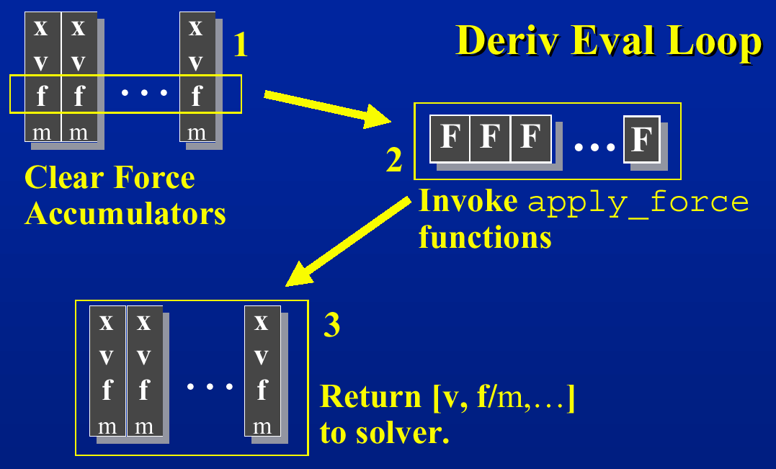
Solving Particle System Dynamics

Slide 13
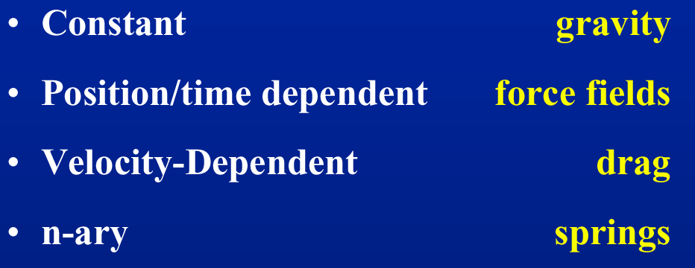
Type of Forces

Slide 14
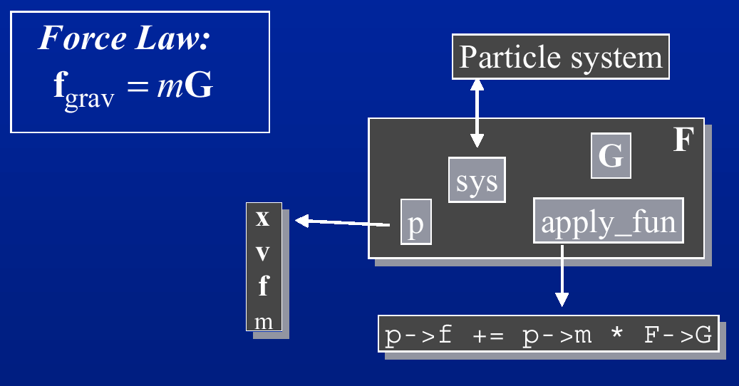
Gravity

Slide 15
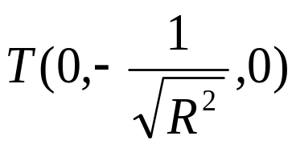
Force Fields
Magnetic Fields
  the direction of the velocity, the direction of the magnetic field, and the resulting force are all perpendicular to each other. The charge of the particle determines the direction of the resulting force.
Vortex (an approximation)
  rotate around an axis of rotation Θ = magnitude/R^{tightness}
  need to specify center, magnitude, tightness
  R is the distance from center of rotation
Tornado
  try a translation along the vortex axis that is also dependent on R, e.g. if Y is the axis of rotation, then

Slide 16
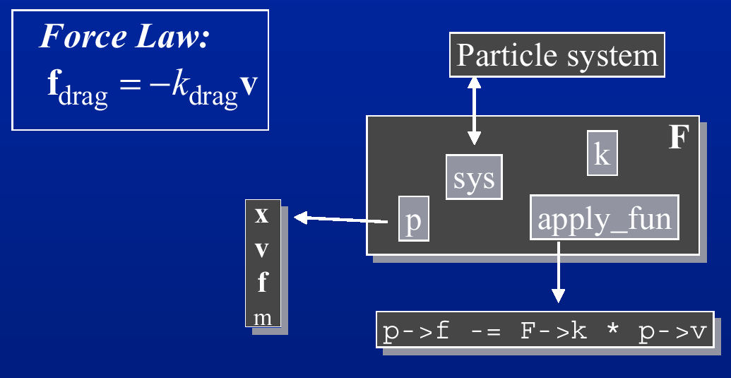
Viscous Drag

Slide 17
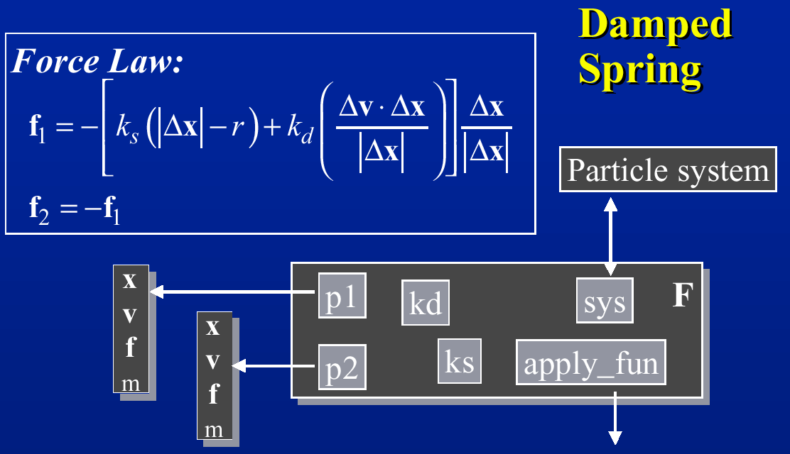
Spring Forces

Slide 18
Collision and Response
After applying forces, check for collisions or penetration
If one has occurred, move particle to surface
Apply resulting contact force (such as a bounce or dampened spring forces)

Slide 19
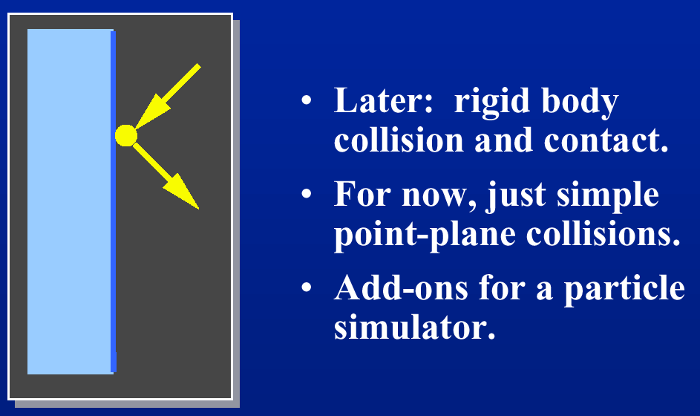
Bouncing off the Wall

Slide 20
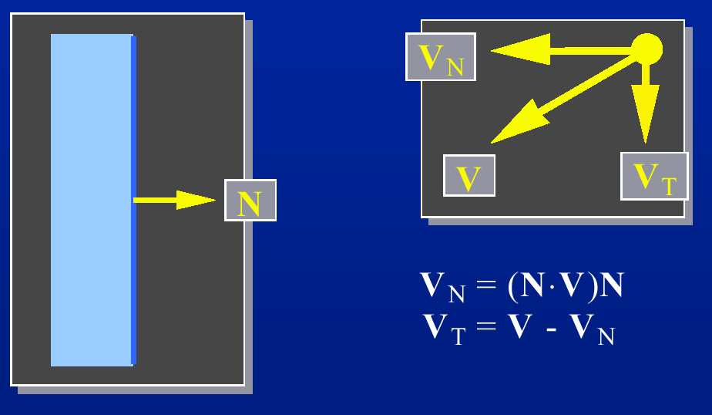
Normal & Tangential Forces

Slide 21
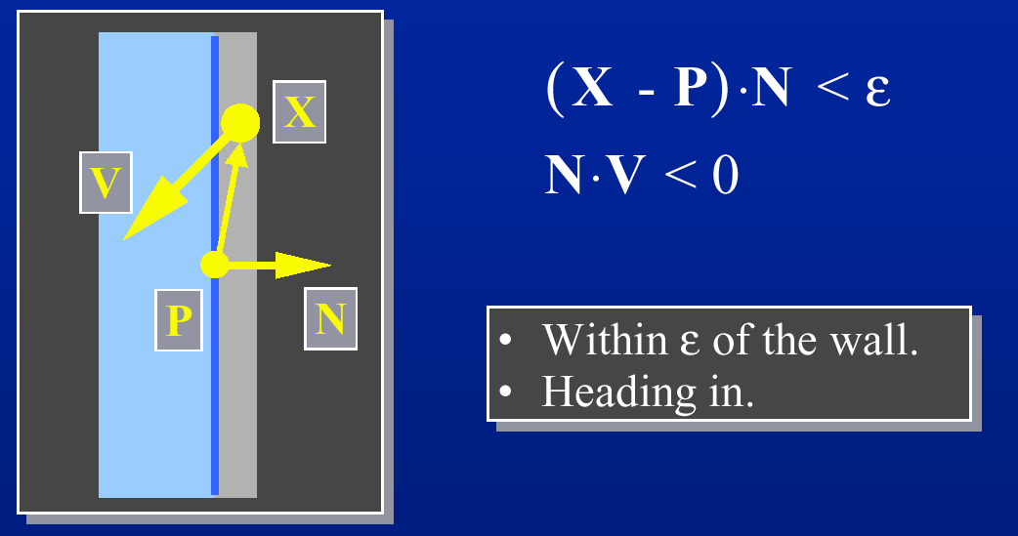
Collision Detection
Collision!

Slide 22
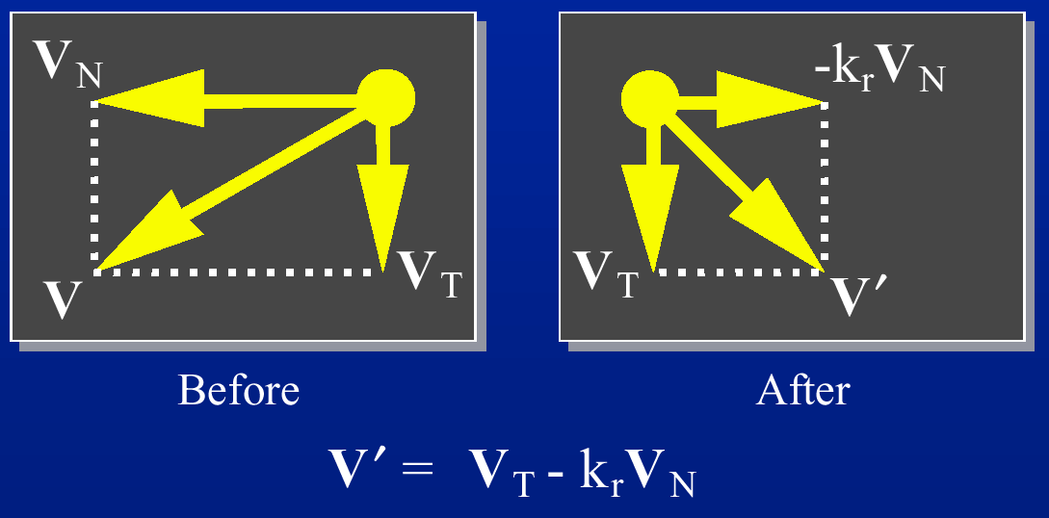
Collision Response
(k_{r} is the coefficient of restitution, 0 ≤ k_{r} ≤ 1)

Slide 23
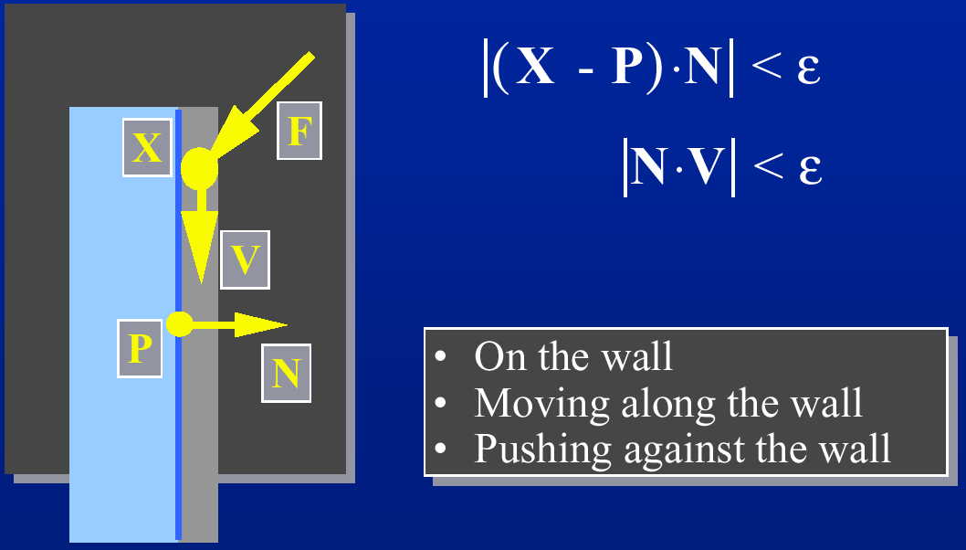
Condition for Contact

Slide 24
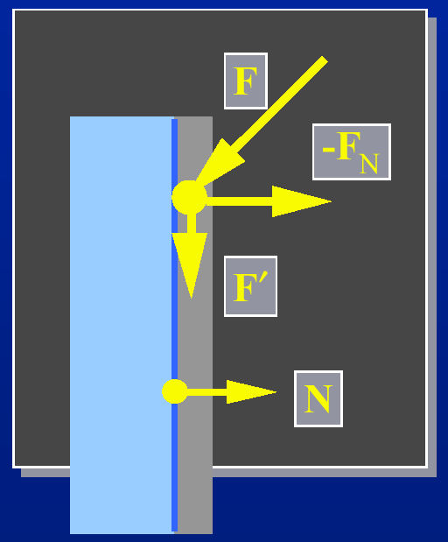
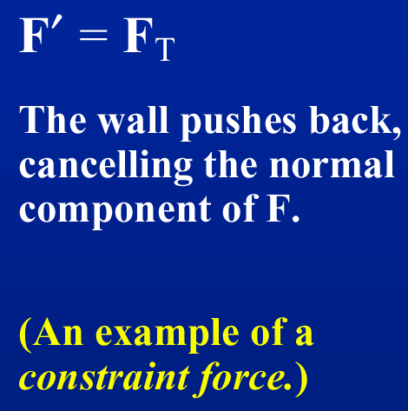
Contact Forces
F_{c} = - F_{N} = - (N•F)F
Friction: F_{f} = -k_{f} (-N•F) v_{t}

