Slide 1
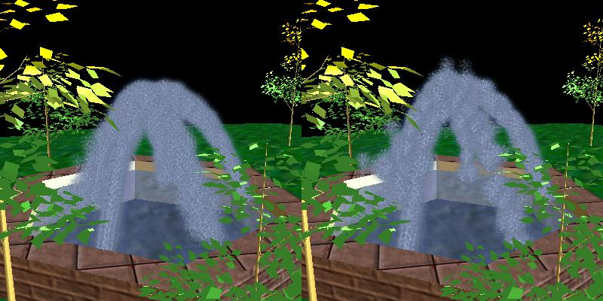
Automatic Simplification of
Particle System Dynamics
David O’Brien Susan Fisher Ming C. Lin
http://gamma.cs.unc.edu/SLOD

Slide 2
Outline
Introduction and Motivation
Simulation Level of Detail (SLOD)
  Definitions and Parameters
  Creation and Maintenance through Physically-based Spatial Subdivision
Adding Flexibility
  Regions of Interest (ROI)
  Switching ROIs
Results
Future Work

Slide 3
Introduction: Motivation
Real-time VEs & Video Games
  Increasingly use particle systems and physically based simulations
  Despite recent advances, still can not simulate complex dynamical systems in real time.
Goal:
  Reduce Cost of Dynamics Computations through Simulation Acceleration Techniques
  Analogous to Model Simplification & Rendering
  Maintain Consistent Frame Rates for Simulations

Slide 4
Previous Work
Model Simplification & Simulation Levels of Detail
  Fumkhouser et al created a generic framework for LOD and rendering techniques to maintain real-time frame rates
  Carlson & Hodgins created Simulation Level of Details for groups of legged creatures.
  Chenney et al proposed view-dependent culling of dynamic systems

Slide 5
Particle Systems
Why Particle Systems?
  Natural Phenomena, Modeling, and Group Behavior
Field System: Force can be applied to a particle in constant time
  Gravity, Drag, Turbulence
  Linear with respect to number of particles
N-Body Simulation:
  Astronomical Simulation, Potential Calculations
  n² interactions, reduced to O(n lg n) with heuristics such as Barnes-Hut Algorithm

Slide 6
Simulation Level of Detail (SLOD)
Simplifying a Particle System:

Slide 7
Simulation Level of Detail (SLOD)
Group into Clusters:

Slide 8
Simulation Level of Detail (SLOD)
Calculated Weighted Center of Mass Position:

Slide 9
Simulation Level of Detail (SLOD)
Calculated Weighted Center of Mass Velocity:

Slide 10
Simulation Level of Detail (SLOD)
Apply Dynamics Engine to the just the Center of Masses:

Slide 11
Simulation Level of Detail (SLOD)
Update particles to match movement of Center of Masses:

Slide 12
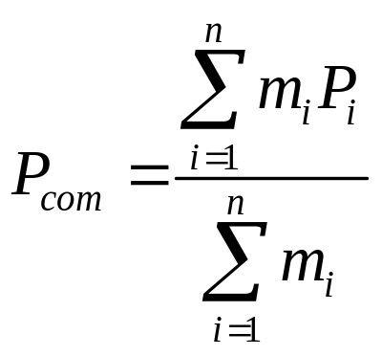
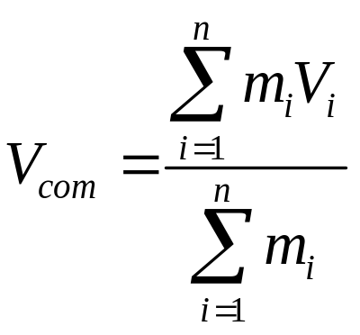
Simulation Level of Detail (SLOD)
Given a Particle Cluster C consisting of n particles:
1. Computer Position P_{com} and Velocity V_{com}
2. Update CoM using standard particle dynamics.
3. Apply change in P_{com} and V_{com} to all particles.
where, m_{i}, P_{i} and V_{i} are mass, position and velocity of i^{th} particle

Slide 13
SLOD Parameters
Main Parameters (used to create clusters):
  Cluster Size: maximum number of particles per cluster
  Cluster Breadth: maximum spatial size of a cluster
Secondary Parameters
(when clusters can be combined):
  Velocity Ratio:
  Relative Angle:

Slide 14
How to Cluster?
Uniform Grids:
Fast placement+lookup
Uneven particle sizes
Quad-Trees:
Adaptive, good clustering
O(n lg n) cost too high

Slide 15
Physically-based Hybrid Subdivision
Base is a uniform grid
  Give good insertion and query speed
When needed, subdivide as a Kd-tree.
Maximum Cluster Breadth

Slide 16
Physically-based Hybrid Subdivision
Why Physically-based?
  We can subdivide on a physical parameter as well
  Usually this is done only at the top of the SD hierarchy
heavy
light

Slide 17
SLOD System Architecture
Set Parameters and
Minimum Frame Rate
Create Initial Subdivision Tree. Initialize SLODs.
Advance Simulation Step.
Update SLODs.
Update Subdivision Tree.
Render Particles

Slide 18
Efficient SLOD Updating
Can not rebuild the Subdivision Tree on each Simulation Step.
After each simulation step:
  Remove and Reinsert each cluster that has moved out of its cell.
  When inserting, merge nearby clusters when possible.
  Prune the tree of unnecessary empty cells
  Insert new particles into nearby clusters.
    If clusters become too large, split them.
Always taking into account changes in SLOD parameters

Slide 19
Smooth SLOD Switching
Only update clusters when they move out of their cell.
  Max Cluster Size switches from 4 to 2

Slide 20
Smooth SLOD Switching
Only update clusters when they move out of their cell.
  Max Cluster Size switches from 4 to 2

Slide 21
Smooth SLOD Switching
Only update clusters when they move out of their cell.
  Max Cluster Size switches from 4 to 2

Slide 22
Smooth SLOD Switching
Only update clusters when they move out of their cell.
  Max Cluster Size switches from 4 to 2

Slide 23
Smooth SLOD Switching
Only update clusters when they move out of their cell.
  Max Cluster Size switches from 4 to 2

Slide 24
Smooth SLOD Switching
Only update clusters when they move out of their cell.
  Max Cluster Size switches from 4 to 2

Slide 25
Smooth SLOD Switching
Only update clusters when they move out of their cell.
  Only changed the SLOD parameters

Slide 26
Regions of Interest (ROI)
System is still not flexible enough
  Real particle systems are dynamic
  Different Areas need Different SLOD levels
Solution:
  Divide Simulation Space into many ROIs.
  ROIs can independently:
    have separate SLOD settings
    size and reshape
    move around the simulation space
    be added or deleted dynamically

Slide 27
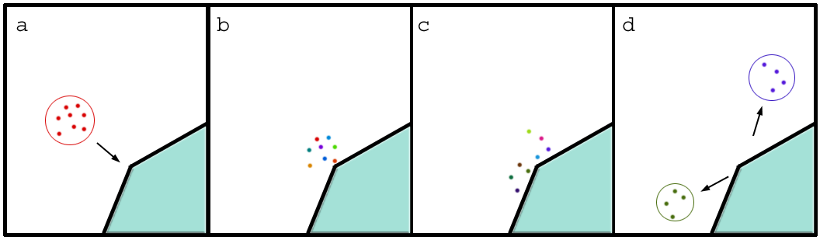
Regions of Interest (ROI)
We need higher resolution SLOD for important events
  Collisions on uneven surfaces
  “Emitter Problem”
    Averaging velocity near emitter cancels out the spreading of the particles

Slide 28
Regions of Interest (ROI)
Hybrid subdivision tree with ROIs:
  Several hybrid SD trees grouped under a Master Node.
Master Node
Background ROI
High Priority ROI
Medium Priority ROI

Slide 29
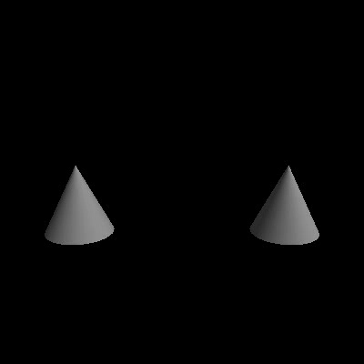
Results: Regions of Interest

Slide 30
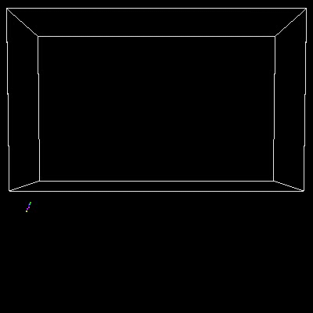
Results: Changing ROIs

Slide 31
Maintaining Constant Frame Rate
After each Step of the Simulation, the frame rate average over the last few frames is checked.
  If too low, adjust SLOD parameters to a coarser level
  Larger clusters begin to form and frame rate increases

Slide 32
Maintaining Constant Frame Rate
How to adjust the parameters?
  First adjust the Max. Cluster Size.
    Increment/Decrement by 1
    Increment/Decrement by a percentage relative to how close we are to achieving frame rate goal
    Both give similar results.
  Adjust Cluster Breadth only if necessary.

Slide 33
Error Analysis
Error in such system not well defined
Concerned with global appearance and macroscopic behavior, not local errors on individual particles
Merges:
  Weighted averaging in merges affects lighter particles/clusters heavier ones
  Maximum shift in velocity is reduced when merging clusters have similar mass
  This provides an argument in favor of subdividing on mass, as well as spatial coordinates.

Slide 34
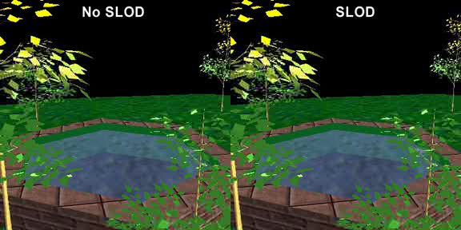
Results: Frame Rates

Slide 35
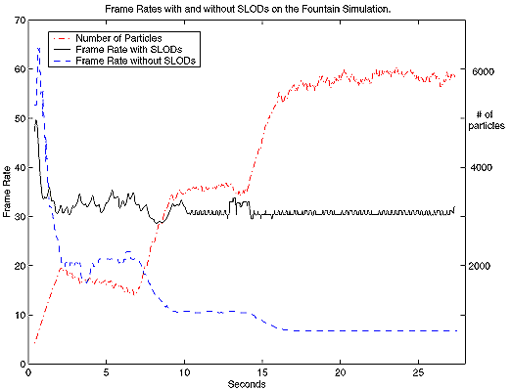
Results: Frame Rates

Slide 36
Future Work
Can this approach or similar ideas be generalized to other dynamical systems?
Automatic Determination of ROIs
Particle based Cloth Simulations
Can we ensure that the Macro Integrity and results of the simulation are correct?

Slide 37

Prairie Grass
Animate prairie grass in real-time
3 LODs: Near, Medium, and Far
Pre-compute physically-based wind effects, and implement with procedural wind effects
“Animating Prairies in Real-Time”
By F. Perbert and M.-P. Cani,
Proc. of I3D 2001.

Slide 38
LODs
Near
  Geometric 3D model
Medium
  Volumetric texture mapped onto vertical polygon strips (“2.5D”)
Far
  Static 2D Texture

Slide 39
Transition: Near to Medium
Volumetric texture for a patch of grass generated from the 3D model
Linearly interpolate each blade of grass to its corresponding position on the texture map

Slide 40
Transition: Medium to Far
Without hills, simple cross dissolve is sufficient, since the 2D texture is far away
To improve appearance with hills, make 2.5 D texture polygons grow (vanish) from (into) the ground, while making the 2D texture vanish (appear)

Slide 41
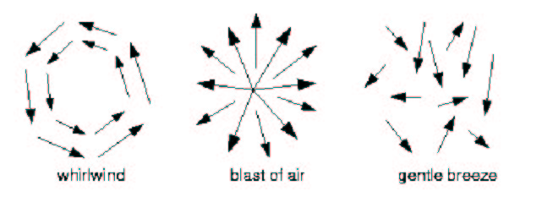
Wind Primitives
Types
  Gentle Breeze
  Gust
  Whirlwind
  Blast

Slide 42
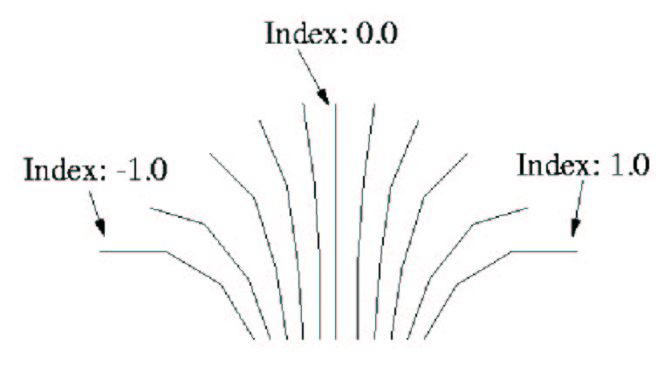
Posture
Range of motion for a blade of grass is computed using a physically-based model

Slide 43
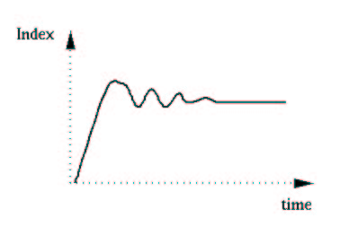
Variation in Posture Index
A constant wind starts blowing

Slide 44
Samples
http://www-imagis.imag.fr/Membres/Frank.Perbet/prairie_dea/

Slide 45
Speed
Quality | Low | Medium | High
No. of blades per patch | 160 | 320 | 500
2.5D distance range | 3m - 8m | 2m –12m | 3m – 20m
No. Seg. Per grass blade | 3 | 4 | 8
Approx. nb. Blades per image | 100,000 | 500,000 | 1,000,000
Frame rate on SGI O2 | 5 Hz | 4 Hz | 2 Hz
Frame rate on ONYX | 25 Hz | 12.5 Hz | 8 Hz

Slide 46
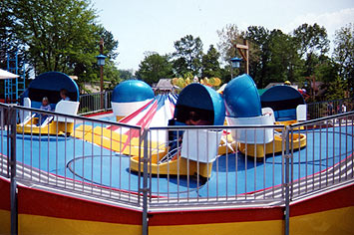
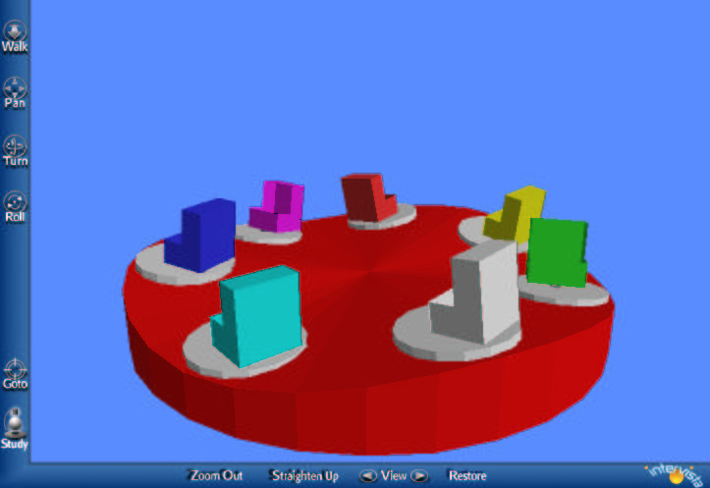
View-dependent Culling of
Dynamic Systems in VEs
By S. Chenney and D. Forsyth
Proc. of I3D 1997

Slide 47
Influence of Initial Conditions
Strong – Viewer can predict state based on initial conditions accurately, so must simulate
Medium – Viewer can make some qualitative predictions
Weak – Viewer can make no predictions, but can have expectations of state, based on physical principles

Slide 48


Parameters
- Angular position of platform on the track
- Angular position of the car on the platform

Slide 49
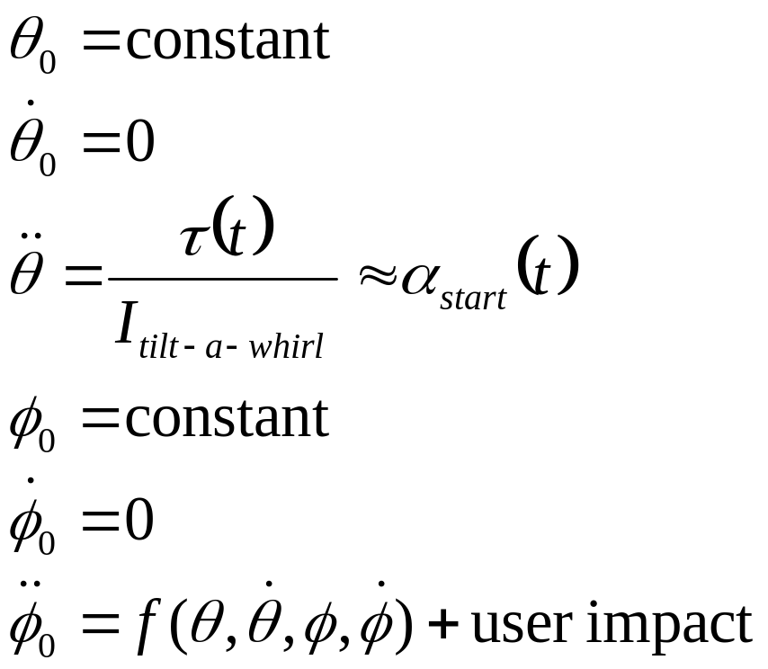
Start State
Platforms accelerate

Slide 50
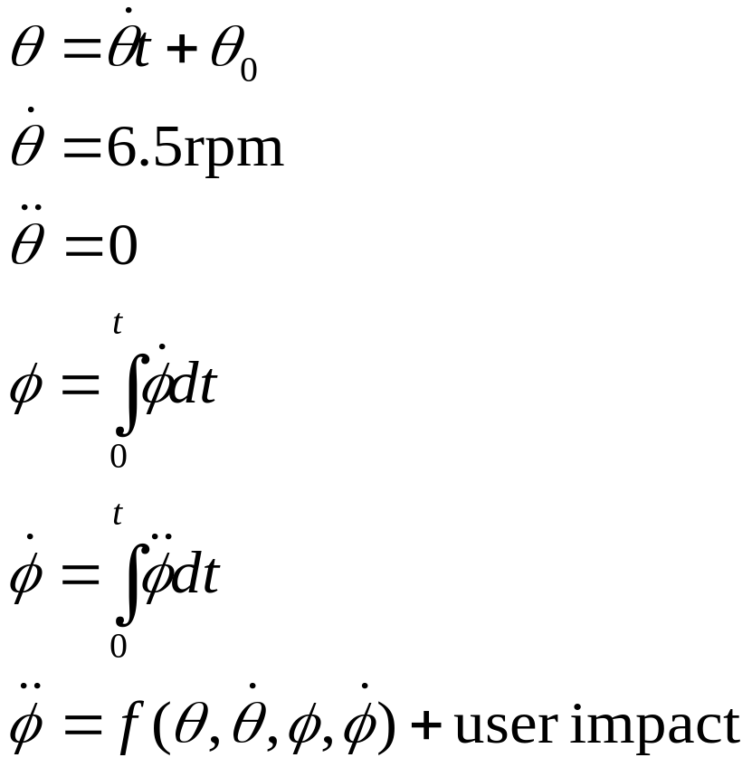
Run State
Motion in a steady state

Slide 51
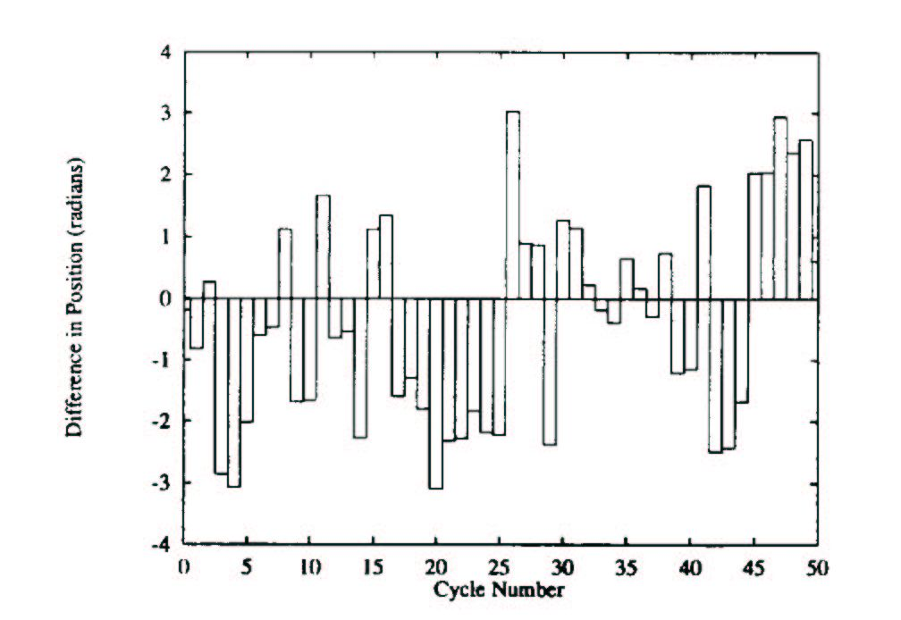
Chaotic Behavior in Run State
φ For 2 cars whose initial conditions vary by 10° and 10°/s
Very hard to predict state and, after 9 seconds of virtual time, state can be sampled from a probability density

Slide 52
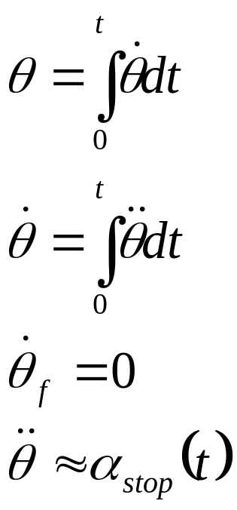
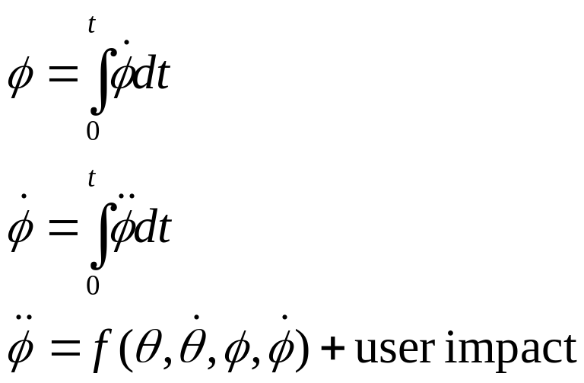
Stop State
Platforms slow down and stop

Slide 53
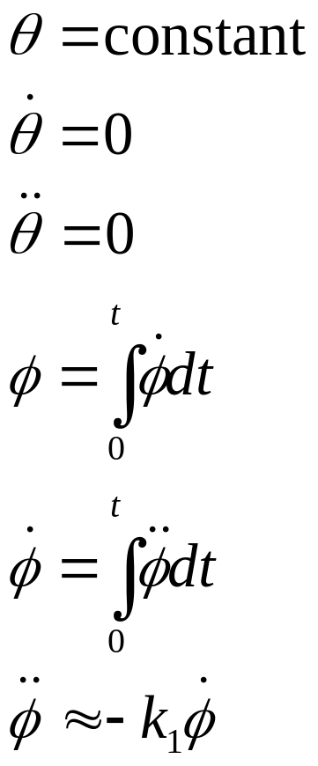
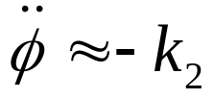
Decay State
Cars are still in motion, and energy is decaying as a damped harmonic oscillator
Once the car’s angular velocity has dropped far enough, we can use a linear model

Slide 54
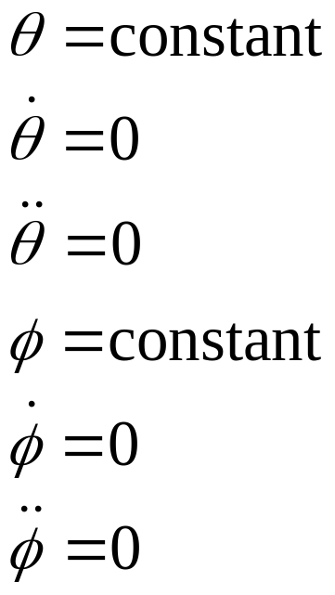
Stationary State
Everything is stationary

Slide 55
Re-entering View
Determine which phase the tilt-a-whirl is in and find a state which matches the last observation
In general, can integrate forward to get state
For run state, can get state from probability distribution
For decay state, can determine energy remaining in system, and choose state accordingly
For stationary state, only one option

Slide 56
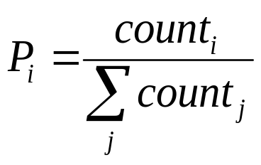
Building the Distribution
Physically simulate the run state over a long time
Create discrete cells corresponding to ranges of states
At each step, increment a counter corresponding to the state the system is in
The probability of being in a state i is

Slide 57
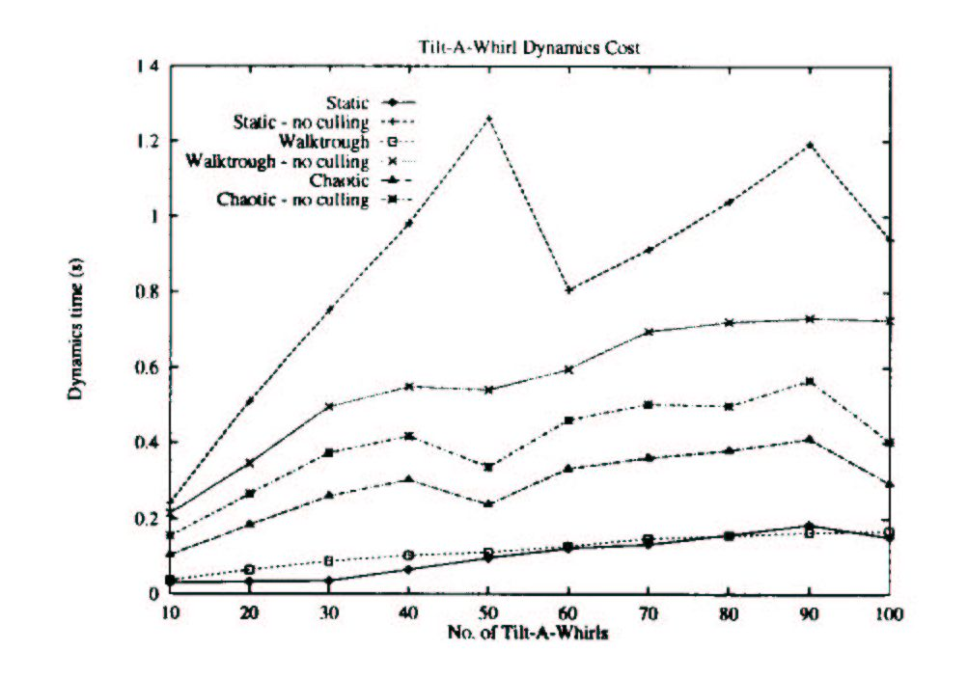
Simulation Cost

Slide 58
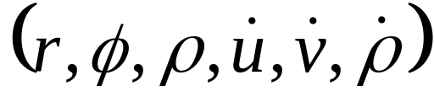
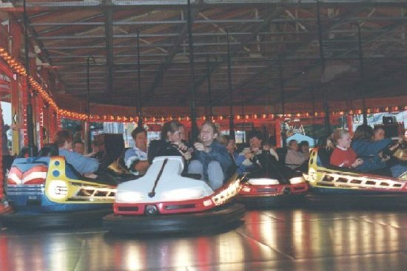
Bumper Car Parameters
Position of each car on an elliptical track
Orientation+angular velocity of each car
Velocity of each car
State for each car is given by

Slide 59
Simulation
Use perturbed motion of 12 cars following an elliptical path
Sample the position of each car independently
If a collision occurs, move the cars so that they are farther apart, but their mutual center is maintained

Slide 60
Influence of Initial State
The uncertainty of the state of each car grows with time, making it harder for a viewer to predict where the cars ought to be
After sufficient time, the states of the car may be chosen from a distribution

