Slide 1
Announcements
Homework #1 is due on Tuesday, 2/14/06
Reading: SIGGRAPH 2001 Course Notes on Physically-based Modeling

Slide 2
Disclaimer
The following slides reuse materials from SIGGRAPH 2001 Course Notes on Physically-based Modeling (copyright © 2001 by Andrew Witkin at Pixar).

Slide 3
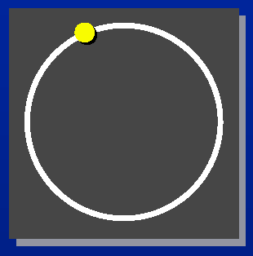
A Bead on a Wire
Desired Behavior
  The bead can slide freely along the circle.
  It can never come off no matter how hard we pull.
So, how do we make this happen?

Slide 4
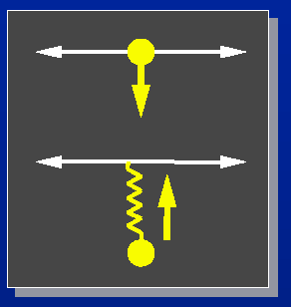
Penalty Constraints
How about using a spring to hold the bead to the wire?
Problem
  Weak springs ⇒ sloppy constraints
  Strong springs ⇒ instability

Slide 5
Basic Ideas
Convert each constraint into a force imposed on a particle (system)
Use principle of virtual work – constraint forces do not add or remove energy
Solve the constraints using Lagrange multipliers, λ’s
  For particle systems, need to use the derivative matrix, J, or the Jacobian Matrix.

Slide 6
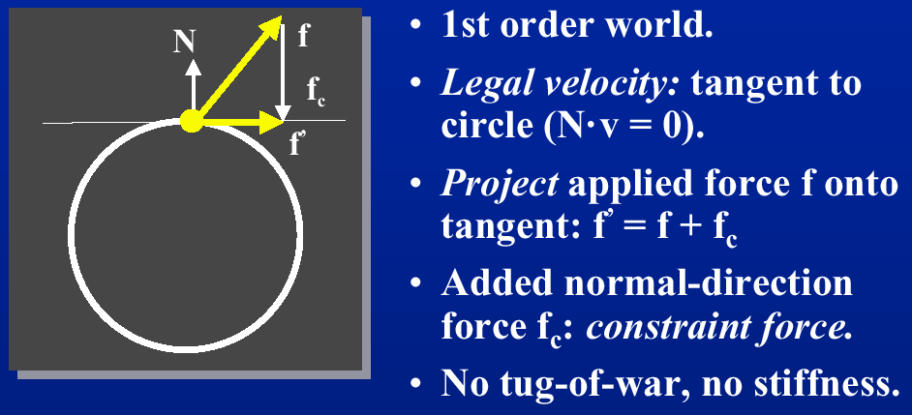

Geometric Interpretation

Slide 7
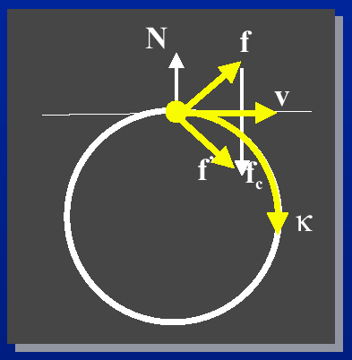
Basic Formulation (F = ma)
Curvature(k) has to match
k depends on both a & v:
  The faster the bead is going, the faster it has to turn
Calculate f_{c} to yield a legal combination of a & v

Slide 8
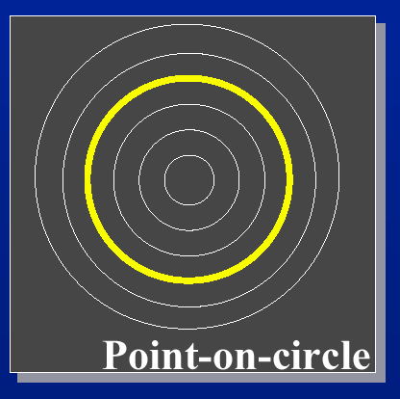

Implicit Representation of Constraints

Slide 9
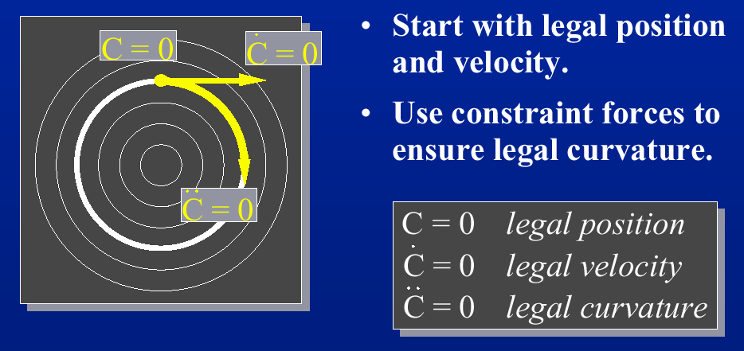
Maintaining Constraints

Slide 10
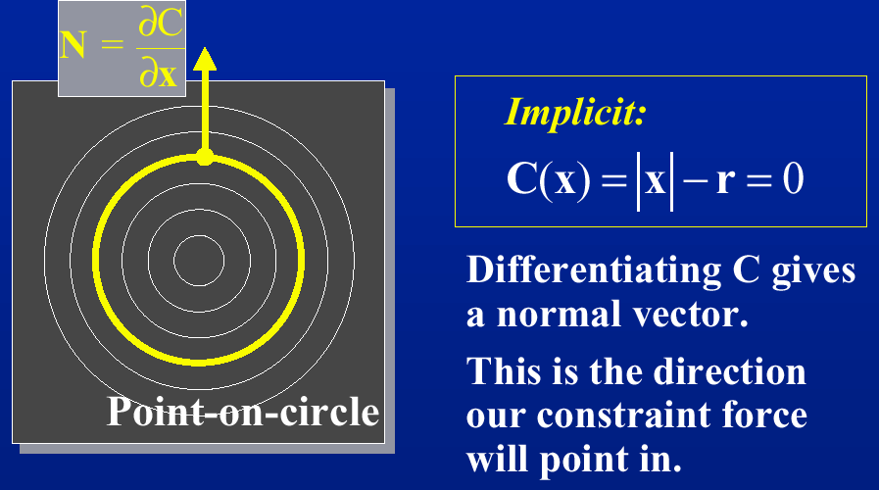
Constraint Gradient

Slide 11
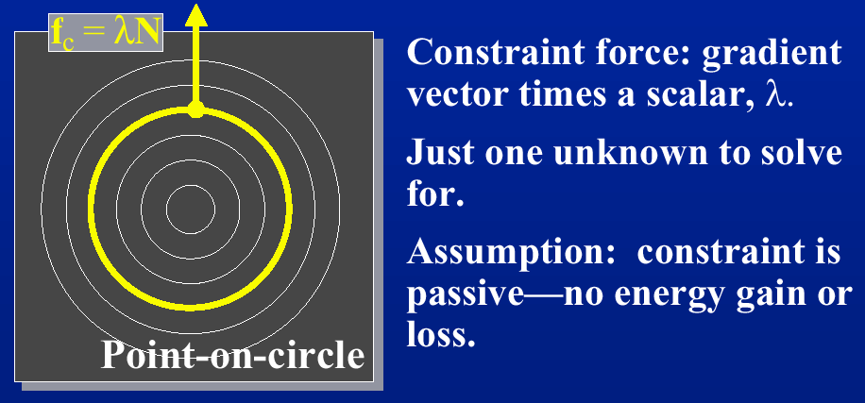
Constraint Forces

Slide 12
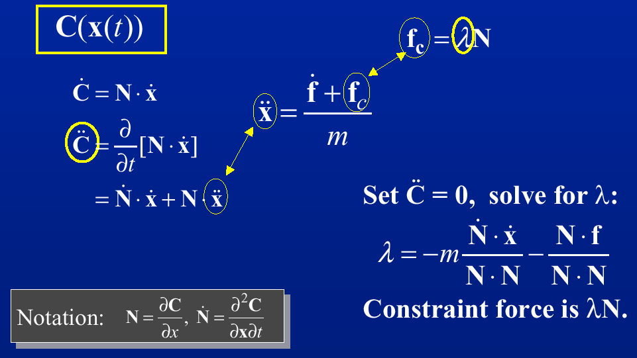
Derivation

Slide 13
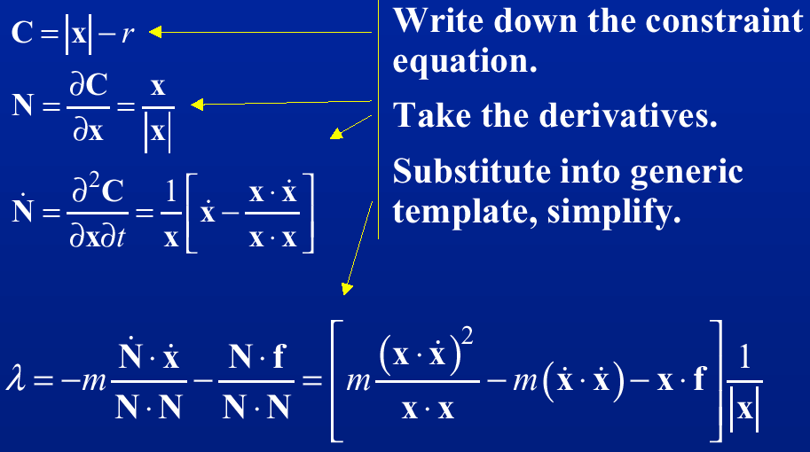
Example: A Bead on a Wire

Slide 14
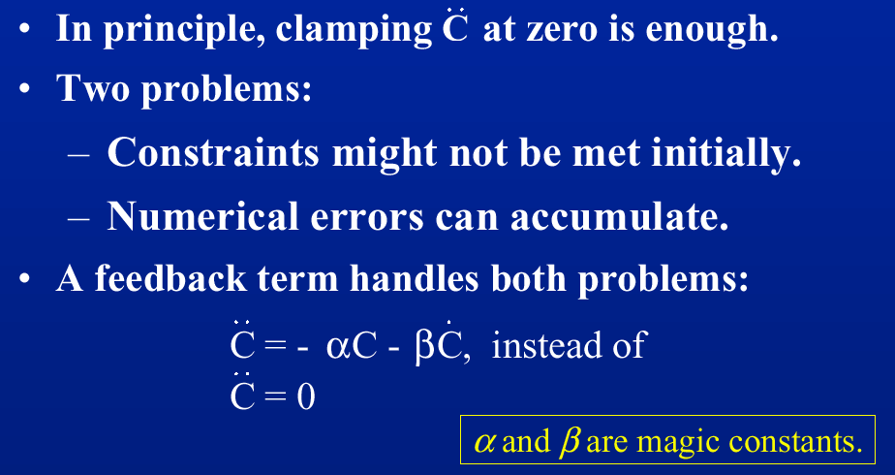
Drift and Feedback

Slide 15
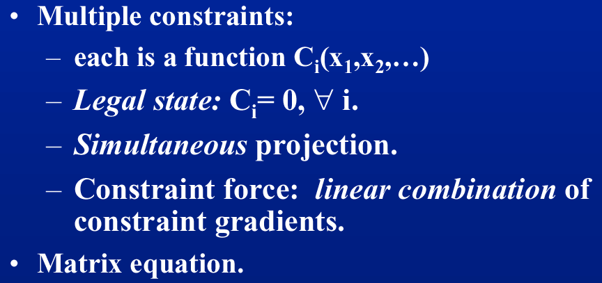
Constrained Particle Systems

Slide 16
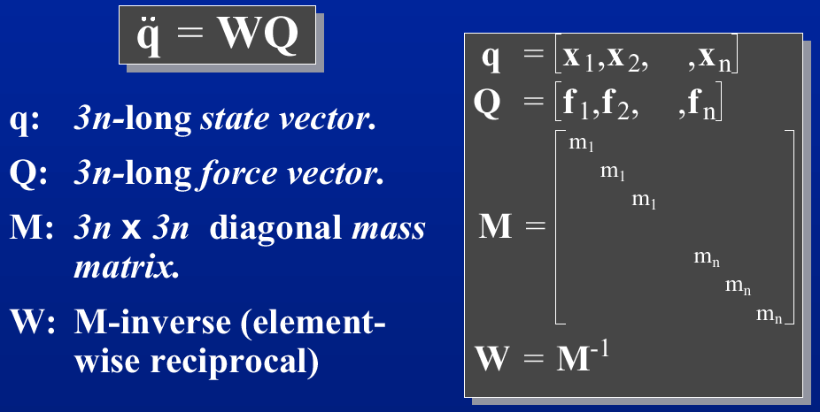
Compact Notation

Slide 17
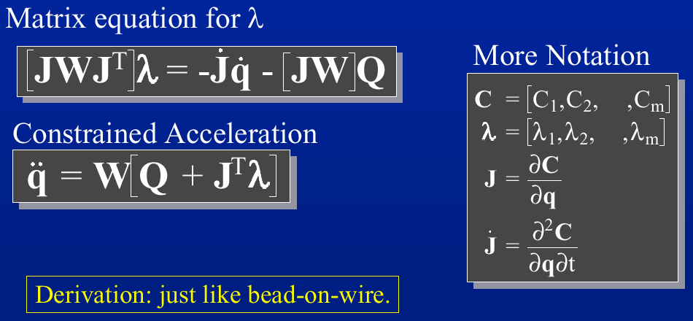
Particle System Constraint Equations

Slide 18
Implementations
A global matrix equation
Matrix block structure with sparsity
Each constraint adds its own piece to the equation

Slide 19
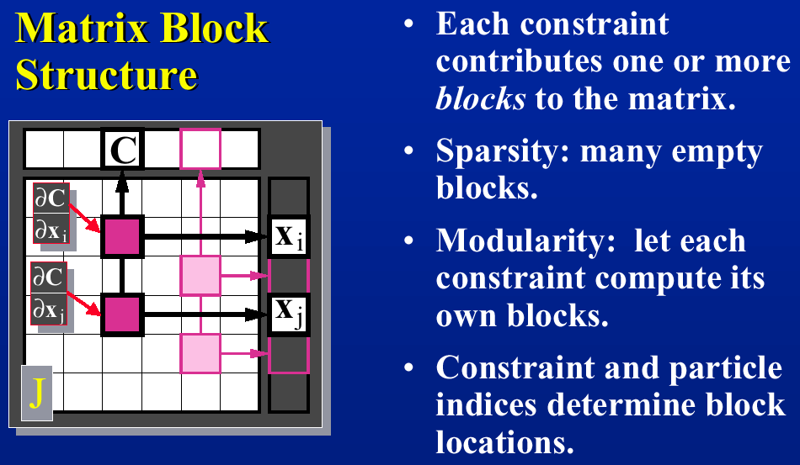
Mathematical Formulation

Slide 20
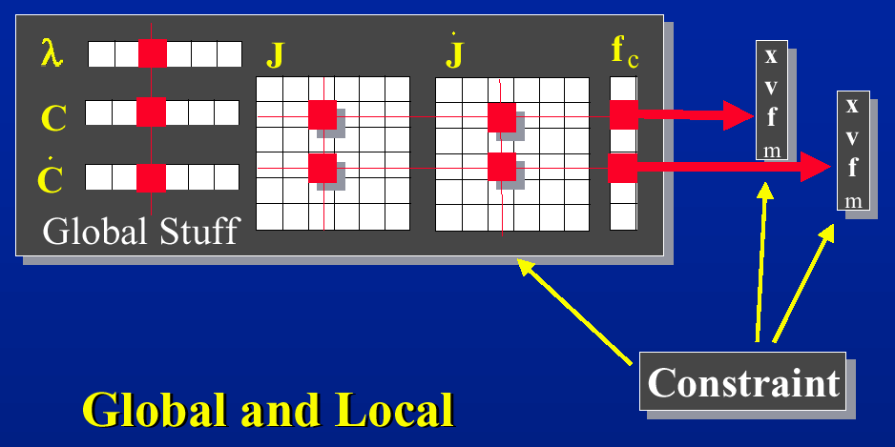
Take a Closer Look

Slide 21
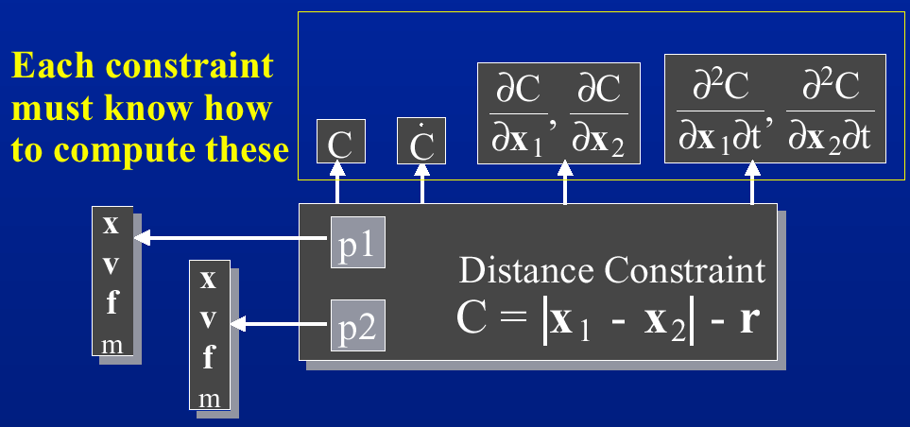
Constraint Structure

Slide 22
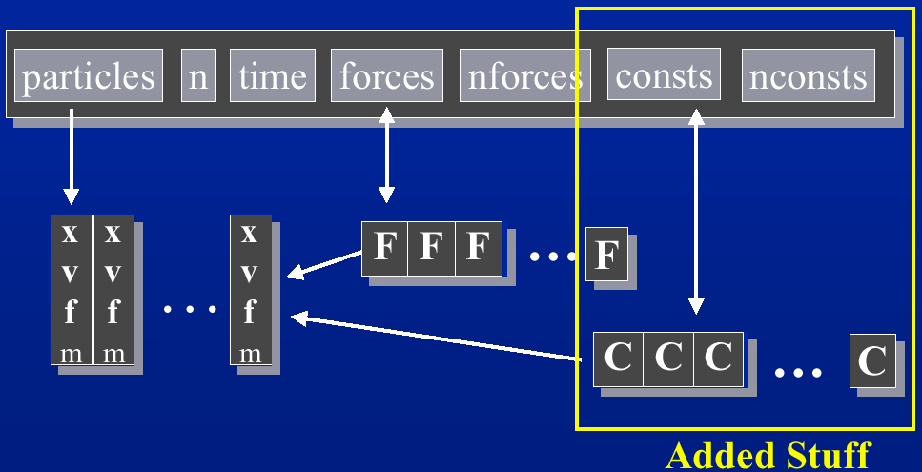
Constrained Particle Systems

Slide 23
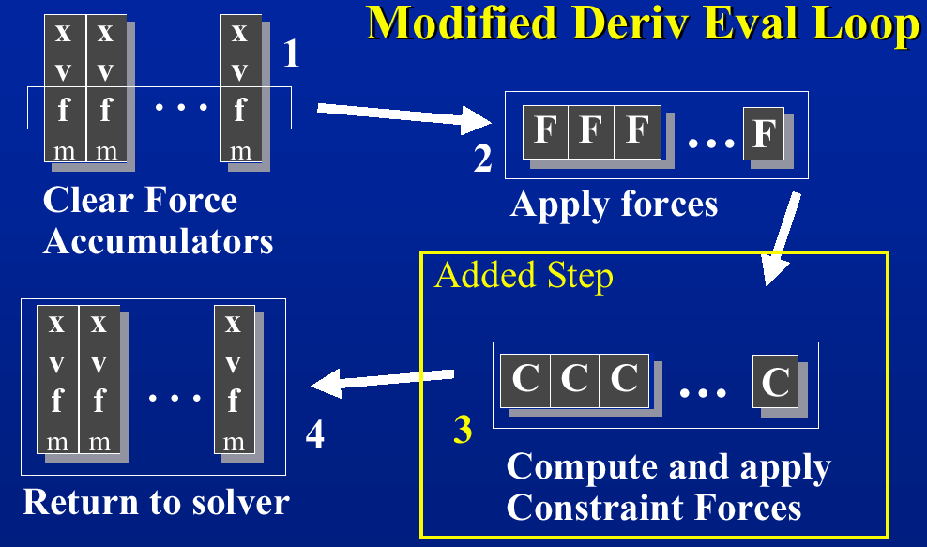
Other Modification

Slide 24
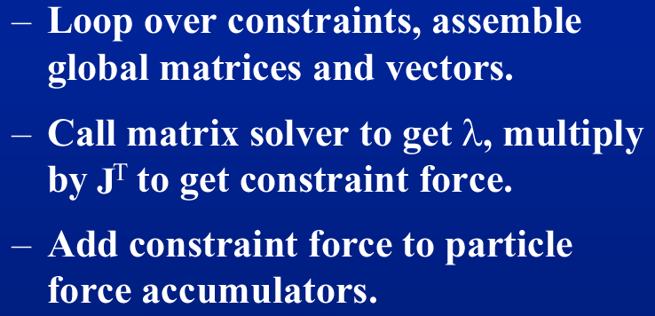
Constraint Force Evaluation
After computing ordinary forces:

Slide 25
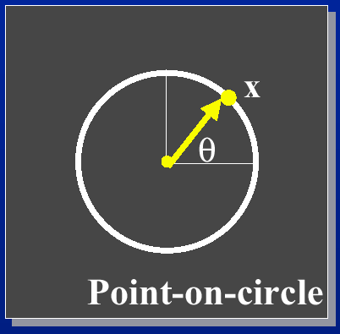

Parametric Representation of Constraints

Slide 26
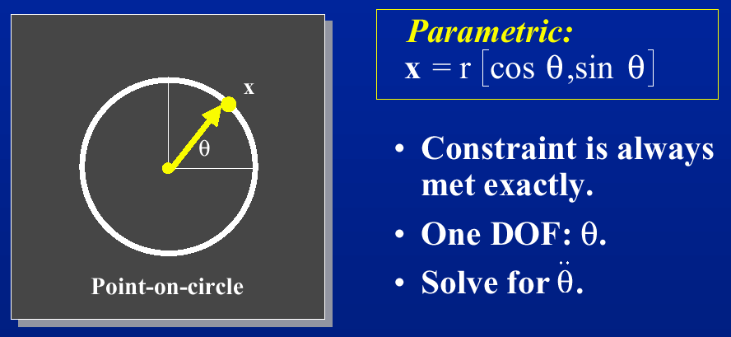
Parametric Constraints

Slide 27
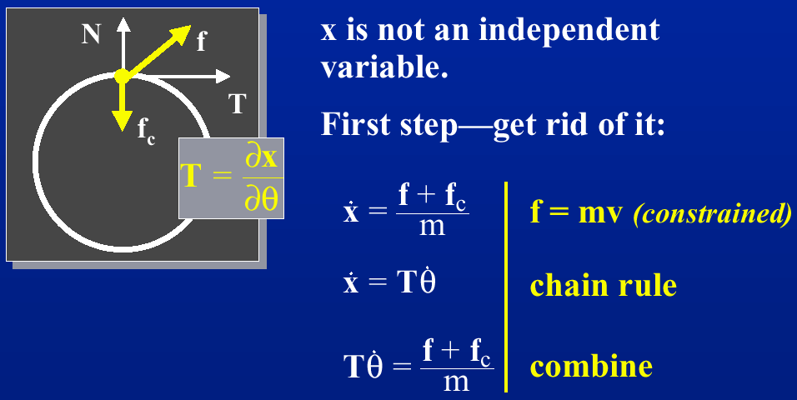
Parametric bead-on-wire (F = mv)

Slide 28
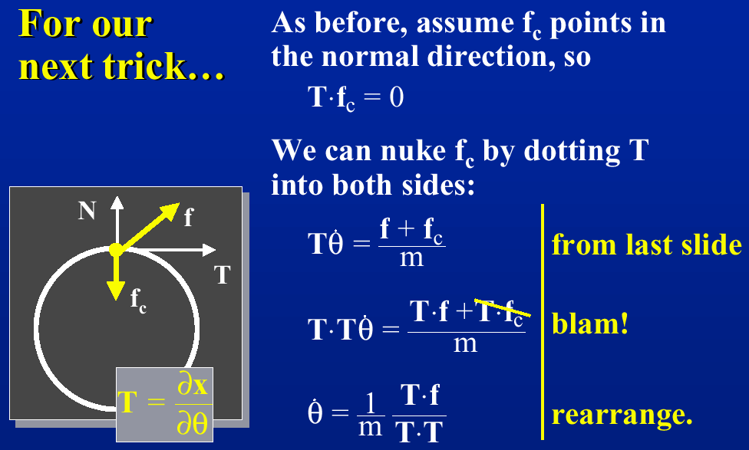
Some Simplification……

Slide 29
Lagrangian Dynamics
Advantages
  Fewer DOF’s
  Constraints are always met
Disadvantages
  Difficult to formulate constraints
  Hard to combine constraints

