Slide 1
Disclaimer
The following slides reuse materials from SIGGRAPH 2001 Course Notes on Physically-based Modeling (copyright © 2001 by David Baraff at Pixar).

Slide 2
Determining Step Size
Explicit Integration
  Too big, unstable!
  Too small, too slow
  Adaptive, maybe
  Ultimately the constants decide!
Implicit Methods
  Taking large steps when possible

Slide 3
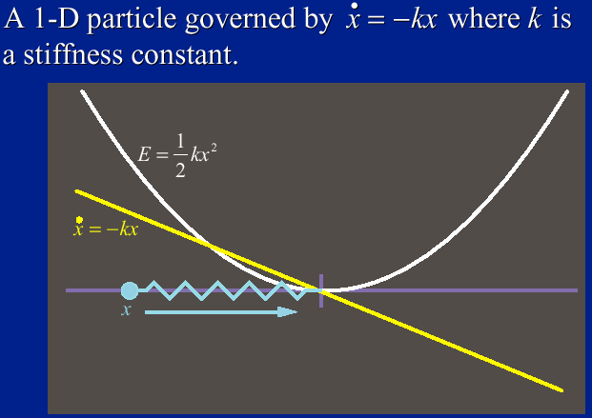
An Example

Slide 4
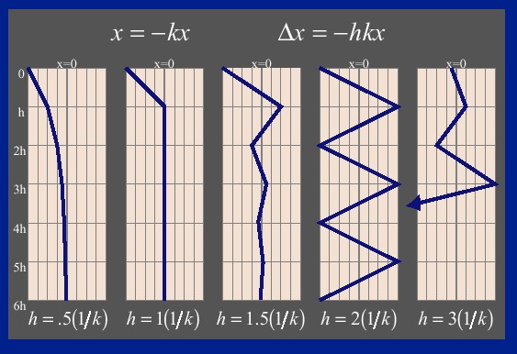
Speed Limitation of Euler’s Method

Slide 5
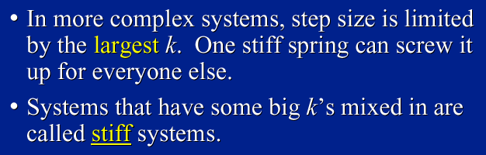
Stiff Equations

Slide 6
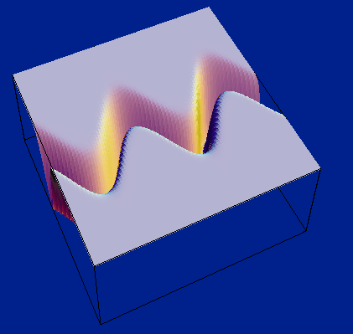
A Stiff Energy Landscape

Slide 7
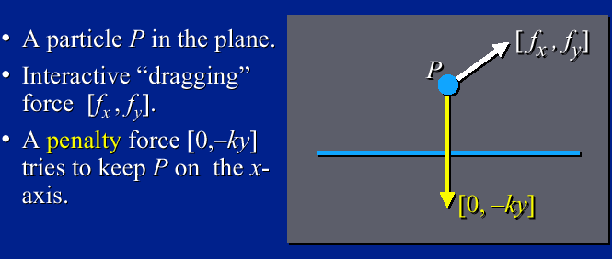
Example: Particle-on-line

Slide 8
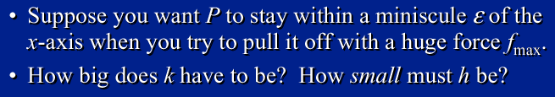
Example: Particle-on-line

Slide 9
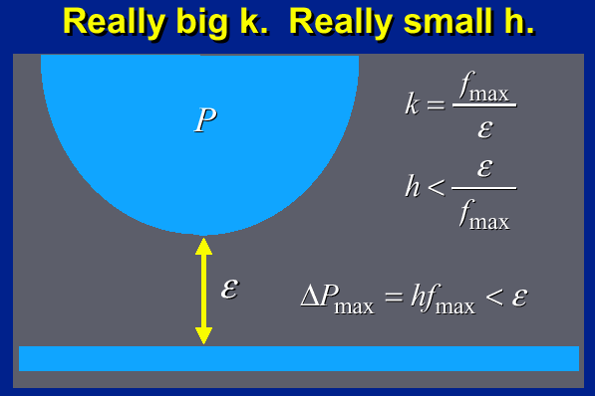
Example: Particle-on-line

Slide 10
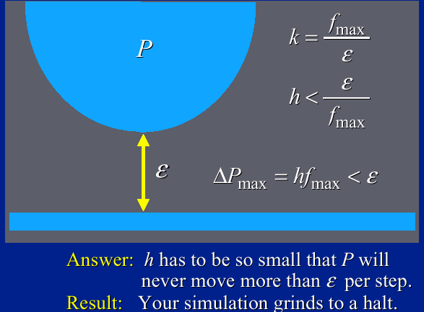
Example: Particle-on-line

Slide 11
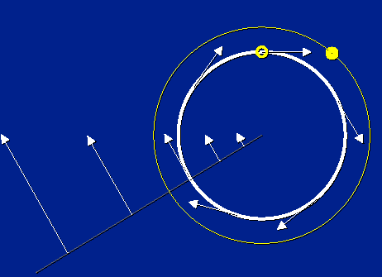
Explicit Integration

Slide 12
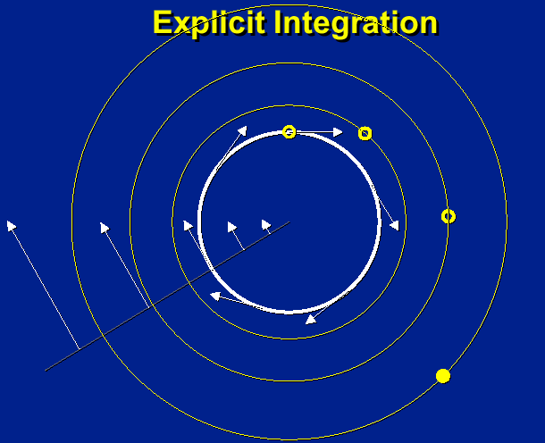
Problems

Slide 13


Explicit vs. Implicit Euler Method
vs.

Slide 14

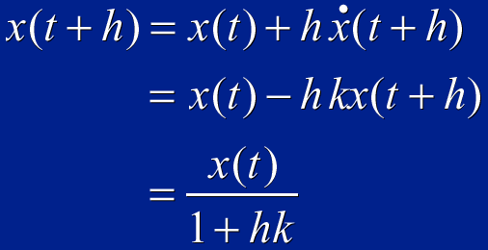

Slide 15
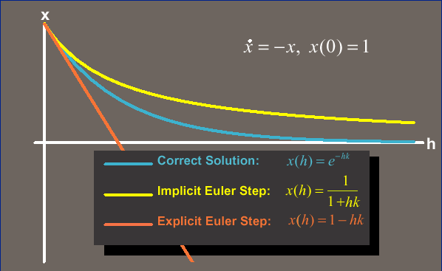
One Step: Implicit vs. Explicit

Slide 16
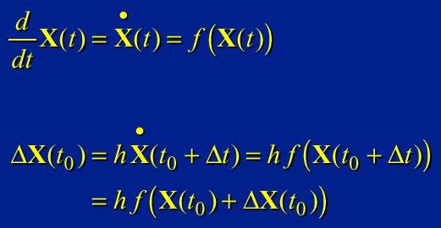
Large Systems

Slide 17
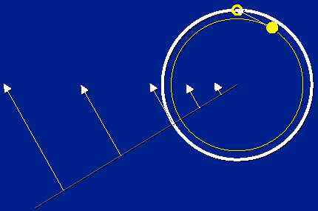
Implicit Integration

Slide 18
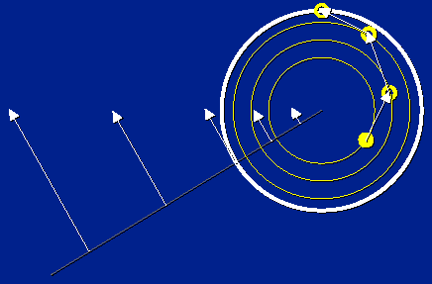
Implicit Integration

Slide 19
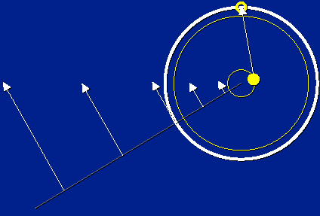
Implicit Integration

Slide 20
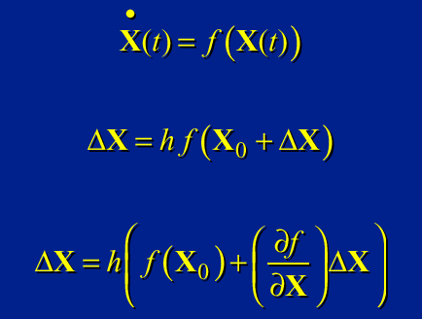
Linearized Implicit Integration

Slide 21
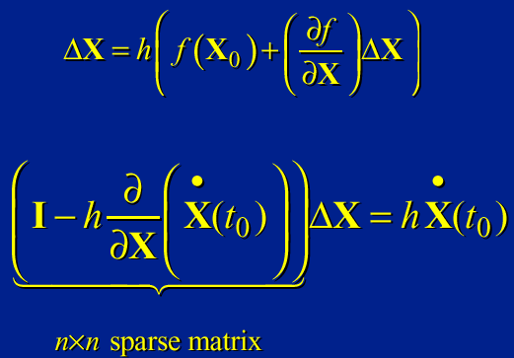
Single-Step Implicit Euler Method

Slide 22
Solving Large Systems
Matrix structure reflects force-coupling:
(i , j)th entry exists iff f_{i} depends on X_{j}
Conjugate gradient a good first choice

