Slide 1
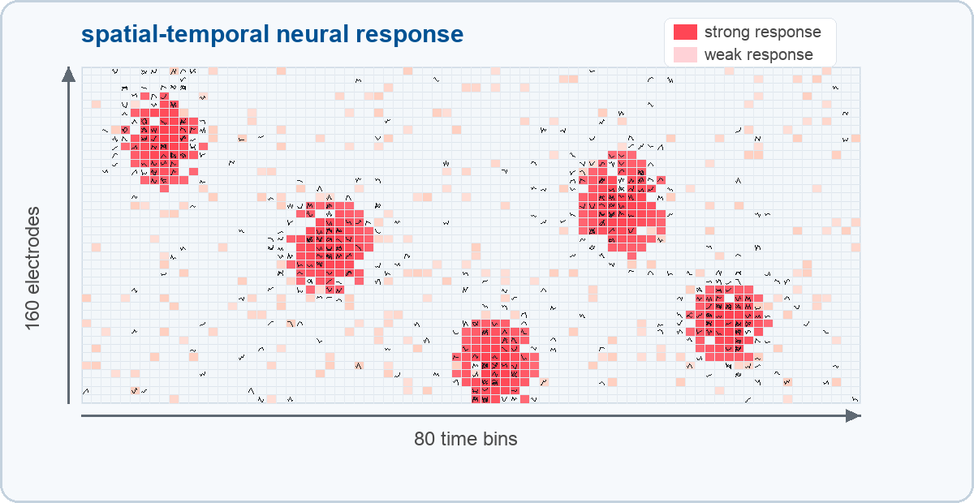

Task 1: decoding stimulation patterns
Predict which of 16 stimulation patterns caused a neural population response.
INPUT RESPONSE X
16-class
classifier
ŷ ∈ {0,…,15}
160 electrodes × 80 time bins
6.25%
66,038
7,341
9,839
One trial = one stimulation event plus its post-stimulus raster-like response.
chance level
training trials
validation trials
hidden test trials
Final setting: network 6, DIV 40, within-recording held-out trials.
Group 4 · Task 1 Decoding
1
Notes:
For Task 1, we solve a decoding problem. For each trial, we receive the post-stimulus population response of the biological neural network, and our goal is to predict which of the 16 stimulation patterns caused it. Our final model uses network 6 at DIV 40. Each response is represented as a matrix with 160 electrodes and 80 time bins, so the model sees both where activity happens and when it happens after stimulation. We used a stratified random validation split with about 66 thousand training trials and 7.3 thousand validation trials. The hidden test set contains 9,839 trials, but we do not know the labels there, so we can only export predictions for submission.

Slide 2
Model: response fingerprint classifier
The classifier combines temporal features, electrode topology, attention, and class prototypes.
KEY ASSUMPTION
Each stimulation pattern creates a reproducible spatial-temporal response fingerprint within the same recording.
Temporal
CNN
Electrode
topology
Class
attention
Class
prototypes
when?
where?
what matters?
which fingerprint?
WHY THIS MODEL
•
uses timing over 80 bins
MODEL OUTPUT
•
shares information across nearby electrodes
16 logits → softmax → predicted stimulation pattern
•
compares trials to class-specific training prototypes
Frequency features were disabled in the final Task 1 model; classification mainly uses the neural response itself.
Group 4 · Task 1 Decoding
2
Notes:
Our main assumption is that each stimulation pattern produces a reproducible spatial-temporal response fingerprint. Therefore, the model is designed to use both timing and spatial structure. The temporal CNN extracts timing features across the 80 time bins. The graph part uses electrode topology, so nearby electrodes can exchange information. Class attention lets the model focus on pattern-specific response regions. The strongest and most interpretable part is the class prototype mechanism. For each class, we compute the average response pattern from the training data only. A new trial is then compared to these class prototypes, almost like template matching. In the final model, frequency features were disabled, so the classifier mainly relies on the neural response itself.

Slide 3
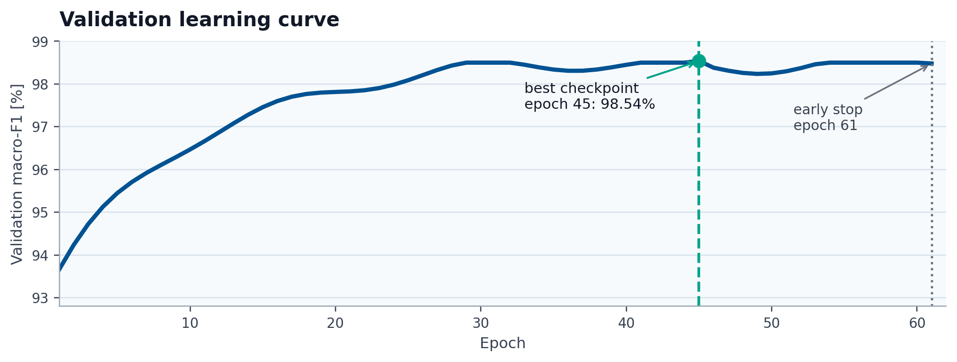
Training: validation-based model selection
Preprocessing and prototypes are computed from training data only.
TRAINING SETUP
•
16-class cross-entropy loss
•
AdamW optimizer
•
stratified 10% validation split
•
macro-F1 used for checkpoint selection
•
normalization and prototypes fitted on train only
Best checkpoint: epoch 29
Learning pattern: fast early improvement, then plateau. Training stopped at epoch 45 after no further macro-F1 improvement.
Group 4 · Task 1 Decoding
3
Notes:
We trained the model with cross-entropy loss, which is standard for multi-class classification, and used AdamW as optimizer. Our primary model-selection metric was macro-F1, because all 16 stimulation patterns should matter equally. The validation split was stratified, so the validation set has a similar distribution to the training set. Importantly, response normalization and class prototypes were computed from the training set only. During training, performance improved very quickly in the first few epochs, then reached a plateau. The best checkpoint was at epoch 45, and training stopped at epoch 61 because validation macro-F1 did not improve further for 16 checks.

Slide 4
Results: strong within-recording decoding
Most stimulation patterns are recovered almost perfectly from the response fingerprint.
98.53%
PERFORMANCE STABILITY
WORST CLASS
ERROR PROFILE
validation macro-F1
34
Pattern 2
108 / 7,341
stimulation frequencies
98.53% validation accuracy
F1 = 91.26%
validation errors
Worst observed frequency accuracy: 95.35%.
Chance: 6.25%
68 cases confused as pattern 0
Most other classes are close to perfect.
INTERPRETATION
The stimulation identity is strongly encoded in the spatial-temporal population response.
Limitation: validation is within-recording, not cross-network.
Group 4 · Task 1 Decoding
4
Notes:
The final validation performance was very strong. The model reached 98.54 percent macro-F1 and 98.54 percent accuracy, compared with a chance level of only 6.25 percent. The result is also stable across stimulation frequencies; even the worst observed frequency is still around 96.9 percent. The main failure mode is very specific: pattern 2 is sometimes predicted as pattern 0. Pattern 2 has the lowest F1 score, around 91.6 percent, while most other patterns are close to perfect. This suggests that patterns 0 and 2 produce relatively similar response fingerprints. Overall, we interpret the result as evidence that the stimulation identity is strongly encoded in the spatial-temporal population response. The main limitation is that our validation tests held-out trials from the same recording distribution, not cross-network generalization.

Slide 5
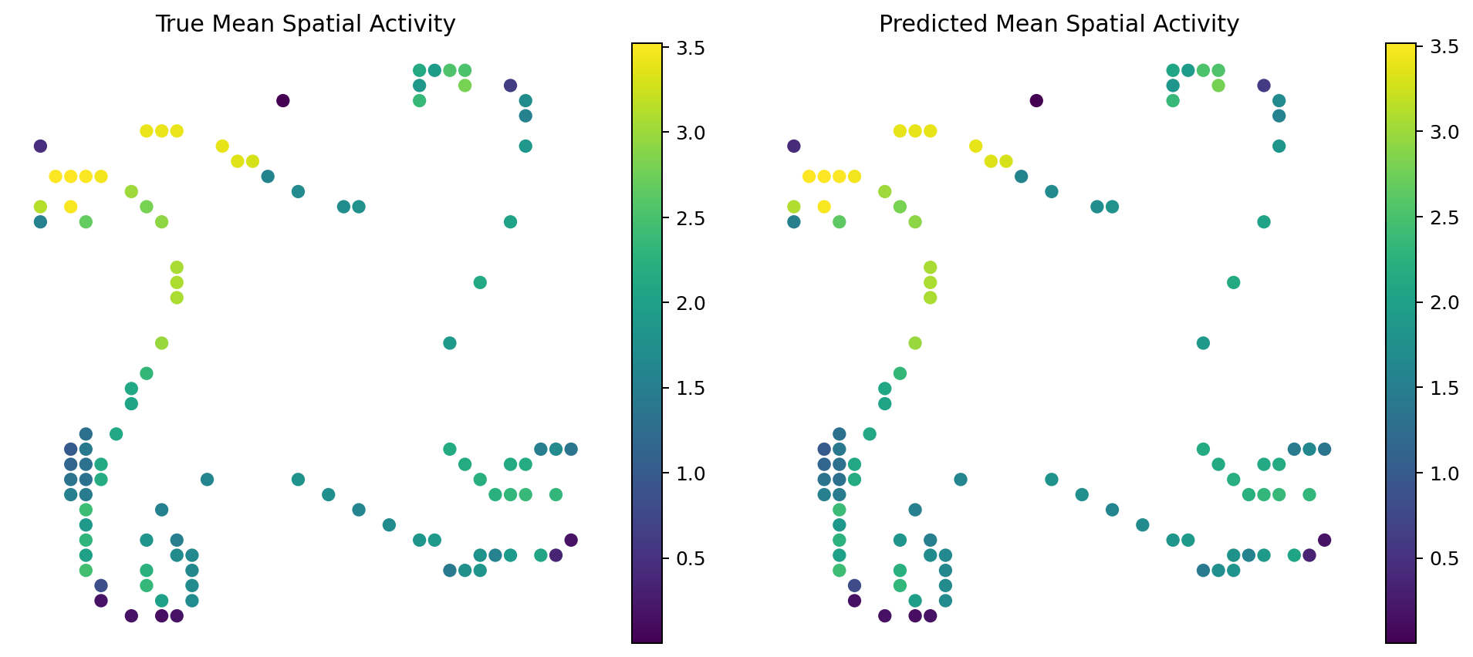
Task 2: predicting spike responses
Predict the full binned spike-train response for hidden stimulation trials.
TASK 2 INPUT
graph
PSTH
decoder
Y-hat response
105 electrodes x 80 time bins
pattern ID + frequency
24-step causal stimulation history
electrode coordinates and train-only rates
16
34
9,839
stimulation patterns
stimulation frequencies
hidden test trials
Final setting: network 5, DIV 40, shared final data; held-out test has no response targets.
Group 4 · Task 2 Prediction
5

Slide 6
Model: metric-aligned adaptive graph PSTH
A baseline-plus-residual decoder predicts electrode x time firing probability.
KEY ASSUMPTION
Responses are partly repeatable for a pattern/frequency, but trial history and electrode topology shift the exact PSTH.
Pattern + freq
baseline
History GRU
+ z-windows
Hybrid graph
residual
W1 blend
prior
context
where/when
metric fit
WHY THIS MODEL
•
uses the final metric: 1 ms PSTH W1
MODEL OUTPUT
•
keeps strong pattern-frequency priors
logits = baseline_logits + residual_scale x learned_residual
•
adds causal history and electrode graph context
•
predicts the full distribution, not a class label
Not a Task 1-style classifier: Task 2 needs calibrated electrode-time probability mass and timing.
Group 4 · Task 2 Prediction
6

Slide 7
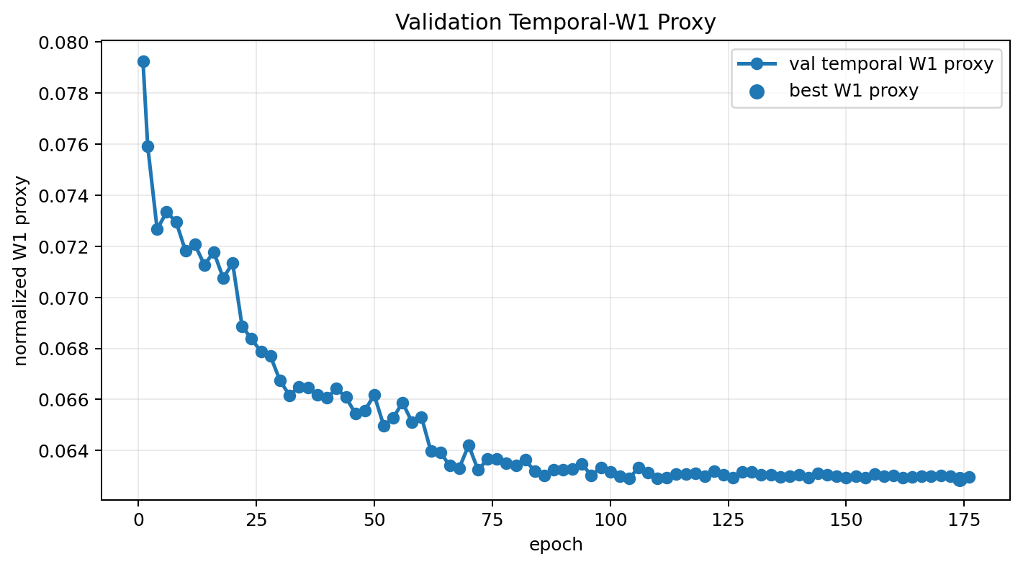
What we tried: align the model to the scoring metric
The winning design came from replacing BCE-only selection with W1/PSTH diagnostics.
WHAT WE TRIED
Pattern averages
too static; misses history/frequency detail
BCE C4 + GRU + freqRBF
strong BCE baseline, not W1-aligned
Loop/gated topology
limited DIV21 W1 gain; setup changed
Raw neural model only
worse than W1-selected blend
Selection switched from BCE-only checkpoints to a final-style weighted 1 ms PSTH W1 proxy.
Group 4 · Task 2 Prediction
7

Slide 8
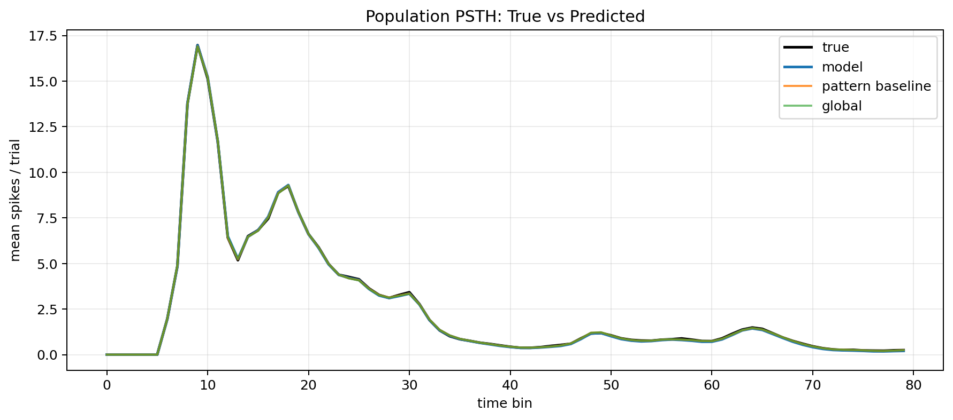
Results: W1 improves after baseline/model blending
The selected robust-grid seed-7 checkpoint achieved the lowest validation W1 proxy among completed runs.
0.3506 ms
RAW MODEL
PATTERN BASELINE
COUNT FIT
blended weighted W1 proxy
23.3%
31.8%
0.91
selected submission checkpoint
better than raw model
better than pattern baseline
total-count correlation
test output: 9,839 x 105 x 80
FINDINGS
•
Pattern-frequency priors are strong but incomplete.
•
The learned residual improves timing and spatial allocation.
•
Validation-selected blending is essential for the W1 objective.
Group 4 · Task 2 Prediction
8

Slide 9
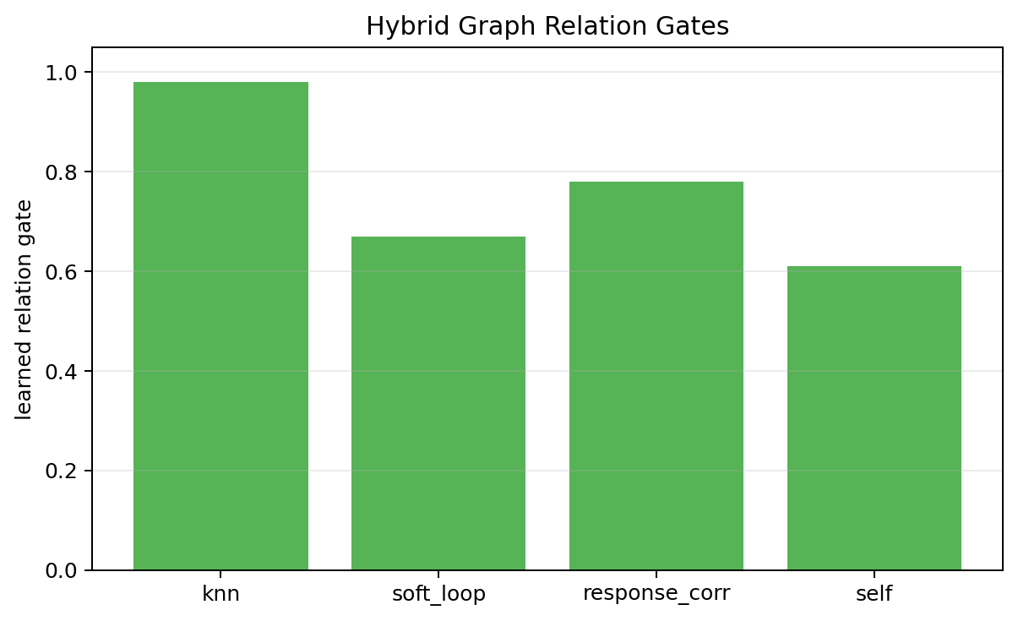
Generalization: frequencies yes, new patterns no
The answer depends on whether the stimulus identity was seen during training.
Our stance: possible for new frequency values of known patterns; not reliable for completely unseen stimulation patterns.
New frequencies
New combinations
New patterns
•
yes, mainly interpolation
•
yes, if pattern is known
•
no strong claim
•
frequency is a continuous input
•
all 16 pattern IDs were represented in training
•
pattern IDs are nominal learned embeddings
•
RBF/FiLM features can handle nearby values
•
pattern/frequency baselines and blend tables can fall back
•
no template or residual gate exists for an unseen ID
•
extrapolation outside the trained range is risky
•
best claim: known pattern, new frequency cell
•
needs retraining or physical stimulus descriptors
BOTTOM LINE
The model is an interpolation model over the trained stimulus family.
It can handle new frequencies/condition cells better than new pattern identities.
Group 4 · Task 2 Prediction
9

