Slide 1
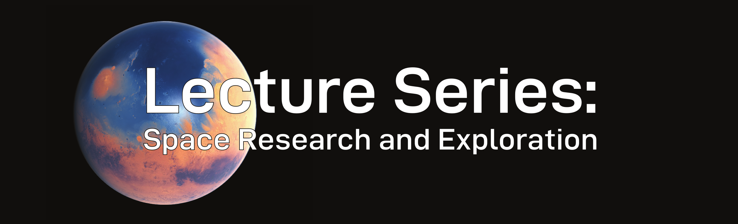
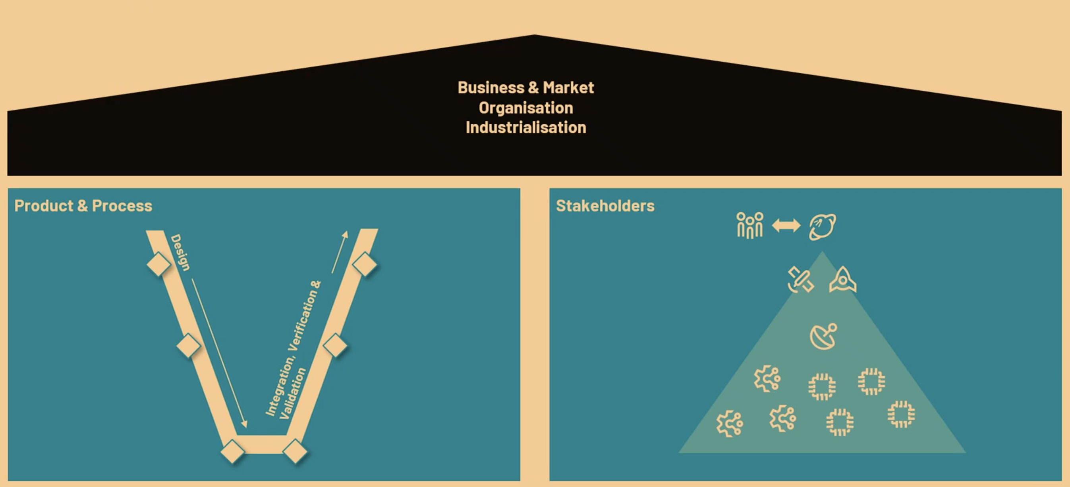
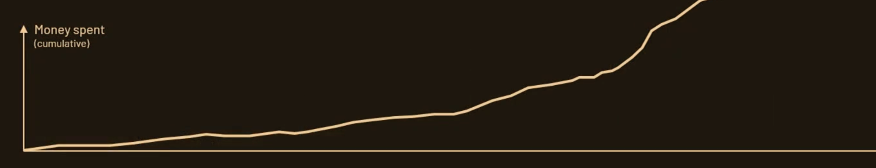
Accelerating the Space Industry
  Robert Jahnke (section 1, 4 and 5), Jivkaran Singh (section 2 and 3)
  04.11.2025, Maximilian Kirchhoff: An Industrial View on Implementing a Space Mission
1 Introduction
3 Main Insights
4 Open Questions
Although the lecture was centered around the LIFE Space Mission it provided an overview of the industrial approach to space in general. The space industry is characterized by the strong interrelationship between the public and private sector resulting in the unique challenge of navigating through fundamentally different approaches to mission management. This leads to the stakeholder dimension of a space mission being as important as the product and business dimensions.
The stakeholder dimension of a space mission determines the business approach: your product cycle strongly depends on the product cycles of your partners, suppliers, subcontractors and customers
Smart manufacturing is key to the business and product dimension: clean up requirements, delete processes, optimize, accelerate, automate
Scientific, non-profit missions can also integrate New Space philosophy: rapid iterations and a constant feedback loop
How do you determine to which degree you want to incorporate commercial approaches into your non-profit, scientific mission objective?
How do you deal with rapid technological change during mission cycle time?
How do you plan the future with funding uncertainty?
Traditional vs. New Space
2 Context
5 Discussion and Bigger Picture
Maximilian Kirchhoff is the Mission Study Preparation Lead of the LIFE Mission
The goal is to discover life beyond earth
While being a purely scientific mission, it nevertheless incorporates traditionally commercial product cycle methods
LIFEs approach leverages the industrial view on a mission to increase the probability of mission success
Serves as an example to other non-profit missions
Several concepts recur throughout all lectures. One of them is the dichotomy between traditional space and New Space. More fundamentally, however, there is a persistent question: how can one justify investing huge amounts of resources in projects that do not deliver immediate or obvious benefits and are largely driven by curiosity? It is precisely this primacy of curiosity that makes space exploration so inspiring.
^{Source: Lecture}
^{Source: Lecture}

