Slide 1

Software methodology
Spring 2020 ● lily chang ● associate teaching professor ● Rutgers Computer science

Slide 2
Class diagram

Slide 3
UML Classes
A class is the definition of the attributes, the operations, and the semantics of a set of objects
Classes are represented by rectangles which either bear only the name of the class (in bold), or show attributes and operations as well.
Class names begin with an uppercase letter and are singular nouns
Attributes and operations are listed at least with their names

Slide 4
Notation – UML classes

Slide 5
Attributes
An attribute is a data element which is contained in each object of a class
Each attribute is at least described by its name; a data type or a class, plus an initial value and constraints may be defined.
Attributes names begin with lowercase characters
Visibility modifiers
+ public, # protected, - private

Slide 6
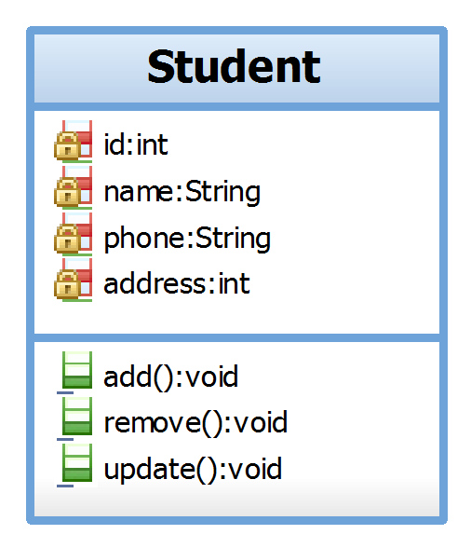
Operations or Methods
Operations are services which may be required from an object, and are described by their signatures (operation name, parameters and return type)
A method implements an operation
A message passes an object the information on the activity it is expected to carry out
A message consists of a name and a list of arguments

Slide 7
Associations
Dependencies and Generalizations represent difference level of importance or difference level of abstraction
Association is a structural relationship that specifies that objects of one thing are connected to objects of another (objects are peers)
You can navigate from an object of one class to an object of the other class, and vice versa. That is, objects rely on each other for services and data.
Associations may be annotated with information that describes the association.
These relationships identify public methods that are used to promote the relationship.

Slide 8
Association Example
multiplicity
Relationship name
▶
◀
roles

Slide 9
Multiplicity
Specify the number of objects of the opposite class to which an object can be associated
Cardinality—number of elements
Multiplicity—range of allowed cardinalities
1 | Exactly one
0, 1 | zero or one
0..4 | Between zero and four
3, 7 | Either three or seven
* | ditto
1..* | Greater than or equal to one
0..3, 7, 9..* | Between zero and three, or exactly seven, or greater than or equal to nine

Slide 10
Multiplicity Example

Slide 11
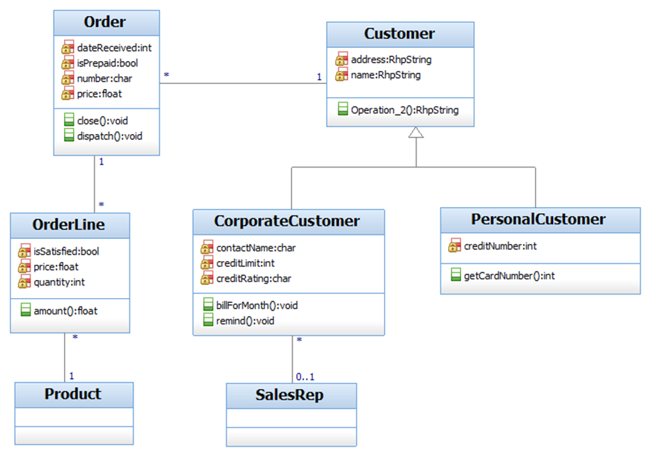
Class Diagram Example

Slide 12
Dependencies
Dependency is a “using” relationship
A change in specification of one thing may affect another thing that uses it
For example, one class uses another class as an argument in the signature of an operation

Slide 13
Generalizations
A relationship between a general thing (superclass) and a more specific kind of that thing (subclass)
“is-a-kind-of” relationship, for example, “rectangle” is a kind of “shape”
A subclass inherits the attributes and operations from its superclass and may add new methods or attributes of its own.
Generalization in the UML is implemented as inheritance in OO programming languages.

Slide 14
Generalization Example

Slide 15
Refining the Associations
Navigation
Aggregation
Composition

Slide 16
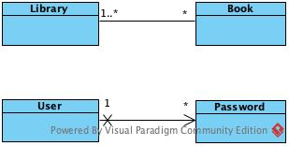
Navigation
Directed associations
For example,
Given a User, you’ll be able to find
the corresponding Password objects,
but given a Password you don’t want
to be able to identify the corresponding
User.

Slide 17
Aggregation
Aggregations are special associations that represent “part-whole” relationships
A “has-a” relationship, meaning that an object of the whole has objects of the part.
Exactly one end of the relation must be the aggregate (whole), and the other stand for the individual parts.
An aggregation is represented by a line drawn between two classes, and it is marked with a small empty diamond on the side of the aggregate

Slide 18
Aggregation Example
Customer class has the attributes of Address, Telecommunication and BankAccount
Address, Telecommunication and BankAccount could be a part of other classes

Slide 19
Composition
A composition is a strict form of aggregation, in which the parts are existence dependent on the entirety
If a part is deleted, the aggregate survives.
If the aggregate is deleted, all parts are deleted with it
An object may be a part of only one composite at a time
The composite must manage the creation and destruction of its parts

Slide 20
Composition Example
Customer class has the attributes of Address and BankAccount
Address and BankAccount CANNOT be a part of other classes
Address and BankAccount live and die with the Customer

Slide 21
How would you interpret the Diagrams?

Slide 22
Rules for Class Diagram
Class names: singular nouns (occasionally, noun phrases) , begin with an uppercase letter
Attributes: nouns; usually begin with a lowercase letter
Operations: verbs/verb phrases, or nouns if it is a value-returning operation
Use legal identifiers in target language, no reserved words, no illegal characters

Slide 23

Thank You

