Slide 1
Image Classification
on Breast Cancer
Statistic Learning and Deep Learning Final Project
烈焰旋風地瓜龍珠
吳冠磊 謝博任 簡睿閎 林書戎 呂皓恩 黃茹暄
Notes:
2021-12-30 下午11:59以前: 自行錄製報告影片上傳最後期限 (包含報告影片、報告投影片、IPYNB檔案與資料檔至COOL作業區)
每組報告的時間為 15分鐘。

Slide 2
Outline
1
4
2
5
3
6
Background
Model Training
Collection of Dataset
Result Evaluation
Dataset Preprocessing
Conclusion

Slide 3
Background
Invasive breast carcinoma with extensive intraductal component (EIC) may result in an incomplete surgical resection, and thus increase risk of local recurrence.
Pre-operative prediction of EIC-positive tumor can help breast surgeon make a surgical plan, and then improve surgical outcome.

Slide 4
Collection of Dataset
For the dataset collection, we cooperate with 蔡蕙怡, a radiologist from Kaohsiung Medical University who is now dedicated in research about applying machine learning on medical image.
The dataset we get is one csv file and 2772 set of images. The csv file is for us to map each image to its outcome and each set of image contains one dicom file and one nrrd file.
The dicom file is the original image and nrrd file is a mask which shows the region we are interested in.

Slide 5
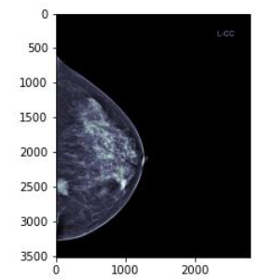
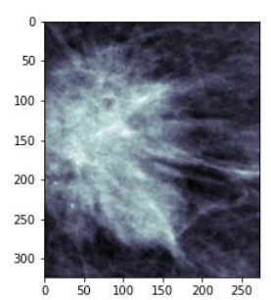
Data Preprocessing - Image cutting
We use the nrrd file to get the position of the tumor and cut it off.
Then we use the image cut off as our input data.
original image image cut off

Slide 6


Data Preprocessing - Remove Bad Image
Removed few broken dicom files or some that cannot be mapped by the csv file.
Resize images to 1000*1000 pixel
Cutting the original image into narrow rectangles, and then resize, may lead to broken images.

Slide 7
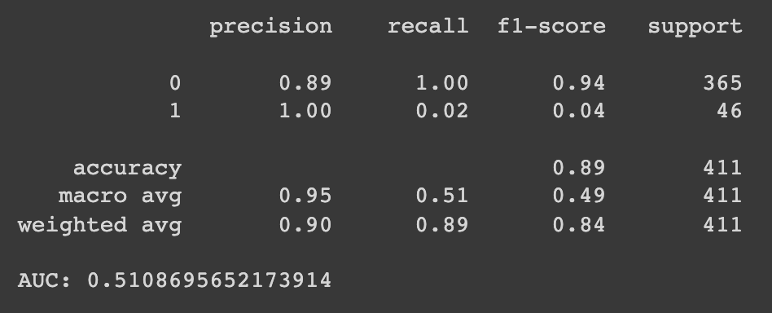
Data Preprocessing - Unbalanced dataset
Original Data
train(0.7), validation(0.15), test(0.15)
positive(0.11), negative(0.89)
unbalanced! -> poor prediction on class positive

Slide 8
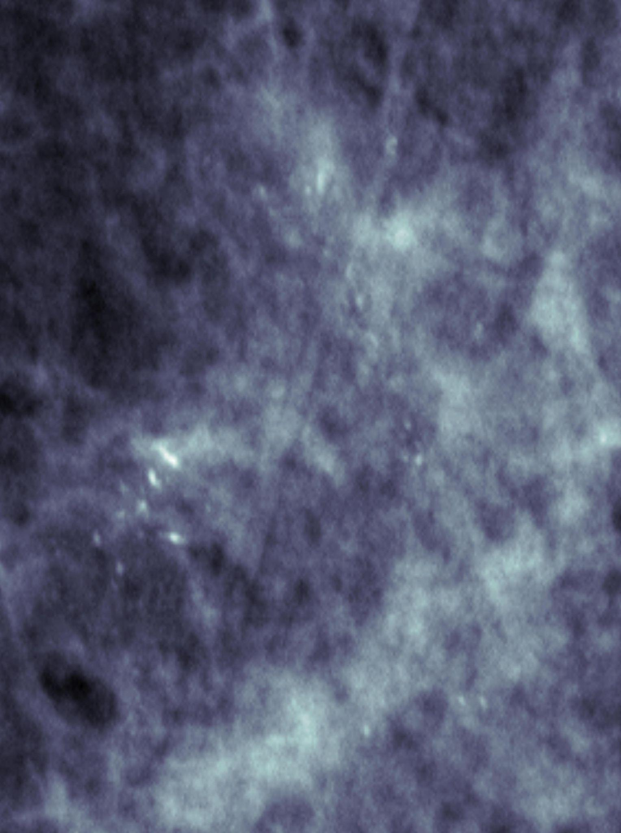
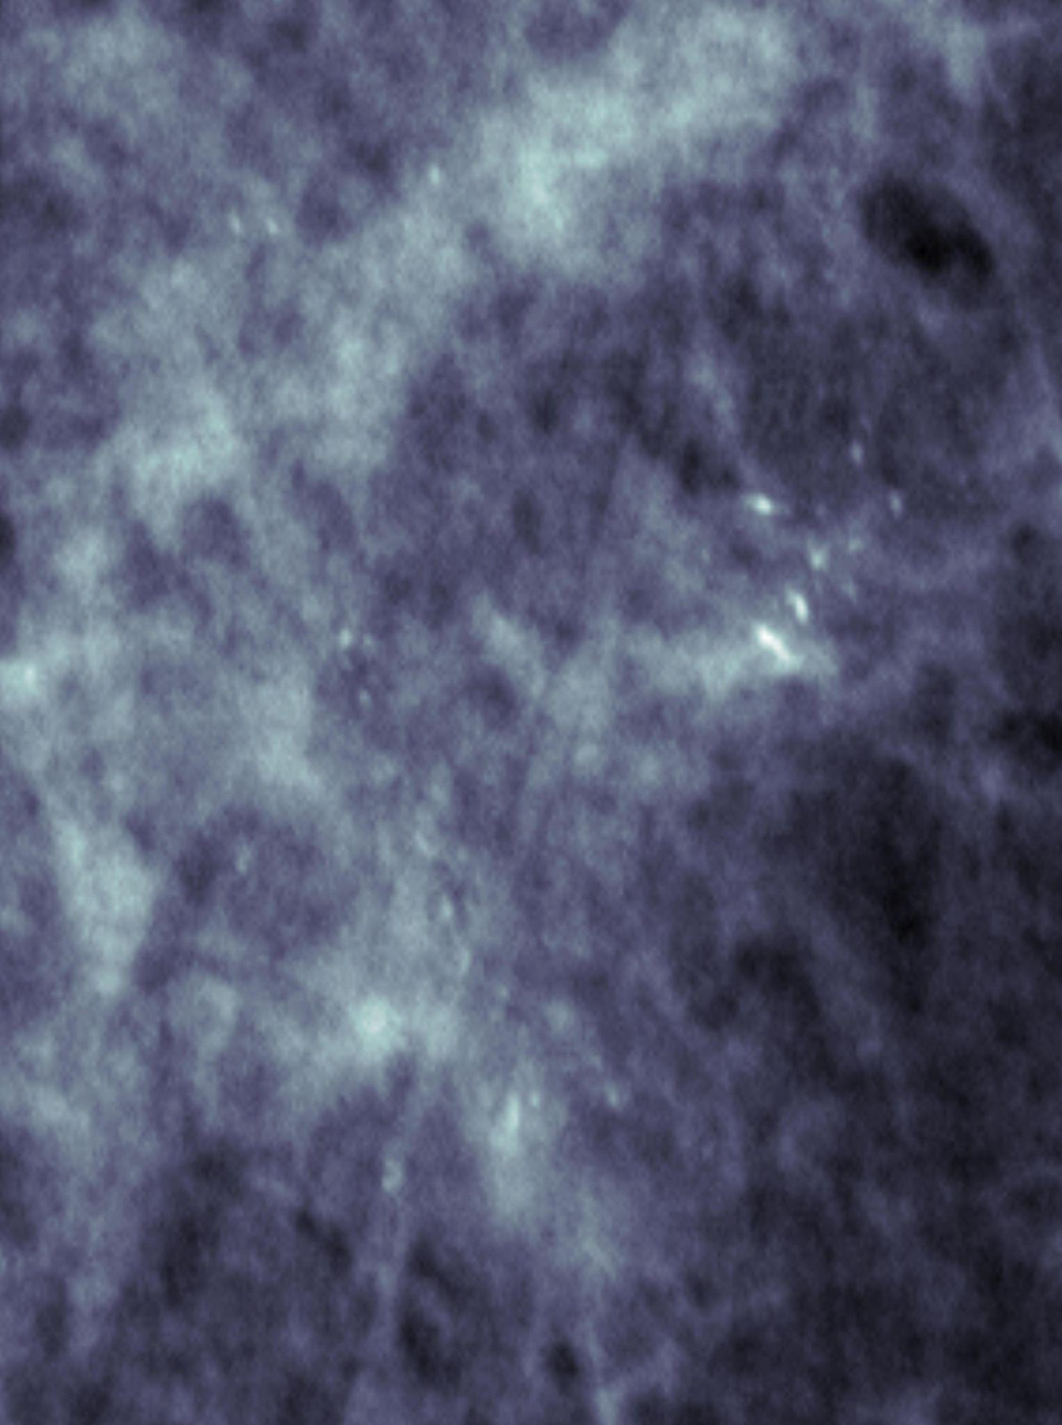
Data Preprocessing - Unbalanced Dataset
Augmentation
flip & rotate in both classes
expand to 2484 images in both classes of train set
Exam if augmentation works on validation
-> original vs. augmented
(positive : negative = 3 : 7)

Slide 9
Model training – Basic Setting
Loss Function: BCE loss
Optimizer: Adam (learning rate = 0.0001)
Early stopping:
Calculate training loss and validation loss every 10 batches
Save model if validation loss reaches historical low
Stop training if no validation loss is lower after 1000 batches

Slide 10
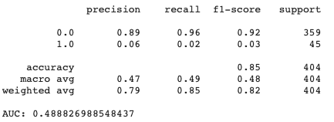
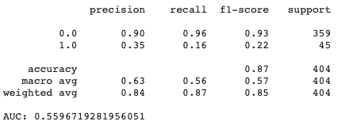
Model training - Result Evaluation
MLP
CNN

Slide 11
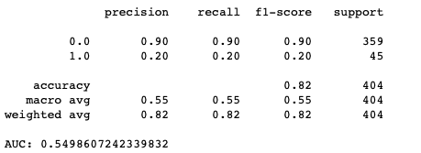
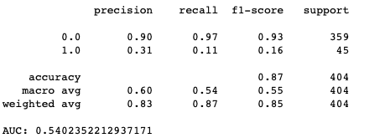
Model training - Result Evaluation
Resnet 18
Resnet 34

Slide 12
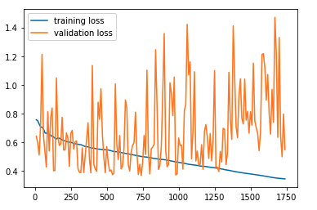
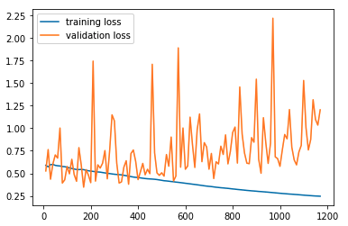
Model training - Effect of Batch Size
Shows no significance difference in perforemnce (AUC 0.53 vs. 0.55)
Resnet 18
Batch Size = 16
Batch Size = 32

Slide 13
Model training - Effect of Model Complexity
the Simplest Model–MLP is poor
However, higher complexity doesn’t guaruntee better performance
CNN achieves the highest AUC and ACC
Resnet34 achieves higher ACC while Resnet18 achieves higher AUC

Slide 14
Model training - Result Evaluation
MLP
CNN

Slide 15
Model training - Result Evaluation
Resnet 18
Resnet 34

Slide 16
Model training - Increasing Recall
Augmentation
on Validation Set
Adjust Probability Threshold
Add Weight to Loss Function by Class
slight increase in AUC
significant decrease in accuracy
Notes:
TP: true positive

Slide 17
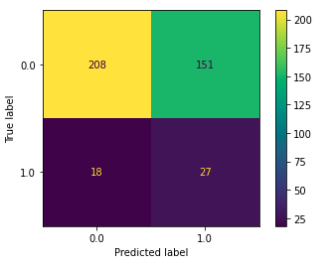
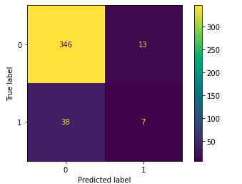
Model training - Comparison
Before
After

Slide 18
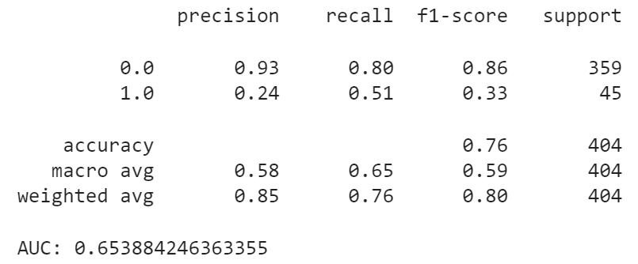
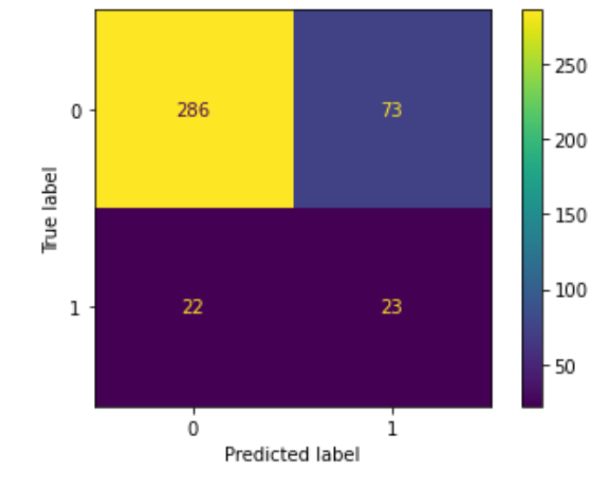
Model training - Result Evaluation
CNN +
Augmentation on validation data
Accuracy = 0.765

Slide 19
Conclusion
Insight
Things to improve …
We can find models emphasizing either AUC or accuracy, depending on the main requirement of doctors.
Need better hardware to try more other models
Need more positive data
Notes:
Improvement by augmentation on imbalanced data is limited

Slide 20
THANK YOU !

