Slide 1
Closest pair problem
By Costean Robert Sorin

Slide 2
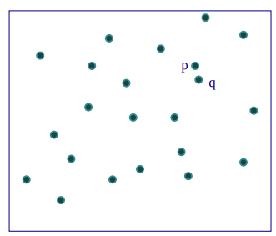
The closest pair problem is a problem in computer science and mathematics that involves finding the pair of points with the smallest distance among a set of points in a plane or in a higher-dimensional space. The points can represent a variety of objects, such as cities, restaurants, or data points in a dataset.

Slide 3
Practical applications of this problem
Computational geometry: The closest pair problem is a classic problem in computational geometry, and it has a number of applications in this field. For example, it can be used to find the shortest distance between two objects in a 3D space, or to determine the nearest pair of points in a set of points that represent a geometric shape.
Data analysis and machine learning: In data analysis and machine learning, the closest pair problem can be used to find patterns and relationships in data. For example, it can be used to identify clusters of data points that are similar to each other, or to identify outliers in a dataset.
Image processing: In image processing, the closest pair problem can be used to identify objects in an image by finding pairs of pixels that are similar to each other.

Slide 4
Practical applications of this problem
Robotics: In robotics, the closest pair problem can be used to navigate a robot through a cluttered environment by identifying the nearest obstacles and avoiding them.
Geographic information systems: In geographic information systems (GIS), the closest pair problem can be used to find the nearest pair of points in a dataset of geographic locations, such as the nearest pair of cities or the nearest pair of restaurants.

Slide 5
Naive approach
The brute force method is a simple and straightforward approach to solving the closest pair problem, the basic idea behind the brute force method is to compare the distance between every pair of points and keep track of the minimum distance. This can be done using a nested loop, where the outer loop iterates over each point in the set and the inner loop iterates over the remaining points. For each pair of points, the distance is calculated and compared to the current minimum distance. If the distance is smaller, the minimum distance is updated and the pair of points is recorded, however this algorithm is going to have O(n^2) time complexity and we can do better than that.

Slide 6
Improved algorithm
Fortunately, there are more efficient algorithms available that can solve the closest pair problem in less time. One such algorithm is the divide and conquer approach, which has a time complexity of O(n log n). This means that it can solve the problem much faster for large sets of points, making it a more practical choice in many situations.
The divide and conquer approach is a technique for solving problems by dividing them into smaller subproblems, solving each subproblem independently, and then combining the solutions to obtain a solution to the original problem.

Slide 7
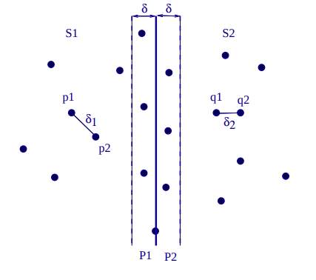
Improved algorithm
In the context of the closest pair problem, the divide and conquer approach works by dividing the set of points into two halves and recursively solving the problem on each half. The subproblems are then combined to find the overall solution.
To find the minimum distance in each subproblem, the divide and conquer approach uses a three-step process:
Find the median of the x-coordinates of the points.
Divide the points into two halves based on their x-coordinates, with one half on either side of the median.
Find the minimum distance between the points in each half, and also the minimum distance between points that straddle the median.

Slide 8
Improved algorithm
We consider that a point is straddling the median if the points is at most δ distance away from the middle line dividing the two sets. The minimum distance between points that straddle the median can be found in O(n) time by sorting the points by their y-coordinates and comparing the distances between the points in a sliding window.
Once the minimum distances for each subproblem have been found, the overall minimum distance can be obtained by comparing the minimum distances of the subproblems and taking the minimum of the three values.

Slide 9
Improved algorithm
To calculate the time complexity of the divide and conquer approach, we consider the number of comparisons that are made at each step. In the first step, the points are divided into two halves, which requires O(n) comparisons. In the second step, the minimum distance is found in each half and between points that straddle the median, which requires O(n log n) comparisons. Therefore, the overall time complexity of the divide and conquer approach is O(n + n log n) = O(n log n).
The time complexity of the divide and conquer approach is O(n log n), which is significantly faster than the O(n^2) time complexity of the brute force method for large sets of points. However, it requires more complex code to implement, and it may not be the most efficient solution for small sets of points.

Slide 10
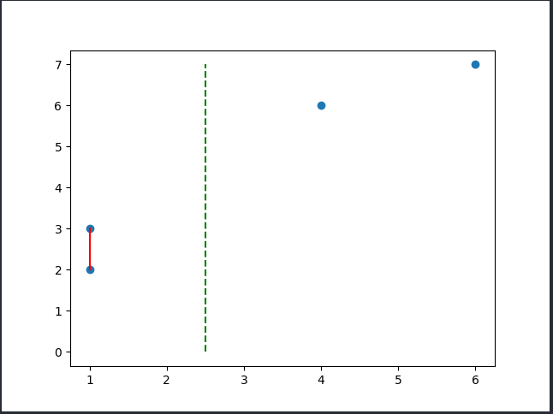

An example
For the set of points [(1, 2), (1, 3), (3, 5), (6, 9)], the first 2 are on the left half and the last 2 are on the right half. There are no points close enough to the median line, so the result will be the minimum of the distances between (1, 2) and (1, 3) and between (3, 5) and (6, 9) which ends up being 1 and the closest pair is [(1, 2), (1, 3)].
Result from implementation in python
Graphical representation using the matplotlib library in python

Slide 11
Bibliography
https://sites.cs.ucsb.edu/~suri/cs235/ClosestPair.pdf

