Slide 1
Library system
By Costean Robert

Slide 2
The point of the project
This project is the beginning to a backend service for an online library, having the ability to add authors, books and book stores to the MySQL database. It can also query the data located in the database to the screen.

Slide 3
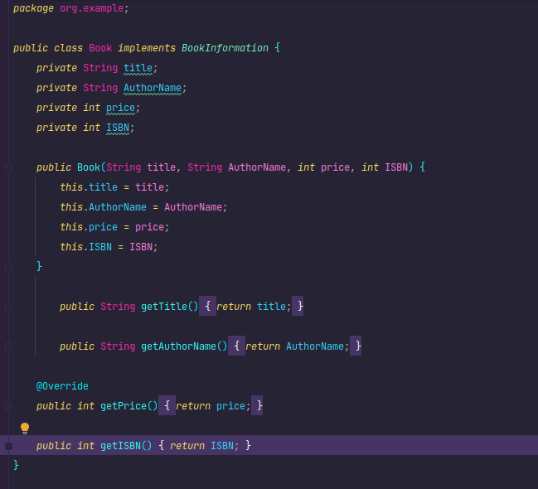
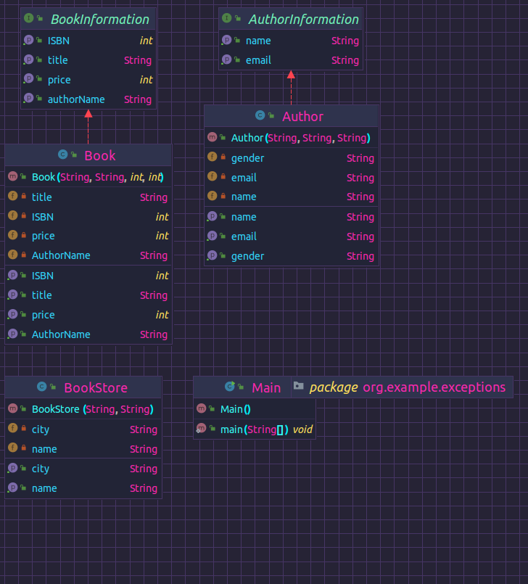
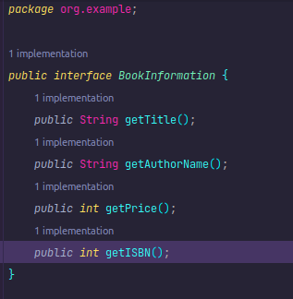
Classes
This point required me to create a visual representation of the classes and interfaces in your project and how they relate to one another. It also required you to use at least two collections in your project.

Slide 4
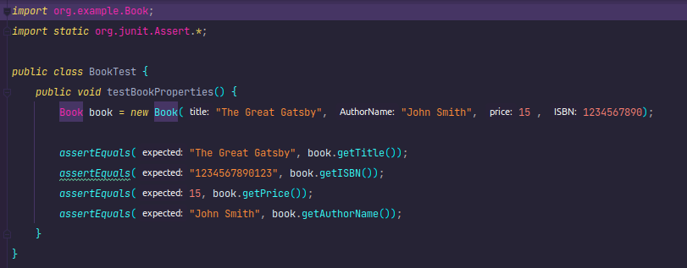
Tests
This point required me to create test cases to ensure that each class in my project is working correctly.

Slide 5
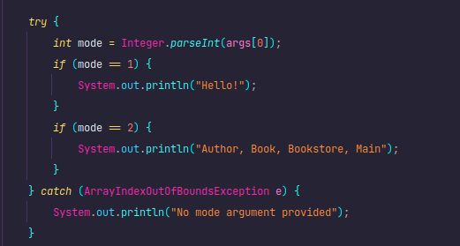
Program arguments
This point required me to use configuration files or program arguments to allow the program to be run in different ways. So I made print messages for certain program arguments.

Slide 6
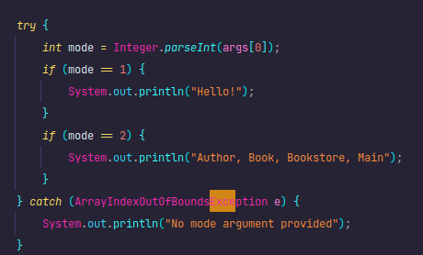
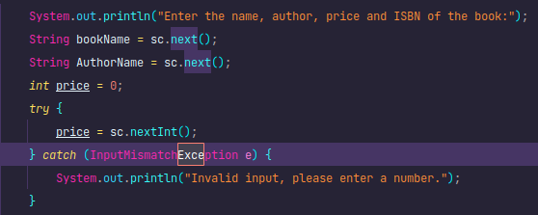
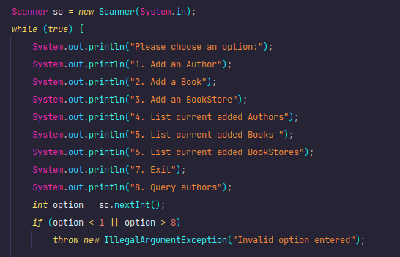
Language exceptions
This point required me to identify and handle at least 3 language exceptions that may occur in my project.

Slide 7
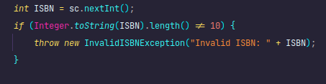
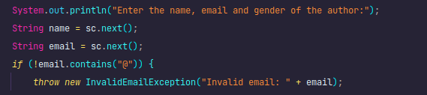

Custom exceptions
This point required me to create at least 3 custom exceptions specific to my project. These exceptions would be used to handle specific error cases that may occur within my program.

Slide 8
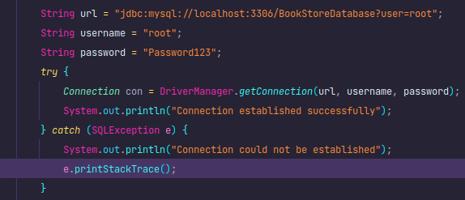
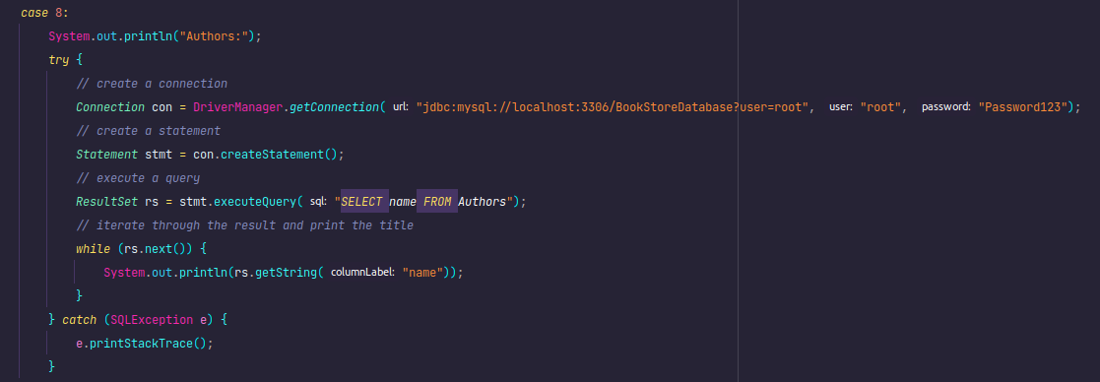
Querying data
I created a connection with the database using the JDBC API and ran a sample query to retrieve data from a table. I also displayed the data on the screen.

Slide 9
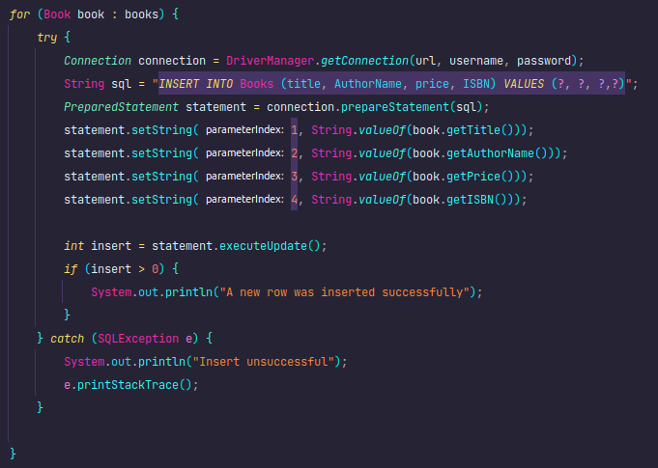
Inserting data
I implemented functionality to insert data from user input into the DB tables using SQL statements and the JDBC API.

Slide 10
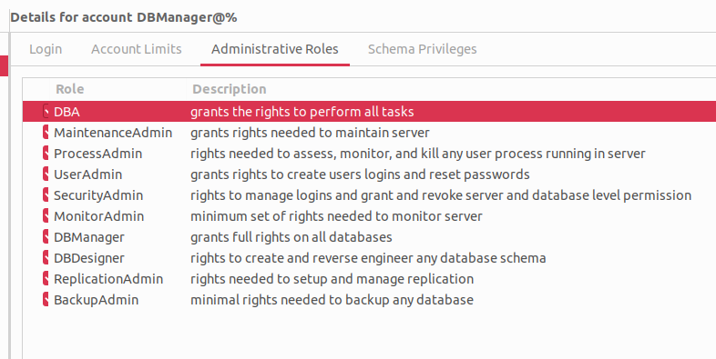
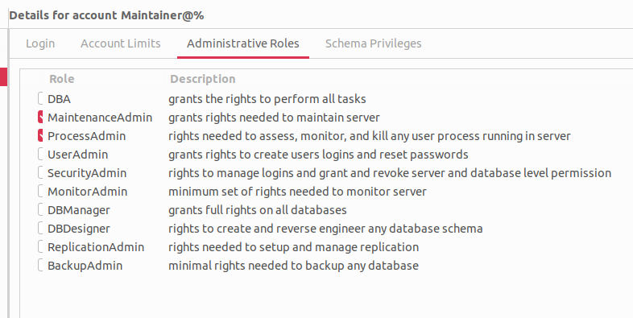
Managing DB roles
I created 2 roles for my database, the admin that has all the privileges and the maintainer.

