Slide 1
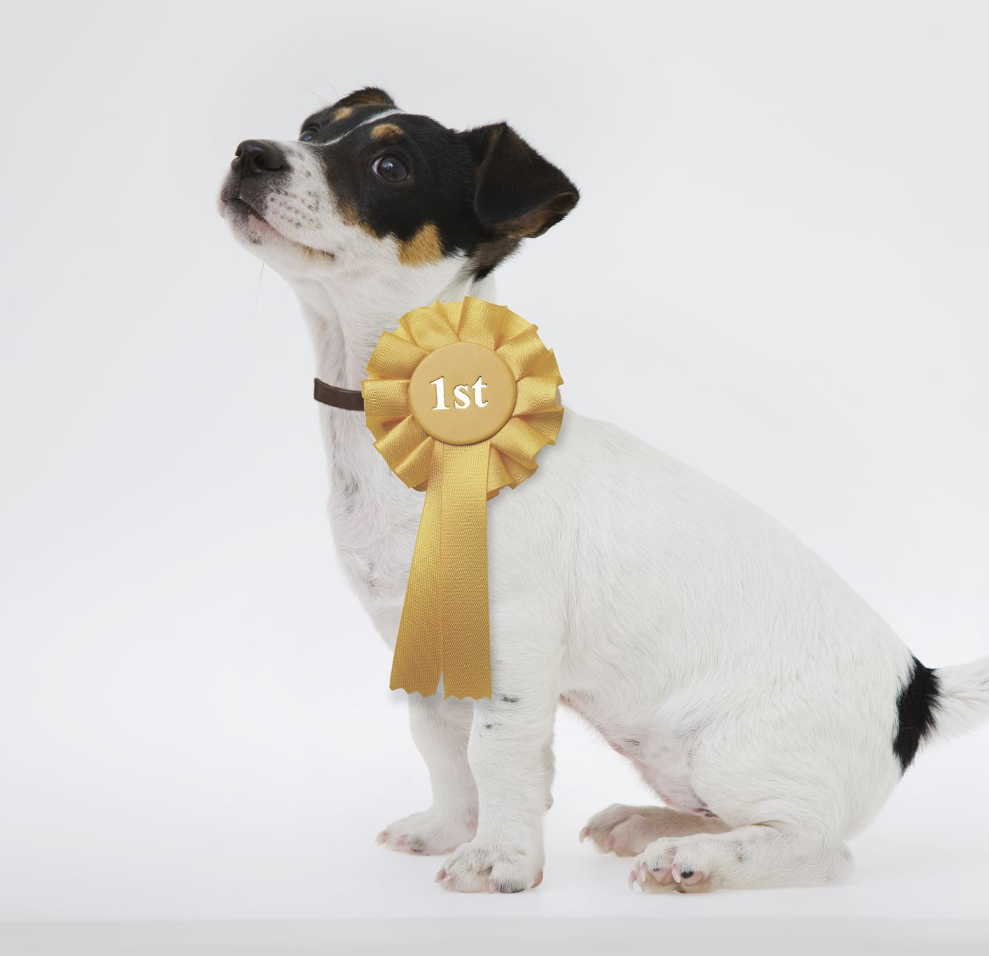
Paradise Pet Project Presentation
Group Members: Monica Berti, Robert Devaney, Bao Nguyen, Celeste Petro

Slide 2
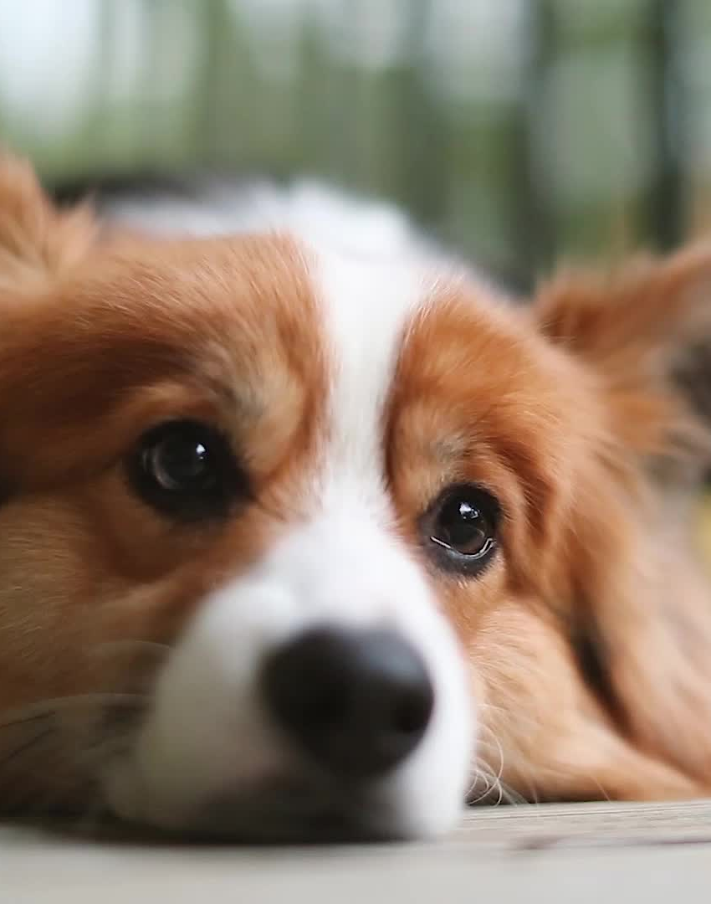
Introduction
Welcome to the Paradise Pet Project, where our endeavor is to transform the way pet adoption and donations are managed through innovative technology.
Backend Database Development Team: Monica Berti and Robert Devaney
Frontend Web Design: Bao Nguyen and Celeste Petro

Slide 3
Front End Progress
Languages and Frameworks used: HTML5, CSS3, Javascript, CSS Framework Tailwind, JQuery.
Work on Adoption Applications.
Donated Page, where you can submit the amount, you want to donate to the organization.
About Us/ Contact Us forms, gives information about Pet Paradise Rescue as well as the different types of Animals, and a Contact Us form where you can use your name and email address to ask any questions.

Slide 4
Database Integration Progress
Languages used: PHP
PHP Files Created in this milestone:
database.php
Contains database connectivity settings
Helps promote database security and prevents redundant code.
fetch_pets.php
Creates MySQl query for Pets database, and outputs data as a JSON file.
Javascript file will read JSON file and allow popups to display information about each pet.

Slide 5
Database Integration Troubleshooting
Ensuring the JSON file created by fetch_pets is formatted correctly
Ensuring Javascript file is able to read JSON file, and will generate pet information in each popup.
Converting tinyInt values from database, into ‘Yes’ and ‘No’ in javascript to make information more user friendly.
Although functional, the addition of the database integration in the Pet Search Page caused the format to change. Will work on correcting format in next Milestone.

Slide 6
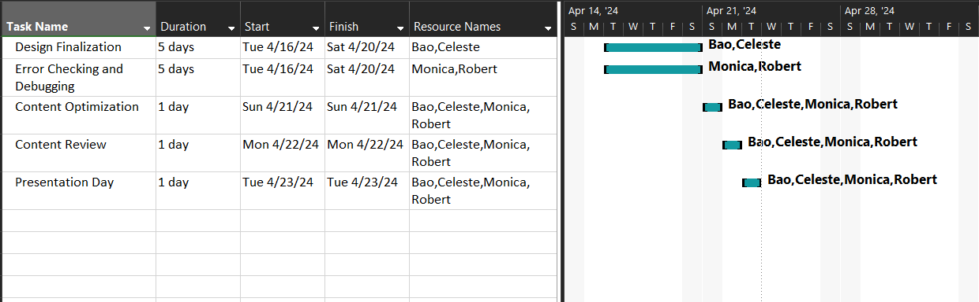
Gantt Chart

Slide 7
GitHub Repository
Rancor Group GitHub Link:
https://github.com/RobertDevaney/ParadisePetRescue

Slide 8
Next Steps and Milestones
Going forward, we will continue to work on completing the front-end of the web application and use PHP to transmit data from the front-end to the database. Testing and Debugging will then be performed.

Slide 9
Q&A
We’d love to answer any questions you have about the Paradise Pet project and our journey so far.

