Slide 1
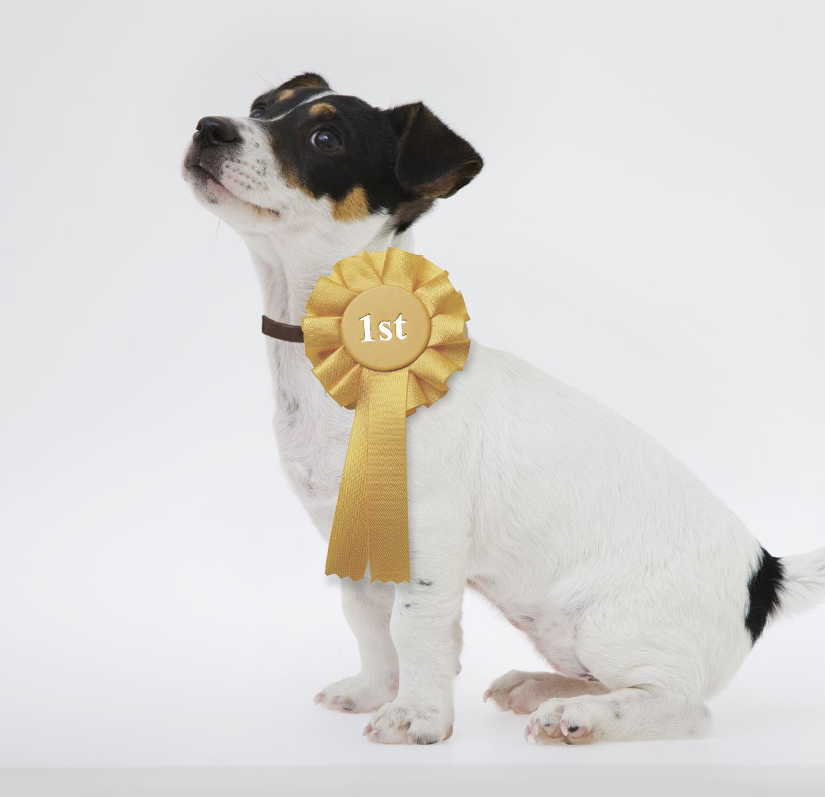
Paradise Pet Project Presentation
Group Members: Monica Berti, Robert Devaney, Bao Nguyen, Celeste Petro

Slide 2
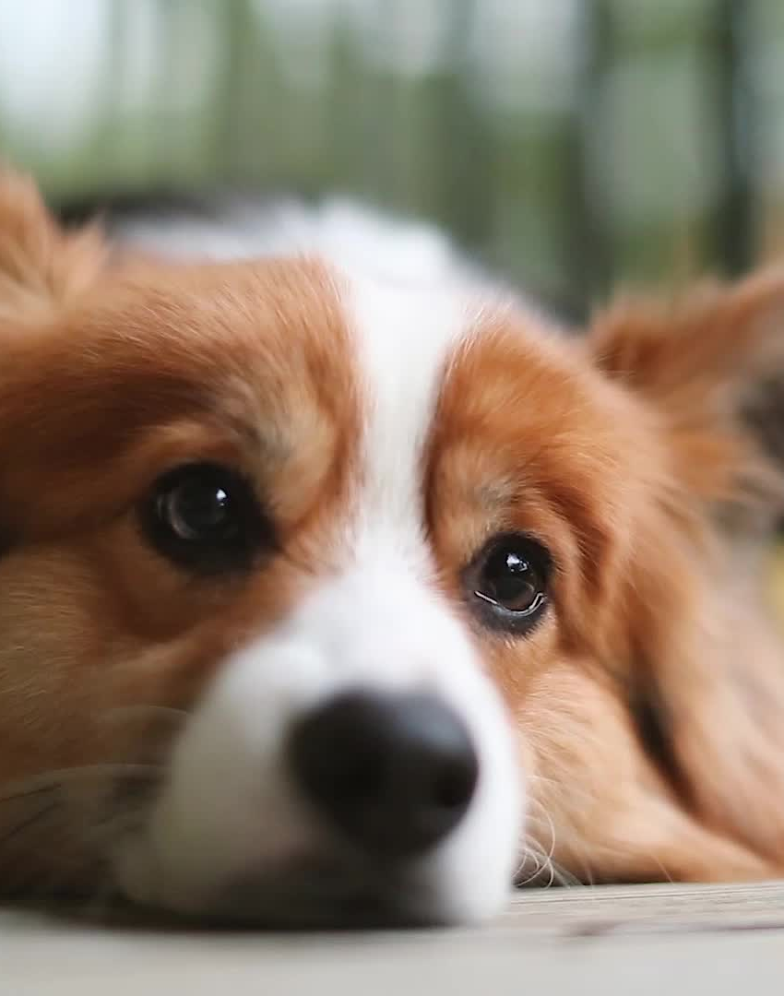
Introduction
Welcome to the Paradise Pet Project, where our endeavor is to transform the way pet adoption and donations are managed through innovative technology.
Backend Database Development Team: Monica Berti and Robert Devaney
Frontend Web Design: Bao Nguyen and Celeste Petro

Slide 3
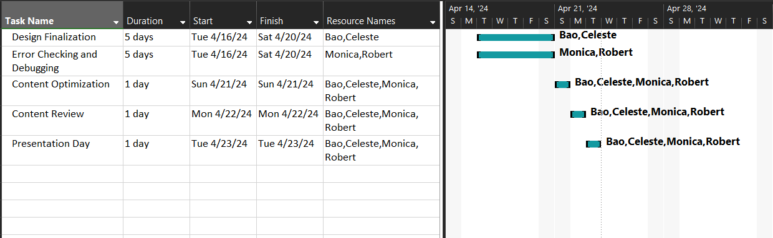
Gantt Chart From: 4/15 – 22 (Presentation Day)

Slide 4
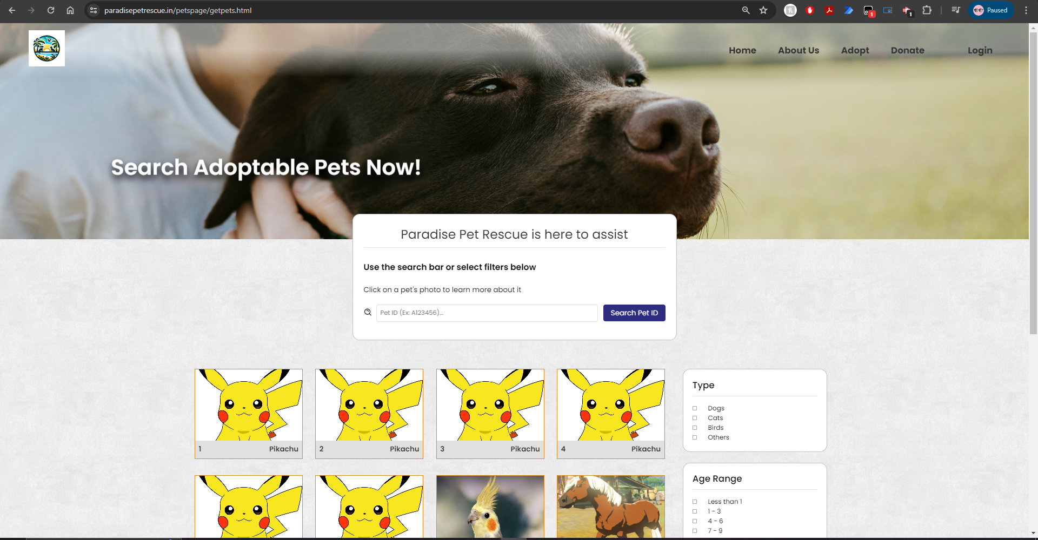
Our Pets Search Page

Slide 5
Front End Progress
Designed a new page dedicated for searching pets, based on the Orange County Animal Service website:
Included a distinct slot for each pet to be displayed on the page
Featured a filter section & search bar for refining searches
A pop-up window of further info for a pet whenever its slot is clicked
Languages/Frameworks:
HTML5
CSS3
JavaScript
CSS Framework Tailwind
JQuery

Slide 6
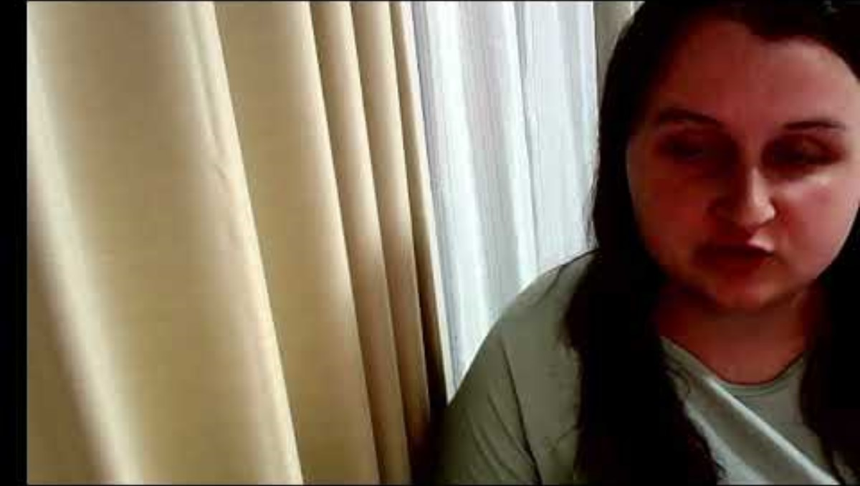
Celeste’s Video

Slide 7
Database Integration Progress
PHP Files Created in this milestone:
database.php
Contains database connectivity settings
Helps promote database security and prevents redundant code.
fetch_pets.php
Creates MySQL query for Pets database, and outputs data as a JSON file.
JavaScript file will read JSON file and allow popups to display information about each pet.
Languages/Frameworks:
PHP

Slide 8
Database Integration Troubleshooting
Ensuring the JSON file created by fetch_pets is formatted correctly
Ensuring Javascript file is able to read JSON file, and will generate pet information in each popup.
Converting tinyInt values from database, into ‘Yes’ and ‘No’ in javascript to make information more user friendly.
Although functional, the addition of the database integration in the Pet Search Page caused the format to change. Will work on correcting format in next Milestone.

Slide 9
For Last Milestone

Slide 10
One page still missing:
admin.html
Only exclusive to users w/ admin privileges (authenticated via login)
Allows them to add/remove/edit pets directly from the database via the webpage
Revamp other pages to match theme
Add missing functionalities to GUIs
Decide the best fit for presenters!
SUIT UP & PRESENT!

Slide 11
GitHub Repository
Rancor Group GitHub Link:
https://github.com/RobertDevaney/ParadisePetRescue

Slide 12
Q&A
We’d love to answer any questions you have about the Paradise Pet project and our journey so far.

