Slide 2

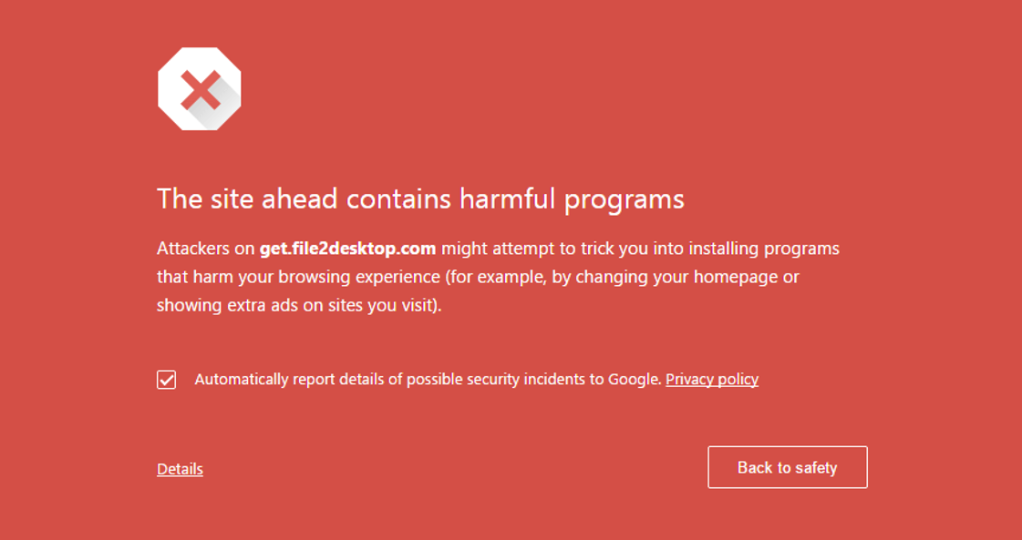
Notes:
When I was young…
Using the family computer
Surfing the internet for games to play (for free)
After clicking around, I got this error message
[CLICK]
Naturally, I overreacted and quickly shutdown the computer
(maybe unplugged it too)
As I got older, I began to wonder how the computer knew the site was malicious…

Slide 3
www.richym.com
www.boahq.com
www.pwsbn.com
ecoonlineb.com
get.file2desktop.com
www.dnb-lt.com
www.assetbkplc.com
treasureaviary.co
www.csonlinetx.com
www.trustpacifics.com
Notes:
A natural place to start would be a blacklist (or list of known malicious sites)
Then you go down the list and check, one-by-one, if the site is on the list
But the internet is a very dangerous place, full of horrible people
There are hundreds of thousands of malicious sites
This list will take up a lot of storage
Going through this list would take a long time
And checking through this entire list every time you visit a website?
This would be very intensive.
There must be a better way.

Slide 4
Bloom Filters: The Internet’s Silent Defenders
By Robert Durfee
Notes:
Thankfully, there is better way!
A very smart man, Burton Bloom, who attend MIT a long time ago developed a way to quickly determine if our site is in our blacklist
(Without going through the entire list)
And, it takes up a very small amount of space.
To explain this crazy (seemingly impossible) idea, I will
Use a shape analogy to show the idea behind Bloom filters
Apply the observations from the shape analogy to create a Bloom filter for checking malicious websites

Slide 5
















Notes:
To understand the intuition behind a Bloom filter, lets abstract away to an example with a more obvious solution
Suppose you have a set of blue and red shapes
Take a second to look at these shapes

Slide 6
Notes:
Now, this is not a trick question, who thinks this shape is in our set?
Clearly, this shape is not in our set.
But how did we know this so quickly?
We didn’t compare this shape to each individual.
Surely we don’t even remember all the shapes in our set

Slide 7
Red, Blue, Yellow
3 Edges
Divided Along Horizontal
Red and/or Blue
0 – 9 Edges
Divided Along Diagonal
Red and Blue
6 Edges
Divided Along Diagonal
Notes:
So when you looked at this set, you likely noticed some qualities, even if is was subconscious
Such as
all the shapes are blue and or red,
they have between 0 and 9 edges
The colors are divided along a diagonal
When you saw this triangle, you noticed some other things
Such as
It is red, blue and yellow
It has three edges
The colors are divided along the horizontal
So there are two qualities of this shape which make it incompatible with the shapes in our set

Slide 8
www.richym.com
www.richym.com
www.richym.com
www.richym.com
www.boahq.com
www.boahq.com
www.boahq.com
www.boahq.com
www.pwsbn.com
www.pwsbn.com
www.pwsbn.com
www.pwsbn.com
ecoonlineb.com
ecoonlineb.com
ecoonlineb.com
ecoonlineb.com
Number of Vowels
www.dnb-lt.com
www.dnb-lt.com
www.dnb-lt.com
www.dnb-lt.com
Length
www.assetbkplc.com
Number of Consonants
www.assetbkplc.com
www.assetbkplc.com
www.assetbkplc.com
treasureaviary.co
treasureaviary.co
treasureaviary.co
treasureaviary.co
www.csonlinetx.com
www.csonlinetx.com
www.csonlinetx.com
www.csonlinetx.com
www.trustpacifics.com
www.trustpacifics.com
www.trustpacifics.com
www.trustpacifics.com
Notes:
So lets apply what we learned from the shape example to the real-world application of malicious websites
For simplicity, let’s focus on the domain name only (what is between ‘www’ and ‘dot com’)
Like with the shapes, these domains have certain characteristics
Such as
Number of vowels
Length
Number of Consonants

Slide 9
1
2
3
4
5
6
7
8
9
10
11
12
Notes:
To hold these values, lets create an array with twelve open slots
(I chose 12 because the longest domain name has 12 characters so 12 is the maximum value for each of the characteristics we chose)
Now, we can go through each domain name and fill the slots of the array that match each characteristic.

Slide 10
www.richym.com
www.richym.com
www.richym.com
www.richym.com
Notes:
For this domain, there is only one vowel
So the first slot of the array is filled
There are also 5 consonants
So the fifth slot is filled
And the domain has a total of 6 characters
So the sixth slot is filled.

Slide 11
ecoonline.com
Notes:
And we can repeat this for another domain
For simplicity and the sake of time, we will stop with two domains

Slide 12
www.richym.com
ecoonline.com
Notes:
As it stands right now, we haven’t done anything spectacular
We still have the same number of entries on our blacklist from before, only now they appear as arrays instead of domain names
But now, we can overlap these two arrays to create a single array
Notice they are no longer colored because the array doesn’t keep track of the source of the filled slots, I only used the colors to show you how I reached this array
Now the information about the two domains are contained within one array
This constitutes the ‘add’ operation of a Bloom filter
And, don’t forget, this can be done for all our domains, not just two
So we have reduced the space to hold the entire blacklist into the length of the longest domain name
This is an incredible improvement from an ordinary list

Slide 13
get.file2desktop.com
get.file2desktop.com
get.file2desktop.com
get.file2desktop.com
Notes:
We can now use this bloom filter to test whether our requested domain is on our blacklist
First, we check the number of vowels
Is there a domain on our list with 4 vowels?
Yes, there is
Okay, so the domain might be on our list
Is there a domain with 7 consonants?
No, there is not
Okay, so the domain cannot be on our list
For completeness, we can also check length,
And there is no domain on our list of length 12
How long did it take us to reach this result?
Instead of comparing the domain to all the domains on our blacklist, we made three simple comparisons
This is also an incredible improvement from the ordinary list!

Slide 14
www.gtryal-24.com
Notes:
Unfortunately, it is not always so clear cut
Supposed we are also trying to reach this domain
If we count the number of vowels, consonants, and the length, each respective slot in the array is filled!
But we know that this domain is not on the blacklist
So there are some modifications to make this example more reliable
I picked very simple characteristics to make the approach obvious
In an actual Bloom filter, there are very specifically chosen, complicated functions designed to convert the domain into a set of numbers
These complicated functions are designed to prevent overlap
Therefore, the probability of a false positive are very small

Slide 15

Notes:
Now my younger self and the rest of you can browse without worry of accidentally visiting a malicious website
As there is a fast and space efficient Bloom filter protecting us by checking each website before we visit.

