Slide 1


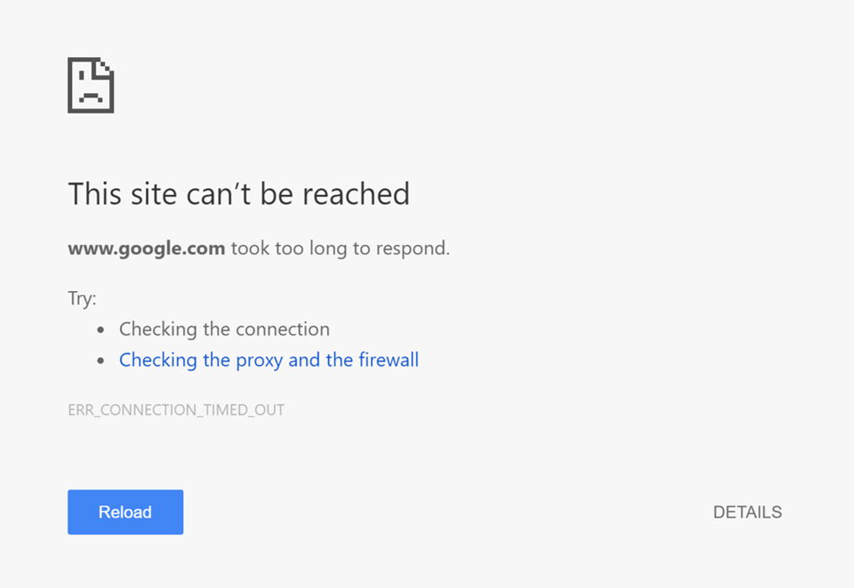

Slide 2



…
…
…

Slide 3
Identifying Threats Using Flexible Server Logs
A Project by Robert Durfee

Slide 4




Time
Ethernet Header
Hour
Minute
Second
Version
DSCP
Length
Identification
Fragment
Checksum
Source IP Address
Destination Port
Source Port
Destination IP Address
Sequence
08:42:13
Acknowledge
18.189.37.12
2869
576
SYN ACK
Payload
Flags
Offset

