Slide 2
Identifying DDoS Attacks Using Flexible Server Logs
A Project by Robert Durfee
Notes:
Consumer internet bandwidth
You can consume more information faster
When expected, all is good
When unexpected, serious negative side effects
An organized exploitation is DDoS
I will explain
How DDoS impacts you
What a DDoS is exactly
How I can detect them before negative impacts
<CLICK>

Slide 3
Notes:
How would a DDoS affect you?
Working on an 8.01 PSet, need to Google a constant
You open up your browser and…
<CLICK>

Slide 4
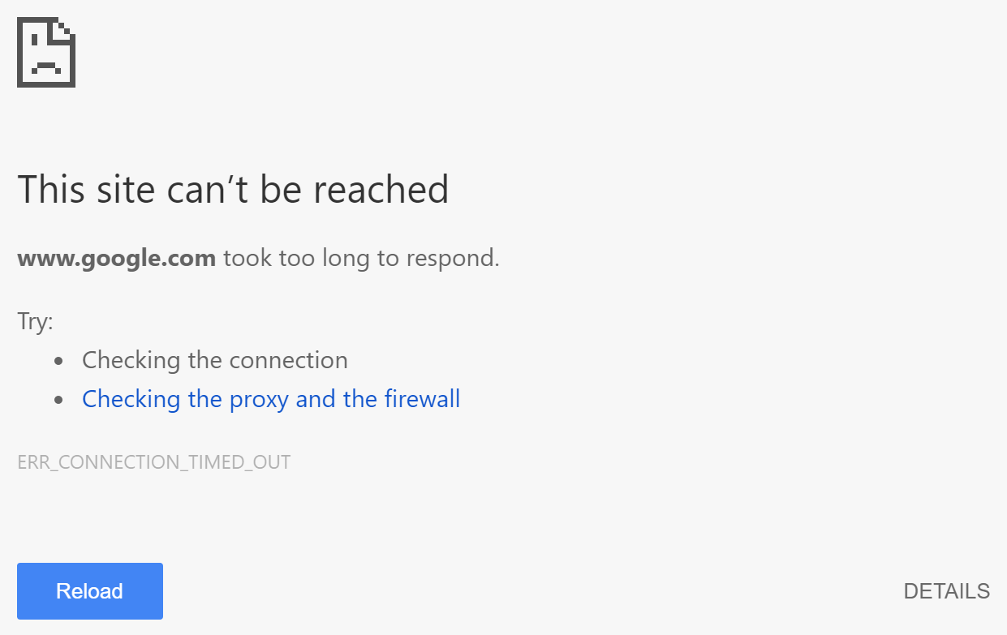
Notes:
Get this message
After intense troubleshooting, not your internet connection
Other websites load
Potential cause: DDoS
<CLICK>

Slide 5
Notes:
So what is a DDoS?
<CLICK>

Slide 6



…
…
…
Notes:
Several computers trying to access a webserver
Not all at same time
<CLICK>
Maybe this one needs a webpage
<CLICK>
Then this one needs a picture
<CLICK>
Then this one needs a video
All other computers remain idle
<CLICK>
Now suppose all these computers are constantly making bogus requests
<CLICK>
Then a legitimate user comes and needs a webpage
<CLICK>
But they can’t get through
<CLICK>
These malicious computers, are executing a DDoS
You are stuck with the error message

Slide 7
Notes:
How do we combat DDoS attacks?
Many complicated methods
I focused on first step: ease of detection
Through detailed, flexible logging, detection is simple
<CLICK>

Slide 8
|{H}:{M}:{S}|{Src_Ip}:{Src_Prt}->{Dest_Ip}:{Dest_Prt}| |{Size}|{Ack_Num}-{Seq_Num}|{Flgs}|
|18:23:19|18.111.29.114:40820->104.197.117.31:00443|
|00216|20234922-39084230|--S-----|
Notes:
My program takes user supplied format sentence
Parses the format sentence determining what the user is looking for
Parses all network traffic
Sorts out all unnecessary information
<CLICK>
Outputs parsed information according to user format
In this example, it is clear to recognize a DDoS attack
The same users making thousands of requests per second
Not waiting for server response before requesting
<CLICK>

Slide 9
Notes:
But we haven’t done anything to stop DDoS!
No, but we did make the first major step
Now this information can be fed into a relational database or program
Firewall rules can be temporarily applied to block users
The beauty of it is: nothing is hardcoded
Everything is
Easily modified
Supremely flexible
Next time you get the took too long to respond error, there may be a DDoS
That DDoS could’ve been detected by my program

