Slide 1

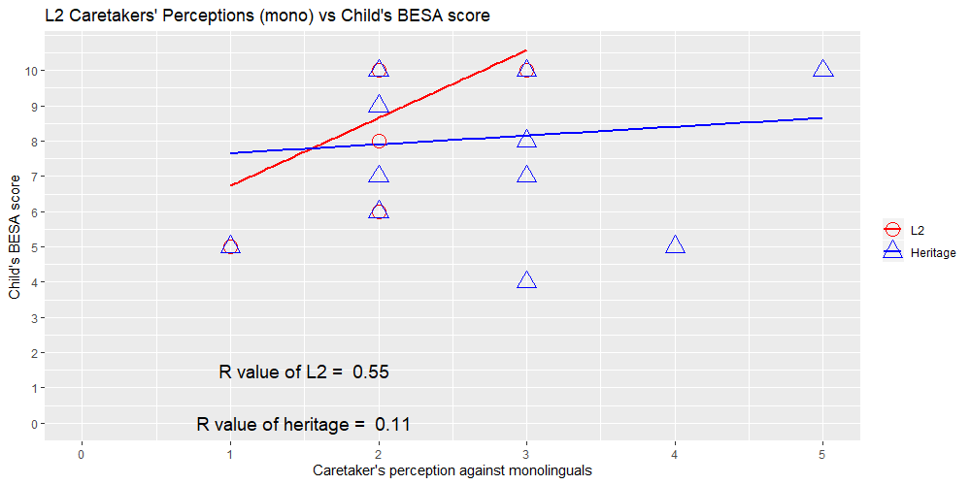
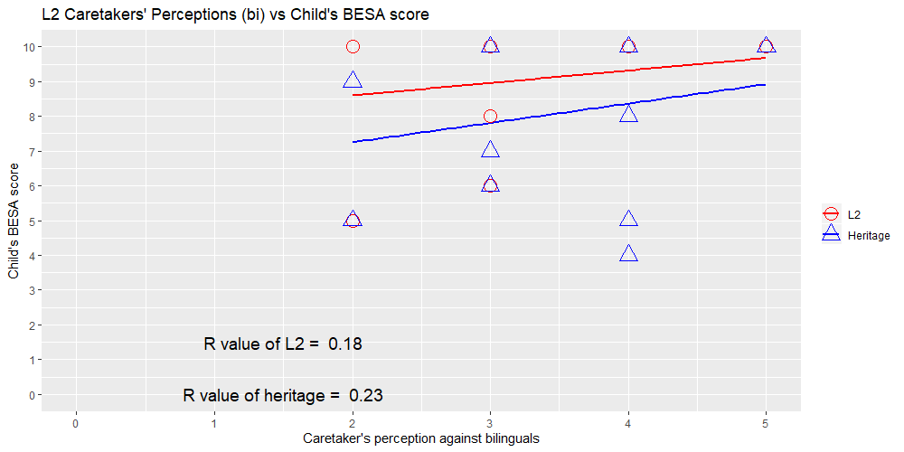
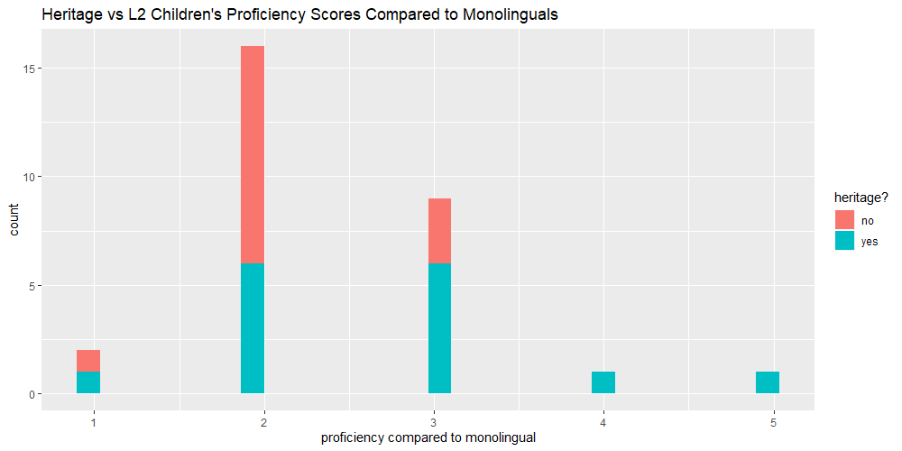
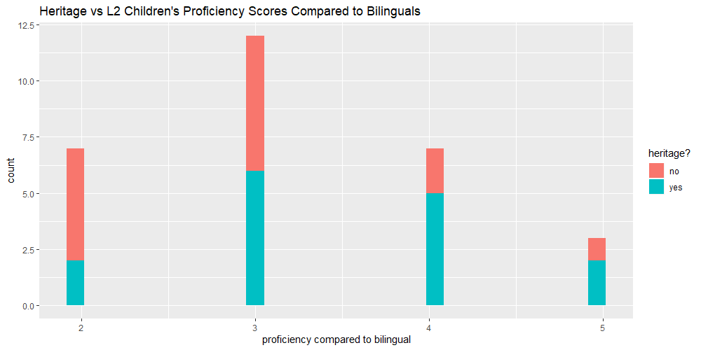
The Impact of Bilingual Children’s Acquisition of Spanish Morpho-Syntax
on Perceptions of Their Fluency by Caretakers
Robert Esposito & Gabriela Rivera; Liliana Sanchez Ph.D & Jennifer Austin Ph.D
Background
Results
Figure 1: Caretakers’ perception (on a scale of 1 to 5) of their child’s proficiency in Spanish compared to monolinguals.
Figure 2: Caretakers’ perception (on a scale of 1 to 5) of their child’s proficiency in Spanish compared to bilinguals.
Figure 3: Count of caretakers’ perception scores compared to monolinguals. The difference between caretakers of heritage children vs L2 children scores is not significant (p > .05).
Figure 4: Count of caretakers’ perception scores compared to bilinguals. The difference between caretakers of heritage children vs L2 children scores is not significant (p > .05).
Materials & Methods
Discussion
Future Direction
Acknowledgements
We would like to thank the following people: Our PIs, Liliana Sanchez & Jennifer Austin Our graduate advisor, Jennifer Markovits The graduate students in the lab: Patrick Thane, Julio Cesar Lopez Otero, and Michele Goldin. Undergraduate London Dixon Rutgers University & the Aresty Program Rutgers Department of Spanish & Portuguese
References

