Slide 1
Underspecification in BMRS: Evidence from Spanish Spirantization
Robert Esposito

Slide 2
Phonological Knowledge
Representational Knowledge: What is the data structure for phonological elements?
Computational Knowledge: What types of operations are computed over phonological elements?

Slide 3
Underspecification
Traditional View (Archangeli, 1988)
(Representation & Computational)
Segments are bundles of features…
{+, 0} (privative)
{+, -} (full binary)
{+, -, 0} (contrastive)
Redundancy rules fill in missing features
Grammar distinguishes between specified & default values

Slide 4
Underspecification
Issues
Traditional View (Archangeli, 1988)
(Representation & Computational)
Ternary distinctions from binary features (Archangeli, 1988)
Ad-hoc rule-based mechanisms to fill in features (Nelson, 2022)
Supposedly underspecified features are required lexically and post-lexically (Nelson & Bakovic, 2024b)
Lexical: advi[s]e ~ advi[z]ory, but re[f] ~ re[f]er
Post-lexical (Avery & Rice, 1989):
e.g., BUT
i[m] [p]ort Jefferson fro[m] [p]ort Jefferson
i[ŋ] [k]anada fro[m] [k]anada
i[n] [t]acoma fro[m] [t]acoma
Segments are bundles of features…
{+, 0} (privative)
{+, -} (full binary)
{+, -, 0} (contrastive)
Redundancy rules fill in missing features
Grammar distinguishes between specified & default values

Slide 5
Underspecification
Alternative Hypothesis (Nelson & Bakovic, 2024)
(Computational only)
Traditional View (Archangeli, 1988)
(Representation & Computational)
Segments are bundles of features {+,-}
Segments only contain contrastive features
Segments are not “missing” features, they simply aren’t relevant for contrast
Grammar is minimal
Logical mapping defines feature realization
Segments are bundles of features…
{+, 0} (privative)
{+, -} (full binary)
{+, -, 0} (contrastive)
Redundancy rules fill in missing features
Grammar distinguishes between specified & default values

Slide 6
So what’s the logical mapping…?

Slide 7
Boolean Monadic Recursive Schemes (BMRS) (Chandlee & Jardine, 2021)
Boolean: +/- truth values
Monadic: Each predicate in system applies to only one element at a time e.g., voi(x), NOT voi(x, y)
Recursive: Applies same operation repeatedly and refers to itself

Slide 8
Russian voicing function (Nelson & Bakovic, 2024a)
Sonorants are traditionally analyzed as underspecified for VOICE
Russian has regressive voicing of adjacent obstruents e.g.,
/tn/ → [tn]
/ta/ → [ta]
/tb/ → [db]
/vk/ → [fk]

Slide 9
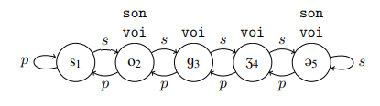
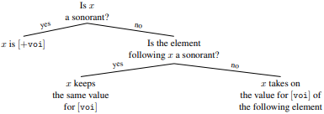
Russian voicing function (Nelson & Bakovic, 2024a)
ϕ_{voi}(x) :=
IF son(x) THEN ⊤
ELSE IF son(s(x)) THEN voi(x)
ELSE voi(s(x))

Slide 10
Underspecification Maps (Nelson & Bakovic, 2024a)
The map will define input-output conditions for the “underspecified feature”.
Any underspecification map will include a nested conditional BMRS term.
Both the upper conditional P and lower conditional Q will determine a truth value based on the antecedent of the redundancy rule that fills in the “underspecified feature”.
P partitions the set of targets while Q partitions the set of triggers.

Slide 11
Underspecification Maps (Nelson & Bakovic, 2024a)
The map will define input-output conditions for the “underspecified feature”.
The mapping determines the conditions for the value of the feature VOICE, a feature traditionally analyzed as “underspecified”
ϕ_{voi}(x) :=
IF son(x) THEN ⊤
ELSE IF son(s(x)) THEN voi(x)
ELSE voi(s(x))

Slide 12
Underspecification Maps (Nelson & Bakovic, 2024a)
Any underspecification map will include a nested conditional BMRS term.
Conditional inside a condition.
ϕ_{voi}(x) :=
IF son(x) THEN ⊤
ELSE IF son(s(x)) THEN voi(x)
ELSE voi(s(x))

Slide 13
Underspecification Maps (Nelson & Bakovic, 2024a)
Both the upper conditional P and lower conditional Q will determine a truth value based on the antecedent of the redundancy rule that fills in the “underspecified feature”.
ϕ_{voi}(x) :=
IF son(x) THEN ⊤
ELSE IF son(s(x)) THEN voi(x)
ELSE voi(s(x))

Slide 14
Underspecification Maps (Nelson & Bakovic, 2024a)
P partitions the set of targets while Q partitions the set of triggers.
P: Partitions the “underspecified” segment(s)
Sonorants
Q: Partitions the environment
Obstruent before sonorant
ϕ_{voi}(x) :=
(P) IF son(x) THEN ⊤
(Q) ELSE IF son(s(x)) THEN voi(x)
ELSE voi(s(x))

Slide 15
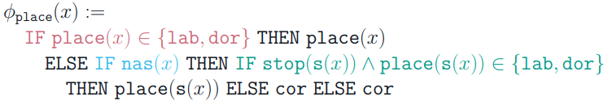
What’s been done so far?
Russian voicing, Turkish word-final voicing (Nelson & Bakovic, 2024a)
English coronals (Nelson & Bakovic, 2024b)

Slide 16
Going forward…
Spanish spirantization
Galician Geada
Gorgia Toscana
These three Romance processes involve stop ~ fricative alternations
Spanish spirantization and Galician geada have been analyzed as underspecification (for Spanish, Colina, 2020; for Galician, Colina, 2013)
Gorgia Toscana has not yet been analyzed with underspecification, but will be included due to its similarity to spirantization and geada

Slide 17
Spanish Spirantization (Colina, 2020)
Voiced stops are [-continuant] after homorganic nasal or pause (or after lateral for /d/)
/bómba/ [bómba] ‘bomb’
/tángo/ [táŋgo] ‘tango’
/dónde/ [dón̪de] ‘where’
/tóldo/ [tól̪do] ‘awning’
[+continuant] elsewhere
/ába/ [áβa] ‘bean’
/náda/ [náða] ‘nothing’
/ágo/ [áɣo] ‘I do/make’
/árbol/ [árβol] ‘tree’
/désde/ [dézðe] ‘since’
/cáigo/ [cájɣo] ‘I fall’

Slide 18

[continuant] Underspecification in Spanish (Colina, 2016)
Ternary distinction: [+continuant], [-continuant], [ ]
Takes onset cluster phonotactics as evidence that [+continuant] alone contributes to sonority
Consonants in onset clusters must be maximally different on the sonority scale

Slide 19
Spanish Spirantization
However, /l/ is a weird case (González, 2009)
Sometimes acts as [-continuant]
/toldo/ [tol̪do] ‘awning’
Sometimes acts as [+continuant]
/balga/ [balɣa] ‘it’s worth’

Slide 20
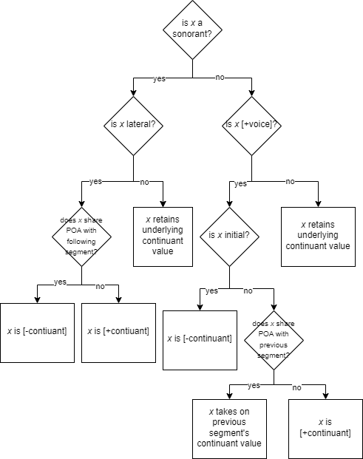
Decision Tree for Spanish [continuant]

Slide 21


























Spanish Continuant Function
ϕcontinuant(x) :=
IF son(x) THEN
IF manner(x) == [lateral] THEN
IF poa(x) == poa(s(x)) THEN ⊥
ELSE T
ELSE T
ELSE IF voi(x) THEN
IF ⋉(x) THEN ⊥
ELSE IF poa(x) == poa(p(x)) THEN cont(p(x))
ELSE T
ELSE cont(x)

Slide 22













































Spanish Continuant Function
/input/ | [output]
b | b
a | a
l | l
g | ɣ
o | o
k | k
a | a
l | l̪
d | d
o | o
a | a
ɾ | ɾ
t | t
o | o
[cont]
-
+
+
+
+
-
+
-
-
+
+
+
-
+
/input/ | [output]
m | m
a | a
n | ŋ
g | g
o | o
[cont]
-
+
-
-
+
ϕcontinuant(x) :=
IF son(x) THEN
IF manner(x) == [lateral] THEN
IF poa(x) == poa(s(x)) THEN ⊥
ELSE T
ELSE cont(x)
ELSE IF voi(x) THEN
IF ⋉(x) THEN ⊥
ELSE IF poa(x) == poa(p(x)) THEN cont(p(x))
ELSE T
ELSE cont(x)

Slide 23
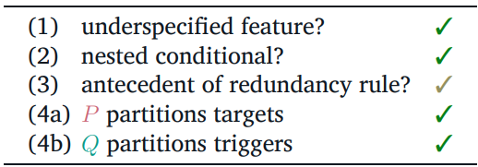

Discussion
Does not comply to Underspecification Map criteria
Note that Nelson & Bakovic’s (2024b) analysis of English coronals does not comply with Underspecification Map criteria
“The data from English segmental phonology suggest that “underspecified” features like [Coronal] are in fact always fully specified. Consequently, having late “underspecification” and early “full specficiation” is fully compatible with our approach.”

Slide 24
What I’m confused about…
In Nelson & Bakovic’s (2024b), they don’t identify what the redundancy rule for English [coronal] even is
Not sure what it would be for Spanish
[+obstruent, +voice] → [+continuant]? But it’s environmentally restricted
Nelson (2024a) doesn’t explain the motivation for the restrictions on the conditionals P and Q

Slide 25
Remaining Issues
Is there a way to capture “initial position” without explicitly stating it, thus reducing the complexity of the function?
Colina (2016) proposed that /f/ is underspecified for [continuant] to account for complex onset phonotactic patterns – does the current underspecification map account for those patterns still?
Does the current mapping correctly predict [continuant] value for /t͡ʃ/ ?
/l/ remains tricky
Is there a way to determine if /l/ in a sequence /lɾ/ (e.g., alrededor ‘around’) is truly [-continuant], and what are the consequences of such an analysis?
Are there places where…
/l/ acts as [+continuant] despite sharing PoA with following segment?
/l/ acts as [-continuant] when it doesn’t share PoA with following segment?

Slide 26
Future Direction (in Spanish)
There are dialects with varying spirantization
Some varieties (e.g., Honduras, Cuba) are “stop-dominant” (Colina, 2020)
árbol [áɾbol] ‘tree’
algo [álgo] ‘something’
desde [dézde] ‘since’
caigo [kájgo] ‘I fall’
Can these dialects be modeled by making slight modifications to the current map?
Will they result in maps that comply with the Underspecification Map criteria?

Slide 27
Future Direction (in BMRS)
Do we propose that these computations are cognitive processes? Do these computations account for both production and perception?
Is this a falsifiable framework if we propose it represents cognitive processes?

Slide 28
Future Direction (in BMRS)
BMRS seems to predict that listeners process phonological information incrementally
Hypothesis A (BMRS): As soon as (phonological) information is available, it is processed
Alternative Hypothesis: (Phonological) information is not processed incrementally
Testing grounds: (Navajo) consonant harmony
EEG proposal:
When exposed to nonce words with unmatching coronals separated by more and more segments, does processing time of second coronal take longer as a function of number of segments?
1. ʃXz (as opposed to grammatical ʃXʒ)
2. ʃXXXXz
3. ʃXXXXXXXXz
etc…
Evidence for BMRS: Processing time does not take longer (the harmony is local)
Evidence against BMRS: Processing time takes longer (the harmony is not local?)

Slide 29
Future Direction (in BMRS)
Are more “complicated” decision trees reflected in cognitive processing times?
E.g., the proposed mapping for Spanish spirantization has more nested expressions that the Russian mapping
Is there a “limit” to the number of nested expressions?

Slide 30
Conclusion
The “Underspecification Map” allows us to capture unique behavior without criss-crossing between representational and computational knowledge
We can assign continuancy to “underspecified” segments without ever actually referring to the segment’s continuancy

Slide 31
References
Archangeli, D. (1988). Aspects of underspecification theory. Phonology, 5(2), 183-207.
Avery, P., & Rice, K. (1989). Segment structure and coronal underspecification. Phonology, 6(2), 179-200.
Chandlee, J., & Jardine, A. (2021). Computational universals in linguistic theory: Using recursive programs for phonological analysis. Language, 97(3), 485-519.
Colina, S. (2013). Galician geada: In defense of underspecification in Optimality Theory. Lingua, 133, 84–100.
Colina, S. (2016). On onset clusters in Spanish: Voiced obstruent underspecification and /f/. The syllable and stress: Studies in honor of James W. Harris, 107-38.
Colina, S. (2020). Spirantization in Spanish: The role of the underlying representation. Linguistics, 58(1), 1–35.
González, C. (2009, November). Continuancy and resonance in Spanish. In Selected Proceedings of the 11th Hispanic Linguistics Symposium. Somerville, MA: Cascadilla Proceedings Project (pp. 196-206).
Marotta, G. (2008). Lenition in Tuscan Italian (gorgia toscana). Lenition and fortition, 235-270.
Nelson, S. (2022, February). A model theoretic perspective on phonological feature systems. In Proceedings of the Society for Computation in Linguistics 2022 (pp. 1-10).
Nelson, S., & Baković, E. (2024a). Underspecification Without Underspecified Representations. Proceedings of the Society for Computation in Linguistics (SCiL), 352-356.
Nelson, S., & Baković, E. (2024b). Computation Clarifies Mixed Specification Behavior of Coronals in English.

