Slide 1
“¿Es una pregunta?”: An ERP Study on the Perception of Early Intonational Cues in Spanish Learners
Robert Esposito
Rutgers University

Slide 2
Introduction
Spanish declaratives and absolute interrogatives are disambiguated only at the level of intonation
Traditionally, the final F0 movement is analyzed as determining sentence modality (Tomás Navrro, 1944)
Sentence Type | Spanish | English
declarative | Mariano habla del tiempo. | Mariano talks about the weather.
absolute interrogative | ¿Mariano habla del tiempo? | Does Mariano talk about the weather?

Slide 3
Introduction
Face (2007) used a gating experiment to show that the first pitch accent is used as a “secondary cue” to determine sentence modality
Do L2 Spanish make use of this early cue as well?

Slide 4
Intonation
All languages have intonation (Arvaniti & Fletcher, 2020)
Encodes semantico-pragmatic information
e.g., speech act marking, information status, belief status, politeness, and sentence modality (Prieto, 2015)
L1 Mandarin speakers integrate intonational cues temporally early in the speech stream, before lexical tone (Li, 2018)

Slide 5
L1 Intonation Processing
Magne et al. (2005) investigated anomalous pitch movements in L1 French question-answer dialogues
Condition | Felicity | Question | Answer
1 | Felicitous | Did he give his fiancée a ring or a bracelet? | He gave a ring to his fiancée.
2 | Felicitous | Did he give a ring to his fiancée or his sister? | He gave a ring to his fiancée.
3 | Infelicitous | Did he give his fiancée a ring or a bracelet? | He gave a ring to his fiancée.
4 | Infelicitous | Did he give a ring to his fiancée or his sister? | He gave a ring to his fiancée.

Slide 6
L1 Intonation Processing (Magne et al., 2005)
Condition | Felicity | Question | Answer | Elicited
1 | Felicitous | Did he give his fiancée a ring or a bracelet? | He gave a ring to his fiancée.
2 | Felicitous | Did he give a ring to his fiancée or his sister? | He gave a ring to his fiancée.
3 | Infelicitous | Did he give a ring to his fiancée or his sister? | He gave a ring to his fiancée. | P3a and P3b
4 | Infelicitous | Did he give his fiancée a ring or a bracelet? | He gave a ring to his fiancée. | N400
P3a = novel and surprising event
P3b = surprising and task-relevant event
N400 = semantic processing and integration of word meaning in sentence or discourse contexts

Slide 7
L2 Intonation Processing
Ganga et al. (2024) investigated L1 Dutch L2 English using EEG
Acquisition of English only and coupled pitch accent
English “only” remains pre-verbal, whereas Dutch moves alleen immediately left of focused element
Language | Condition | Sentence
English | Object-focus (non-adjacent) | John is only throwing the ball, not throwing the pen.
English | Verb-focus (adjacent) | John is only throwing the ball, not kicking the ball.
Dutch | Verb-focus (adjacent) | Uk heb alleen een appel gegeten.
Dutch | Object-focus (adjacent) | Ik heb een appel alleen gegeten.

Slide 8
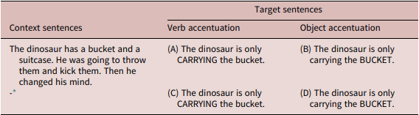
L2 Intonation Processing (Ganga et al., 2024)
Also added context to half of the stimuli
For object accentuation (i.e., non-adjacent only), L1 and L2 performed similarly → elicited N400-like component

Slide 9
Associative Learning theory (Kamin, 1969)
If individual learns particular stimulus-outcome situation, later stimulus that maps to same outcome are more difficult to acquire
E.g., if L2 Spanish learn that final rise = question, final fall = statement, they will have difficulty associating other cues to sentence modality

Slide 10
L1 & L2 Early Intonation Cues in Spanish
Face (2007) found that L1 Spanish can use the first pitch accent to determine sentence modality
Bedialauneta Txurruka (2023) found that L2 Spanish (>5 years learning experience) relied on “universal tendencies” of interrogation i.e., final rise or fall
Didn’t report specific information or proficiency on participants

Slide 11
Research Questions
RQ1: Are Spanish learners sensitive to early intonational cues that signal if an utterance is a declarative or absolute interrogative?
i.e., do incongruous pitch accents result in N400?
RQ2: Is sensitivity to early intonational cues modulated by proficiency?
i.e., do incongruous pitch accents result in N400 only for higher proficiency individuals?

Slide 12
Hypotheses
RQ1: Associative Learning theory (Kamin, 1969) posits that L2 Spanish would have difficulty associating more than one cue with sentence modality, so it would be expected that an N400 would not be elicited on the second pitch accent
RQ2: As proficiency increases, L2 speakers exhibit more L1-like processing – we would expect higher proficiency individuals to be more sensitive to additional intonational cues of sentence modality, and thus the incongruous first pitch accent would elicit an N400 on the second pitch accent

Slide 13
Participants
25 participants (14 females)
Age range = 18 to 28
Proficiency measured with DELE, divided categorically into two groups (intermediate and high proficiency)

Slide 14
Two-Alternative Forced Choice Task
Two versions
Condition X Sentence Type X First Pitch Accent Peak
20 items per condition, 80 target items total
160 filler items (2:3 ~ filler:target)
Condition | Early Cue | Sentence Type | First Pitch Accent Peak
1 | absolute interrogative | info-seeking absolute interrogative | original
2 | declarative | info-seeking absolute interrogative | lowered
3 | Declarative | braod focus declarative | original
4 | absolute interrogative | braod focus declarative | heightened

Slide 15
Stimuli
L1 Spanish recorded 160 utterances
80 declaratives, 80 matching interrogatives
First pitch accent manipulated in Praat to match the first pitch accent of corresponding utterance

Slide 16
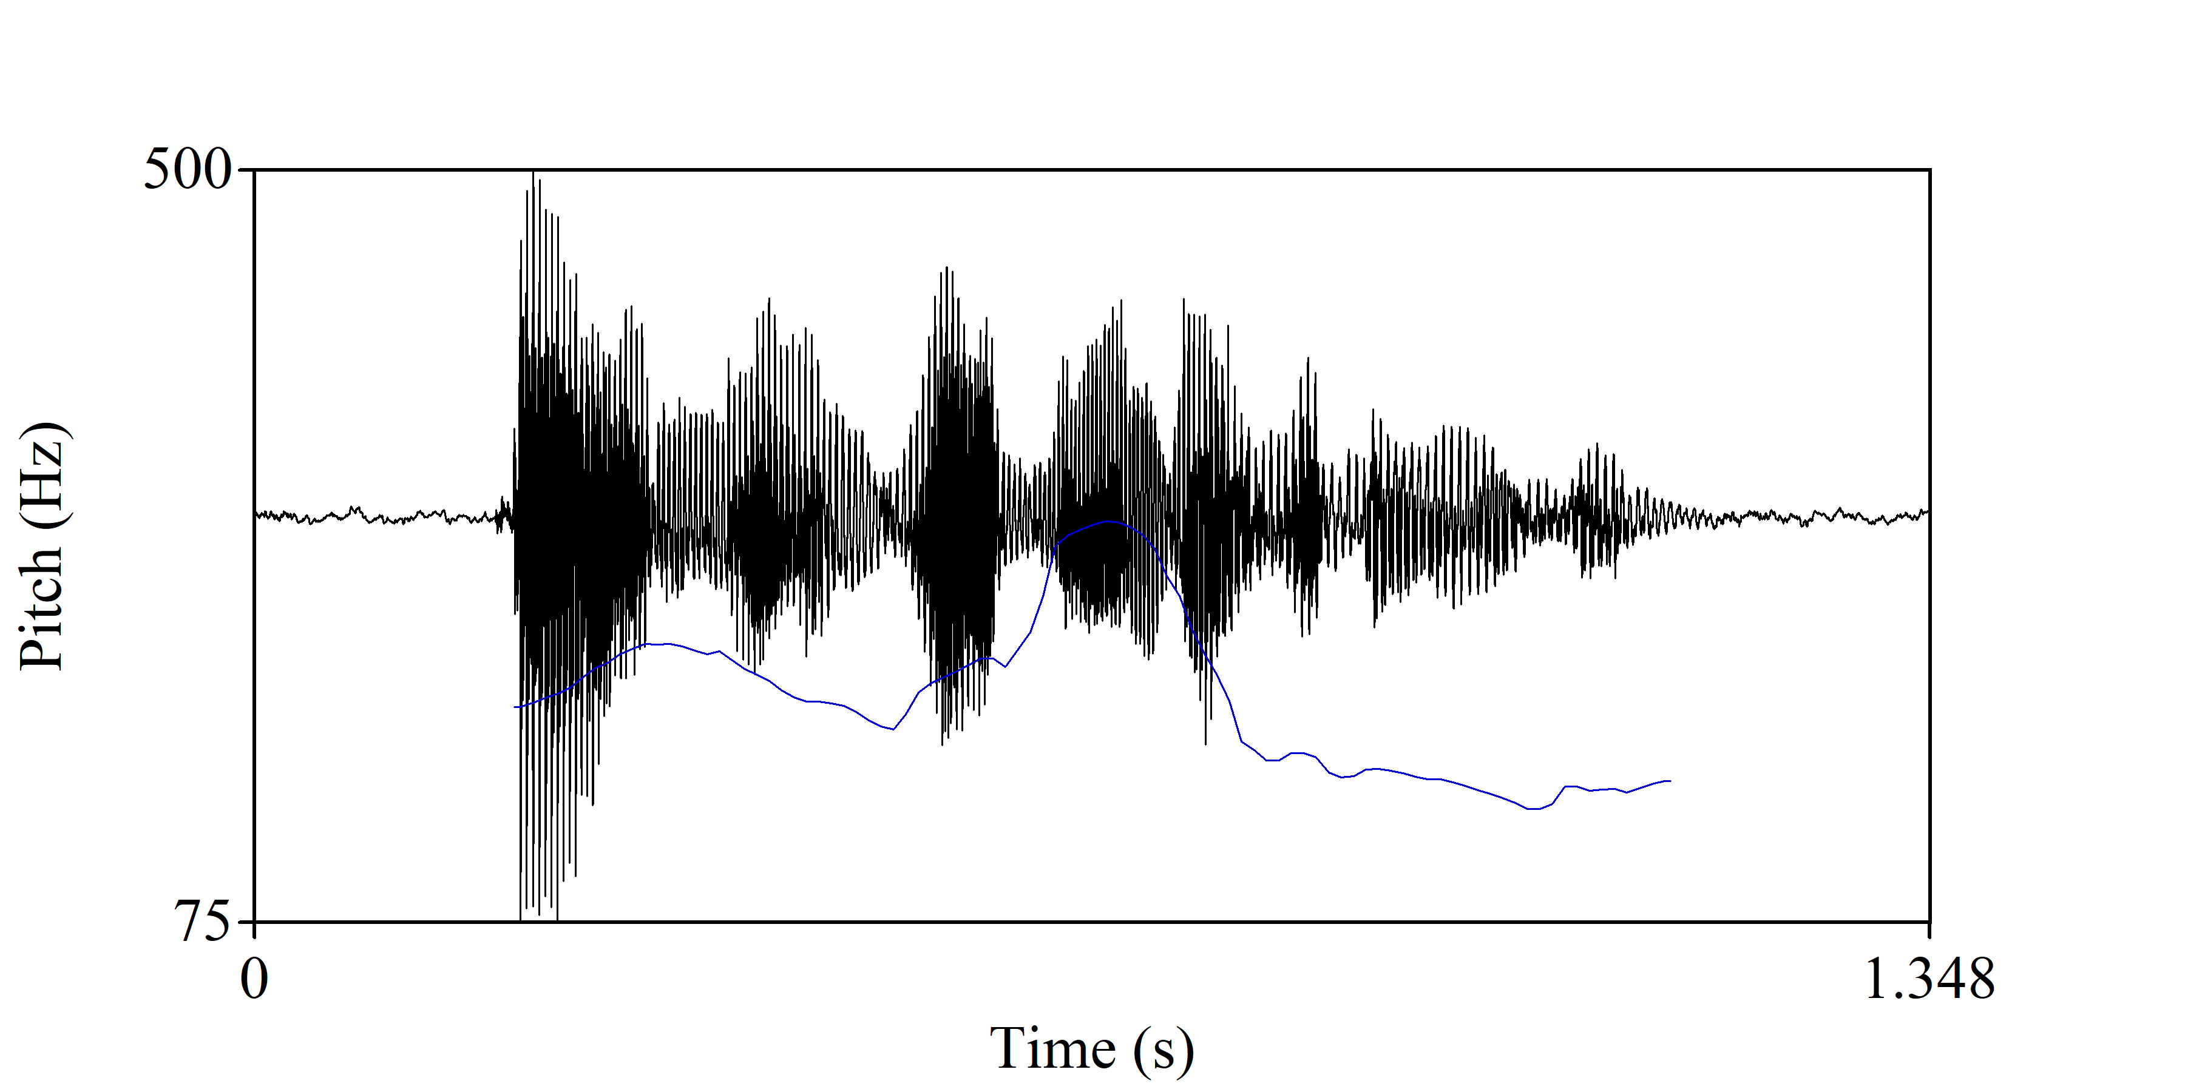
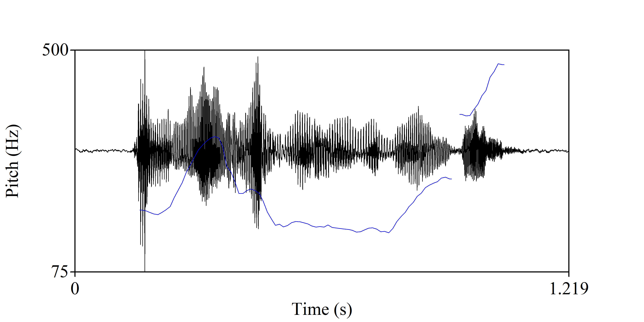

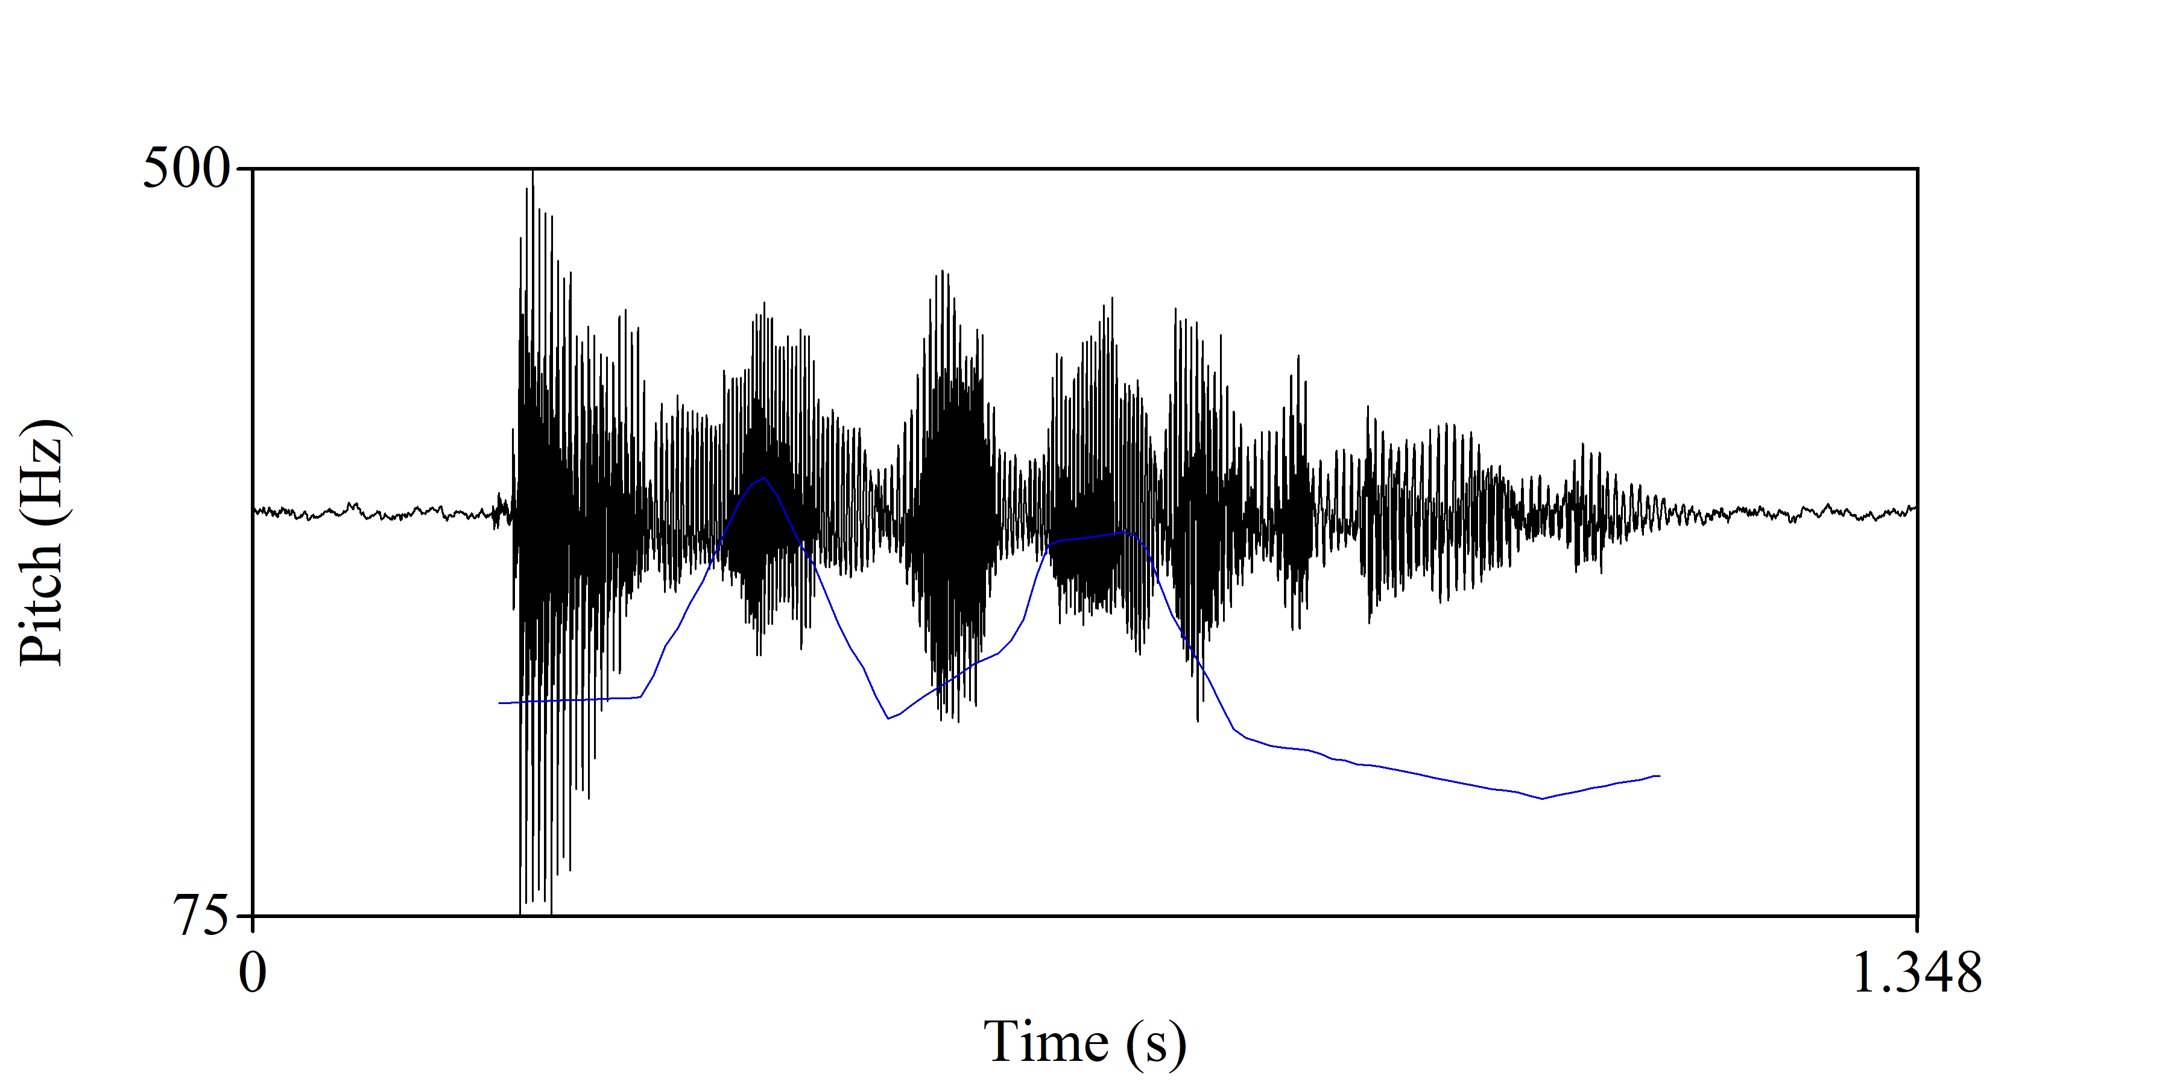
Stimuli

Slide 17
Procedure
Participants trained to respond to each item using keyboard 0 = not a question, 1 = is a question
Response keys counterbalanced pseudorandomly
All participants received the same 32 training items (8 items per condition)
Once the trials began, interval between stimuli varied between 2.5 and 5.0 s
Every 30 items, participants took a 3-5 min break

Slide 18


Slide 20


Slide 21
Future Direction
Need to make the stimuli and in line with Face (2007)
Include L1 Spanish to make sure they have a neurocognitive difference in processing
Include a language experience component (e.g., study abroad experience?)

Slide 22
Thank you!

Slide 23
References
Arvaniti, A., & Fletcher, J. (2020). The autosegmental-metrical theory of intonational phonology.
Bedialauneta Txurruka, I. (2023). Perception of Spanish declarative questions and statements by L2 Spanish speakers. In R. Skarnitzl & J. Volín (Eds.), Proceedings of the 20th International Congress of Phonetic Sciences (pp. 2591–2596). Guarant International.
Face, T. L. (2007). The role of intonational cues in the perception of declaratives and absolute interrogatives in Castilian Spanish. Journal of Experimental Phonetics, 16, 185–225.
Ganga, R., Ge, H., Struiksma, M. E., Yip, V., & Chen, A. (2024). Prosodic processing in sentences with ‘only’ in L1 and L2 English. Studies in Second Language Acquisition, 46(2), 478–503.
Kamin, L. J. (1969). Selective association and conditioning. In Fundamental issues in associative learning (pp. 42–64).
Li, J. (2018). Temporal hierarchy of intonation and tone processing in Mandarin Chinese.
Navarro, T. (1944). Manual de entonación española. Colección Málaga.
Prieto, P. (2015). Intonational meaning. Wiley Interdisciplinary Reviews: Cognitive Science, 6(4), 371–381.

