Slide 1
Empathy Conditions ERP Responses in Low-Proficiency Bilinguals
Robert Esposito

Slide 2
Methods

Slide 3
Participants
25 low-proficiency L1 English L2 Spanish late bilinguals

Slide 4
Match/Mismatch Task
Participants were given an expectation that they would listen to a question or statement, and they explicitly decided if the audio matched the given image
Sentence types:
Broad focus: “Ana lleva el abrigo.”
Narrow focus: (A: “Qué lleva Ana?”) “Ana lleva el abrigo.”
Partial wh-question: “¿Por qué ama la navidad?”
Absolute interrogative: “¿Ana lleva el abrigo?”

Slide 5
Boundary Tones
Sentence type | English | Spanish (stimuli)
Broad focus declarative | L% | L% or H%
Narrow focus declarative | L% | L% or H%
Partial wh-question | H% | L% or H%
Absolute interrogative | H% | L% or H%

Slide 6
Stimuli
Fixation cross →
Image of stick figure with speech bubble; inside speech bubble is question mark or period →
Image disappears →
Fixation cross & audio stimulus →
On screen: “¿La frase coincide con la imagen?”

Slide 7


Slide 8
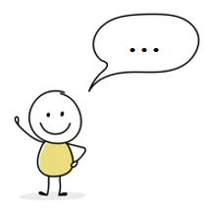

Slide 9


Slide 10
¿La frase coincide con la imagen?

