Slide 1
Empathy Conditions ERP Responses in Late Bilinguals
Robert Esposito

Slide 2
Methods

Slide 3
Participants
20 low, intermediate, and high proficiency L1 English L2 Spanish late bilinguals
Empathy quotient test
Working memory test
Notes:
Prof measured w/ lextale

Slide 4
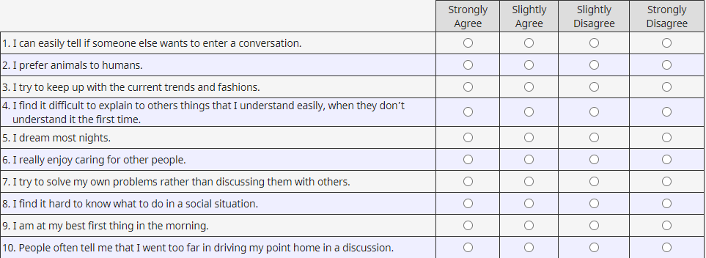
Empathy Quotient

Slide 5
Stimuli
Sentence type | Example | Spanish (stimuli) | English
Broad focus declarative | Ana lleva el abrigo. | L% or H% | L%
Narrow focus declarative | (A: Qué lleva Ana?) Ana lleva el Abrigo. | L% or H% | L%
Partial wh-question | ¿Por qué ama la navidad? | L% or H% | H%
Absolute interrogative | ¿Ana lleva el abrigo? | L% or H% | H%
Notes:
320 exp sentences minimum
8 practice sentences, randomization is same for all participants.
Randomize exp uniquely for each part.
2 versions.
Latin square in both versions.

Slide 6
Stimuli
4 sentence types X 2 boundary tones = 8 conditions
8 practice sentences per condition
40 items per condition, 320 items total

Slide 7
Stimuli
Fixation cross →
Audio stimulus →
On screen: “¿Es una pregunta?”
Notes:
Need to mention limitations – wrap up effects.

Slide 8



Slide 9
¿Es una pregunta?

