Slide 1
Intonational Phonology of Polite L2 Spanish
Robert Esposito

Slide 2
Introduction
All languages use intonation to encode pragmatic meaning (Arvaniti & Fletcher, 2020)
E.g., sentence modality (declarative vs interrogative), express surprise, inclusive vs exclusive “or”, focus, politeness
How do L1 English L2 Spanish speakers express politeness through intonation?

Slide 3
Intonation & Politeness (Herrero & Devís, 2020)
L1 Mandarin L2 Spanish, CEFR = A2/B1
Participants completed discourse completion task for polite requests
L1 Spanish rated utterances based on politeness
Utterances rated as impolite were analyzed
Lexical-grammatical politeness strategies are insufficient for an utterance to be perceived as polite – it must have the correct intonation
Notes:
Herrero & Devís, 2020 – L1 Mandarin L2 Spanish

Slide 4
Politeness (Brown & Levinson, 1987)
Politeness strategies are used to mitigate face threatening acts (FTAs)
Positive face = one’s self-image, desire to be appreciated and approved of
Positive strategies: in-group identity markers, seeking agreement on safe topic, presupposing common ground
Negative face = one’s basic claim to freedom of action and from imposition
Negative strategies: hedging, using interrogatives, pessimism about interlocutor’s response to request

Slide 5
Politeness (Brown & Levinson, 1987)
politeness strategy
power
social distance
level of imposition of request

Slide 6
Research Question 1
Do pitch accents map categorically to the independent variables power, social distance, and level of imposition of request (Brown & Levinson, 1987)?

Slide 7
The Frequency Code (Ohala, 1983)
Pitch in human language evolved from a cross-species use of F0
Lower pitch = aggressive, assertive
Higher pitch = nonthreatening, submissive, subordinate
Accordingly, low pitch is associated with statements, high pitch is associated with interrogatives
Higher pitch is universally associated with politeness

Slide 8
High Pitch and Politeness (Brown & Levinson, 1974)
Politeness in Tzeltal marked by high pitch/falsetto
Universal association between high pitch and tentativeness?
… so do we expect L1 English speakers to recruit universal strategies of politeness i.e., use higher pitch to “be” more polite?

Slide 9
Research Question 2
Does higher pitch correlate with higher politeness (Ohala, 1983)?

Slide 10
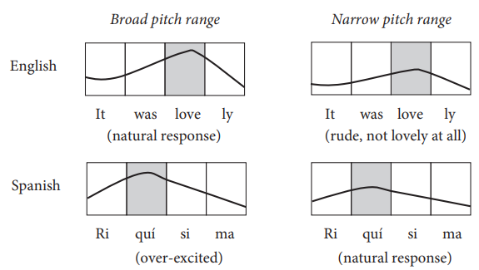
Intonation & Politeness (Estebas-Vilaplana, 2014)
How was the food?
Figure 1

Slide 11
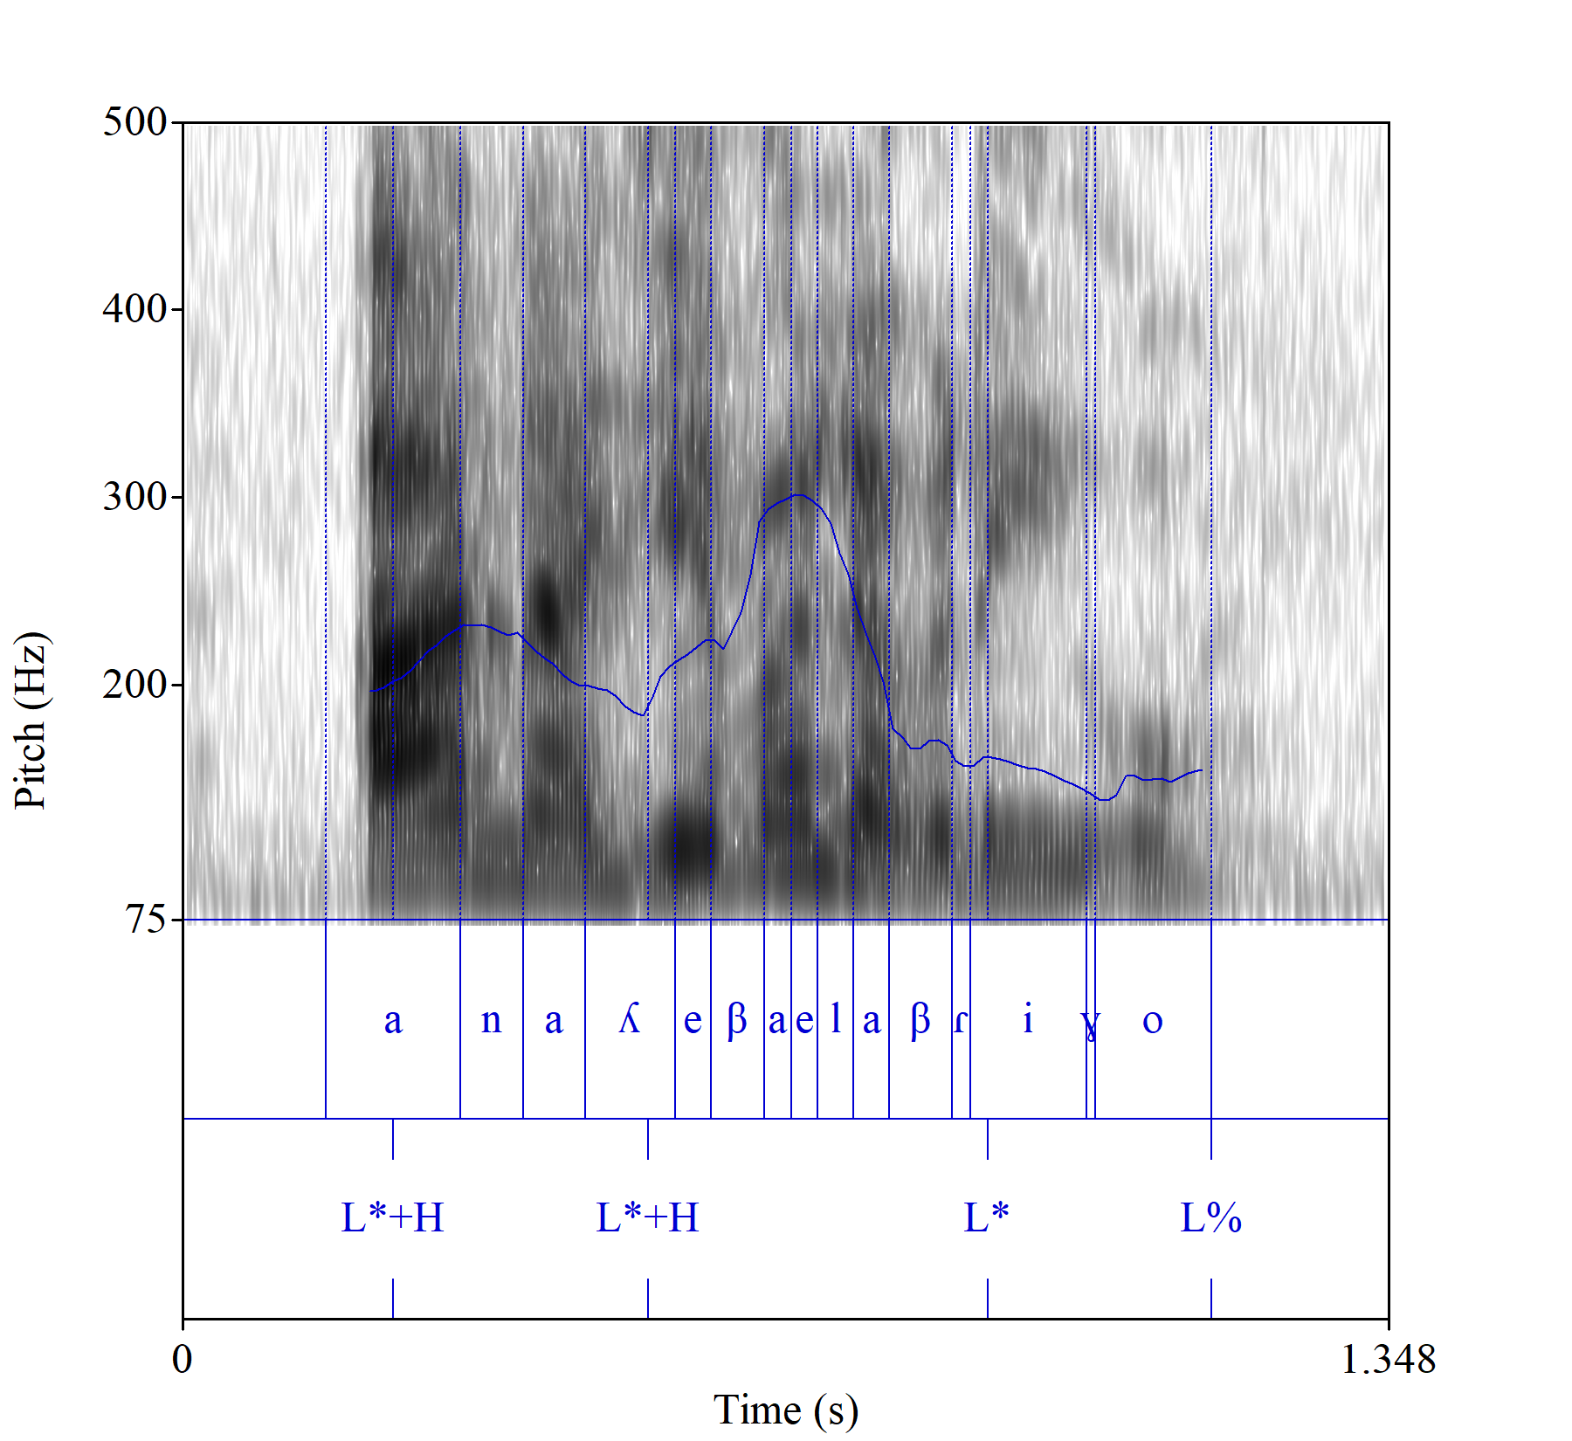
Autosegmental Metrical (AM) Theory
H(igh) and L(ow) tones
Rise = L+H Fall = H+L
Tones can be anchored to…
stressed syllable (pitch accent e.g., L*)
utterance-final boundary (boundary tone e.g., L%)
Figure 2: Casillas et al. (2023)

Slide 12

Autosegmental Metrical (AM) Theory
Nuclear configuration = Final pitch accent + boundary tone
Figure 3: Aguilar et al. (2024)
Figure 2: Casillas et al. (2023)

Slide 13
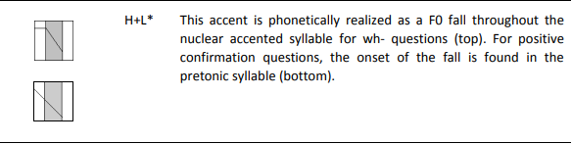
Autosegmental Metrical (AM) Theory
We care about the phonology – how do speakers map the continuous signal to discrete categories?
Just like in segmental phonology, the same underlying “toneme” can have different phonetic realizations!
Figure 4: Armstrong (2010)

Slide 14
L2 Intonation Learning Theory (LiLT; Mennen, 2015)
The inventory and distribution of categorical phonological elements
The phonetic implementation of these categorical elements
The functionality of the categorical elements of tunes
The frequency of use of the categorical elements
systemic
realizational
semantic
frequency
Figure 5

Slide 15
L2 Intonation Learning Theory (LiLT; Mennen, 2015)
L+¡H* and L+H* exist in EN & ES
L+¡H* and L+H* are realized similarly in EN & ES
!!! L+¡H* is polite in EN, but impolite in ES !!!
Not entirely clear how to quantify…
Systemic: The inventory and distribution of categorical phonological elements
Realizational: The phonetic implementation of these categorical elements
Semantic: The functionality of the categorical elements of tunes
Frequency: The frequency of use of the categorical elements
Figure 6

Slide 16
Intonation & Politeness (Estebas-Vilaplana, 2014)
How was the food?
Figure 5

Slide 17
L2 Spanish Polite Intonation (Astruc & Mar Vanrell, 2016)
L1 UK English L2 Spanish (CEFR = A2) polite requests
Corpus of fourteen utterances
Found L1 English transfer effects

Slide 18
Research Question 3
What pitch accents do L1 General American English L2 Spanish learners use for requests in Spanish?

Slide 19
Research Questions
1. Do pitch accents map categorically to the independent variables power, social distance, and level of imposition of request (Brown & Levinson, 1987)?
3. What pitch accents do L1 General American English L2 Spanish learners use for requests in Spanish?
Based on the analysis of L1 UK English L2 Spanish by Astruc & Mar Vanrell (2016), we expect there to be L1-L2 transfer of pitch contours, such that L1 English pitch contours will be used in the L2 Spanish.
Due to insufficient previous data in L2 Spanish, we must rely on L1 Spanish research to inform our hypothesis. Astruc & Mar Vanrell (2016) reported that in their L1 corpus, only the level of imposition of the request presented a categorical usage of pitch accent, and so we expect here similar results: power and social distance will not categorically map to pitch accents, but level of imposition of request will.
2. Does higher pitch correlate with higher politeness (Ohala, 1983)?
This question will be examined quantitatively in two ways. First, the mean pitch of the utterance will be examined, and then the mean pitch of the final boundary tone. These two measures have been chosen due to their salience in the speech stream. Informed by the Frequency Code, we expect higher pitch to be associated with higher degree of politeness.

Slide 20
Participants
L1 English L2 Spanish learners (ages x to y, mean = mean, sd = sd)
Proficiency measured by LexTALE-ESP (Izura et al., 2014)
n medium proficiency
n high proficiency

Slide 21
(Pilot) Participants
Table 1
Participant | Gender | Age (years) | Began Learning Spanish (years) | LexTALE Score | Study Abroad Experience (months)
test00 | male | 25 | 7 | NA | 10
test01 | female | 28 | 8 | NA | 4
test02 | female | NA | NA | NA | NA

Slide 22
Task Conditions
Discourse completion task (DCT)
Table 2
Condition | Power | Distance | Level of Imposition | Context
1 | - | - | - | sibling
2 | - | - | + | sibling
3 | + | + | - | unfamiliar professor
4 | + | + | + | unfamiliar professor
5 | + | - | - | familiar professor
6 | + | - | + | familiar professor
7 | - | + | - | unfamiliar student
8 | - | + | + | unfamiliar student

Slide 23
Discourse Completion Task (DCT) Examples
[-Power, -Social Distance, -Level of Imposition]
Imagina que estás en casa con tu hermana. Tienes hambre y ves unas bananas al lado de tu hermana. ¿Qué le dirías?
[+Power, +Social Distance, +Level of Imposition]
Imagina que tienes una reunión con tu consejera, una profesora a la que no conoces bien. Quieres dejar una clase, pero la fecha límite ya ha pasado. Aunque sabes que es mucho pedir, quieres intentarlo. ¿Qué le dirías?

Slide 24

Results (only for Research Question 2)

Slide 25

BAYESIAN MODELING
Our models:
Boundary tone’s mean pitch ~ power + social distance + level of imposition
Utterance’s mean pitch ~ power + social distance + level of imposition
What we’re looking for: the confidence interval (CI) to not include zero

Slide 26
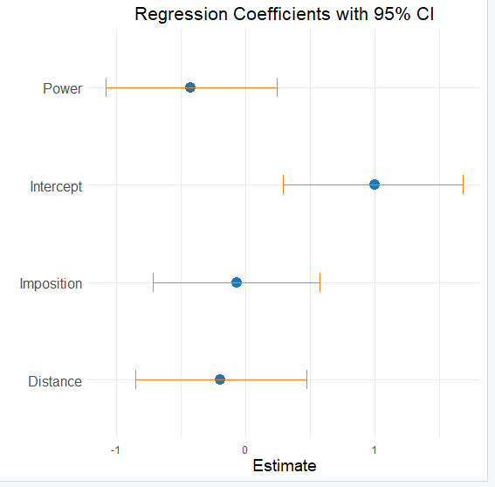
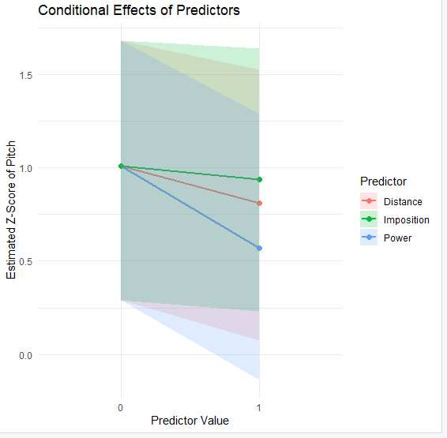
Research Question 2 Results BOUNDARY
Figure 6
Figure 7
Notes:
This is data only from 1 participant. In left graph, the intercept value is 0 for all.

Slide 27
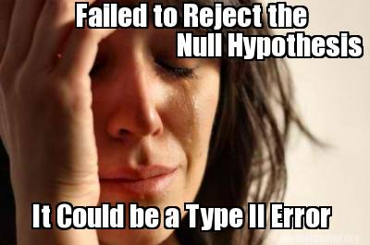
The takeaway…
Figure 6
Figure 7

Slide 28
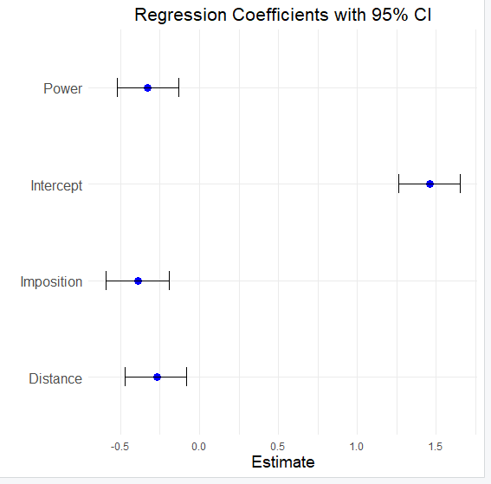
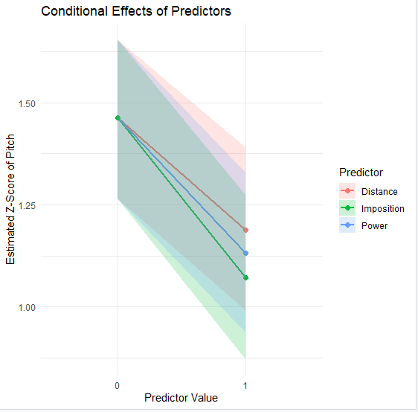
Research Question 2 Results UTTERANCE
Figure 8
Figure 9
Notes:
This is data only from 1 participant. In left graph, the intercept value is 0 for all.

Slide 29
The takeaway…
The utterance’s mean pitch (for this speaker) is dependent on the power & social distance of their interlocutor, as well as the imposition of the request!!
There are no interactions – it doesn’t seem like there’s a “stacking” effect of politeness

Slide 30
Discussion
Although pitch does seem related to politeness, it’s in an unexpected direction!!
Lower pitch is associated with higher politeness
Evidence against the Frequency Code

Slide 31
What about the other research questions?
It’s really annoying to annotate intonation; felt like a waste of resources to annotate loads of data that I can’t use

Slide 32
Remaining Issues
1. Only one participant (who doesn’t actually fit the criteria for inclusion)
This will be rectified in the actual study
2. Participant responses varied a lot in length, range: 5 - 30 s
How can this be constrained?
Will constraints impact naturalness?
Is it fair to compare a 5 s response to a 30 s response?
3. Are my quantitative methods actually valid?
Mean pitch of utterance seems like a good measurement
Mean pitch of boundary tone is a bit sketchier…

Slide 33
The Issue with Mean Boundary Tone
Where does the boundary tone actually start? Here it’s pretty clear – the onset of the [ɣ]
Figure 9

Slide 34
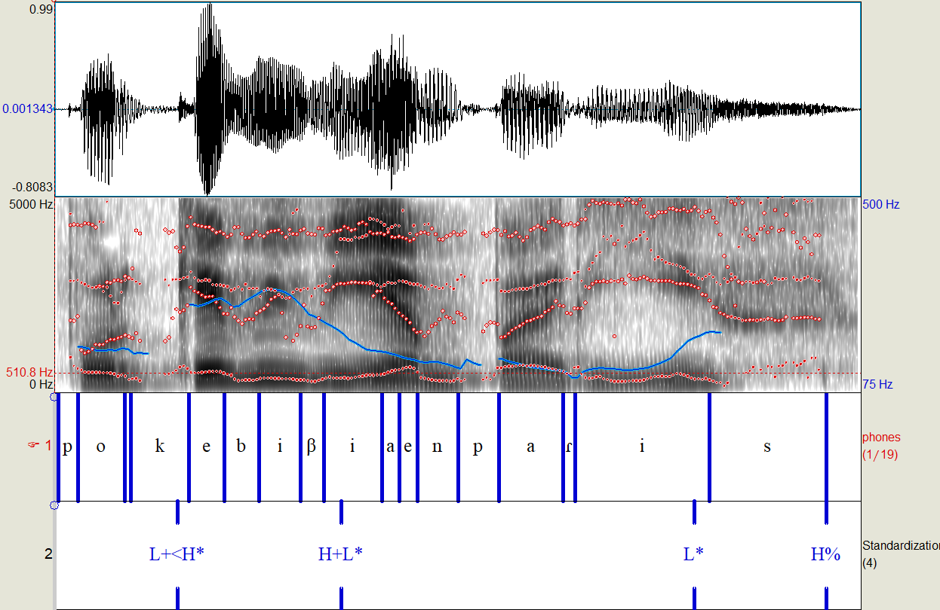
The Issue with Mean Boundary Tone
What about here? Sort of have to pick an arbitrary point on the curve…
Figure 10

Slide 35
Future Research
What will be addressed:
How does proficiency impact choice of pitch accents and nuclear configurations?
How does proficiency modulate overall mean pitch by politeness?
What should be addressed beyond this study?
Does gender/empathy/language use impact an individual’s use of intonation to express politeness in L2 Spanish?

Slide 36
References
Armstrong, M. E. (2010). Puerto Rican Spanish intonation. Transcription of intonation of the Spanish language, 155-189.
Astruc, L., & Mar Vanrell, M. del. (2016). Intonational phonology and politeness in L1 and L2 spanish. Probus, 28(1), 91–118.
Arvaniti, A., & Fletcher, J. (2020). The autosegmental-metrical theory of intonational phonology.
Brown, P., & Levinson, S. (1974). A theory of prosodic semantics. Unpublished MS. Language Behavior Research Lab, Univ. Of California, Berkley.
Brown, P., & Levinson, S. C. (1987). Politeness: Some universals in language usage. Cambridge university press.
Casillas, J. V., Garrido-Pozú, J. J., Parrish, K., Arroyo, L. F., Rodrı́guez, N., Esposito, R., Chang, I., Gómez, K., Constantin-Dureci, G., Shao, J., et al. (2023). Using intonation to disambiguate meaning: The role of empathy and proficiency in L2 perceptual development. Applied Psycholinguistics, 44(5), 913–940.
Estebas-Vilaplana, E. (2014). The evaluation of intonation. Evaluation in Context. Philadelphia: John Benjamins, 179–194.
Herrero, C., & Devı́s, E. (2020). Unintentional impolite intonation in L2 spanish requests produced by chinese workers living in madrid. Proceedings of the 10th International Conference on Speech Prosody, 2020–2173.
Aguilar, Roseano, Vanrell-De-la-Mota, Prieto (2024) Sp_ToBI Traning Materials. Web page: Sp_ToBI Training Materials https://sp-tobi.upf.edu
Ohala, J. J. (1983). Cross-language use of pitch: An ethological view. Phonetica, 40(1), 1–18.
Izura, C., Cuetos, F., & Brysbaert, M. (2014). Lextale-esp: A test to rapidly and efficiently assess the spanish vocabulary size. Psicológica, 35(1), 49–66.

Slide 37
Thank you!

