Slide 1

Final Project Local AI RAG Agent
Frenette, Robert
CSCI E-89 Deep Learning, Fall 2025
Harvard University Extension School
Prof. Zoran B. Djordjević & prof. Rahul Joglekar

Slide 2
Introduction
Traditional Chatbots -vs- Retrieval Augmented Data (RAG) Agents
Traditional chatbots face significant limitations when handling complex, domain-specific queries that require access to both structured and unstructured data.
Standard LLMs suffer from hallucinations, lack access to real-time data, and cannot seamlessly integrate multiple knowledge sources.
Cloud-based AI services pose critical security and compliance risks for industries handling sensitive information (financial services, healthcare, insurance) which cannot be transmitted over the public internet due to regulatory requirements (HIPAA, PCI) and data governance concerns.
Local RAG agents drastically reduce hallucinations by grounding every response in your organization's verified, private documents—ensuring accurate, domain-specific answers.
Because all processing happens on-prem, local RAG agents eliminate security and compliance risks associated with cloud AI. This keeps PHI, PII, and proprietary data fully internal, meeting regulatory requirements without compromising capability.

Slide 3
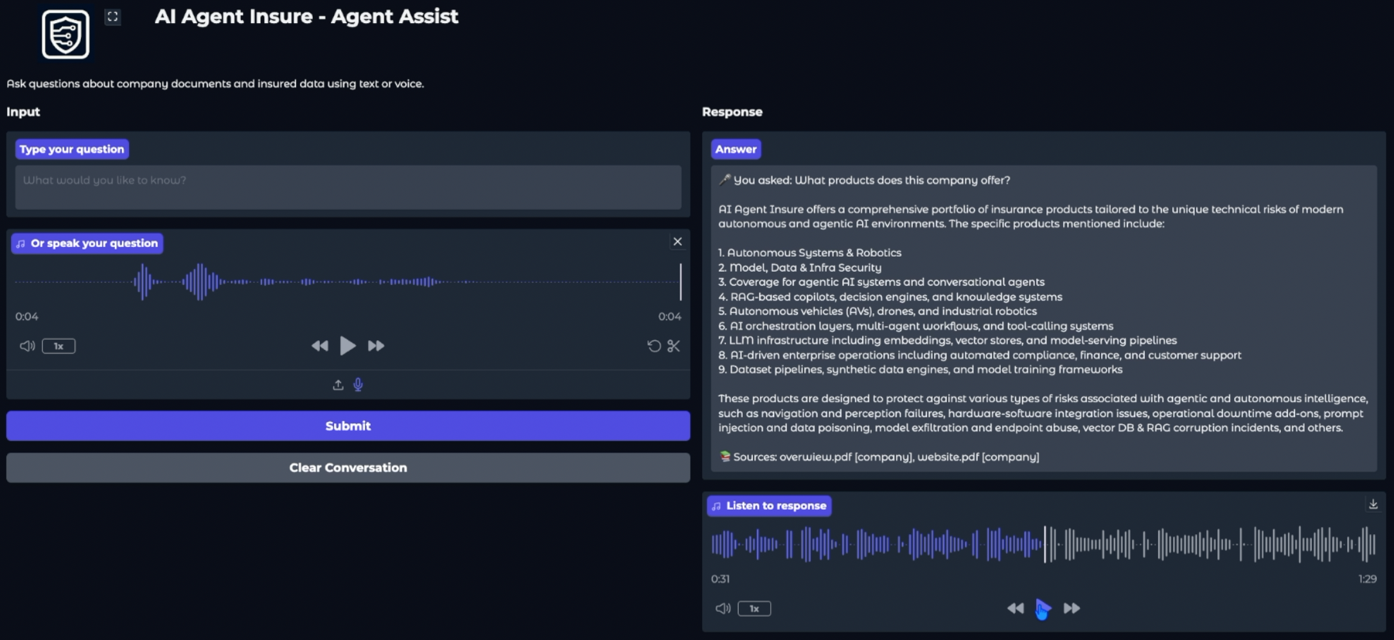
AI Agent Insure - Agent Assist
This project demonstrates a local hybrid RAG Agent that intelligently routes user queries between a SQL database and unstructured document retrieval, providing source-grounded responses while maintaining complete data privacy through local processing.

Slide 4
Tech Stack
The application is built using a local-first tech stack which runs on Ollama:
Framework: LangChain for RAG pipeline orchestration
LLM: llama3.2:3b via Ollama for local inference
Embeddings: nomic-embed-text via Ollama
Vector Database: ChromaDB for persistent vector storage
SQL Database: SQLite3 (built-in Python library)
UI Framework: Gradio for web-based interface
Speech-to-Text: OpenAI Whisper
Text-to-Speech: macOS say command + ffmpeg for audio conversion
PDF Processing: pypdf 3.17.0s
Environment Management: uv (Universal Virtualenv Manager)
Note: The Agent was built, tested, and demoed on an Apple Mac Studio (M1 Max Chip, 10-core CPU, 32-core GPU, 64 GB RAM).

Slide 5
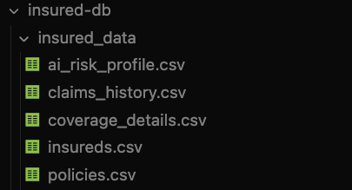
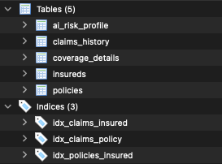
Data Sets
Structured Data
CSVs / SQLite DB
100 insureds with 208 policies
46 claims
Associated coverage details, risk profiles, and claims history in five related tables

Slide 6
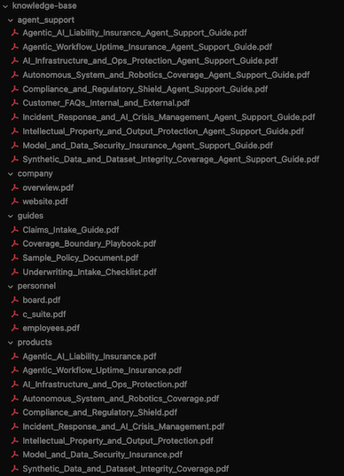
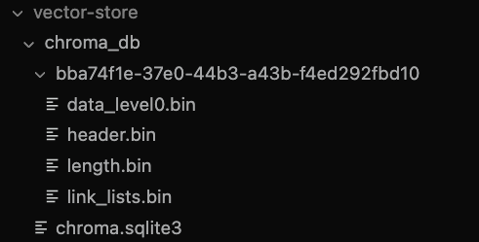
Data Sets
Unstructured Data
PDFs / ChromaDB Vector Store
Knowledge base of 20+ PDF documents organized into categories such as company information, agent support guides, procedural documentation, and personnel information.
PDFs are processed into vector embeddings using nomic-embed-text, then put into a ChromaDB vector store with enhanced metadata (document type, chunk indices, and page counts).

Slide 7
Demo

Slide 8
YouTube URLs, Last Page
2 minute (short):
https://youtu.be/HinayJJ687k
15 minutes (long):
https://youtu.be/V0mAQjiUK6Q
YouTube Project Playlist:
https://www.youtube.com/playlist?list=PLRBkbp6t5gM12JGRlbGomEETO2RknoRbP
GitHub Repo:
https://github.com/RobertFrenette/CSCI_E-89_Deep_Learning_Fall_25

