Slide 1




PAPR-Aware Beam Division Multiple Access for
mmWave Massive MIMO Systems
Guanchong Niu and Man-On Pun
The Chinese University of Hong Kong, Shenzhen
Sep 21, 2018
Notes:
Today, my topic is PAPR-Aware beam division multiple access for mmWave Massive MIMO systems. It’s a long title. The abbreviation of Beam Division multiple access is BDMA. You may have heard CDMA, TDMA or SDMA. BDMA is a new technique for fifth generation wireless communication based on beamforming.

Slide 2
Executive Summary
Challenges:
BDMA residual Interference: The beams can’t be strictly orthogonal.
Large PAPR problem: The peak-to-average-ratio (PAPR) will be large obtained by zero-forcing.
Capacity reduction: The capacity will be sacrificed if we clip the digital precoder
to solve the large PAPR problem.
Our Contributions:
we have developed hybrid beamforming system to eliminate the interference
of non-orthogonal beams.
We have proposed a new method for PAPR reduction by convex optimization.
An opportunistic scheme is proposed to improve the capacity by efficiently scheduling users
with the least interference.
Notes:
This is the brief summary of my presentation. When we use BDMA, the beams can’t be strictly orthogonal for distinct users and it will result some residual interference for others. If we use hybrid beamforming to eliminate the interference, the peak-to-average-ratio will be large. Of course, we can clip the digital precoder but it will reduce the capacity signaficantly.
According to the challenges, our contributions are as follows.
Next I will explain the details.

Slide 3
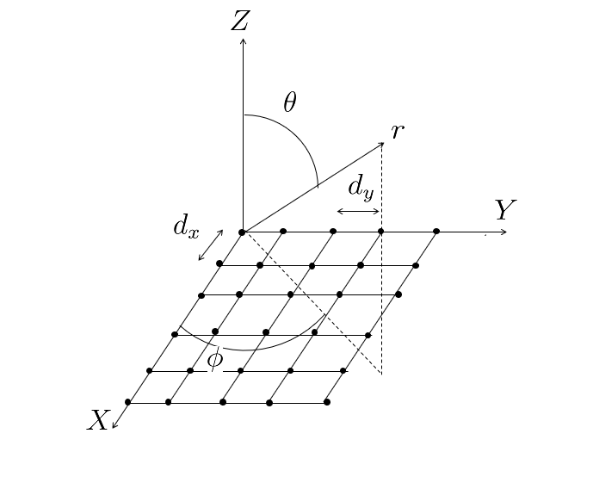
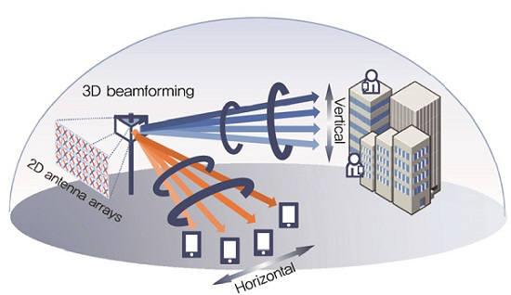
3D Beamforming for 5G Communication
The block diagram of uniform planar array (UPA)
antennas. The transmitted signal can be represented as
The higher frequency transmitted, the higher
pathloss in the propagation.
We use 3D beamforming to transmit the beam
directionally such that the pathloss can be overcome.
Notes:
Beamforming is a signal processing technique used in antenna array for directional transmission or reception. Considering the physical property of electromagnetic wave, the higher frequency transmitted, the higher pathloss in the propagation. We use 3D beamforming to transmit the beam directionally such that the pathloss can be overcome.

Slide 4
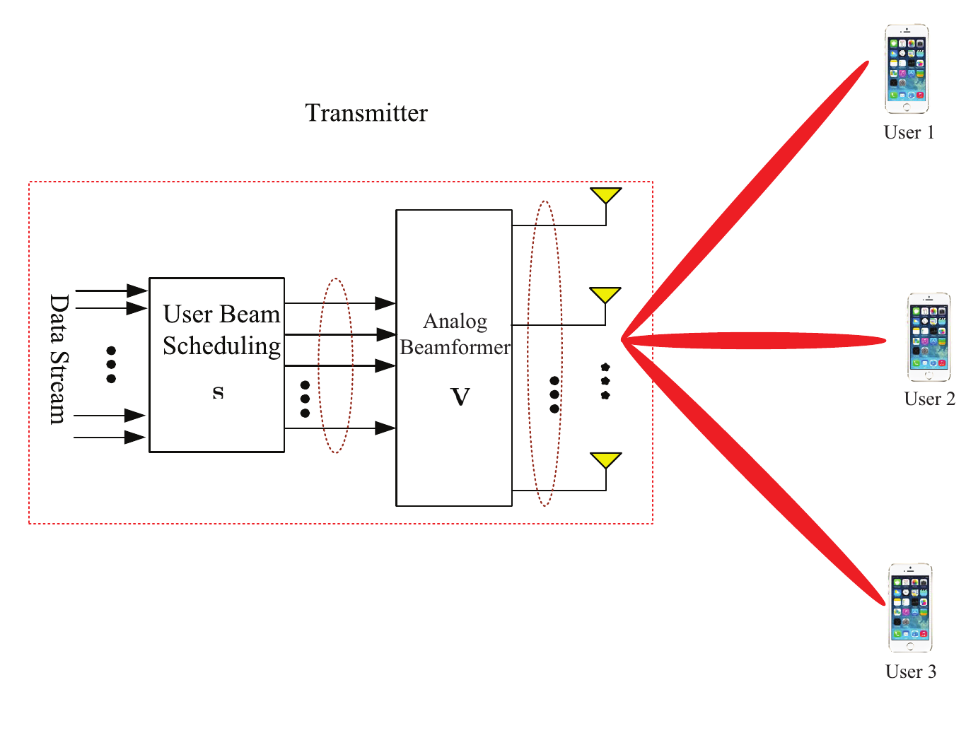
Beam division multiple access (BDMA)
Orthogonal to each other
We assume the array response vectors corresponding to distinct beams are
asymptotically orthogonal with infinite number of antennas at transmitter, i.e.
Notes:
This is a simple block diagram of BDMA. In the base station, we will transmit the orthogonal beams to distinct users. Here we assume the array response vectors corresponding to distinct beams are asymptotically orthogonal with infinite number of antennas at transmitter as shown in this equation.

Slide 5
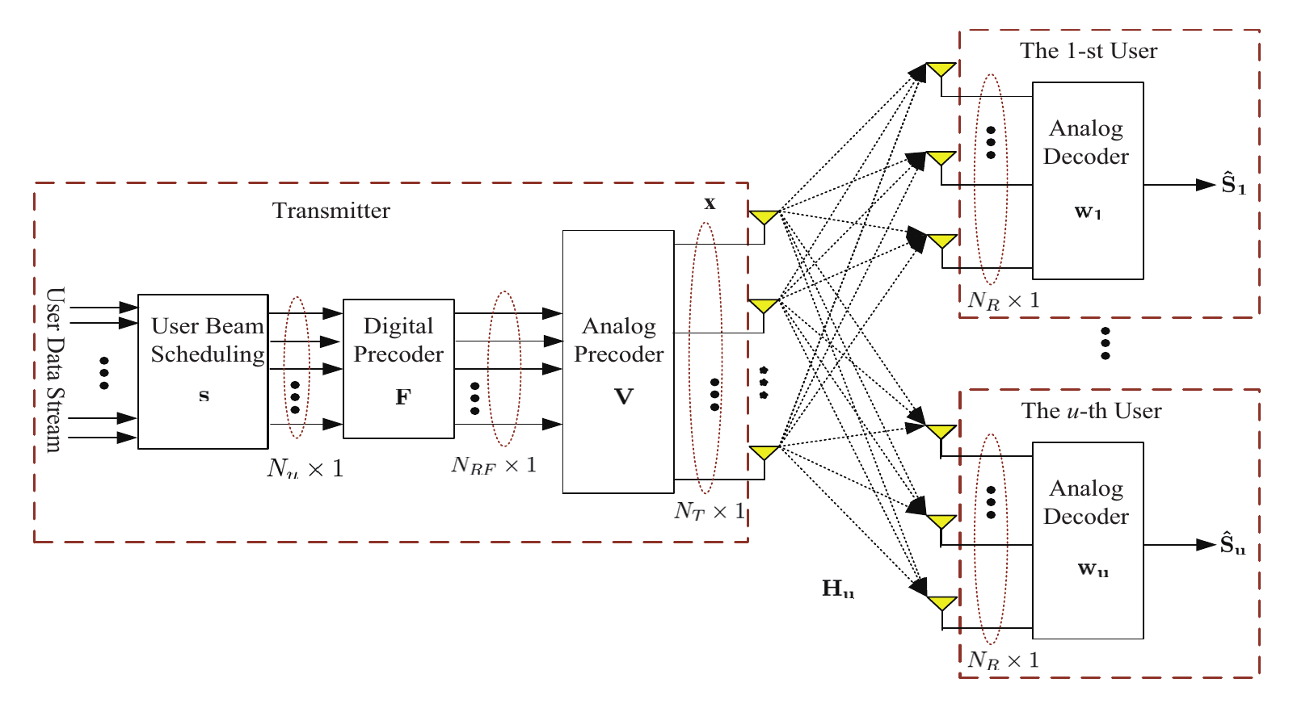
Block diagram of the hybrid precoding system
Our proposed BDMA scheme can achieve multiuser interference free
without requiring perfectly orthogonal beams as residual interference can be removed by digital precoder .
The hybrid precoding system is to jointly design analog and digital precoder to use less RF chains to eliminate the interference between users.
Notes:
This is the block diagram of my hybrid precoding system. The difference between my system and previous one is that we use digital precoder to further eliminate the interference among users. Thanks to the digital precoder, our proposed algorithm can achieve multiuser interference free without requiring perfectly orthogonal beams. Why do we need hybrid beamforming? Of course, a simple method for digital precoding is to implement SVD on channel model Hu and then the digital precoder will be obtained. However, it’s impractical because of the huge hardware cost, especially for RF chain. The hybrid precoding system is to jointly design analog and digital precoder to use less RF chains to eliminate the interference between users.

Slide 6
System Model(1)
The signal received by the -th user is given by setting
where
For notational simplicity, we denote by the effective array gain of the u-th user with
Then, the channel capacity of the u-th user is given by
The power in transmitter is uniformly allocated.
Notes:
The received signal is divided into 3 parts, desired signal, interference and noise. We use single path channel and the channel model can be represented as a multiplication of two vectors. For notational simplicity, we use gu to represent the effective array gain of the u-th user and then the channel capacity can be given by. The power in transmitter is uniformly allocated.

Slide 7
System Model(2)
The system sum-rate capacity:
Finally, the optimal design of the digital and analog precoding matrices can be formulated as
The constraint is the power limitation in transmitter.
Notes:
Our objective function is to maximize the sum-rate capacity R. we need to jointly design the digital precoder and analog precoder subject to the power and analog constraint.

Slide 8
Solve the digital precoder by zero-forcing
The single-path channel model is give by:
Analog
precoding
The analog precoder can be set as:
The problem is then simplified as
Digital
precoding
The optimum F can be obtained by zero-forcing:
Where
Notes:
To maximize the total capacity, the optimal analog precoding at the transmitter is given by simply equal to the response array vector a T. Then the digital precoder can be obtained by zero-forcing, where G is the collection of effective array gains. And the digital precoder is the right pseudo inverse of G

Slide 9
Problem formulation: Large-PAPR problem
To realize zero-forcing, the digital precoder
F* can theoretically ramp up to M folds.
A large M can potentially incur large
peak-to-average power ratio (PAPR) problem,
such as expensive hardware cost and distortion.
A new constraint is required for each element of
digital precoder, i.e.
Notes:
However, to realize zero-forcing, the digital precoder F can theoretically ramp up to M folds. A large M can potentially incur large peak-to-average power ratio problem such as expensive hardware cost and distortion. A new constraint is required for each element of digital precoder so that the PAPR can be reduced.

Slide 10
Clipping and CVX methods to reduce PAPR
Clipping on
Formulated by a convex optimization problem
Notes:
Next we will introduce two methods to solve the large PAPR problem. Firstly, clipping is a very simple and easy technique to implement by setting the amplitude that higher than threshold lambda just equal to the lambda. Secondly, this problem can be formulated as a convex optimization problem subject to the PAPR constraint. This convex problem can be solved by cvx tool.

Slide 11
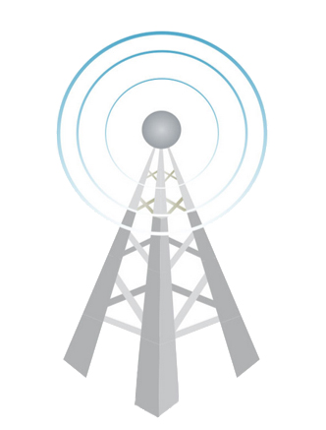

Opportunistic scheme (User scheduling)
The selected beams are orthogonal with each other.
Imaging a special case that all beams are orthogonal with each other, the digital
precoder won’t be required to eliminate the interference, i.e. digital precoder can
be set as identity matrix. Then the PAPR is very small.
Based on this idea, we will select the users that have least interference to improve
the capacity and suppress the PAPR.
Notes:
Obviously, the reduction of PAPR will bring in some residual interference on other users. Imaging a special case that all beams are orthogonal with each other, the digital precoder won’t be required to eliminate the interference, i.e. digital precoder can be set as identity matrix. Then the PAPR is very small.
Based on this idea, we will select the users that have least interference to improve the capacity and suppress the PAPR. Therefore, We can use the opportunistic scheme to reduce the PAPR without sacrificing the SINR.

Slide 12
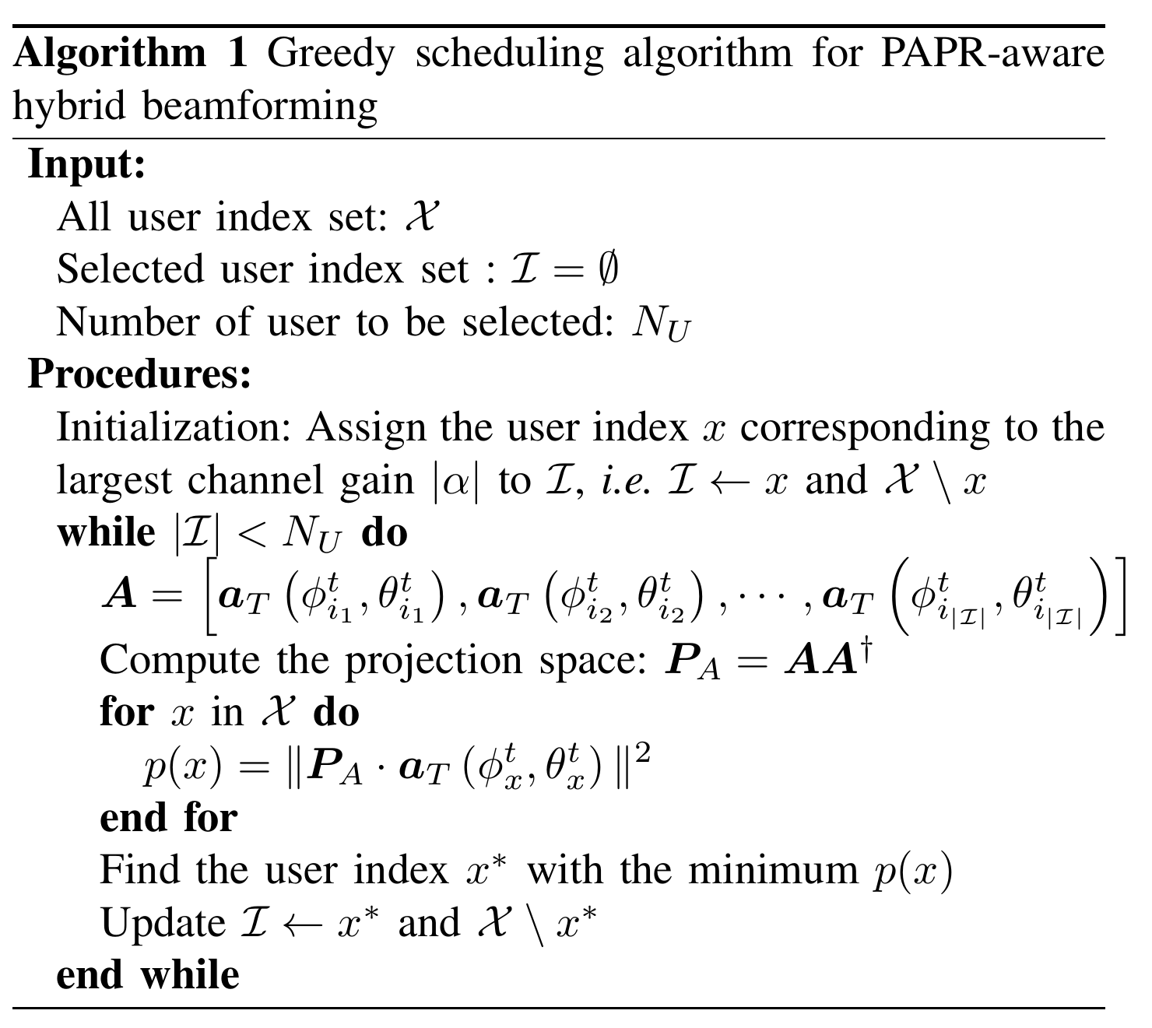
Greedy Algorithm
Notes:
This is the greedy algorithm to select the active users to suppress the interference. Intuitively, the best performance for opportunistic scheme is to exhaustive searching the combination of all users. However, the computation cost is too high for exhaustive searching. Thus, we use the greedy algorithm to find the suboptimal solution. Firstly, we select one user with largest channel gain, and then find the second one with least interference in the rest users and by the same manner, one group can be selected. Next, we will use the simulation to prove the effective of our algorithm.

Slide 13
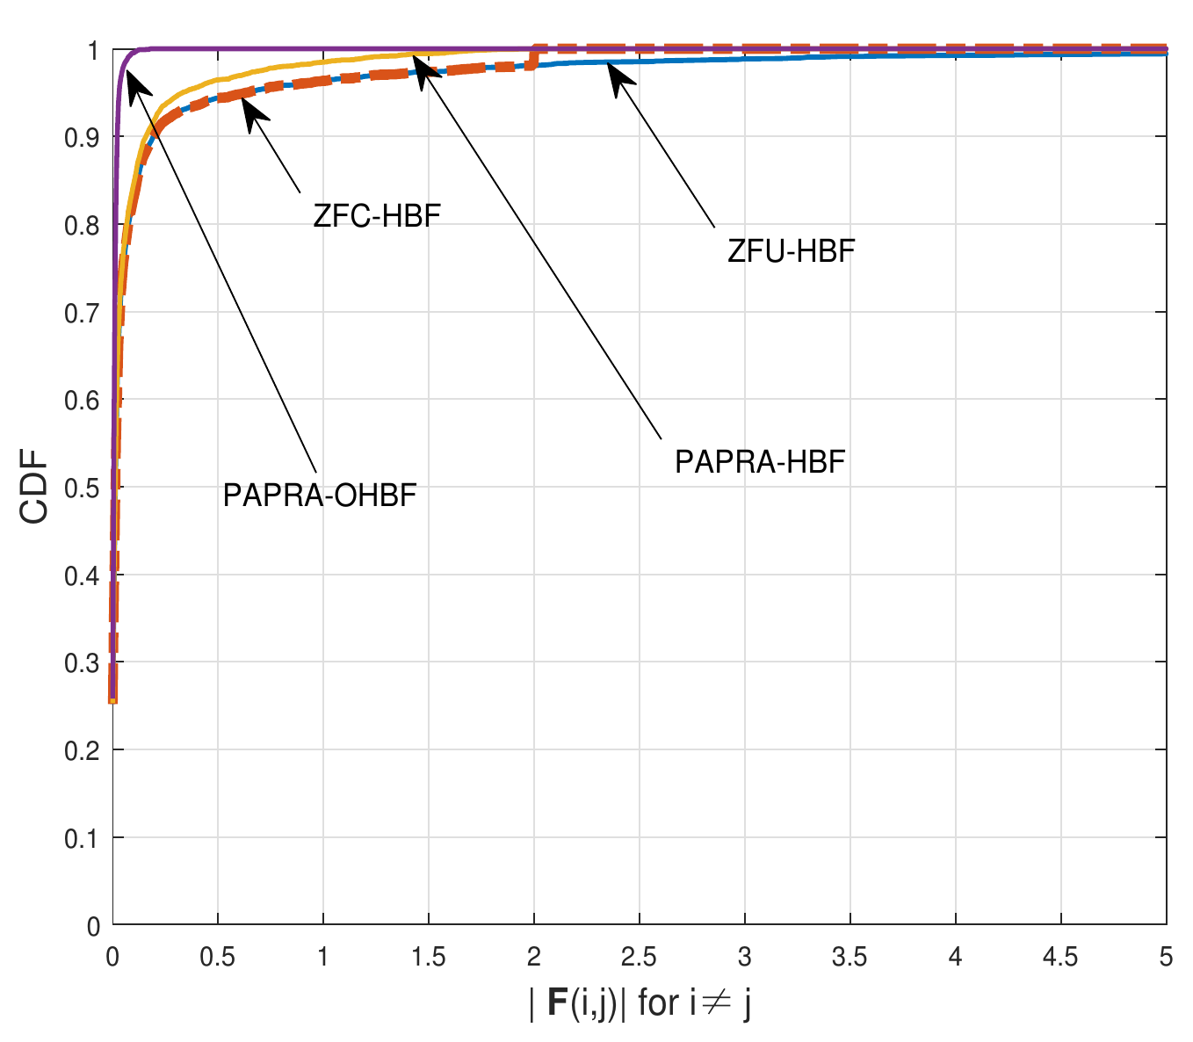
Simulation Result: CDF of digital precoder
Performance on PAPR
PAPRA-OHBF: PAPR-aware opportunistic hybrid beamforming;
PAPRA-HBF: PAPR-aware hybrid beamforming obtained by convex optimization problem;
ZFC-HBF: Zero-forcing with clipping hybrid beamforming;
ZFU-HBF: Zero-forcing hybrid beamforming.
Notes:
The purple line has the best performance since all the elements of digital precoder matrix are concentrated on 0 to 1. This is because the opportunistic algorithm can reduce the interference in analog precoding. Then we don’t need the digital precoder to do much to eliminate the interference.

Slide 14
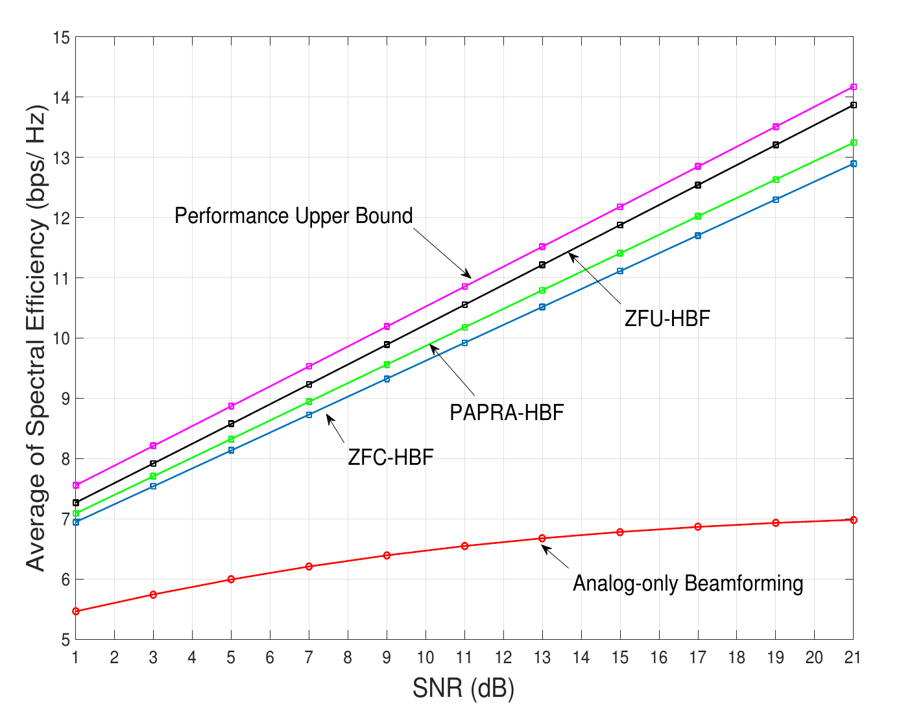
Comparison of non-opportunistic schemes
Performance on SINR
Performance Upper Bound: Obtained by fully-digital precoding(SVD);
ZFU-HBF: Zero-forcing hybrid beamforming.
PAPRA-HBF: PAPR-aware hybrid beamforming obtained by convex optimization problem;
ZFC-HBF: Zero-forcing with clipping hybrid beamforming;
Analog-only Beamforming: Only analog precoding is considered.
Notes:
The upper bound is given by fully-digital precoding where we use SVD to obtain the digital precoder. The capacity will be sacrificed after adding the PAPR constraint. The green line is PAPR-aware hybrid beamforming which is obtained by solving convex optimization problem. It’s lower than zero-forcing one since the interference will be introduced by the PAPR constraint. Although the convex optimization method is more complicated than clipping one, the performance will be better.

Slide 15
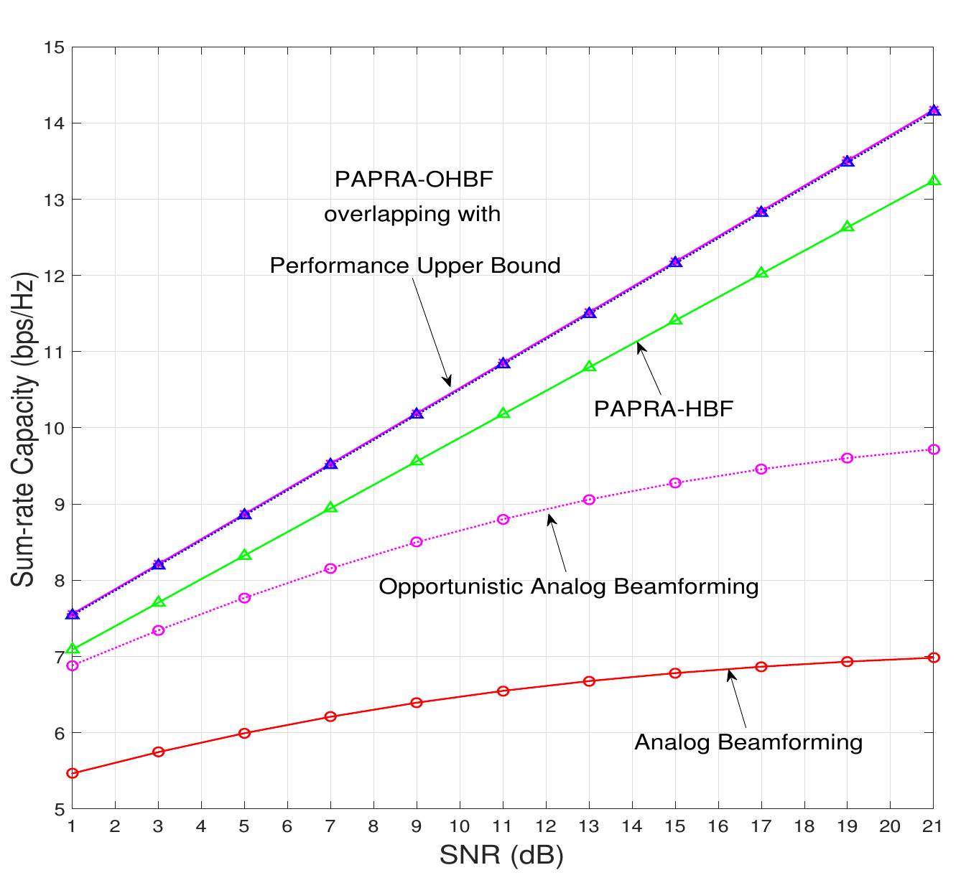
Comparison of opportunistic schemes
Opportunistic Hybrid beamforming: obtained by selecting 4 users from 20 active candidates and PAPR reduction is considered.
Opportunistic Analog Beamforming: obtained by selecting 4 users from 20 active candidates.
Notes:
By introducing the idea of opportunistic scheme, the performance will be compensated by opportunistic. The capacity of opportunistic hybrid beamforming is obtained by selecting 4 users from 20 active candidates and the PAPR reduction is also considered. The

Slide 16
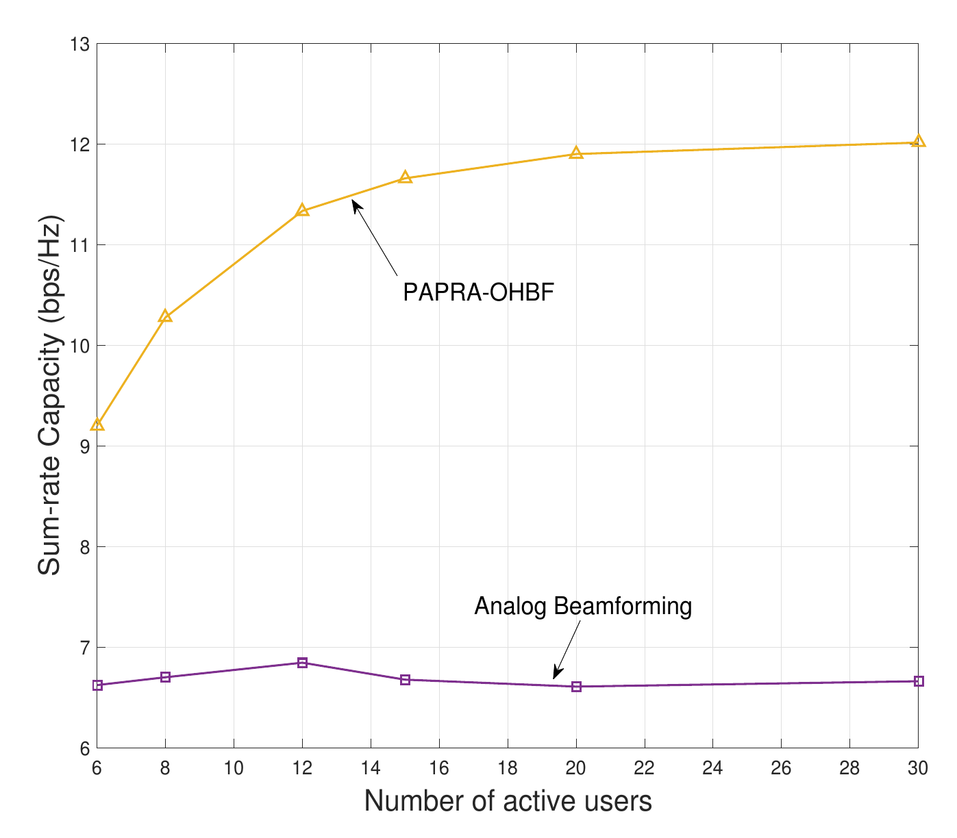
Comparison of different active users
This figure shows that PAPRA-OHBF can significantly benefit from the increase of active users as the number of active users grows from 6 to 20.
However, the benefit of having more active users diminishes as the number of active users increases beyond 30. The SINR is bounded by the fully-digital hybrid beamforming.
Notes:
This figure shows that PAPRA-OHBF can significantly benefit from the increase of active users as the number of active users grows from 6 to 20.
However, the benefit of having more active users diminishes as the number of active users increases beyond 30. The capacity is bounded by the fully-digital hybrid beamforming.
the curve labelled “Analog Beamforming” does not change much with the number of active users.

Slide 17
Conclusion
we have developed PAPR-aware BDMA scheme for mmWave massive MIMO systems by jointly performing hybrid analog-digital precoding and user-beam scheduling.
We have modeled the analog-digital precoder design as a convex optimization problem with explicit PAPR constraints.
To efficiently schedule users with the least interference, we develop a greedy algorithm to opportunistically select users.
Simulation results have demonstrated the good performance of the proposed PAPR-aware BDMA scheme.
Notes:
The conclusion is given here. we have developed PAPR-aware BDMA scheme for millimeter wave massive MIMO systems by jointly preforming hybrid analog-digital precoding and user- beam scheduling. To reduce the PAPR, we have modeled the analog-digital precoder as a convex optimization problem and compared with clipping method. To efficiently schedule users with the least interference, we develop a greedy algorithm to opportunistically select users. The simulation results prove the good performance of the PAPR-aware BDMA scheme.

